Slide 1
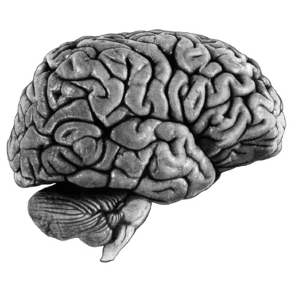
Dynamic Causal Modelling (DCM) for fMRI
Klaas Enno Stephan
Laboratory for Social & Neural Systems Research (SNS)
University of Zurich
Wellcome Trust Centre for Neuroimaging
University College London
SPM Course, FIL
13 May 2011

Slide 2
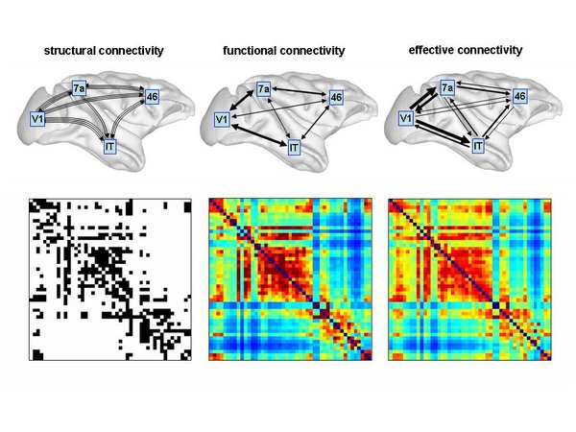
Structural, functional & effective connectivity
anatomical/structural connectivity
= presence of axonal connections
functional connectivity
= statistical dependencies between regional time series
effective connectivity
= directed influences between neurons or neuronal populations
Sporns 2007, Scholarpedia

Slide 3
Some models of effective connectivity for fMRI data
Structural Equation Modelling (SEM)
McIntosh et al. 1991, 1994; Büchel & Friston 1997; Bullmore et al. 2000
regression models
(e.g. psycho-physiological interactions, PPIs)
Friston et al. 1997
Volterra kernels
Friston & Büchel 2000
Time series models (e.g. MAR/VAR, Granger causality)
Harrison et al. 2003, Goebel et al. 2003
Dynamic Causal Modelling (DCM)
bilinear: Friston et al. 2003; nonlinear: Stephan et al. 2008

Slide 4
Dynamic causal modelling (DCM)
DCM framework was introduced in 2003 for fMRI by Karl Friston, Lee Harrison and Will Penny (NeuroImage 19:1273-1302)
part of the SPM software package
currently more than 160 published papers on DCM

Slide 5
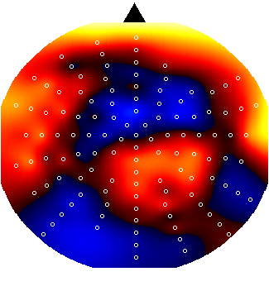
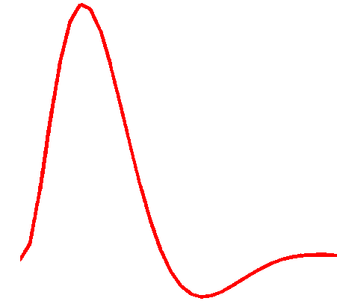
Dynamic Causal Modeling (DCM)
Hemodynamic
forward model:
neural activity→BOLD
Electromagnetic
forward model:
neural activity→EEG
MEG
LFP
Neural state equation:
fMRI
EEG/MEG
simple neuronal model
complicated forward model
complicated neuronal model
simple forward model
inputs

Slide 6
Example:
a linear model of interacting visual regions
LG = lingual gyrus
FG = fusiform gyrus
Visual input in the
- left (LVF)
- right (RVF)
visual field.
x₃
FG
left
FG
right
x₄
x₁
LG
left
LG
right
x₂
RVF
LVF
u₂
u₁

Slide 7
Example:
a linear model of interacting visual regions
LG = lingual gyrus
FG = fusiform gyrus
Visual input in the
- left (LVF)
- right (RVF)
visual field.
x₃
FG
left
FG
right
x₄
x₁
LG
left
LG
right
x₂
RVF
LVF
u₂
u₁
state
changes
effective
connectivity
system
state
input
parameters
external
inputs

Slide 8
Extension:
bilinear model
x₃
FG
left
FG
right
x₄
x₁
LG
left
LG
right
x₂
RVF
CONTEXT
LVF
u₂
u₃
u₁

Slide 9
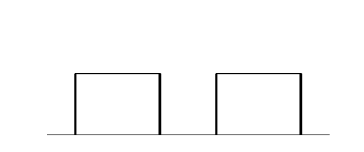
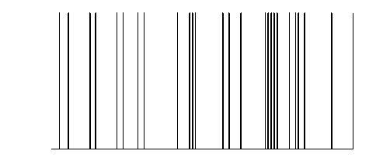
y
y
y
BOLD
y
−
−
λ
−
hemodynamic
model
activity
x₂(t)
activity
x₃(t)
activity
x₁(t)
neuronal
states
x
modulatory
input u₂(t)
integration
driving
input u₁(t)
t
Neural state equation
endogenous connectivity
t
modulation of
connectivity
direct inputs

Slide 10
Bilinear DCM
driving
input
modulation
Two-dimensional Taylor series (around x₀=0, u₀=0):
Bilinear state equation:

Slide 11
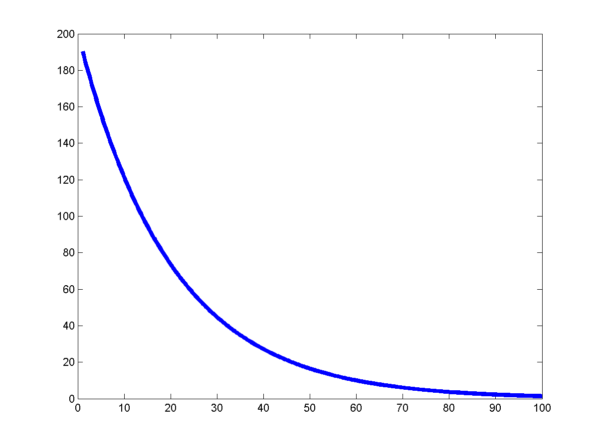
DCM parameters = rate constants
Integration of a first-order linear differential equation gives an
exponential function:
Coupling parameter a is inversely
proportional to the half life τ of z(t):
The coupling parameter a
thus describes the speed of
the exponential change in x(t)

Slide 12
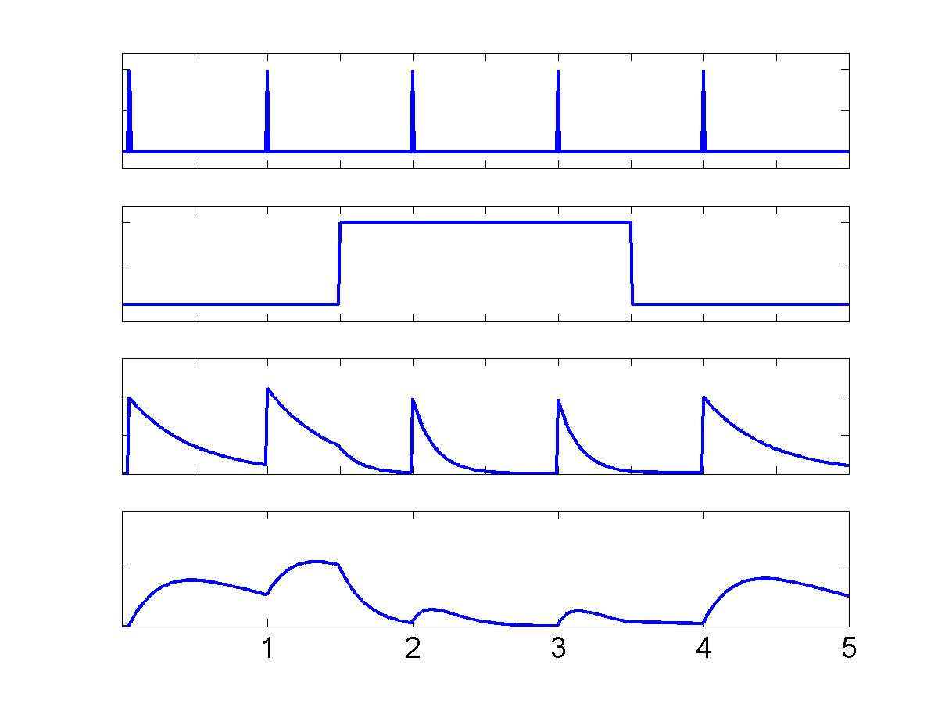
Example:
context-dependent decay
u
1
u₁
u
stimuli
u₁
context
u₂
2
u₂
-
Z
+
1
-
x1
x₁
Z
+
2
x₂
+
x2
-
-
Penny et al. 2004, NeuroImage

Slide 13
The problem of hemodynamic convolution
Goebel et al. 2003, Magn. Res. Med.

Slide 14
Hemodynamic forward models are important for connectivity analyses of fMRI data
Granger causality
DCM
David et al. 2008, PLoS Biol.

Slide 15
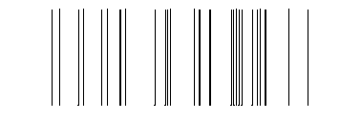
u
stimulus functions
The hemodynamic model in DCM
t
neural state
equation
hemodynamic
state
equations
Balloon model
BOLD signal change equation
Stephan et al. 2007, NeuroImage

Slide 16
How interdependent are neural and hemodynamic parameter estimates?
A
B
C
θ^{h}
ε
Stephan et al. 2007, NeuroImage

Slide 17
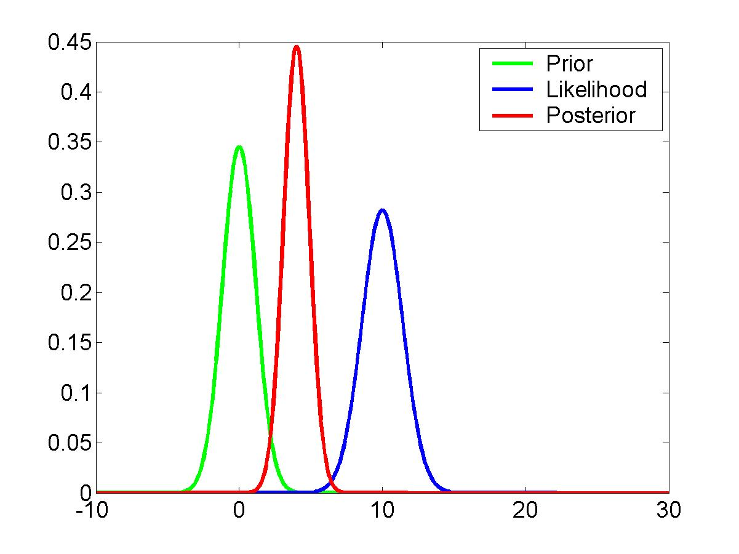
DCM is a Bayesian approach
new data
prior knowledge
posterior ∝ likelihood ∙ prior
Bayes theorem allows one to formally incorporate prior knowledge into computing statistical probabilities.
In DCM:
empirical, principled & shrinkage priors.
The “posterior” probability of the parameters given the data is an optimal combination of prior knowledge and new data, weighted by their relative precision.

Slide 18
stimulus function u
Overview:
parameter estimation
neural state
equation
Combining the neural and hemodynamic states gives the complete forward model.
An observation model includes measurement
error e and confounds X (e.g. drift).
Bayesian inversion: parameter estimation by means of variational EM under Laplace approximation
Result:
Gaussian a posteriori parameter distributions, characterised by
mean η_{θ|y} and
covariance C_{θ|y}.
parameters
hidden states
state equation
η_{θ|y}
modelled
BOLD response
observation model

Slide 19
VB in a nutshell (mean-field approximation)
❶ Neg. free-energy approx. to model evidence.
❷ Mean field approx.
❸ Maximise neg. free energy wrt. q = minimise divergence,
by maximising variational energies
❹ Iterative updating of sufficient statistics of approx. posteriors by gradient ascent.

Slide 20
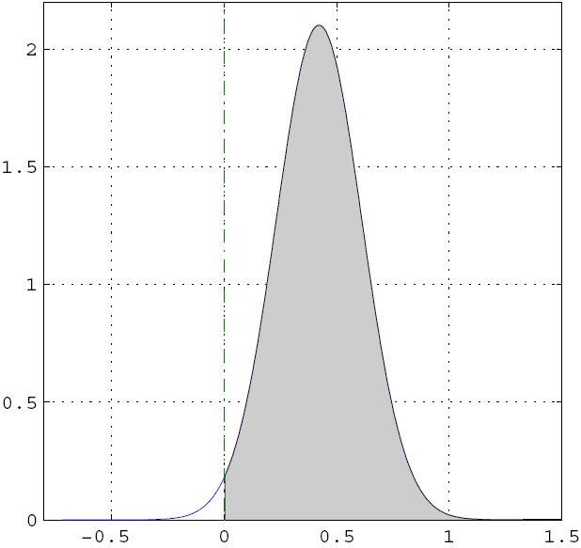
Inference about DCM parameters:
Bayesian single-subject analysis
Gaussian assumptions about the posterior distributions of the parameters
posterior probability that a certain parameter (or contrast of parameters c^{T} η_{θ|y}) is above a chosen threshold γ:
By default, γ is chosen as zero ("does the effect exist?").

Slide 21
Bayesian single subject inference
LD|LVF
0.13
± 0.19
0.34
± 0.14
p(c^{T}θ>0|y)
= 98.7%
FG
left
FG
right
LD
LD
0.44
± 0.14
0.29
± 0.14
LG
left
LG
right
0.01
± 0.17
-0.08
± 0.16
RVF
stim.
LD|RVF
LVF
stim.
Contrast:
Modulation LG right → LG links by LD|LVF
vs.
modulation LG left → LG right by LD|RVF
Stephan et al. 2005,
Ann. N.Y. Acad. Sci.

Slide 22
Inference about DCM parameters:
Bayesian parameter averaging (FFX group analysis)
Likelihood distributions from different subjects are independent
→ one can use the posterior from one subject as the prior for the next
Under Gaussian assumptions this is easy to compute:
group
posterior
covariance
individual
posterior
covariances
group
posterior
mean
individual posterior
covariances and means
“Today’s posterior is tomorrow’s prior”

Slide 23
Inference about DCM parameters:
RFX group analysis (frequentist)
In analogy to “random effects” analyses in SPM, 2nd level analyses can be applied to DCM parameters:
Separate fitting of identical models for each subject
Selection of (bilinear) parameters of interest
one-sample t-test:
parameter > 0 ?
paired t-test:
parameter 1 >
parameter 2 ?
rmANOVA:
e.g. in case of multiple sessions per subject

Slide 24
definition of model space
inference on model structure or inference on model parameters?
inference on
individual models or model space partition?
inference on
parameters of an optimal model or parameters of all models?
optimal model structure assumed to be identical across subjects?
comparison of model families using
FFX or RFX BMS
optimal model structure assumed to be identical across subjects?
BMA
yes
no
yes
no
FFX BMS
RFX BMS
FFX BMS
RFX BMS
FFX analysis of parameter estimates
(e.g. BPA)
RFX analysis of parameter estimates
(e.g. t-test, ANOVA)
Stephan et al. 2010, NeuroImage

Slide 25
Any design that is good for a GLM of fMRI data.
What type of design is good for DCM?

Slide 26
GLM vs. DCM
DCM tries to model the same phenomena (i.e. local BOLD responses) as a GLM, just in a different way (via connectivity and its modulation).
No activation detected by a GLM
→ no motivation to include this region in a deterministic DCM.
However, a stochastic DCM could be applied despite the absence of a local activation.
Stephan 2004, J. Anat.

Slide 27
Multifactorial design:
explaining interactions with DCM
Task factor
Stim1/
Task A
Stim2/
Task A
Task A
Task B
Stim 1
T_{A}/S₁
T_{B}/S₁
X₁
X₂
GLM
Stimulus factor
Stim 2
T_{A}/S₂
T_{B}/S₂
Stim 1/
Task B
Stim 2/
Task B
Let’s assume that an SPM analysis shows a main effect of stimulus in X₁ and a stimulus × task interaction in X₂.
How do we model this using DCM?
Stim1
X₁
X₂
DCM
Stim2
Task A
Task B

Slide 28
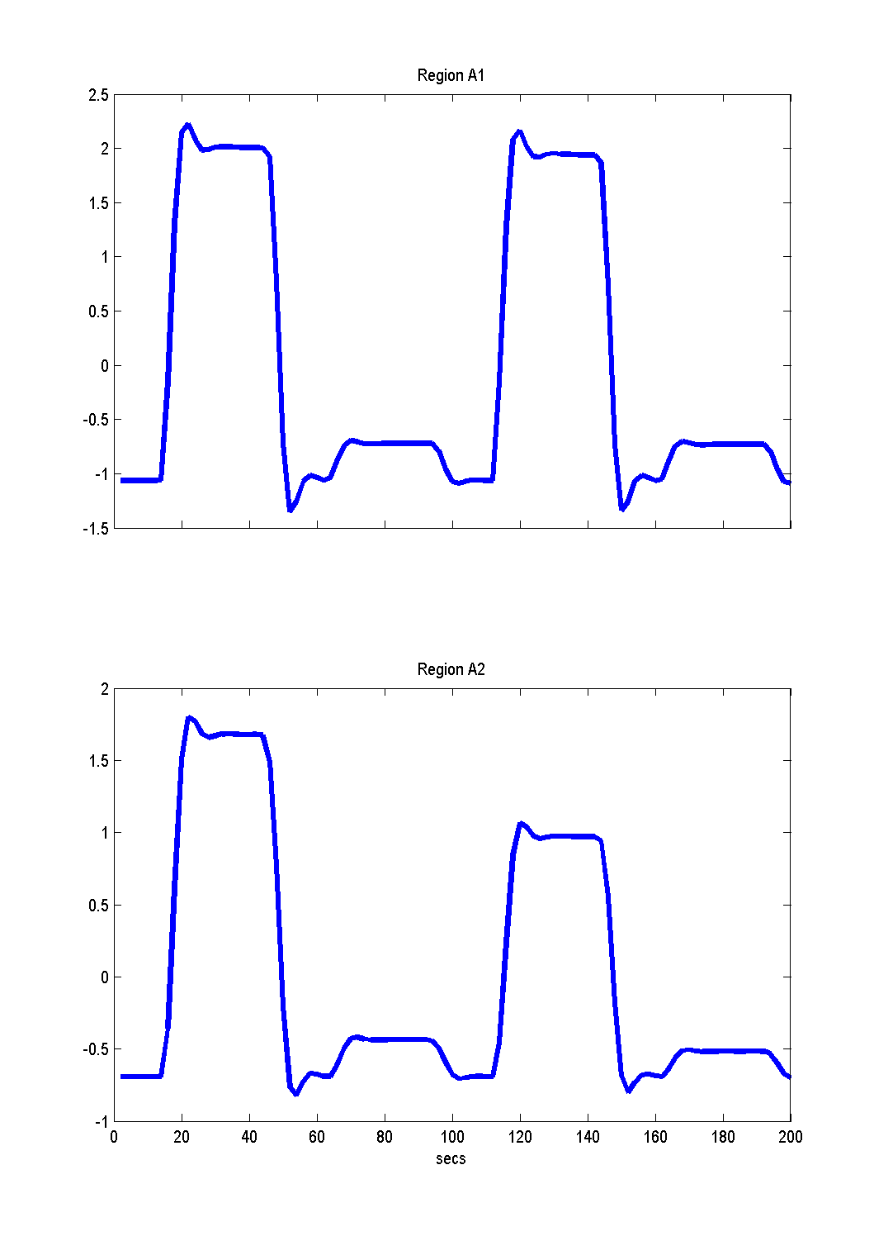
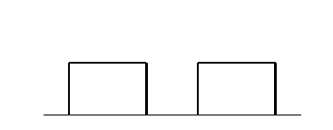
Simulated data
X₁
+++
–
–
Stimulus 1
+
X₁
+++
X₂
Stim 1
Task A
Stim 2
Task A
Stim 1
Task B
Stim 2
Task B
Stimulus 2
+
+++
+
Task A
Task B
X₂
Stephan et al. 2007, J. Biosci.

Slide 29
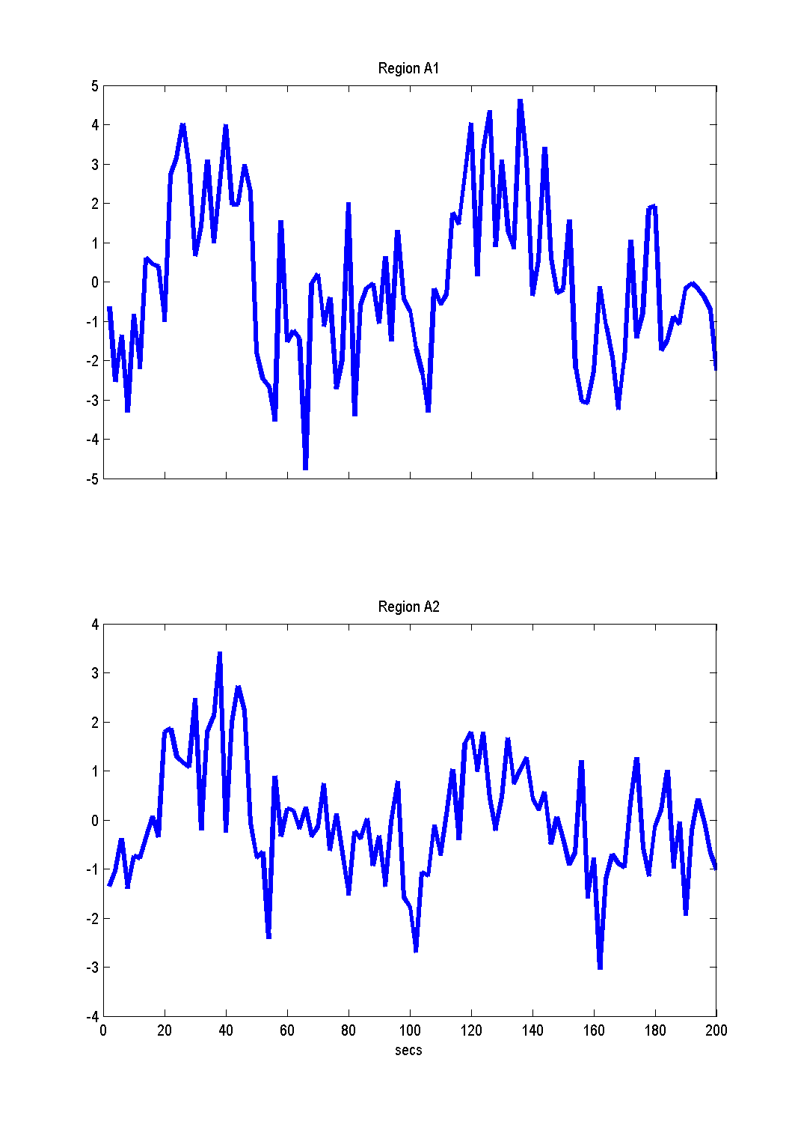
X₁
Stim 1
Task A
Stim 2
Task A
Stim 1
Task B
Stim 2
Task B
X₂
plus added noise (SNR=1)

Slide 30
DCM10 in SPM8
DCM10 was released as part of SPM8 in July 2010 (version 4010).
Introduced many new features, incl. two-state DCMs and stochastic DCMs
This led to various changes in model defaults, e.g.
  inputs mean-centred
  changes in coupling priors
  self-connections: separately estimated for each area
For details, see: www.fil.ion.ucl.ac.uk/spm/software/spm8/SPM8_Release_Notes_r4010.pdf
Further changes in version 4290 (released April 2011) to accommodate new developments and give users more choice (e.g. whether or not to mean-centre inputs).

Slide 31
The evolution of DCM in SPM
DCM is not one specific model, but a framework for Bayesian inversion of dynamic system models
The default implementation in SPM is evolving over time
  better numerical routines for inversion
  change in priors to cover new variants (e.g., stochastic DCMs, endogenous DCMs etc.)
To enable replication of your results, you should ideally state which SPM version you are using when publishing papers.

Slide 32
Factorial structure of model specification in DCM10
Three dimensions of model specification:
  bilinear vs. nonlinear
  single-state vs. two-state (per region)
  deterministic vs. stochastic
Specification via GUI.

Slide 33
bilinear DCM
non-linear DCM
modulation
driving
input
driving
input
modulation
Two-dimensional Taylor series (around x₀=0, u₀=0):
Bilinear state equation:
Nonlinear state equation:

Slide 34
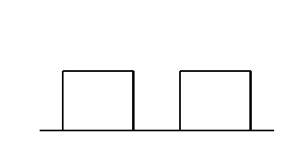
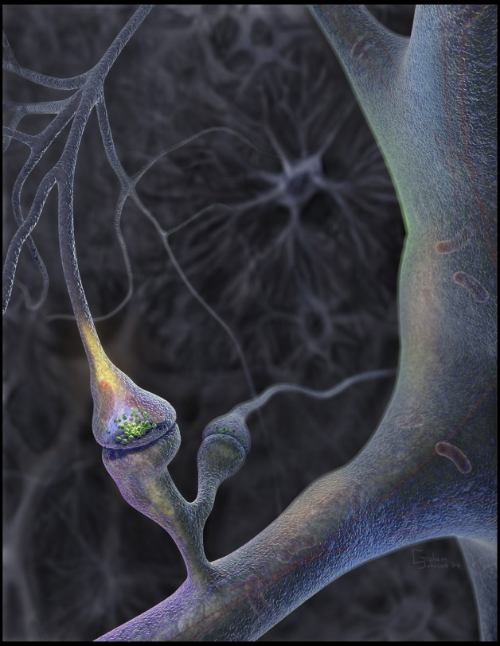
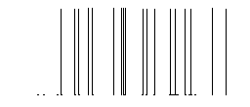
Neural population activity
u₂
u₁
x₃
fMRI signal change (%)
x₁
x₂
Nonlinear dynamic causal model (DCM)
Stephan et al. 2008, NeuroImage

Slide 35
attention
MAP = 1.25
0.10
PPC
0.26
1.25
0.39
stim
0.26
V1
0.13
V5
0.46
0.50
motion
Stephan et al. 2008, NeuroImage

Slide 36
motion &
attention
motion &
no attention
static
dots
V1
V5
PPC
observed
fitted

Slide 37
Two-state DCM
Single-state DCM
Two-state DCM
input
Extrinsic (between-region) coupling
Intrinsic (within-region) coupling
Marreiros et al. 2008, NeuroImage

Slide 38
Stochastic DCM
accounts for stochastic neural fluctuations
can be fitted to resting state data
ω has unknown precision and smoothness
→ additional hyperparameters
Friston et al. (2008, 2011) NeuroImage
Daunizeau et al. (2009) Physica D
Li et al. (2011) NeuroImage

Slide 39
Thank you

