Slide 1

The General Linear Model
Guillaume Flandin
Wellcome Trust Centre for Neuroimaging
University College London
SPM fMRI Course
London, October 2012

Slide 2



Image time-series
Spatial filter
Design matrix
Statistical Parametric Map
Realignment
Smoothing
General Linear Model
Statistical
Inference
RFT
Normalisation
Anatomical
reference
p <0.05
Parameter estimates

Slide 3
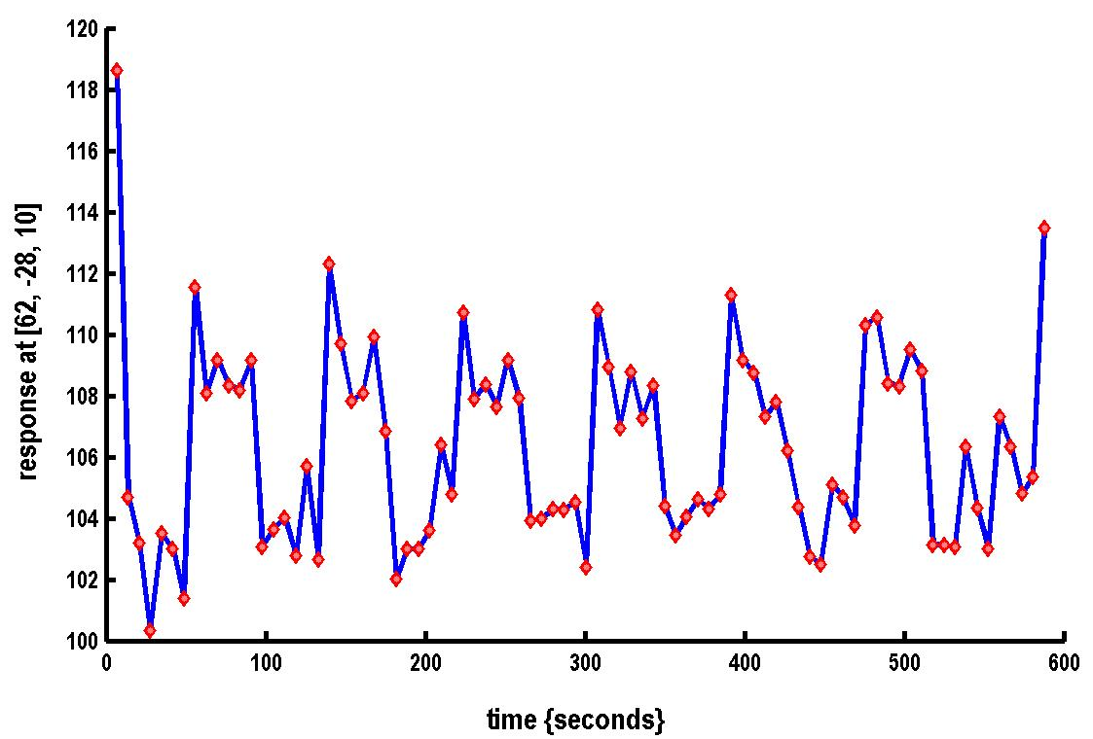

A very simple fMRI experiment
One session
Passive word listening
versus rest
7 cycles of
rest and listening
Blocks of 6 scans
with 7 sec TR
Stimulus function
Question: Is there a change in the BOLD response between listening and rest?

Slide 4
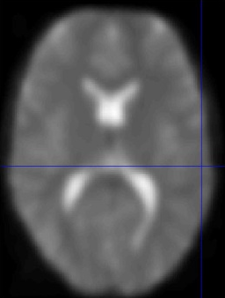
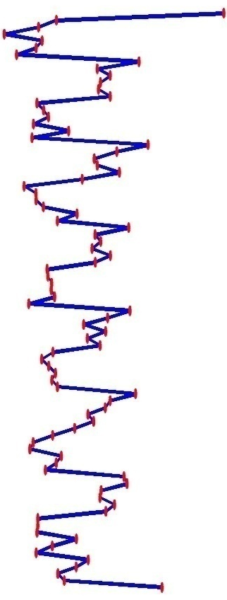
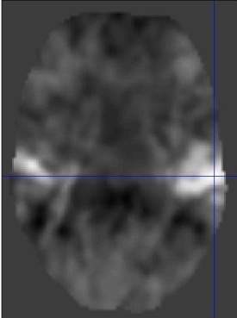
Voxel-wise time series analysis
Model
specification
Parameter
estimation
Time
Hypothesis
Statistic
Time
BOLD signal
single voxel
time series
SPM

Slide 5

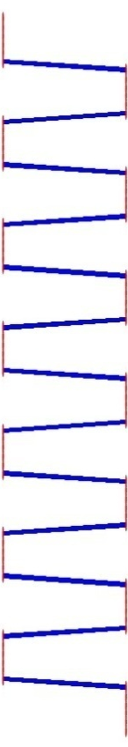

Single voxel regression model
error
=
β₁
+
β₂
+
Time
x₁
x₂
e
BOLD signal

Slide 6
Mass-univariate analysis: voxel-wise GLM
X
y
+
=
Model is specified by
Design matrix X
Assumptions about e
N: number of scans
p: number of regressors
The design matrix embodies all available knowledge about experimentally controlled factors and potential confounds.

Slide 7
GLM: a flexible framework for parametric analyses
    one sample t-test
    two sample t-test
    paired t-test
    Analysis of Variance (ANOVA)
    Analysis of Covariance (ANCoVA)
    correlation
    linear regression
    multiple regression

Slide 8



Parameter estimation
Objective:
estimate parameters to minimize
=
+
y
X
Ordinary least squares estimation (OLS) (assuming i.i.d. error):

Slide 9
A geometric perspective on the GLM
Smallest errors (shortest error vector)
when e is orthogonal to X
y
e
x₂
x₁
Design space defined by X
Ordinary Least Squares (OLS)

Slide 10
Problems of this model with fMRI time series
The BOLD response has a delayed and dispersed shape.
The BOLD signal includes substantial amounts of low-frequency noise (eg due to scanner drift).
Due to breathing, heartbeat & unmodeled neuronal activity, the errors are serially correlated. This violates the assumptions of the noise model in the GLM.

Slide 11
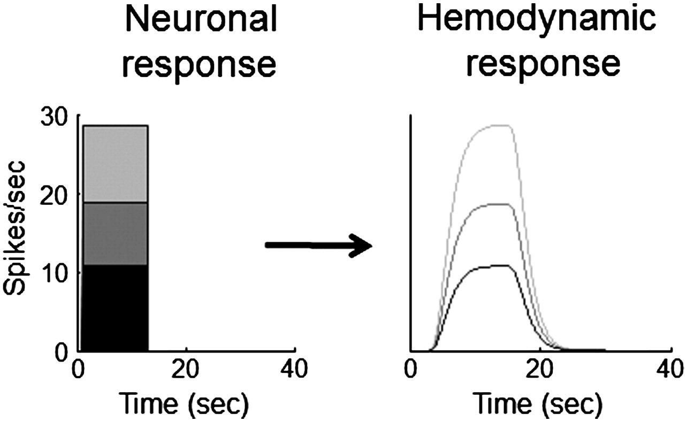
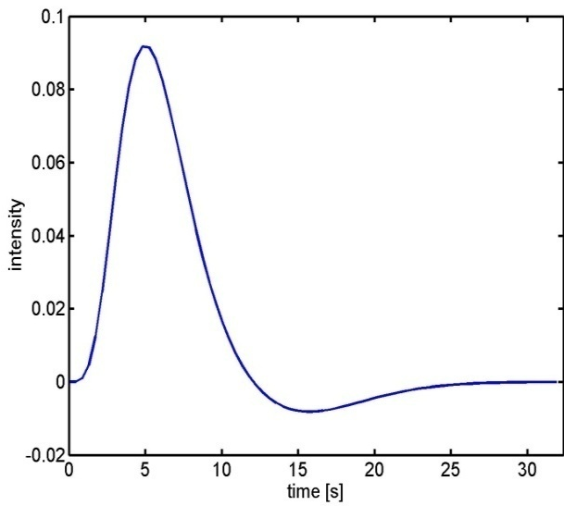
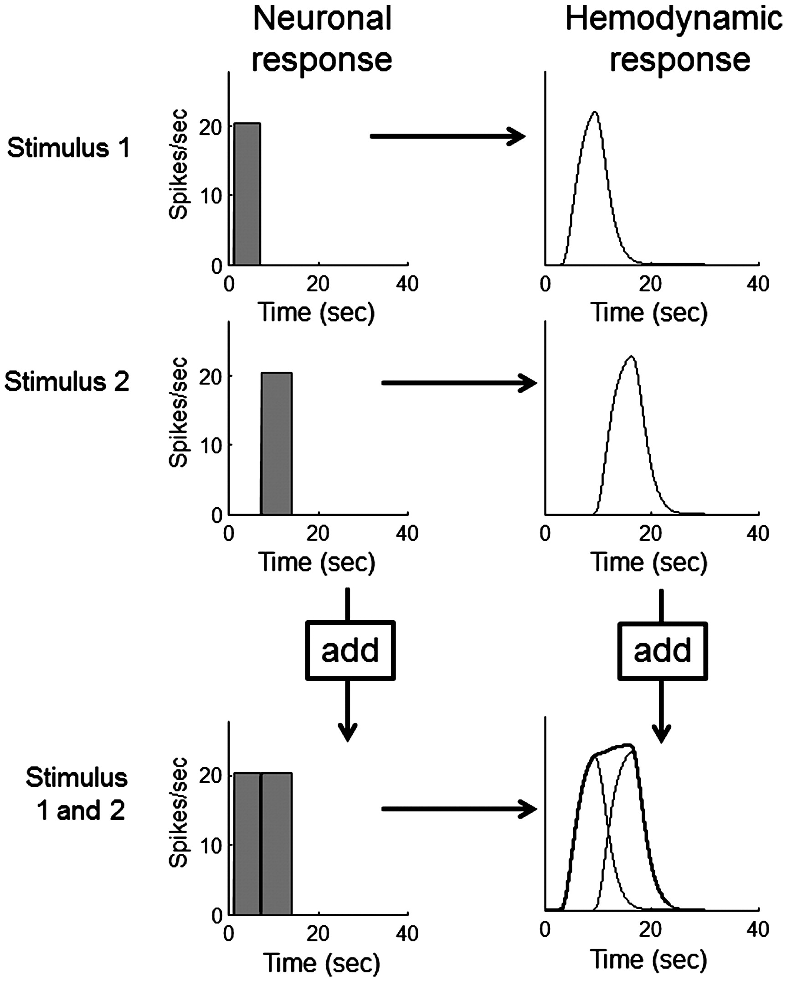
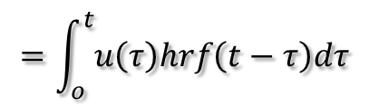

Problem 1: BOLD response
Hemodynamic response function (HRF):
Scaling
Shift
invariance
Linear time-invariant (LTI) system:
u(t)
hrf(t)
x(t)
Convolution operator:
$$x\left(t\right)=u\left(t\right)∗hrf\left(t\right)$$
Additivity
$$=\int_{o}^{t}{u\left(τ\right)hrf\left(t−τ\right)dτ}$$
Boynton et al, NeuroImage, 2012.

Slide 12
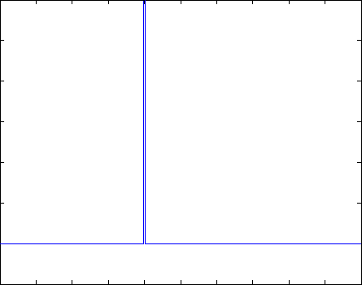
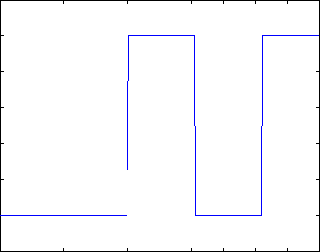
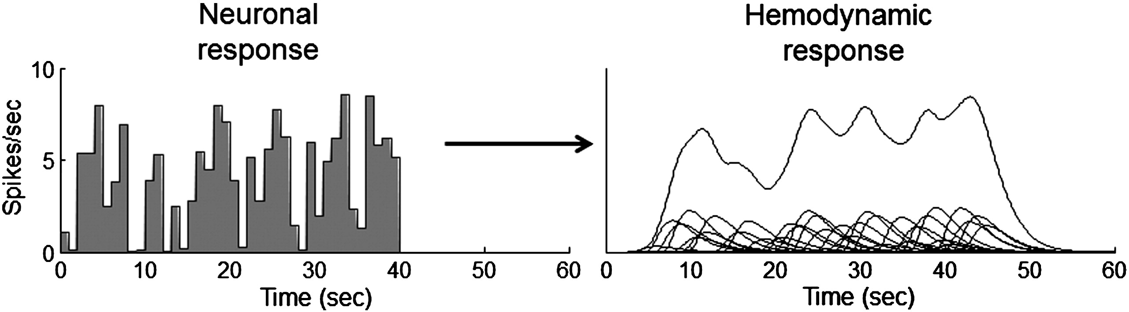
Problem 1: BOLD response
Solution: Convolution model

Slide 13
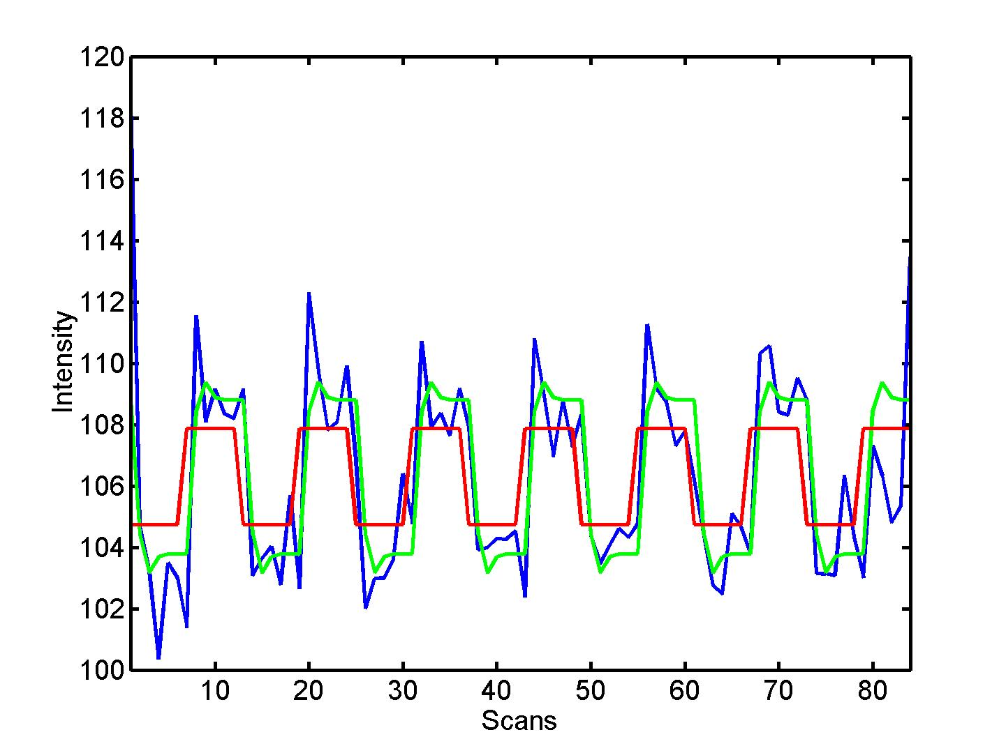


Convolution model of the BOLD response
Convolve stimulus function with a canonical hemodynamic response function (HRF):
⊗ HRF

Slide 14
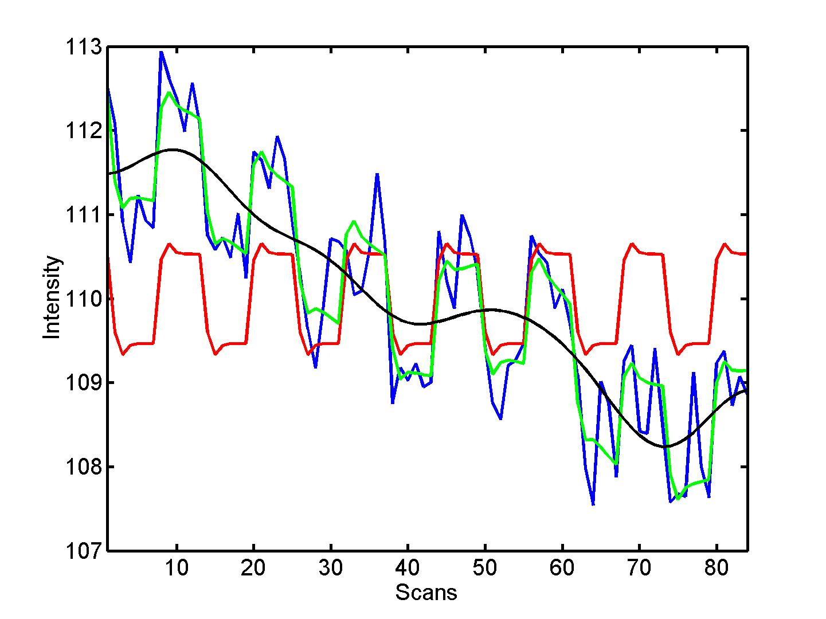

Problem 2: Low-frequency noise
Solution: High pass filtering
blue = data
black = mean + low-frequency drift
green = predicted response, taking into account low-frequency drift
red = predicted response, NOT taking into account low-frequency drift
discrete cosine transform (DCT) set

Slide 15
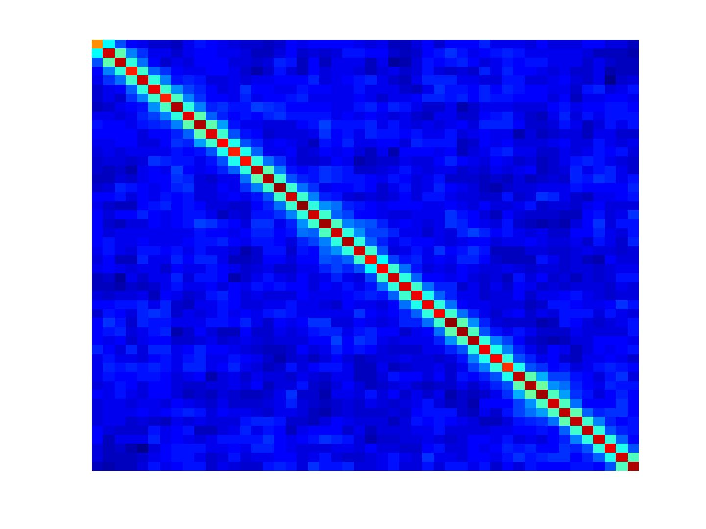
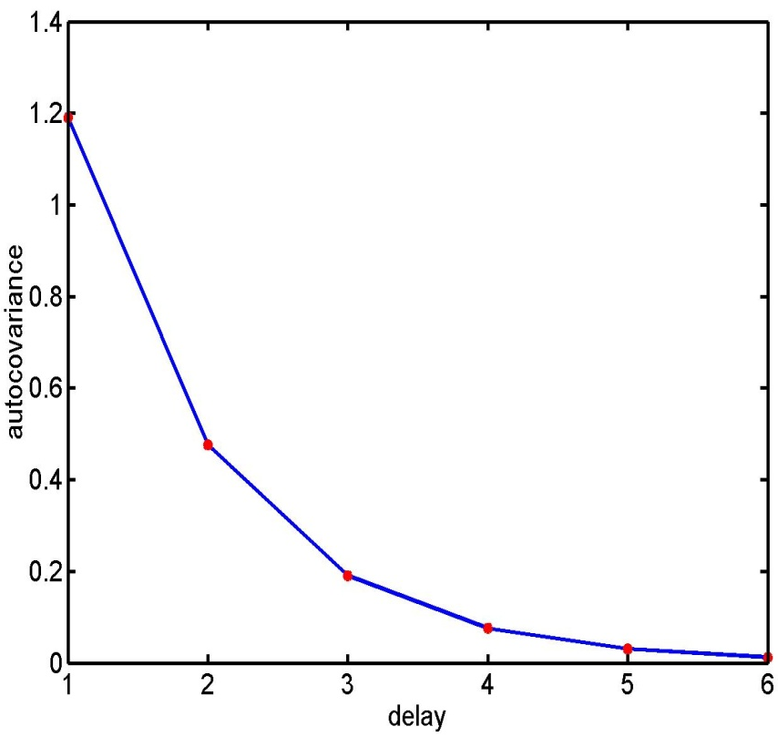
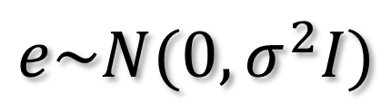
Problem 3: Serial correlations
i.i.d:
$$e\sim N(0,σ^{2}I)$$
autocovariance
function

Slide 16
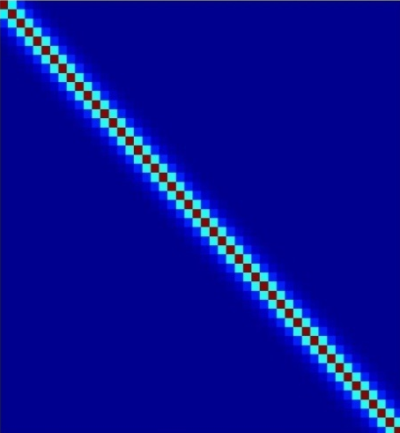
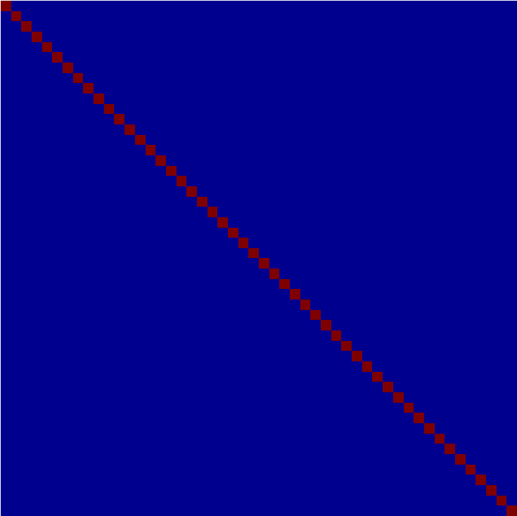
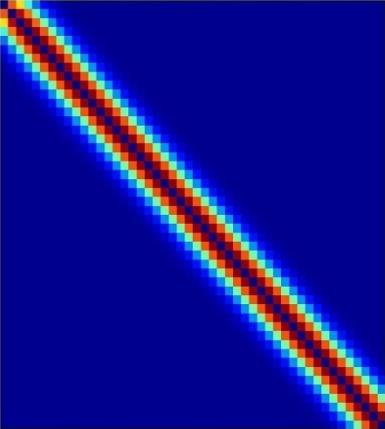
Multiple covariance components
enhanced noise model at voxel i
error covariance components Q and hyperparameters λ
V
Q₁
Q₂
=
λ₁
+ λ₂
Estimation of hyperparameters λ with ReML (Restricted Maximum Likelihood).

Slide 17
Weighted Least Squares (WLS)
Let
Then
WLS equivalent to
OLS on whitened
data and design
where

Slide 18
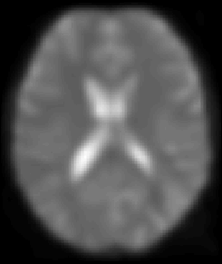
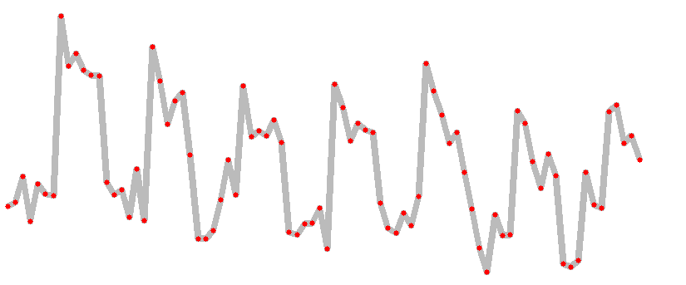
A mass-univariate approach
Summary
Time

Slide 19
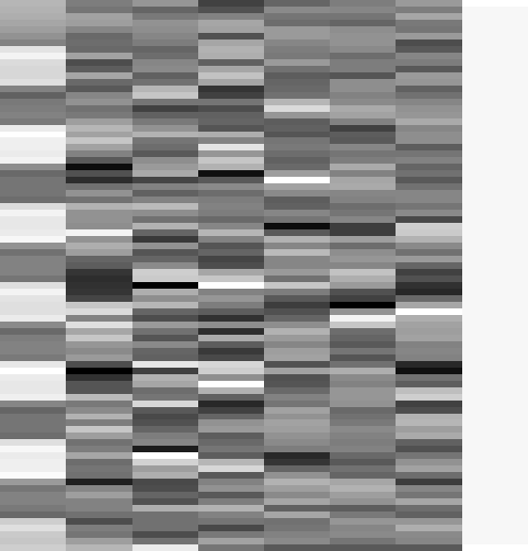


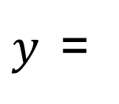
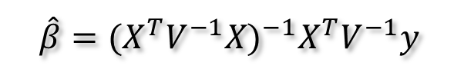
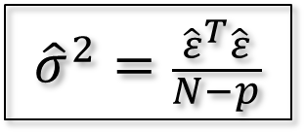
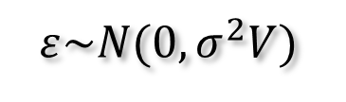
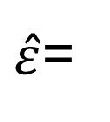



Estimation of the parameters
Summary
noise assumptions:
$$ε\sim N(0,σ^{2}V)$$
WLS:
$$\hat{β}={(X^{T}V^{−1}X)}^{−1}X^{T}V^{−1}y$$
$${\hat{β}}_{1}=3.9831$$
$${\hat{β}}_{2−7}=\{0.6871, 1.9598, 1.3902, 166.1007, 76.4770, −64.8189\}$$
$$β$$
$${\hat{β}}_{8}=131.0040$$
$y$=
$$+ε$$
$\hat{ε}$=
$${\hat{σ}}^{2}=\frac{{\hat{ε}}^{T}\hat{ε}}{N−p}$$
$$\hat{β}\sim N\left(β,σ^{2}{(X^{T}X)}^{−1}\right)$$

Slide 20
References
Statistical parametric maps in functional imaging: a general linear approach, K.J. Friston et al, Human Brain Mapping, 1995.
Analysis of fMRI time-series revisited – again, K.J. Worsley and K.J. Friston, NeuroImage, 1995.
The general linear model and fMRI: Does love last forever?, J.-B. Poline and M. Brett, NeuroImage, 2012.
Linear systems analysis of the fMRI signal, G.M. Boynton et al, NeuroImage, 2012.

Slide 21
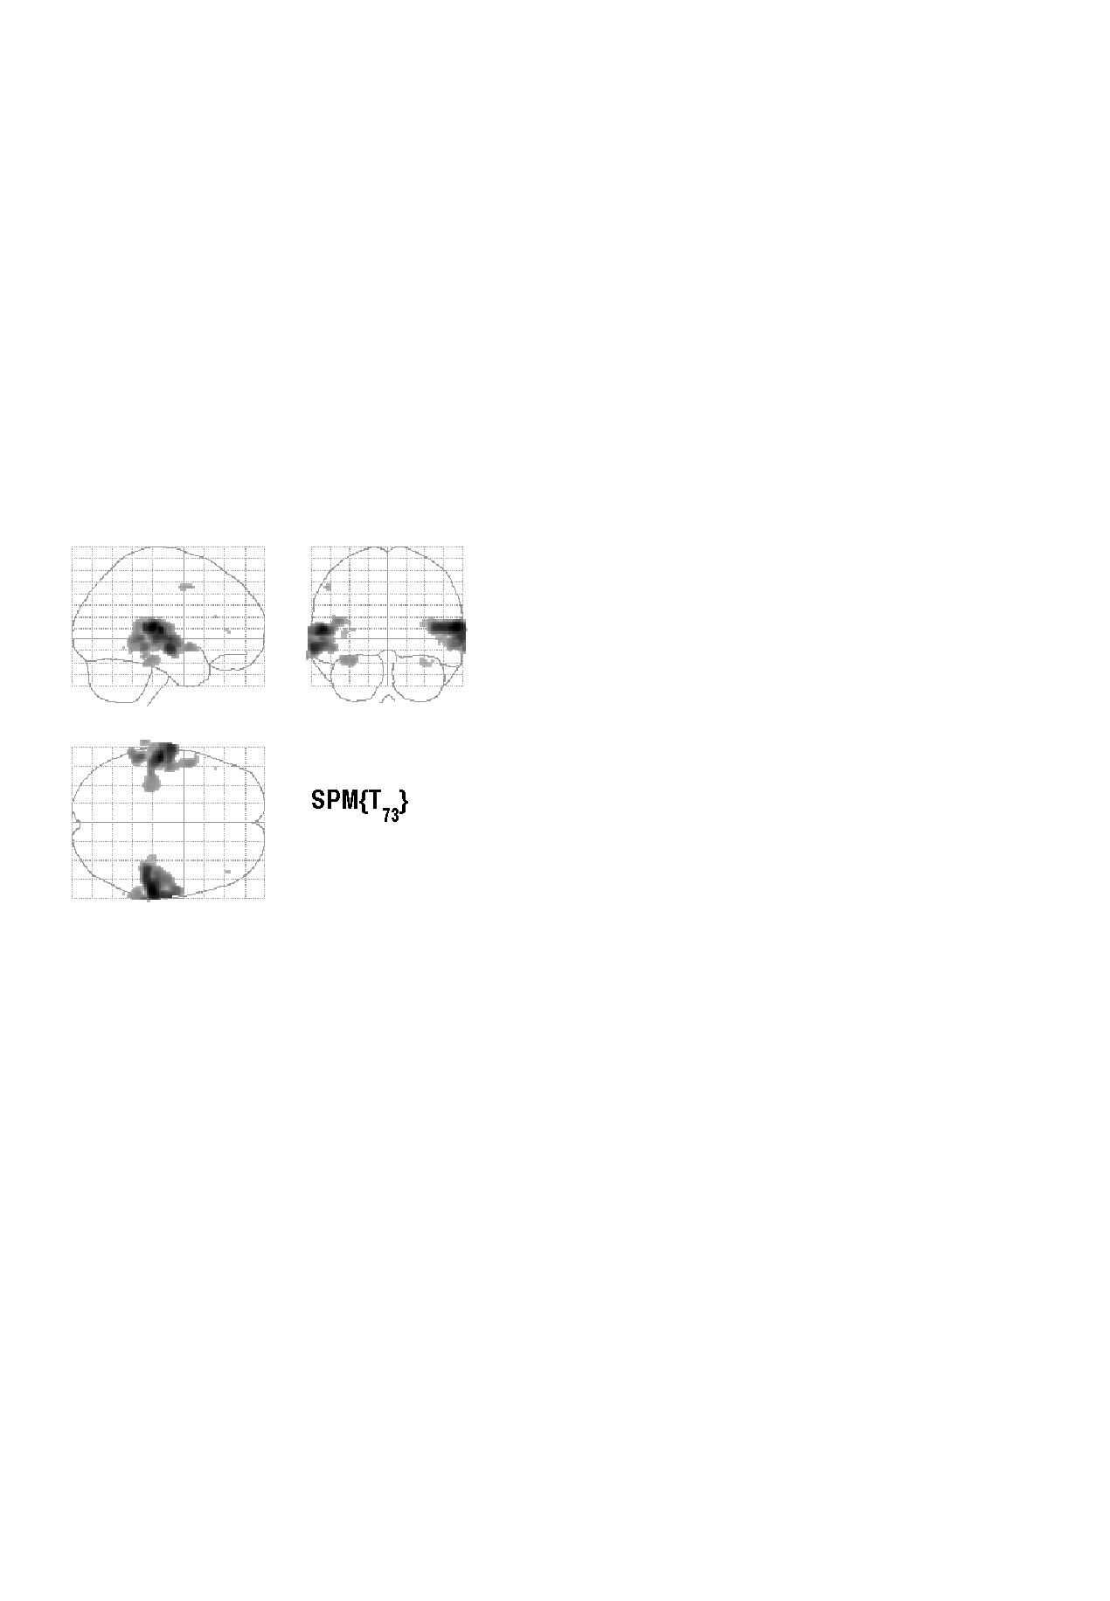


Contrasts &
statistical parametric maps
c = 1 0 0 0 0 0 0 0 0 0 0
Q: activation during listening ?
Null hypothesis:

Slide 22


Modelling the measured data
Make inferences about effects of interest
Why?
Decompose data into effects and error
Form statistic using estimates of effects and error
How?
stimulus function
effects estimate
linear
model
statistic
data
error estimate

Slide 23
Summary
Mass univariate approach.
Fit GLMs with design matrix, X, to data at different points in space to estimate local effect sizes,
GLM is a very general approach
Hemodynamic Response Function
High pass filtering
Temporal autocorrelation

Slide 24
Problem 3: Serial correlations
with
1st order autoregressive process: AR(1)
autocovariance
function

Slide 25
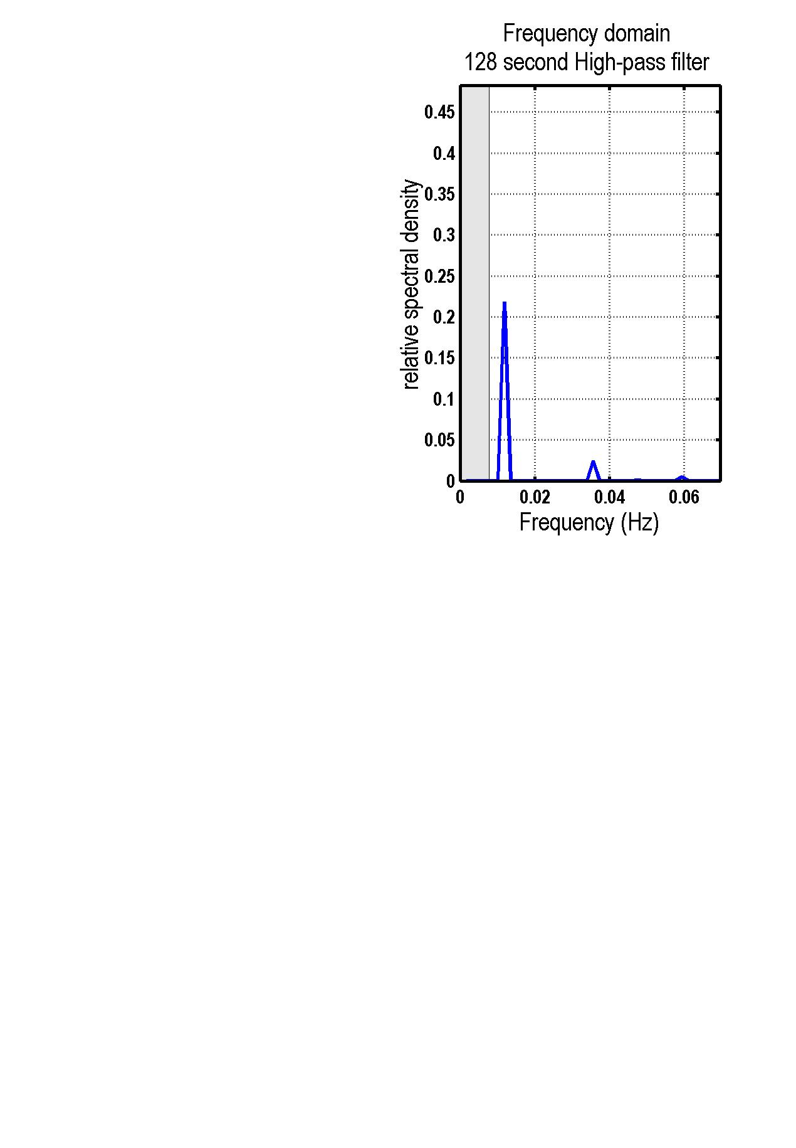
High pass filtering
discrete cosine transform (DCT) set

Slide 26
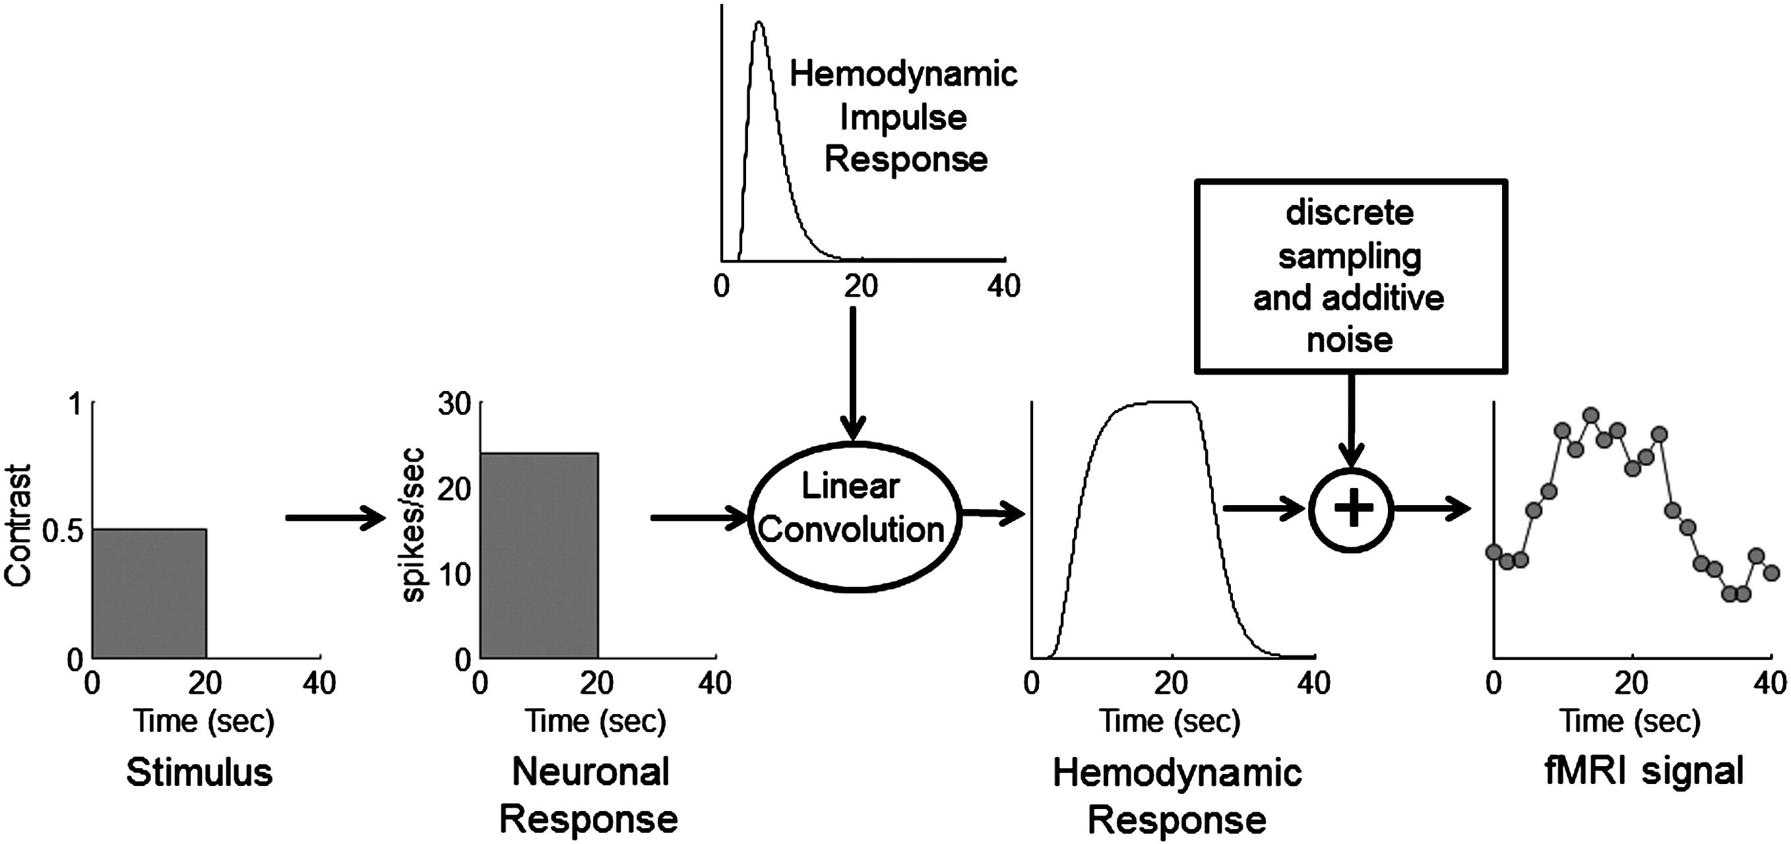
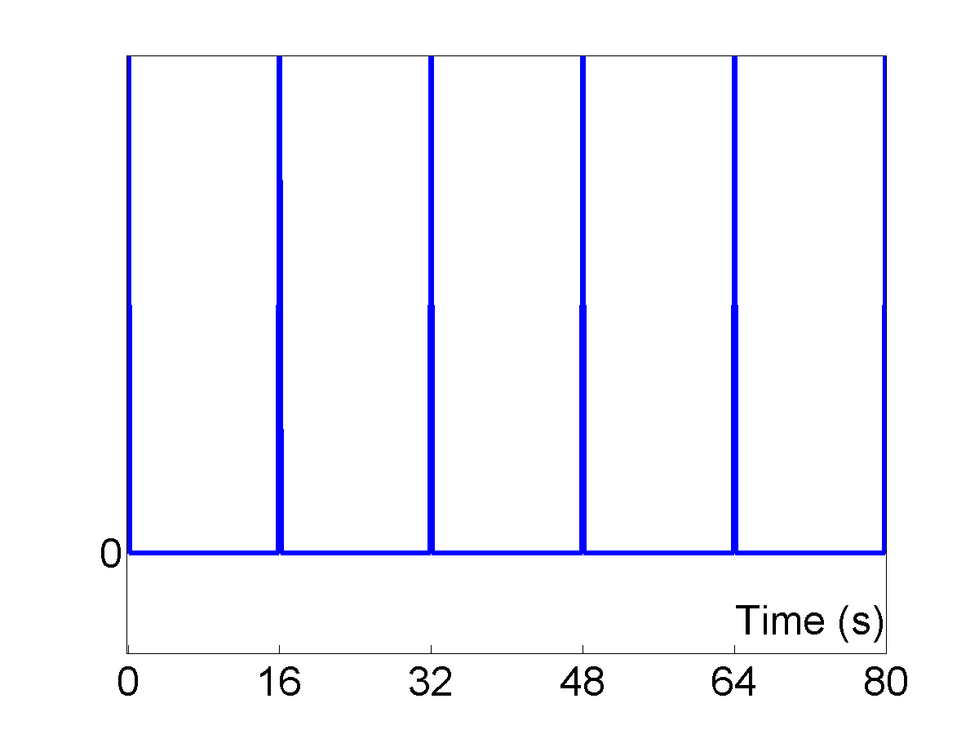
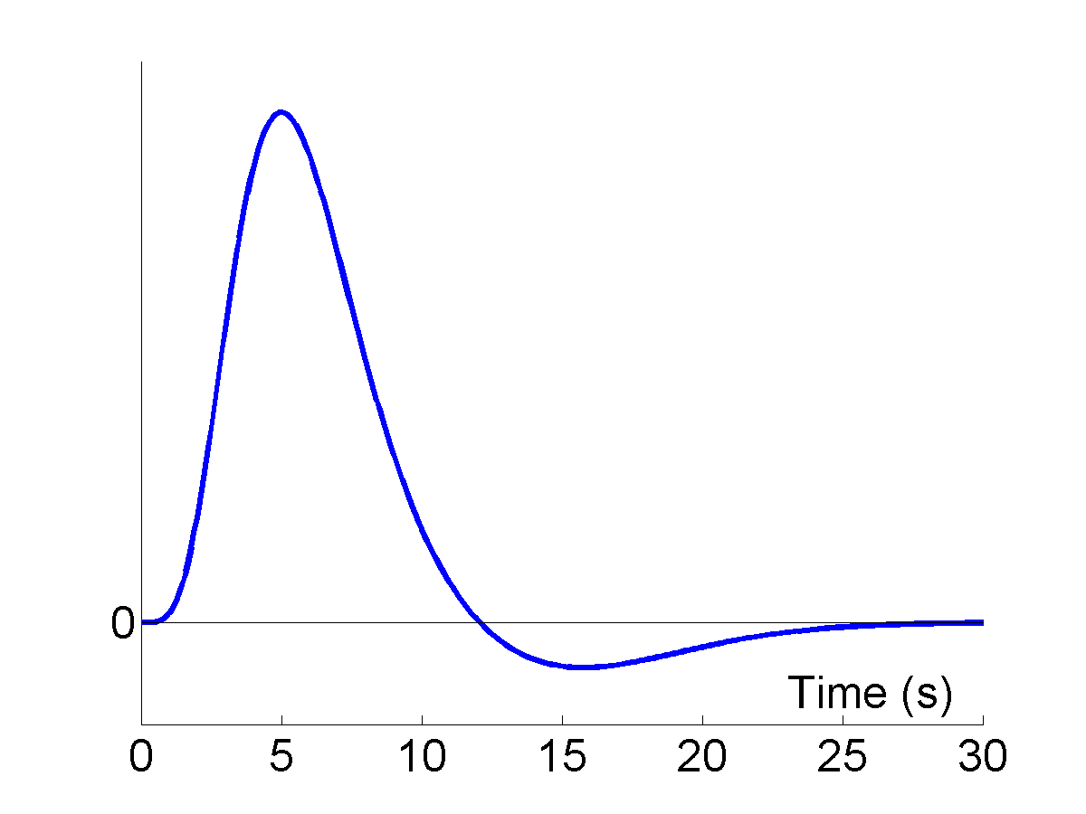
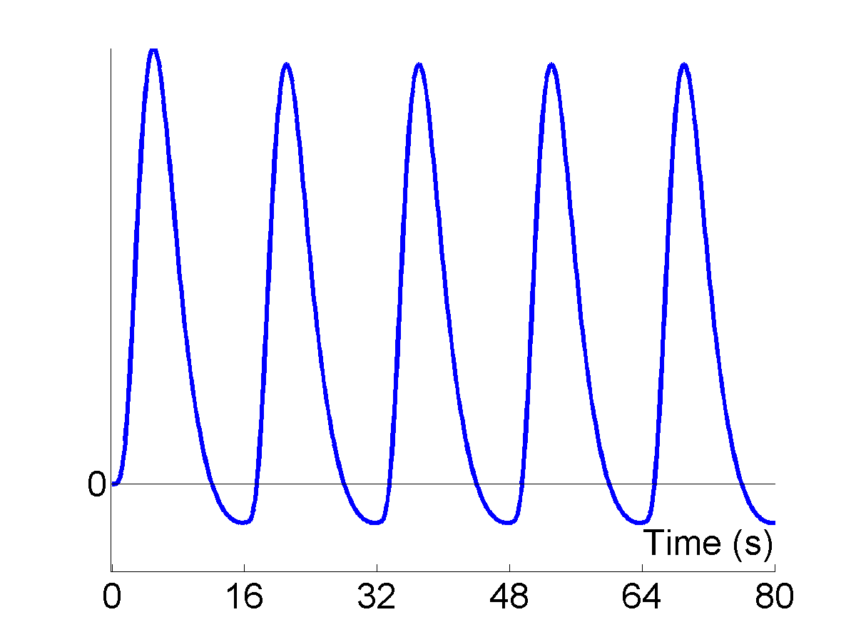
Problem 1: BOLD response
Solution: Convolution model
Impulses
HRF
Expected BOLD
⊗
=
expected BOLD response
= input function ⊗ impulse response function (HRF)

