Slide 1
FIL SPM Course Oct 2012
Voxel-Based Morphometry
Ged Ridgway, FIL/WTCN
With thanks to John Ashburner

Slide 2
Overview
Unified segmentation recap
Voxel-based morphometry (VBM)
Spatial normalisation with Dartel

Slide 3
Tissue segmentation
High-resolution MRI reveals fine structural detail in the brain, but not all of it reliable or interesting
  Noise, intensity-inhomogeneity, vasculature, …
MR intensity is usually not quantitative (cf. relaxometry)
  fMRI time-series allow signal changes to be analysed statistically, compared to baseline or global values
Regional volumes of the three main tissue types: gray matter, white matter and CSF, are well-defined and potentially very interesting

Slide 4
Summary of unified segmentation
Unifies tissue segmentation and spatial normalisation
  Principled Bayesian formulation: probabilistic generative model
Gaussian mixture model with deformable tissue prior probability maps (from segmentations in MNI space)
  The inverse of the transformation that aligns the TPMs can be used to normalise the original image to standard space
  [Or the rigid component can be used to initialise Dartel]
Intensity non-uniformity (bias) is included in the model

Slide 5
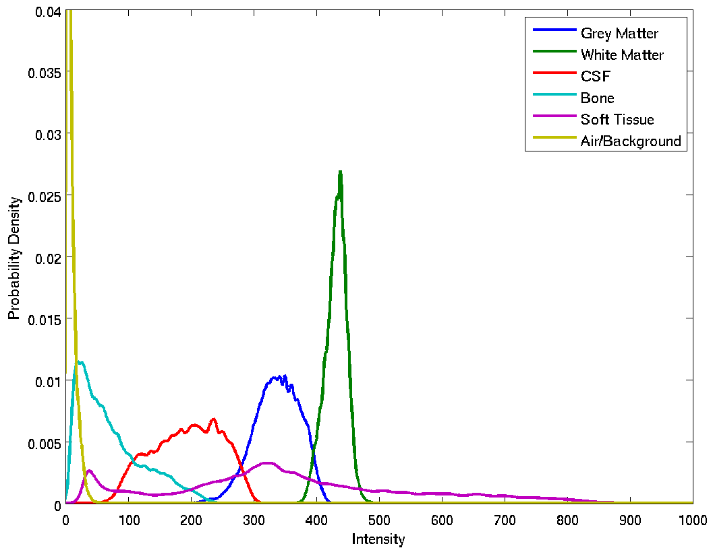
Tissue intensity distributions (T1-w MRI)

Slide 6
Gaussian mixture model (GMM or MoG)
Classification is based on a Mixture of Gaussians (MoG) model fitted to the intensity probability density (histogram)
Frequency
Image Intensity

Slide 7
Non-Gaussian Intensity Distributions
Multiple Gaussians per tissue class allow non-Gaussian intensity distributions to be modelled.
  E.g. accounting for partial volume effects

Slide 8
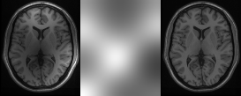
Modelling inhomogeneity
MR images are corrupted by spatially smooth intensity variations (worse at high field strength)
A multiplicative bias correction field is modelled as part of unified segmentation
Corrupted image
Bias Field
Corrected image

Slide 9
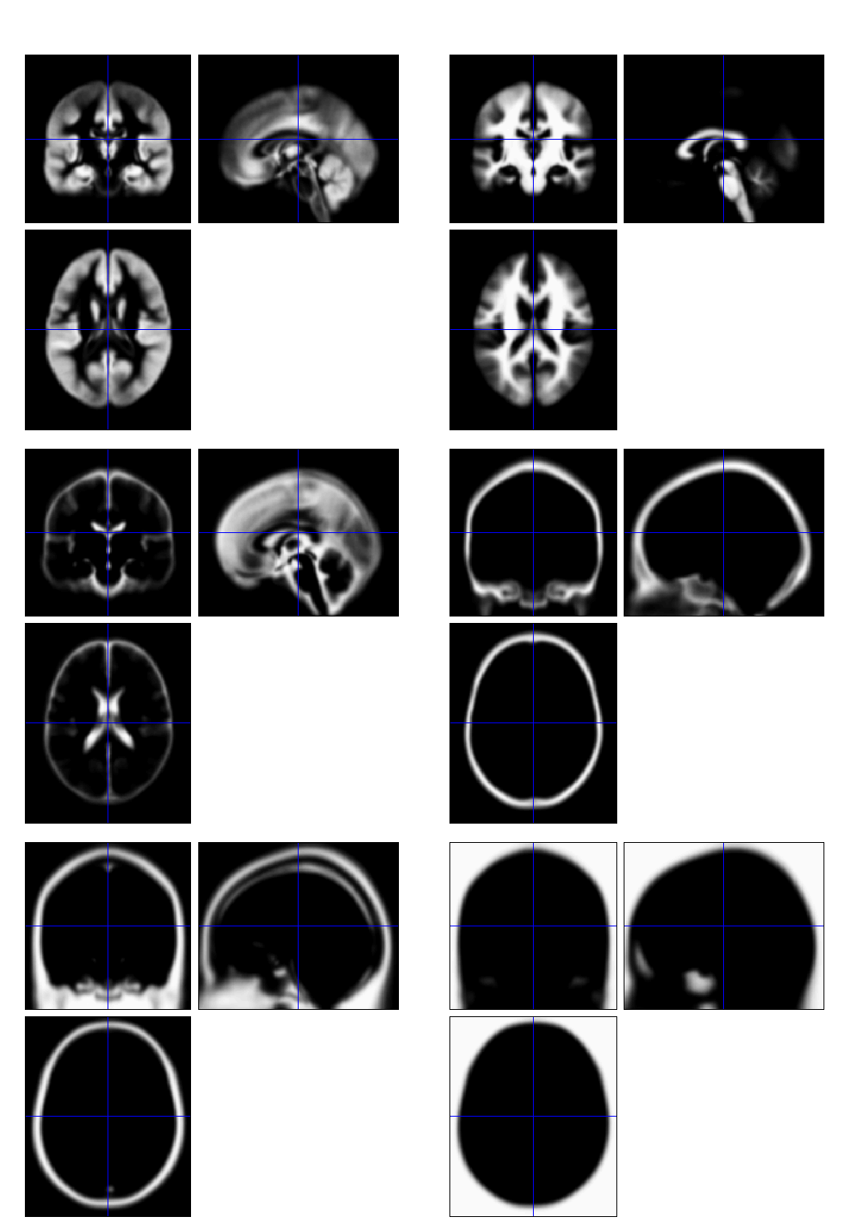
TPMs – Tissue prior probability maps
Each TPM indicates the prior probability for a particular tissue at each point in MNI space
  Fraction of occurrences in previous segmentations
TPMs are warped to match the subject
  The inverse transform normalises to MNI space

Slide 10
Overview
Unified segmentation
Voxel-based morphometry (VBM)
Spatial normalisation with Dartel

Slide 11
Computational neuroanatomy
Quantitative analysis of variability in biological shape
  Can be univariate or multivariate, inferential or predictive
Example applications
  Distinguish groups (e.g schizophrenics from healthy controls)
  Model changes (e.g. in development or aging)
  Characterise plasticity, e.g. when learning new skills
  Find structural correlates (scores, traits, genetics, etc.)
  Differentiate degenerative disease from healthy aging
    Evaluate subjects on drug treatments versus placebo

Slide 12
Voxel-Based Morphometry
Most widely used method for computational anatomy
VBM is essentially Statistical Parametric Mapping of regional segmented tissue density or volume
The exact interpretation of gray matter density or volume is complicated, and depends on the preprocessing steps used
  It is not interpretable as neuronal packing density or other cytoarchitectonic tissue properties
  The hope is that changes in these microscopic properties may lead to macro- or mesoscopic VBM-detectable differences

Slide 13
VBM methods overview
Unified segmentation and spatial normalisation
  More flexible groupwise normalisation using DARTEL
Volume-preserving transformation/warping
Gaussian smoothing
Optional computation of tissue totals/globals
Voxel-wise statistical analysis

Slide 14
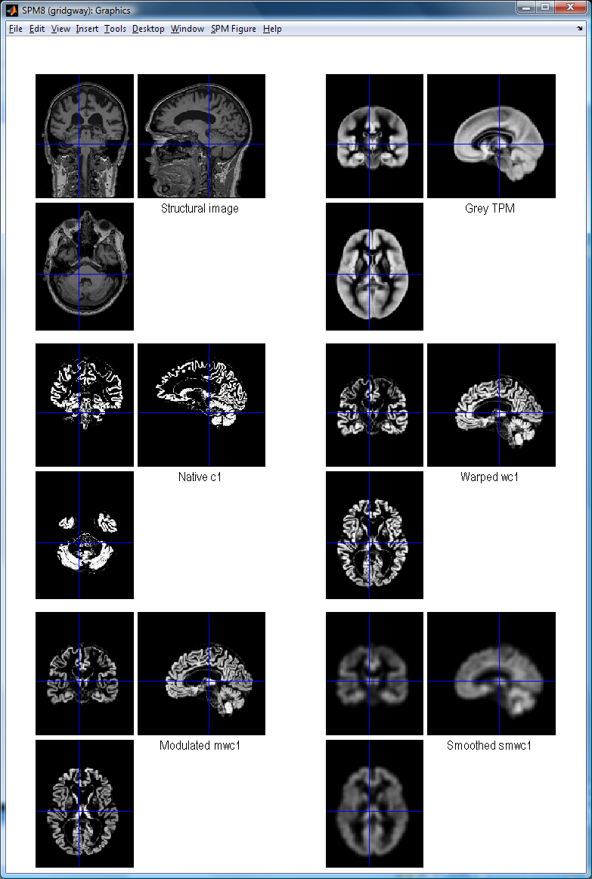
VBM in pictures
Segment
Normalise

Slide 15
VBM in pictures
Segment
Normalise
Modulate
Smooth

Slide 16
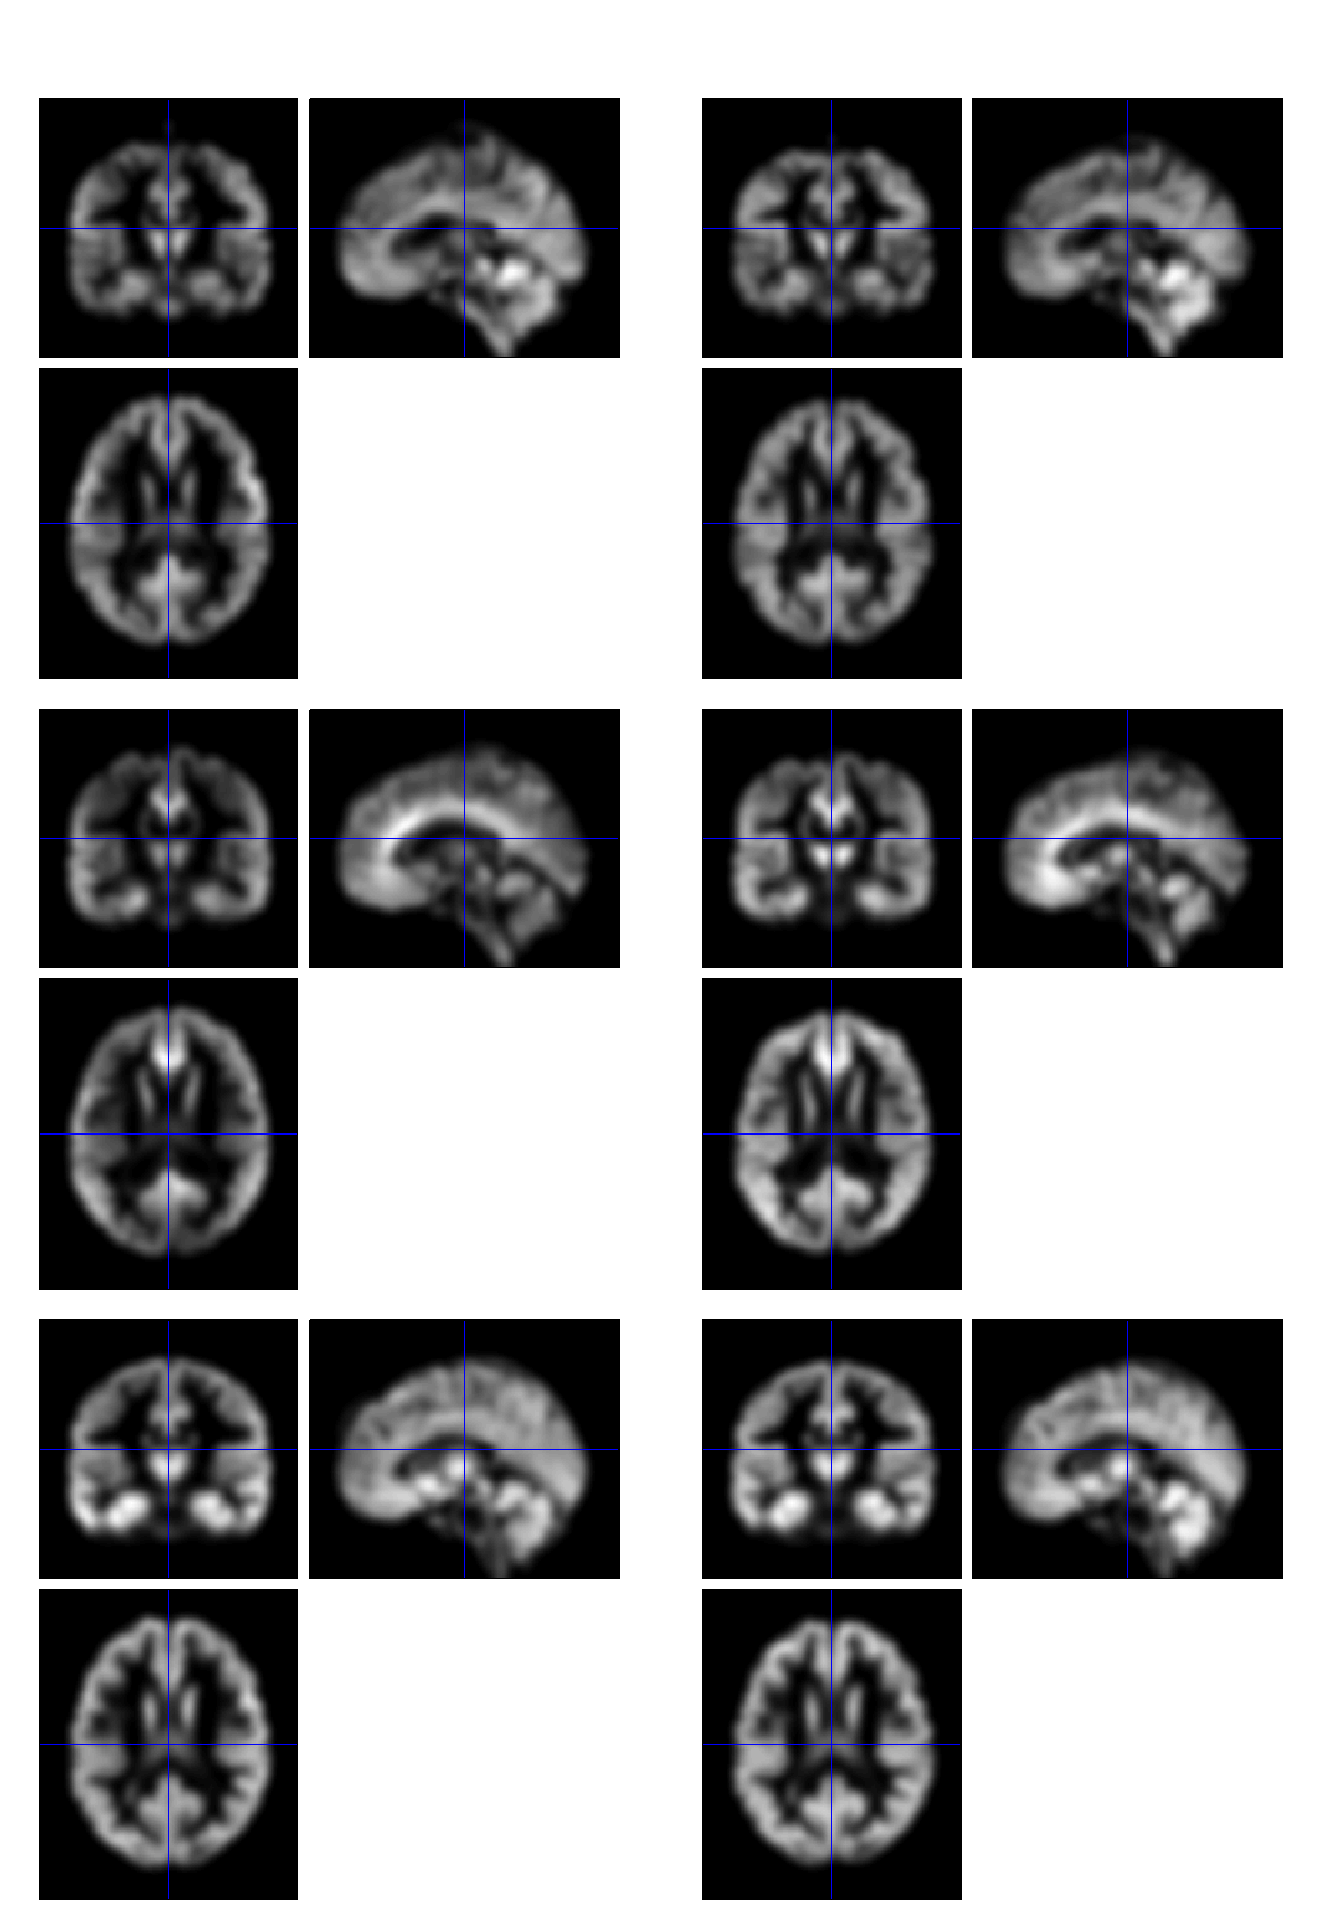
VBM in pictures
Segment
Normalise
Modulate
Smooth
Voxel-wise statistics

Slide 17
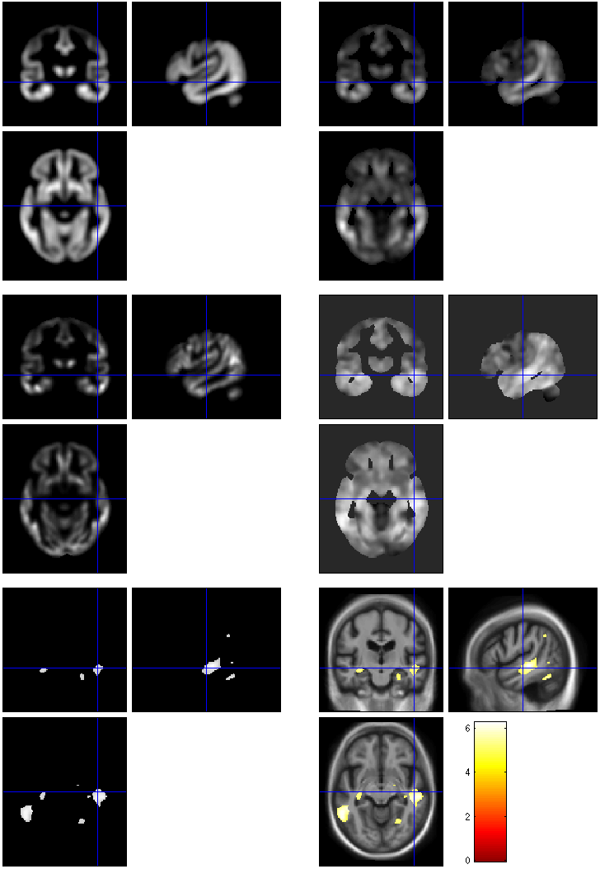
VBM in pictures
beta_0001
con_0001
Segment
Normalise
Modulate
Smooth
Voxel-wise statistics
ResMS
spmT_0001
FWE < 0.05

Slide 18
Modulation
(“preserve amounts”)
1 1
Native
intensity = tissue density
Multiplication of the warped (normalised) tissue intensities so that their regional or global volume is preserved
  Can detect differences in completely registered areas
Otherwise, we “preserve concentrations”, and are detecting mesoscopic effects that remain after approximate registration has removed the macroscopic effects
  Flexible (not necessarily “perfect”) registration may not leave any such differences
Unmodulated
1 1 1 1
Modulated
2/3 1/3 1/3 2/3
Notes:
Clarify, modulation not a step (as spm2) but an option in the segment and the normalise GUIs

Slide 19
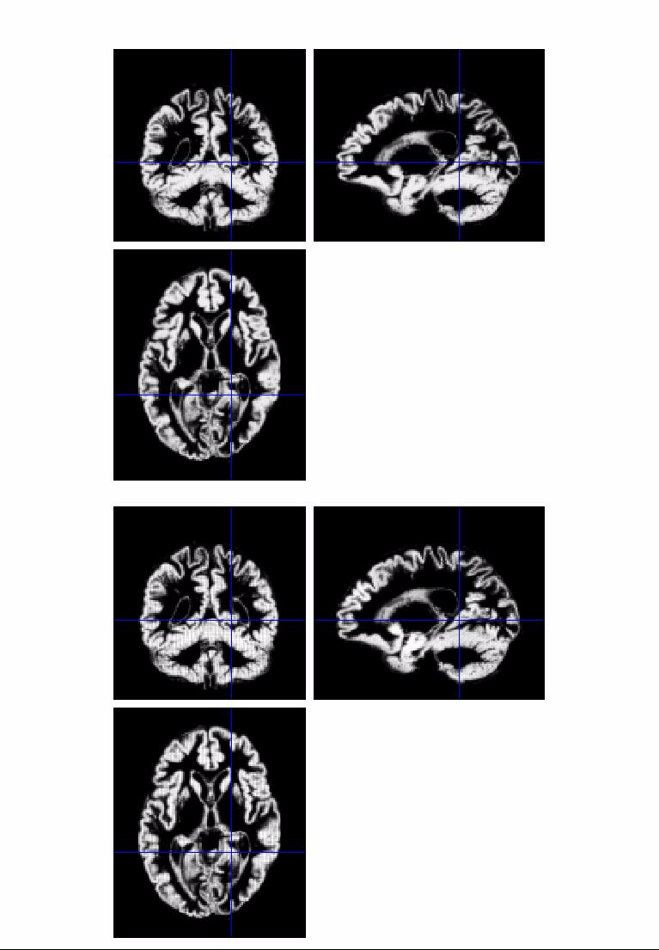
Modulation
(“preserve amounts”)
Top shows “unmodulated”
data (wc1), with intensity or concentration preserved
  Intensities are constant
Below is “modulated” data (mwc1) with amounts or totals preserved
  The voxel at the cross-hairs brightens as more tissue is compressed at this point

Slide 20
Smoothing
The analysis will be most sensitive to effects that match the shape and size of the kernel
The data will be more Gaussian and closer to a continuous random field for larger kernels
  Usually recommend >= 6mm
Results will be rough and noise-like if too little smoothing is used
Too much will lead to distributed, indistinct blobs
  Usually recommend <= 12mm

Slide 21
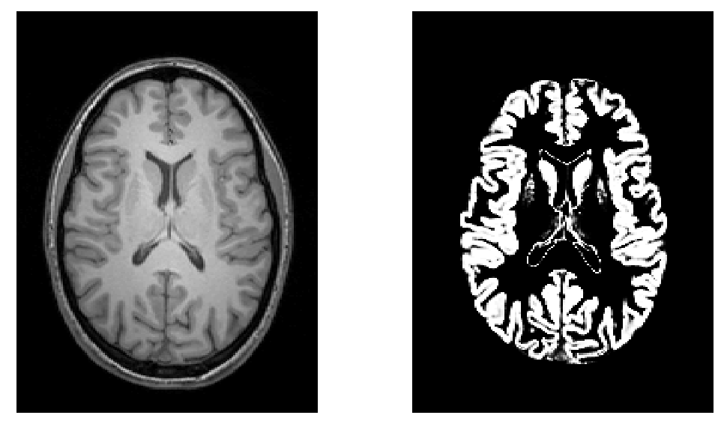
Smoothing as a locally weighted ROI
VBM > ROI: no subjective (or arbitrary) boundaries
VBM < ROI: harder to interpret blobs & characterise error

Slide 22
Interpreting findings
Thinning
Contrast
Mis-register
Mis-register
Thickening
Folding
Mis-classify

Slide 23
Interpreting findings
VBM is sometimes described as
“unbiased whole brain volumetry”
Regional variation in registration accuracy
Segmentation problems, issues with analysis mask
Intensity, folding, etc.
But significant blobs probably still indicate meaningful systematic effects!

Slide 24
Adjustment for “nuisance” variables
Anything which might explain some variability in regional volumes of interest should be considered
  Age and gender are obvious and commonly used
    Consider age+age² to allow quadratic effects
  Site or scanner if more than one
  (NB factor, not covariate!)
  Interval in longitudinal studies
    Some “12-month” intervals end up months longer…
Total grey matter volume often used for VBM
  Changes interpretation when correlated with local volumes (shape is a multivariate concept…)
  Total intracranial volume (TIV/ICV) sometimes more useful/interpretable, see also
  Barnes et al., (2010), NeuroImage 53(4):1244-55

Slide 25
VBM’s statistical validity
Residuals are not normally distributed
  Little impact for comparing reasonably sized groups
  Potentially problematic for comparing single subjects or tiny patient groups with a larger control group
  Mitigate with large amounts of smoothing
  Or use nonparametric tests that make fewer assumptions, e.g. permutation testing with SnPM
Smoothness is not spatially stationary
  Bigger blobs expected by chance in smoother regions
  NS toolbox http://www.fil.ion.ucl.ac.uk/spm/ext/#NS
Voxel-wise FDR is common, but not recommended

Slide 26
Longitudinal VBM
The simplest method for longitudinal VBM is to use cross-sectional preprocessing, but longitudinal statistics
  Standard preprocessing not optimal, but unbiased
  Non-longitudinal statistics would inflate false positive rates
    (Estimates of standard errors would be too small)
  Simplest longitudinal statistical analysis: two-stage summary statistic approach (common in fMRI)
    Within subject longitudinal differences or beta estimates from linear regressions against time

Slide 27
Longitudinal VBM variations
Intra-subject registration over time is much more accurate than inter-subject normalisation
A simple approach is to apply one set of normalisation parameters (e.g. estimated from baseline images) to both baseline and repeat(s)
  Draganski et al (2004) Nature 427: 311-312
More sophisticated approaches use nonlinear within-subject registration, e.g. with HDW or new toolbox
  E.g. Kipps et al (2005) JNNP 76:650
  Beware of bias from asymmetries! (Thomas et al 2009) doi:10.1016/j.neuroimage.2009.05.097

Slide 28
Overview
Unified segmentation
Voxel-based morphometry (VBM)
Spatial normalisation with Dartel

Slide 29
Spatial normalisation with DARTEL
VBM is crucially dependent on registration performance
  Limited flexibility (low DoF) registration has been criticised
  Inverse transformations are useful, but not always well-defined
  More flexible registration requires careful modelling and regularisation (prior belief about reasonable warping)
  MNI/ICBM templates/priors are not universally representative
The DARTEL toolbox combines several methodological advances to address these limitations
Evaluations show DARTEL performs at state-of-the art
  E.g. Klein et al., (2009) NeuroImage 46(3):786-802
  …

Slide 30
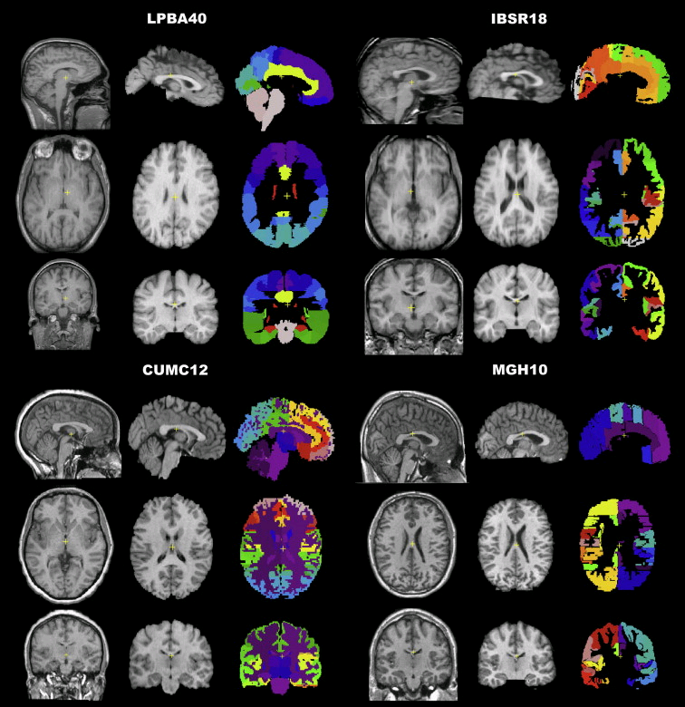
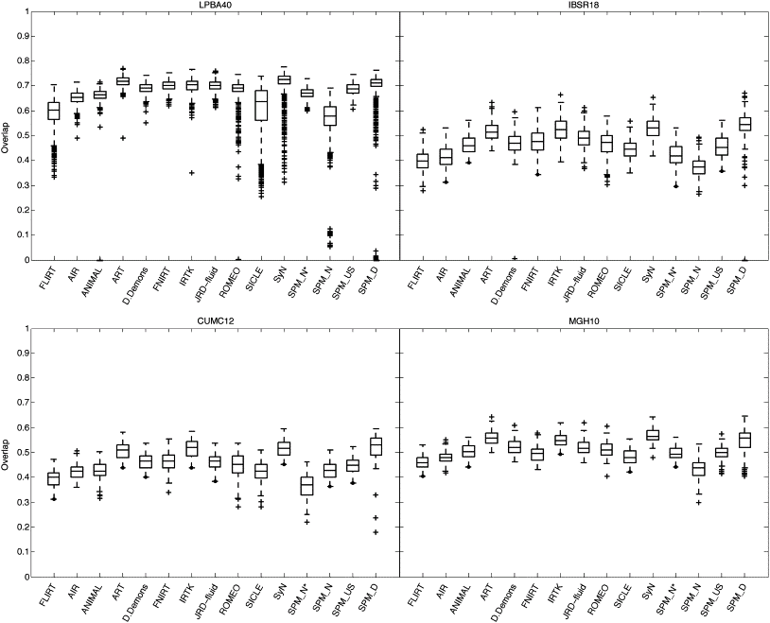
Part of Fig.1 in Klein et al.
Part of Fig.5 in Klein et al.
Notes:
Recent papers comparing different approaches have favoured more flexible methods
DARTEL usually outperforms DCT normalisation
Also comparable to the best algorithms from other software packages
(though note that DARTEL and others have many tunable parameters...)

Slide 31
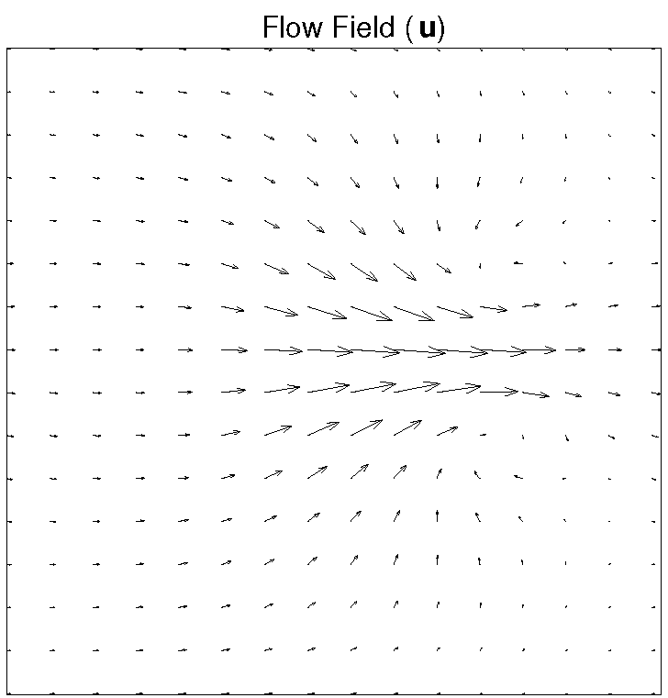
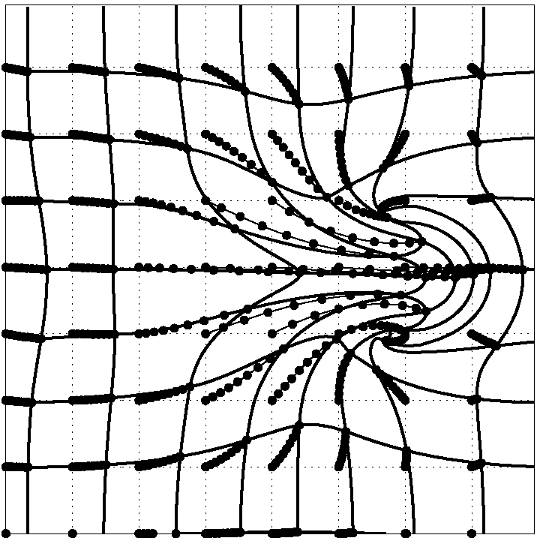
DARTEL Transformations
Estimate (and regularise) a flow u
  Think syrup rather than elastic
  3 (x,y,z) parameters per 1.5mm³ voxel
  10^6 degrees of freedom vs. 10^3 DF for old discrete cosine basis functions
Scaling and squaring is used to generate deformations
Inverse simply integrates -u

Slide 32
DARTEL objective function
Likelihood component (matching)
  Specific for matching tissue segments to their mean
  Multinomial distribution (cf. Gaussian)
Prior component (regularisation)
  A measure of deformation (flow) roughness = ½u^{T}Hu
Need to choose H and a balance between the two terms
  Defaults usually work well (e.g. even for AD)
  Though note that changing models (priors) can change results

Slide 33
Simultaneous registration of GM to GM and WM to WM, for a group of subjects
Grey matter
Subject 1
White matter
Grey matter
Subject 3
White matter
Grey matter
White matter
Grey matter
Template
Grey matter
White matter
White matter
Subject 2
Subject 4

Slide 34
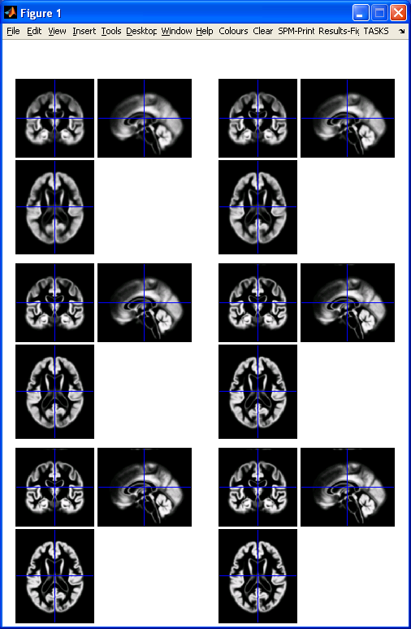
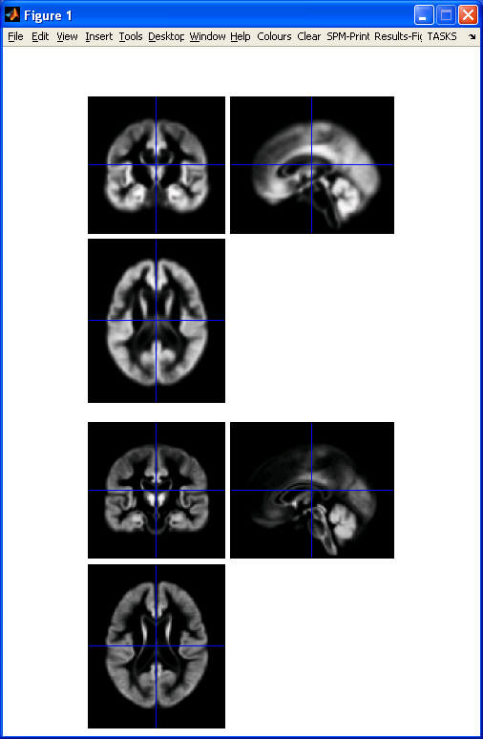
DARTEL average template evolution
Template
1
Rigid average
(Template_0)
Average of
mwc1 using
segment/DCT
Template
6
Notes:
60 images from OASIS cross-sectional data (as in VBM practical)

Slide 35
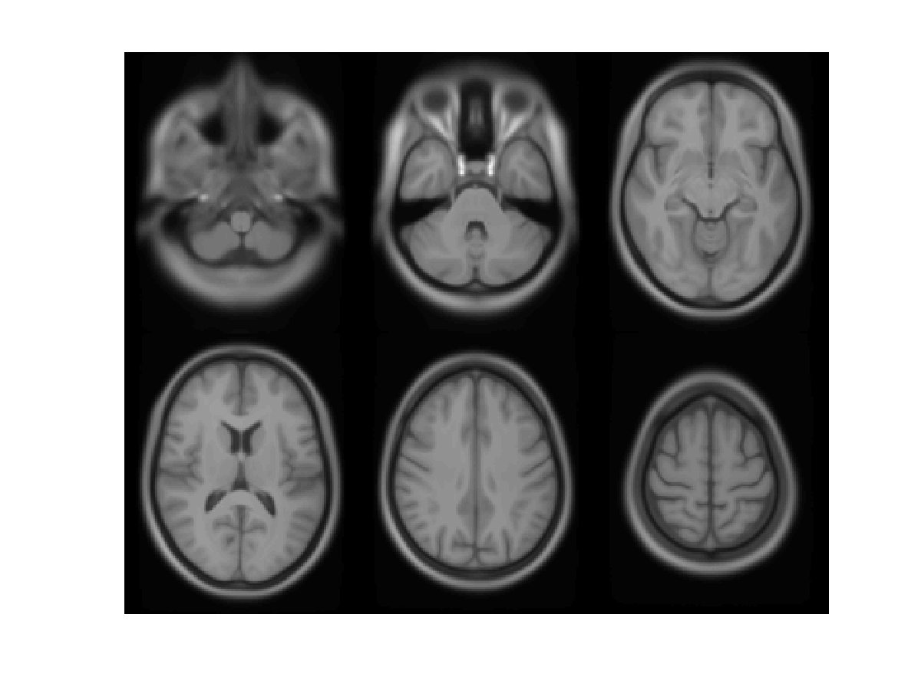

Slide 36
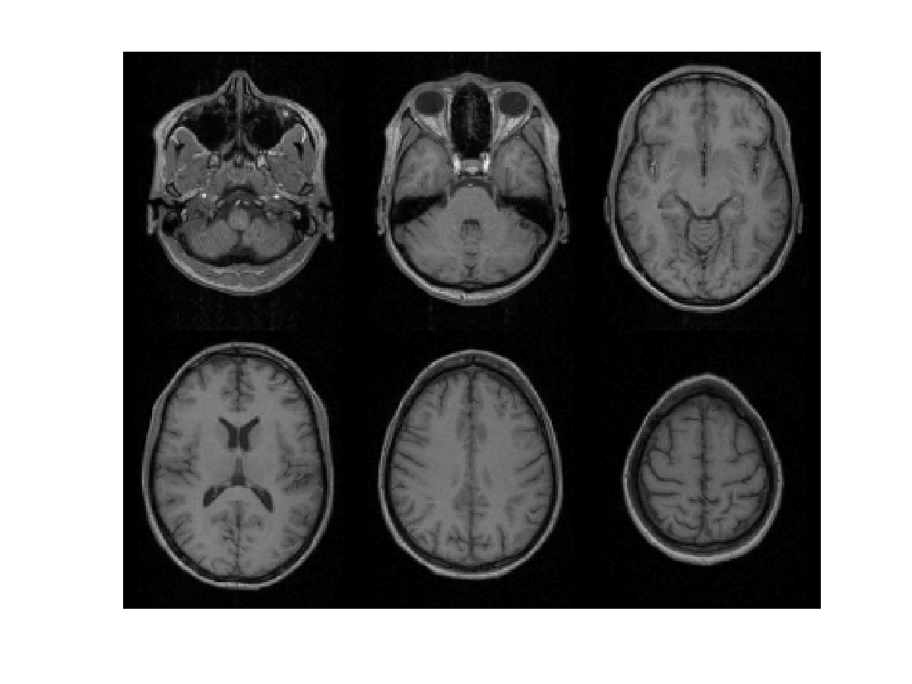

Slide 37
Summary
VBM performs voxel-wise statistical analysis on smoothed (modulated) normalised tissue segments
SPM8 performs segmentation and spatial normalisation in a unified generative model
  Based on Gaussian mixture modelling, with DCT-warped spatial priors, and multiplicative bias field
  The new segment toolbox includes non-brain priors and more flexible/precise warping of them
Subsequent (currently non-unified) use of DARTEL improves normalisation for VBM
  And probably also fMRI...

Slide 38
Extra material

Slide 39
Mathematical advances in computational anatomy
VBM is well-suited to find focal volumetric differences
Assumes independence among voxels
  Not very biologically plausible
  But shows differences that are easy to interpret
Some anatomical differences can not be localised
  Need multivariate models
  Differences in terms of proportions among measurements
  Where would the difference between male and female faces be localised?

Slide 40
Mathematical advances in computational anatomy
In theory, assumptions about structural covariance among brain regions are more biologically plausible
  Form influenced by spatio-temporal modes of gene expression
Empirical evidence, e.g.
  Mechelli, Friston, Frackowiak & Price. Structural covariance in the human cortex. Journal of Neuroscience 25:8303-10 (2005)
Recent introductory review:
  Ashburner & Klöppel. “Multivariate models of inter-subject anatomical variability”. NeuroImage 56(2):422-439 (2011)

Slide 41
Summary of extra material
VBM uses the machinery of SPM to localise patterns in regional volumetric variation
  Use of “globals” as covariates is a step towards multivariate modelling of volume and shape
More advanced approaches typically benefit from the same preprocessing methods
  New segmentation and DARTEL close to state of the art
  Though possibly little or no smoothing
Elegant mathematics related to transformations (diffeomorphism group with Riemannian metric)
VBM – easier interpretation – complementary role

Slide 42
Historical bibliography of VBM
A Voxel-Based Method for the Statistical Analysis of Gray and White Matter Density… Wright, McGuire, Poline, Travere, Murrary, Frith, Frackowiak and Friston (1995 (!)) NeuroImage 2(4)
  Rigid reorientation (by eye), semi-automatic scalp editing and segmentation, 8mm smoothing, SPM statistics, global covars.
Voxel-Based Morphometry – The Methods. Ashburner and Friston (2000) NeuroImage 11(6 pt.1)
  Non-linear spatial normalisation, automatic segmentation
  Thorough consideration of assumptions and confounds

Slide 43
Historical bibliography of VBM
A Voxel-Based Morphometric Study of Ageing… Good, Johnsrude, Ashburner, Henson and Friston (2001) NeuroImage 14(1)
  Optimised GM-normalisation (“a half-baked procedure”)
Unified Segmentation. Ashburner and Friston (2005) NeuroImage 26(3)
  Principled generative model for segmentation using
  deformable priors
A Fast Diffeomorphic Image Registration Algorithm. Ashburner (2007) Neuroimage 38(1)
  Large deformation normalisation
Computing average shaped tissue probability templates. Ashburner & Friston (2009) NeuroImage 45(2): 333-341

