Slide 1
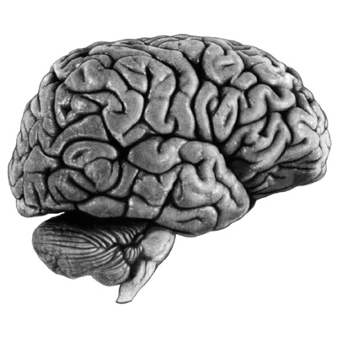
Dynamic Causal Modelling (DCM) for fMRI
Rosalyn Moran
Virginia Tech Carilion Research Institute
With thanks to the FIL Methods Group
for slides and images
SPM Course, UCL
May 2013

Slide 2
Dynamic causal modelling (DCM)
DCM framework was introduced in 2003 for fMRI by Karl Friston, Lee Harrison and Will Penny (NeuroImage 19:1273-1302)
part of the SPM software package
currently more than 160 published papers on DCM
250

Slide 3
Overview
Dynamic causal models (DCMs)
  Basic idea
  Neural level
  Hemodynamic level
  Parameter estimation, priors & inference
Applications of DCM to fMRI data
- Attention to Motion
- The Status Quo Bias

Slide 4
Overview
Dynamic causal models (DCMs)
  Basic idea
  Neural level
  Hemodynamic level
  Parameter estimation, priors & inference
Applications of DCM to fMRI data
- Attention to Motion
- The Status Quo Bias

Slide 7
Functional vs Effective
Connectivity
Functional connectivity is defined in terms of statistical dependencies, it is an operational concept that underlies the detection of (inference about) a functional connection, without any commitment to how that connection was caused
Assessing mutual information & testing for significant departures from zero
Simple assessment: patterns of correlations
Undirected or Directed Functional Connectivity eg. Granger Connectivity
Effective connectivity is defined at the level of hidden neuronal states generating measurements. Effective connectivity is always directed and rests on an explicit (parameterised) model of causal influences — usually expressed in terms of difference (discrete time) or differential (continuous time) equations.
Eg. DCM
causality is inherent in the form of the model ie. fluctuations in hidden neuronal states cause changes in others: for example, changes in postsynaptic potentials in one area are caused by inputs from other areas.

Slide 8
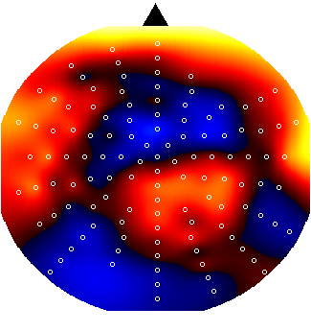
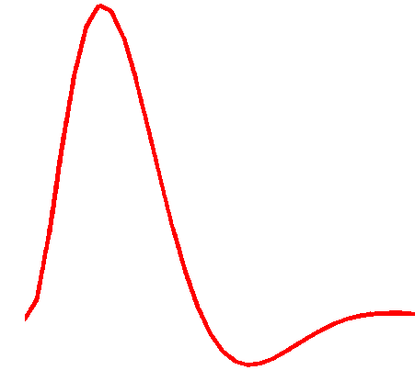
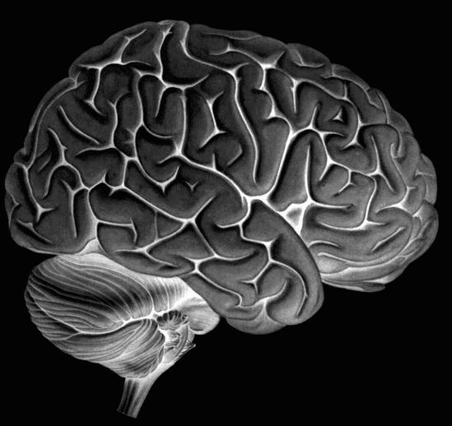
Dynamic Causal Modeling (DCM)
Hemodynamic
forward model:
neural activity→BOLD
Electromagnetic
forward model:
neural activity→EEG
MEG
LFP
Neural state equation:
fMRI
EEG/MEG
simple neuronal model
complicated forward model
complicated neuronal model
simple forward model
inputs

Slide 9
Deterministic DCM
y
y
H{2}
x₂
H{1}
A(2,2)
A(2,1)
x₁
A(1,2)
C(1)
B(1,2)
u1
A(1,1)
u2
Notes:
The elements of this connectivity matrix are not a function of the input, and can be considered as an endogenous or condition-invariant. Second, the elements of B^{(j)} represent the changes of connectivity induced by the inputs, u_{j}. These condition-specific modulations or bilinear terms B^{(j)} are usually the interesting parameters. The endogenous and condition-specific matrices are mixed to form the total connectivity or Jacobian matrix I. Third, there is a direct exogenous influence of each input u_{j} on each area, encoded by the matrix C. The parameters of this system, at the neuronal level, are given by θ^{n} ⊇ A, B¹,…, B^{Nu}, C. At this level, one can specify which connections one wants to include in the model. Connections (i.e., elements of the matrices) are removed by setting their prior mean and variance to zero. We will illustrate this later.

Slide 10
Overview
Dynamic causal models (DCMs)
  Basic idea
  Neural level
  Hemodynamic level
  Parameter estimation, priors & inference
Applications of DCM to fMRI data
- Attention to Motion
- The Status Quo Bias

Slide 11
Example:
a linear model of interacting visual regions
FG
left
FG
right
Visual input in the
- left (LVF)
- right (RVF)
visual field.
LG = lingual gyrus
FG = fusiform gyrus
x₃
x₄
x₁
LG
left
LG
right
x₂
RVF
LVF
u₂
u₁

Slide 12
Example:
a linear model of interacting visual regions
LG = lingual gyrus
FG = fusiform gyrus
Visual input in the
- left (LVF)
- right (RVF)
visual field.
x₃
FG
left
FG
right
x₄
x₁
LG
left
LG
right
x₂
RVF
LVF
u₂
u₁

Slide 13
Example:
a linear model of interacting visual regions
LG = lingual gyrus
FG = fusiform gyrus
Visual input in the
- left (LVF)
- right (RVF)
visual field.
x₃
FG
left
FG
right
x₄
x₁
LG
left
LG
right
x₂
RVF
LVF
u₂
u₁
state
changes
effective
connectivity
system
state
input
parameters
external
inputs

Slide 14
Extension:
bilinear model
x₃
FG
left
FG
right
x₄
x₁
LG
left
LG
right
x₂
RVF
CONTEXT
LVF
u₂
u₃
u₁

Slide 15
Vanilla DCM:
Deterministic Bilinear DCM
driving
input
Simply a two-dimensional
taylor expansion (around x₀=0, u₀=0):
modulation
Bilinear state equation:

Slide 17
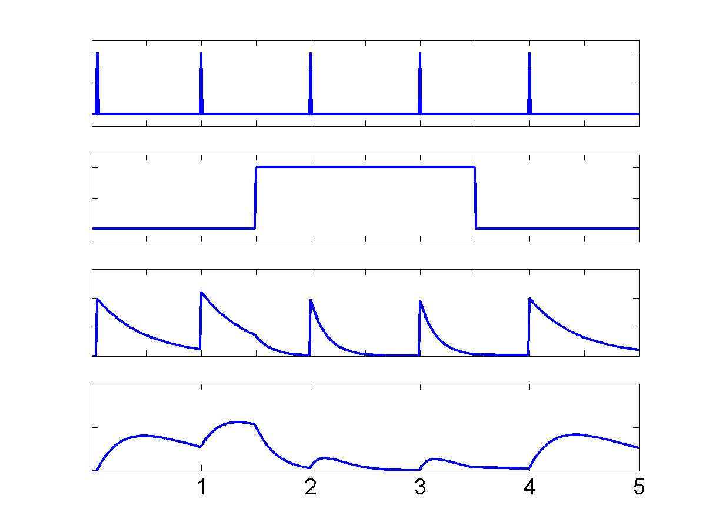
Example:
context-dependent decay
stimuli
u₁
context
u₂
+
-
u
1
-
u₁
x1
u
+
+
2
u₂
Z
+
1
x2
x₁
Z
-
2
-
x₂
Penny et al. 2004, NeuroImage

Slide 18
bilinear DCM
non-linear DCM
modulation
driving
input
driving
input
modulation
Two-dimensional Taylor series (around x₀=0, u₀=0):
Bilinear state equation:
Nonlinear state equation:

Slide 19
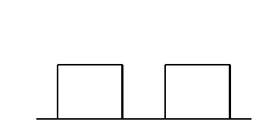
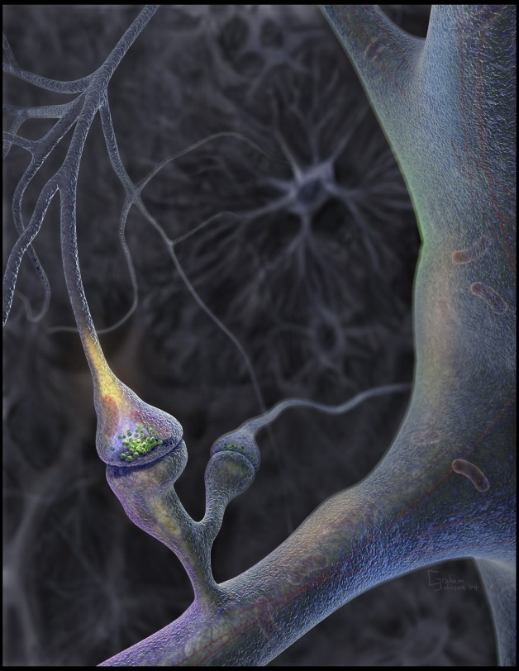
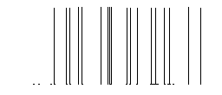
Neural population activity
u₂
u₁
x₃
fMRI signal change (%)
x₁
x₂
Nonlinear dynamic causal model (DCM)
Stephan et al. 2008, NeuroImage

Slide 20
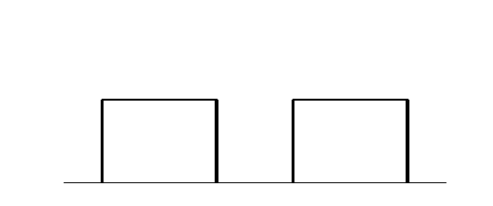
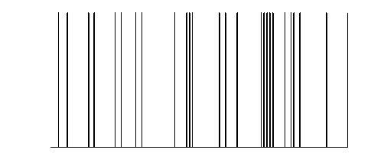
y
y
y
BOLD
y
−
−
λ
−
hemodynamic
model
activity
x₂(t)
activity
x₃(t)
activity
x₁(t)
neuronal
states
x
modulatory
input u₂(t)
integration
driving
input u₁(t)
t
Neural state equation
endogenous connectivity
t
modulation of
connectivity
direct inputs

Slide 21
Overview
Dynamic causal models (DCMs)
  Basic idea
  Neural level
  Hemodynamic level
  Parameter estimation, priors & inference
Applications of DCM to fMRI data
- Attention to Motion
- The Status Quo Bias

Slide 22
Basics of DCM:
Neuronal and BOLD level
y
Cognitive system is modelled at its underlying neuronal level (not directly accessible for fMRI).
The modelled neuronal dynamics (x) are transformed into area-specific BOLD signals (y) by a hemodynamic model (λ).
Overcoming Regional variability of the haemodynamic response
ie DCM not based on temporal precedence at the measurement level
λ
x

Slide 23
Basics of DCM:
Neuronal and BOLD level
y
λ
“Connectivity analysis applied directly on fMRI signals failed because hemodynamics varied between regions, rendering termporal precedence irrelevant” ….The neural driver was identified using DCM, where these effects are accounted for…
x

Slide 24
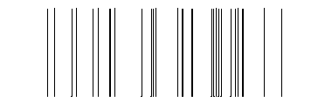
The hemodynamic model
6 hemodynamic parameters:
u
stimulus functions
t
neural state equation
important for model fitting, but of no interest for statistical inference
hemodynamic state equations
Computed separately for each area → region-specific HRFs!
Friston et al. 2000, NeuroImage
Stephan et al. 2007, NeuroImage
Estimated BOLD response

Slide 25
The hemodynamic model
6 hemodynamic parameters:
u
stimulus functions
t
neural state equation
important for model fitting, but of no interest for statistical inference
hemodynamic state equations
Computed separately for each area → region-specific HRFs!
Friston et al. 2000, NeuroImage
Stephan et al. 2007, NeuroImage
Estimated BOLD response

Slide 26
How interdependent are neural and hemodynamic parameter estimates?
A
B
C
θ^{h}
ε
Stephan et al. 2007, NeuroImage

Slide 27
Overview
Dynamic causal models (DCMs)
  Basic idea
  Neural level
  Hemodynamic level
  Parameter estimation, priors & inference
Applications of DCM to fMRI data
- Attention to Motion
- The Status Quo Bias

Slide 28
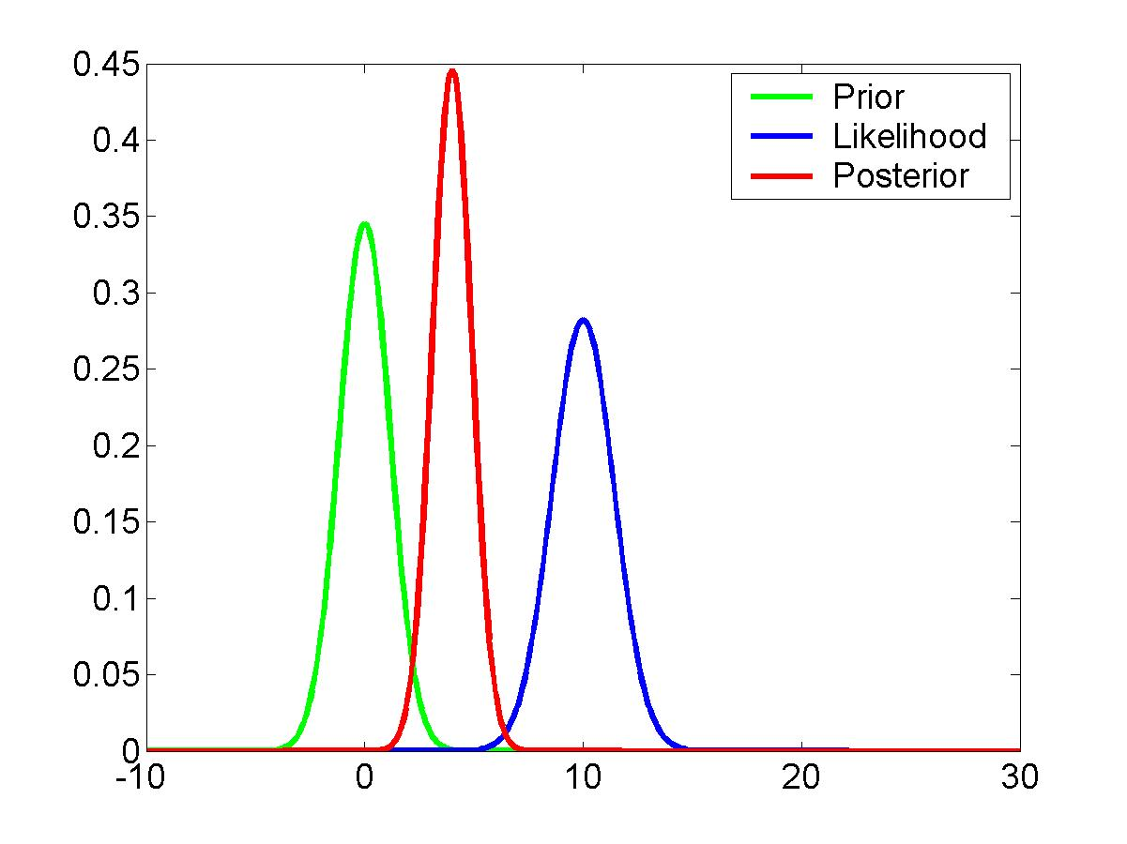
DCM is a Bayesian approach
new data
prior knowledge
posterior ∝ likelihood ∙ prior
Bayes theorem allows one to formally incorporate prior knowledge into computing statistical probabilities.
In DCM:
empirical, principled & shrinkage priors.
The “posterior” probability of the parameters given the data is an optimal combination of prior knowledge and new data, weighted by their relative precision.

Slide 29
stimulus function u
Overview:
parameter estimation
neural state
equation
Combining the neural and hemodynamic states gives the complete forward model.
An observation model includes measurement
error e and confounds X (e.g. drift).
Bayesian inversion: parameter estimation by means of variational EM under Laplace approximation
Result:
Gaussian a posteriori parameter distributions, characterised by
mean η_{θ|y} and
covariance C_{θ|y}.
parameters
hidden states
state equation
η_{θ|y}
modelled
BOLD response
observation model

Slide 30
VB in a nutshell (mean-field approximation)
❶ Neg. free-energy approx. to model evidence.
❷ Mean field approx.
❸ Maximise neg. free energy wrt. q = minimise divergence,
by maximising variational energies
❹ Iterative updating of sufficient statistics of approx. posteriors by gradient ascent.

Slide 31
Bayesian Inversion
Specify generative forward model
(with prior distributions of parameters)
Regional responses
Variational Expectation-Maximization algorithm
Iterative procedure:
Compute model response using
current set of parameters
Compare model response with data
Improve parameters, if possible
Posterior distributions of parameters
Model evidence
Notes:
31

Slide 32
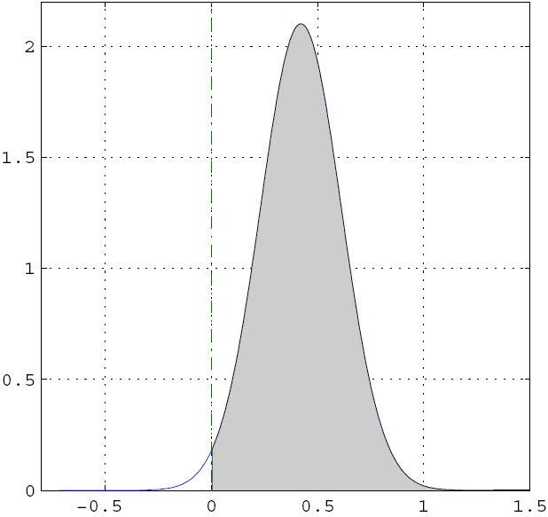
Inference about DCM parameters:
Bayesian single-subject analysis
Gaussian assumptions about the posterior distributions of the parameters
posterior probability that a certain parameter (or contrast of parameters) is above a chosen threshold γ:
By default, γ is chosen as zero – the prior ("does the effect exist?").

Slide 33
Inference about DCM parameters:
Bayesian parameter averaging (FFX group analysis)
Likelihood distributions from different subjects are independent
Under Gaussian assumptions this is easy to compute:
group
posterior
covariance
individual
posterior
covariances
group
posterior
mean
individual posterior
covariances and means

Slide 34
Inference about DCM parameters:
RFX group analysis (frequentist)
In analogy to “random effects” analyses in SPM, 2nd level analyses can be applied to DCM parameters:
Separate fitting of identical models for each subject
Selection of parameters of interest
one-sample t-test:
parameter > 0 ?
paired t-test:
parameter 1 >
parameter 2 ?
rmANOVA:
e.g. in case of multiple sessions per subject

Slide 35
Inference about Model Architecture, Bayesian Model Selection
Model evidence:
Approximation: Free Energy
accounts for both accuracy and complexity of the model
allows for inference about structure (generalisability) of the model
Fixed Effects Model selection via
log Group Bayes factor:
Random Effects Model selection
via Model probability:

Slide 36
Overview
Dynamic causal models (DCMs)
  Basic idea
  Neural level
  Hemodynamic level
  Parameter estimation, priors & inference
Applications of DCM to fMRI data
- Attention to Motion
- The Status Quo Bias

Slide 37
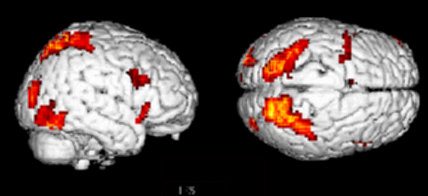
DCM – Attention to Motion
Bayesian Model Selection
Results
Paradigm
4 conditions
  - fixation only baseline
  observe static dots + photic
  - observe moving dots + motion
  attend to moving dots
SPC
V3A
V5+
Attention – No attention
Büchel & Friston 1997, Cereb. Cortex
Büchel et al. 1998, Brain
What connection in the network mediates attention ?

Slide 38
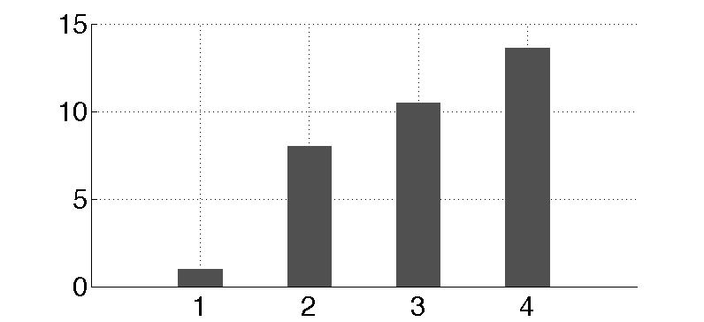
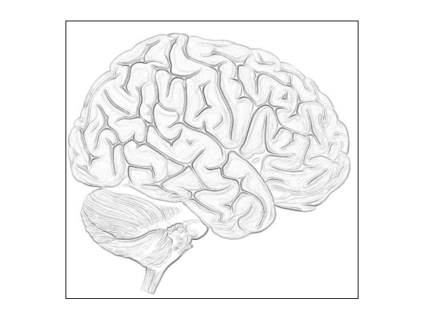
Bayesian Model Selection
m₁
m₂
m₃
m₄
Modulation
By attention
Modulation
By attention
Modulation
By attention
Modulation
By attention
PPC
PPC
PPC
PPC
External
stim
V1
V5
stim
V1
V5
stim
V1
V5
stim
V1
V5
estimated
effective synaptic strengths
for best model (m₄)
models marginal likelihood
attention
0.10
PPC
0.39
1.25
0.26
stim
0.26
V1
0.13
V5
0.46
[Stephan et al., Neuroimage, 2008]

Slide 39
Parameter Inference
attention
MAP = 1.25
0.10
PPC
0.26
1.25
0.39
stim
0.26
V1
0.13
V5
0.46
0.50
motion
Stephan et al. 2008, NeuroImage

Slide 40
Data Fits
motion &
attention
motion &
no attention
static
dots
V1
V5
PPC
observed
fitted

Slide 41
Overview
Dynamic causal models (DCMs)
  Basic idea
  Neural level
  Hemodynamic level
  Parameter estimation, priors & inference
Applications of DCM to fMRI data
- Attention to Motion
- The Status Quo Bias

Slide 42
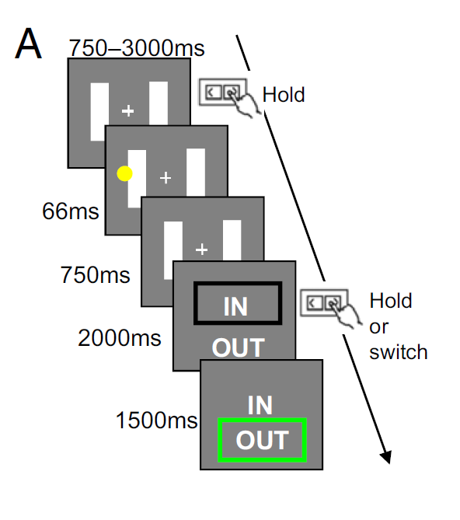
Overcoming status quo bias in the human brain Fleming et al PNAS 2010
Decision
Accept Reject
Difficulty
Low High

Slide 43
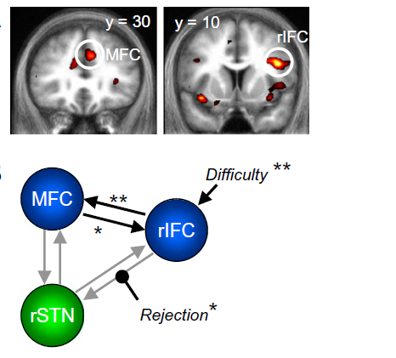
Overcoming status quo bias in the human brain Fleming et al PNAS 2010
Decision
Accept Reject
Difficulty
Low High
Main effect of difficulty
in medial frontal and right inferior frontal cortex

Slide 44
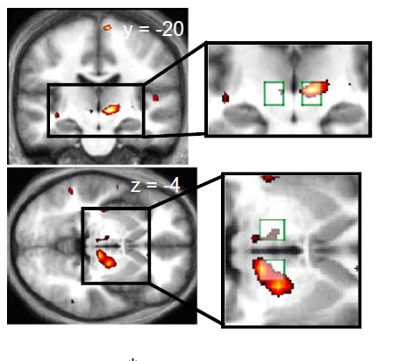
Overcoming status quo bias in the human brain Fleming et al PNAS 2010
Decision
Accept Reject
Difficulty
Low High
Interaction of decision and difficulty
in region of subthalamic nucleus:
Greater activity in STN when default is rejected in difficult trials

Slide 45
Overcoming status quo bias in the human brain Fleming et al PNAS 2010
DCM: “aim was to establish a possible mechanistic explanation for the interaction effect seen in the STN.
Whether rejecting the default option is reflected in a modulation of connection strength from rIFC to STN, from MFC to STN, or both “…
MFC
rIFC
STN

Slide 46
Overcoming status quo bias in the human brain Fleming et al PNAS 2010
Difficulty
Difficulty
MFC
Difficulty
MFC
Difficulty
MFC
rIFC
rIFC
rIFC
Reject
Reject
Reject
STN
STN
STN
Difficulty
Difficulty
MFC
Difficulty
MFC
Difficulty
MFC
rIFC
rIFC
rIFC
STN
STN
Reject
STN
Reject
Reject
Difficulty
Difficulty
MFC
MFC
Difficulty
MFC
Difficulty
rIFC
rIFC
rIFC
Reject
Reject
STN
STN
Reject
Reject
Reject
STN
Reject

Slide 47
Example:
Overcoming status quo bias in the human brain Fleming et al PNAS 2010
Difficulty
Difficulty
MFC
Difficulty
MFC
Difficulty
MFC
rIFC
rIFC
rIFC
Reject
Reject
Reject
STN
STN
STN
Difficulty
Difficulty
MFC
Difficulty
MFC
MFC
Difficulty
rIFC
rIFC
rIFC
STN
STN
Reject
STN
Reject
Reject
Difficulty
Difficulty
MFC
MFC
Difficulty
MFC
Difficulty
rIFC
rIFC
rIFC
Reject
Reject
STN
STN
Reject
Reject
Reject
STN
Reject

Slide 48
Overcoming status quo bias in the human brain Fleming et al PNAS 2010
The summary statistic approach
Effects across subjects consistently greater than zero
P < 0.01 *
P < 0.001 **

Slide 49
The evolution of DCM in SPM
DCM is not one specific model, but a framework for Bayesian inversion of dynamic system models
The default implementation in SPM is evolving over time
  better numerical routines for inversion
  change in priors to cover new variants (e.g., stochastic DCMs, endogenous DCMs etc.)
To enable replication of your results, you should ideally state which SPM version you are using when publishing papers.

Slide 50
GLM vs. DCM
DCM tries to model the same phenomena (i.e. local BOLD responses) as a GLM, just in a different way (via connectivity and its modulation).
No activation detected by a GLM
→ no motivation to include this region in a deterministic DCM.
However, a stochastic DCM could be applied despite the absence of a local activation.
Stephan 2004, J. Anat.

Slide 51
Thank you

