Slide 1

General Linear Model
&
Classical Inference
Guillaume Flandin
Wellcome Trust Centre for Neuroimaging
University College London
SPM M/EEGCourse
London, May 2013

Slide 2
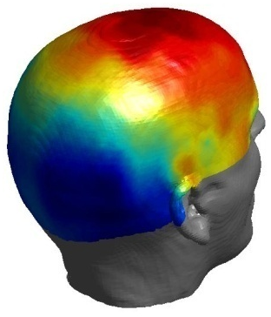
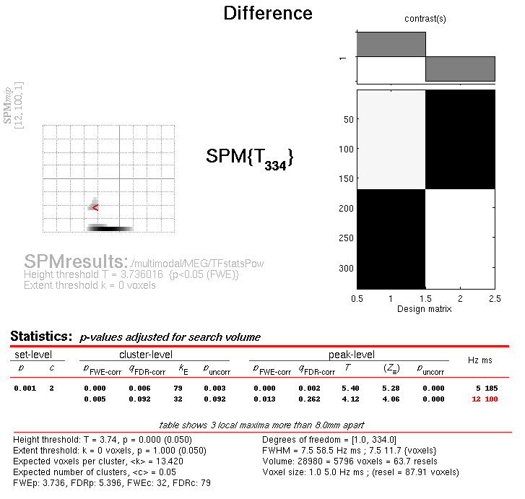
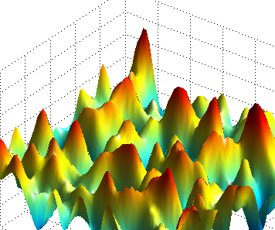
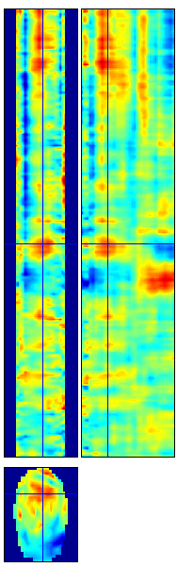
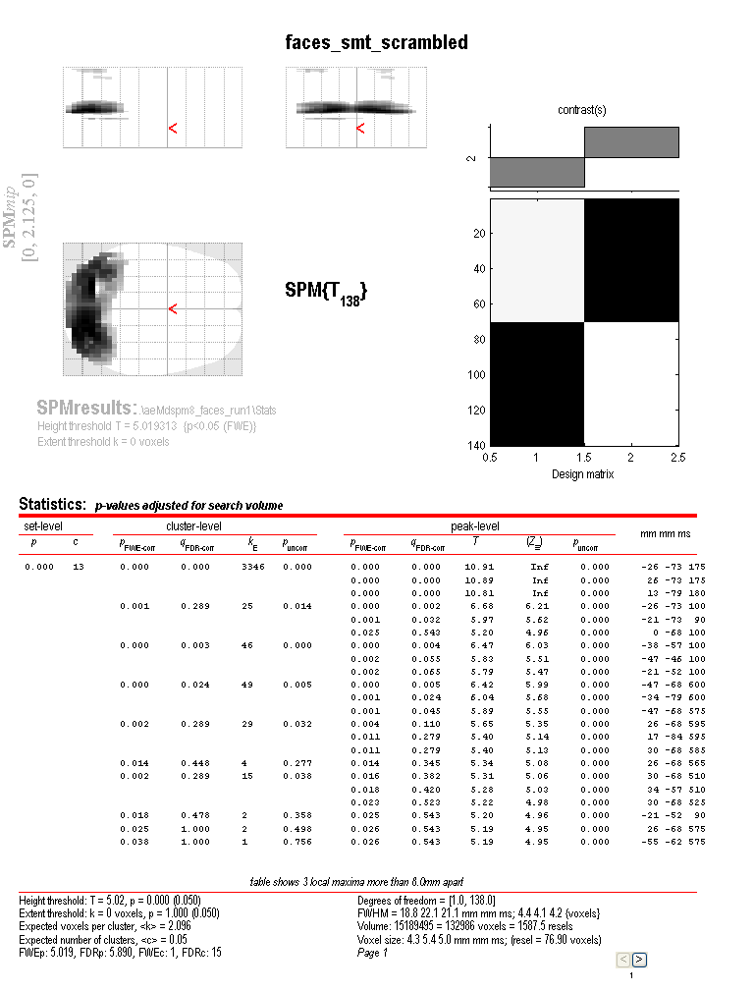
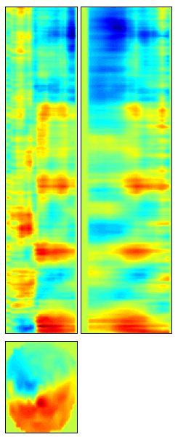
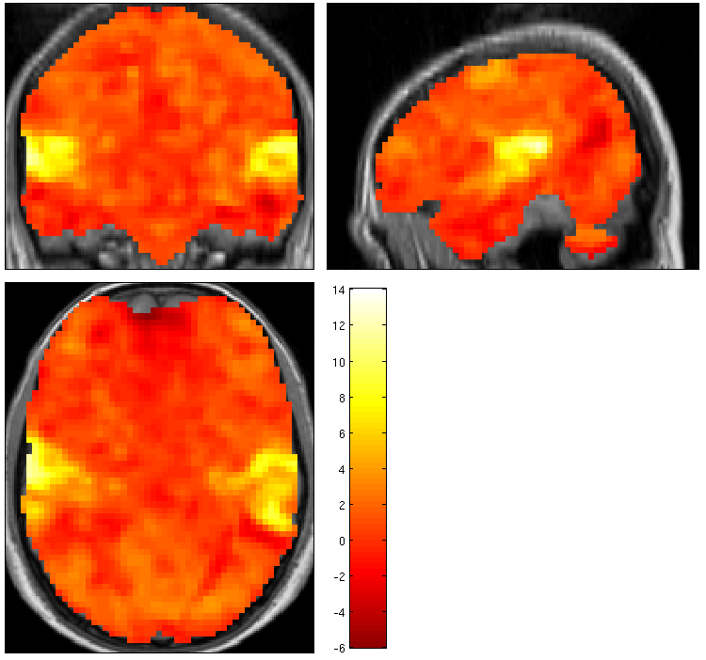
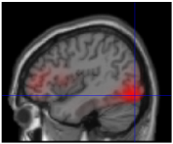
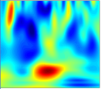
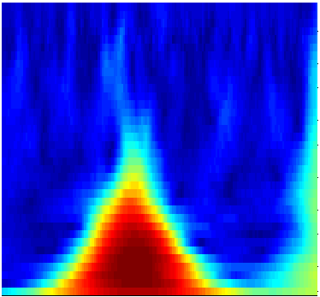

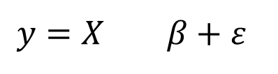
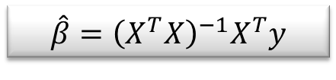
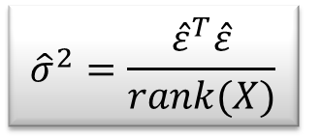
Random
Field Theory
$$y=X β+ε$$
Contrast c
Pre-
processings
General
Linear
Model
Statistical Inference
$$\hat{β}={\left(X^{T}X\right)}^{−1}X^{T}y$$
$${\hat{σ}}^{2}=\frac{{\hat{ε}}^{T}\hat{ε}}{rank(X)}$$
$$SPM\{T,F\}$$

Slide 3
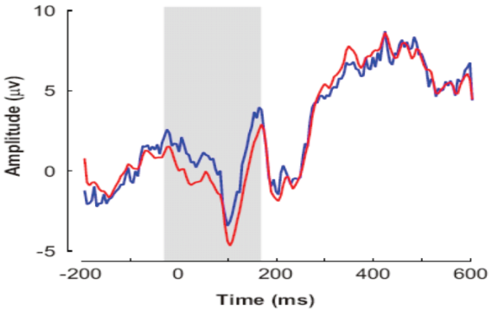

Statistical Parametric Maps
mm
time
time
1D time
mm
frequency
mm
3D M/EEG source
reconstruction,
fMRI, VBM
2D+t
scalp-time
mm
time
2D time-frequency
mm

Slide 4
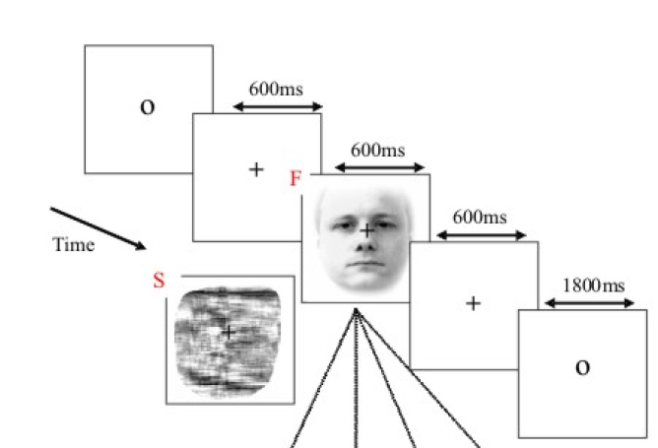
ERP example
Random presentation of ‘faces’ and ‘scrambled faces’
70 trials of each type
128 EEG channels
Question:
is there a difference between the ERP of ‘faces’ and ‘scrambled faces’?

Slide 5
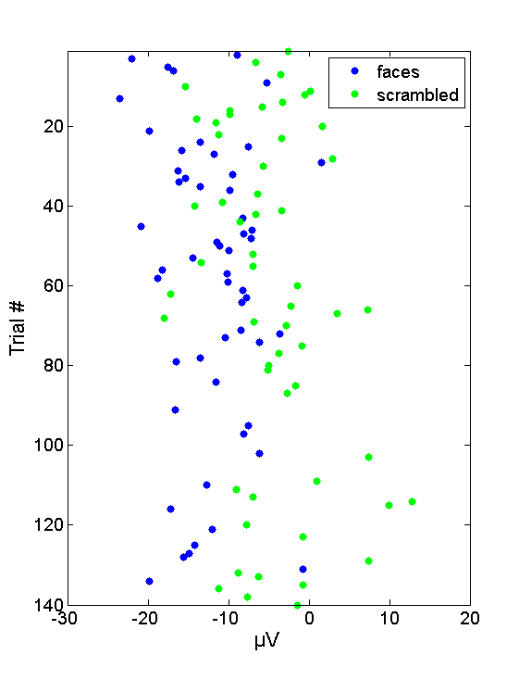
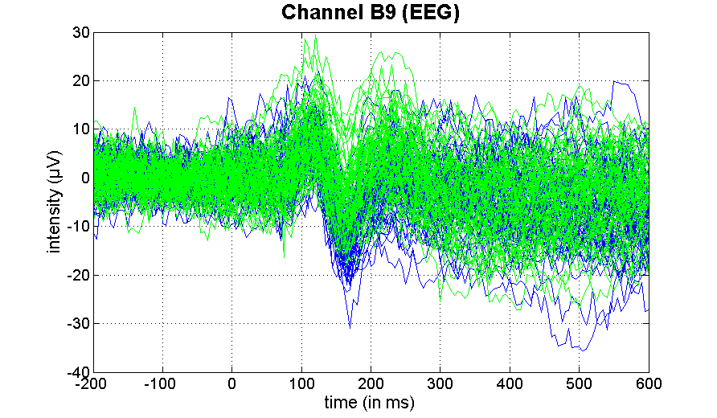
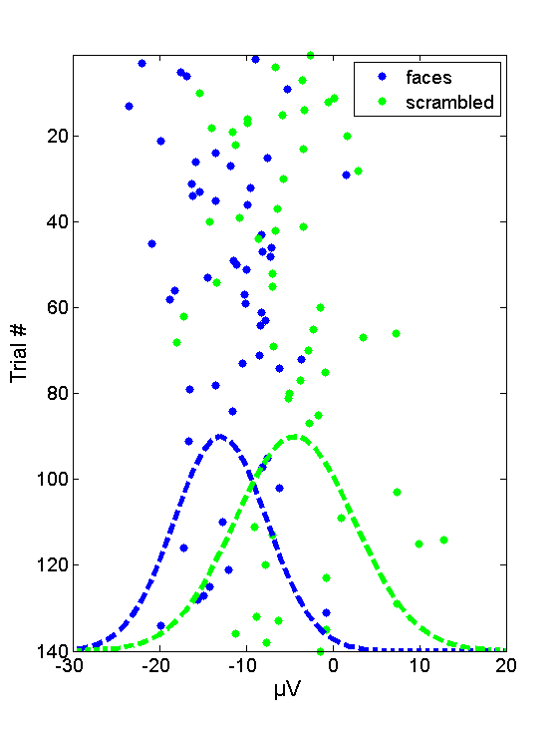
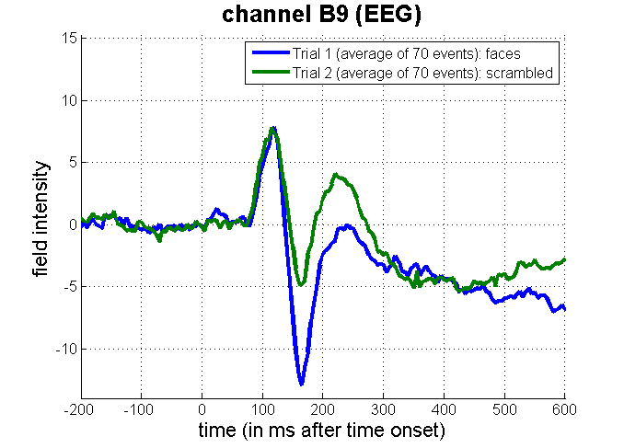
ERP example: channel B9
Focus on N170
compares size of effect to its error standard deviation

Slide 6
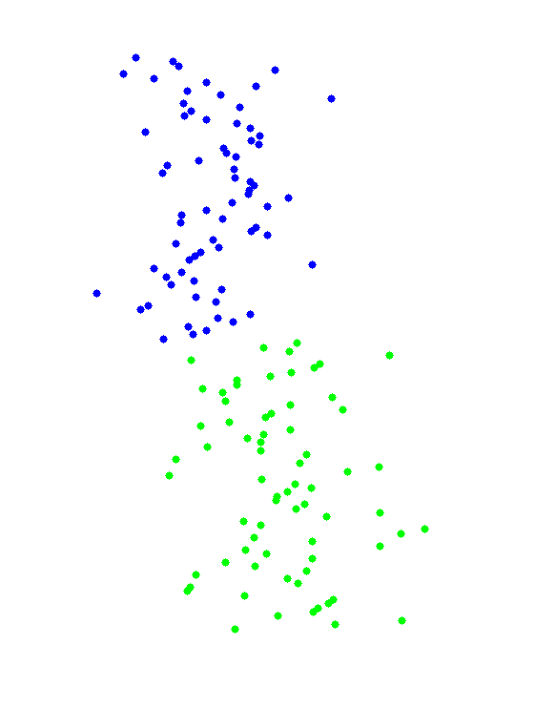
Data modelling
Data
Faces
Scrambled
=
β₁
+
β₂
+
Error
Y
=
β₁
•
X₁
+
β₂
•
X₂
+
ε

Slide 7

Design matrix
Design matrix
Parameter vector
Error vector
Data vector
β₁
=
+
β₂
Y
=
X
•
β
+
ε

Slide 8
General Linear Model
X
y
+
=
Model is specified by
Design matrix X
Assumptions about e
N: number of scans
p: number of regressors
The design matrix embodies all available knowledge about experimentally controlled factors and potential confounds.

Slide 9
GLM: a flexible framework for parametric analyses
    one sample t-test
    two sample t-test
    paired t-test
    Analysis of Variance (ANOVA)
    Analysis of Covariance (ANCoVA)
    correlation
    linear regression
    multiple regression

Slide 10

Parameter estimation
Objective:
estimate parameters to minimize
β₁
=
+
β₂
Ordinary least squares estimation (OLS) (assuming i.i.d. error):

Slide 11
A geometric perspective on the GLM
Smallest errors (shortest error vector)
when e is orthogonal to X
y
e
x₂
x₁
Design space defined by X
Ordinary Least Squares (OLS)

Slide 12
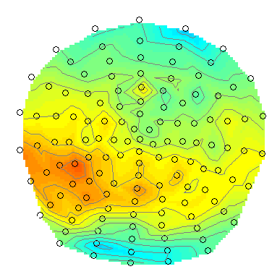
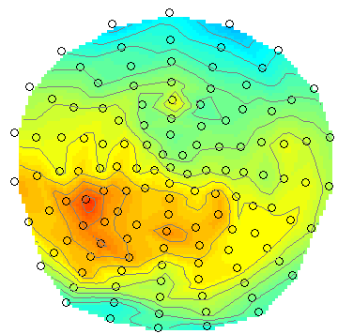
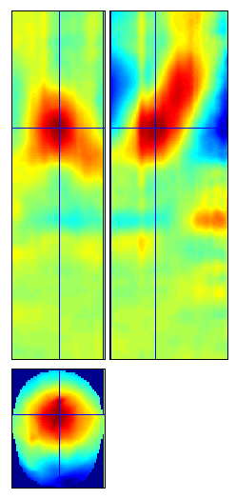
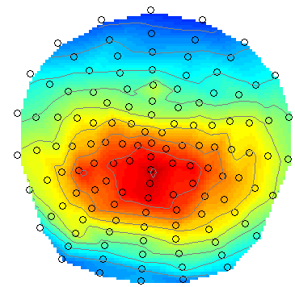
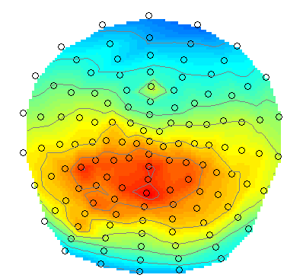
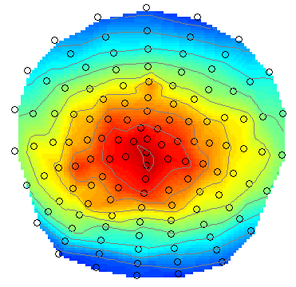
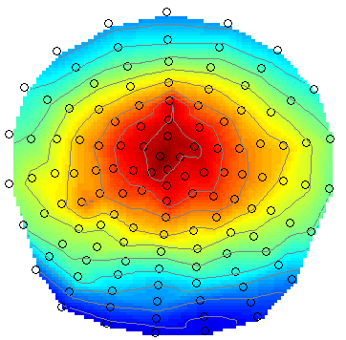
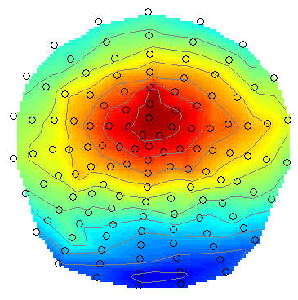
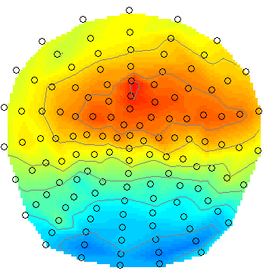
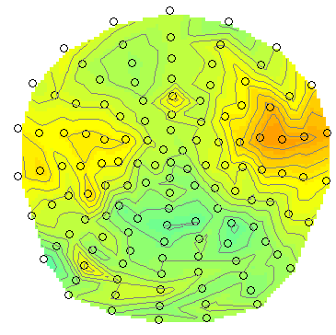
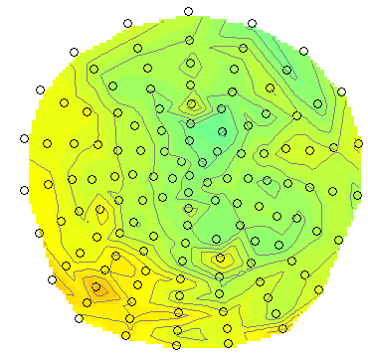
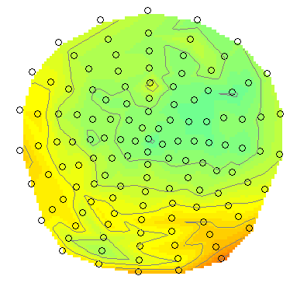
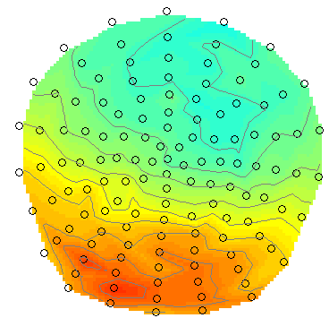
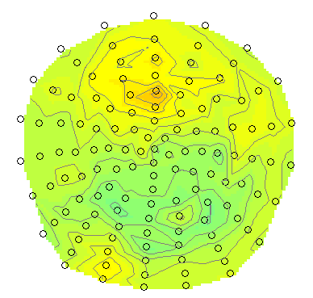
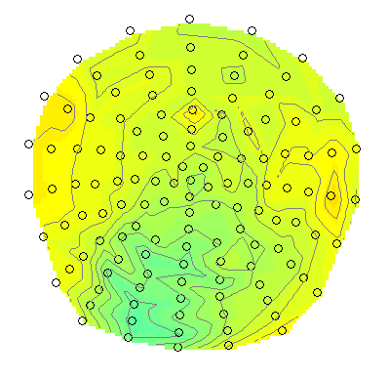
Mass-univariate analysis: voxel-wise GLM
Evoked response image
Sensor to voxel
transform
Time
Transform data for all subjects and conditions
SPM: Analyse data at each voxel

Slide 13
Hypothesis Testing
To test an hypothesis, we construct “test statistics”.
Null Hypothesis H₀
Typically what we want to disprove (no effect).
⇨ The Alternative Hypothesis H_{A} expresses outcome of interest.
Test Statistic T
The test statistic summarises evidence about H₀.
Typically, test statistic is small in magnitude when the hypothesis H₀ is true and large when false.
⇨ We need to know the distribution of T under the null hypothesis.
Null Distribution of T

Slide 14
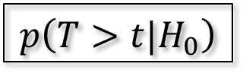
Hypothesis Testing
Significance level α:
Acceptable false positive rate α.
⇨ threshold u_{α}
Threshold u_{α} controls the false positive rate
u_{α}
α
Null Distribution of T
Conclusion about the hypothesis:
We reject the null hypothesis in favour of the alternative hypothesis if t > u_{α}
t
p-value:
A p-value summarises evidence against H₀.
This is the chance of observing value more extreme than t under the null hypothesis.
p-value
$$p\left(T>t|H_{0}\right)$$
Null Distribution of T

Slide 15
Contrast & t-test
Contrast : specifies linear combination of parameter vector:
c^{T} = -1 +1
SPM-t over time & space
ERP: faces < scrambled ?
=
Test H₀:
contrast of
estimated
parameters
t =
variance
estimate

Slide 16
T-test: summary
T-test is a signal-to-noise measure (ratio of estimate to standard deviation of estimate).
Alternative hypothesis:
H₀:
vs H_{A}:
T-contrasts are simple combinations of the betas; the T-statistic does not depend on the scaling of the regressors or the scaling of the contrast.

Slide 17
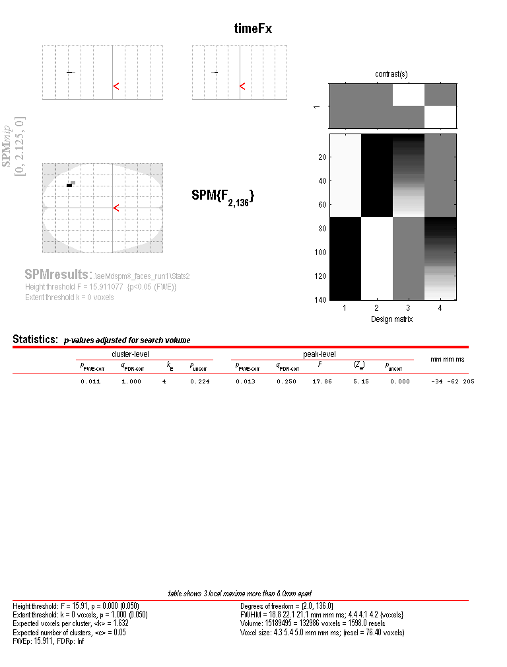
Extra-sum-of-squares & F-test
Model comparison: Full vs. Reduced model?
Null Hypothesis H₀: True model is X₀ (reduced model)
X₀
X₁
X₀
Test statistic: ratio of explained and unexplained variability (error)
RSS
RSS₀
ν₁ = rank(X) – rank(X₀)
ν₂ = N – rank(X)
Full model ?
Or reduced model?

Slide 18
F-test & multidimensional contrasts
Tests multiple linear hypotheses:
H₀: True model is X₀
H₀: β₃ = β₄ = 0
test H₀ : c^{T}β = 0 ?
X₀
X₁ (β₃₋₄)
X₀
c^{T} =
0 0 1 0
0 0 0 1
Full or reduced model?

Slide 19
F-test: summary
F-tests can be viewed as testing for the additional variance explained by a larger model wrt a simpler (nested) model ⇨ model comparison.
F tests a weighted sum of squares of one or several combinations of the regression coefficients β.
In practice, we don’t have to explicitly separate X into [X₁X₂] thanks to multidimensional contrasts.
Hypotheses:
In testing uni-dimensional contrast with an F-test, for example β₁ – β₂, the result will be the same as testing β₂ – β₁. It will be exactly the square of the t-test, testing for both positive and negative effects.

Slide 20

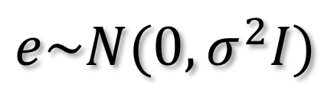
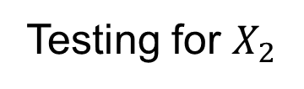
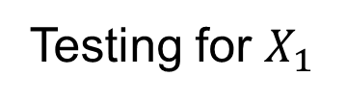
Orthogonal regressors
Variability described by $X_{1}$
Variability described by $X_{2}$
Testing for $X_{1}$
Testing for $X_{2}$
Variability in Y

Slide 21


Correlated regressors
Shared variance
Variability described by $X_{1}$
Variability described by $X_{2}$
Variability in Y

Slide 22


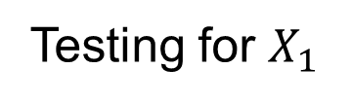
Correlated regressors
Testing for $X_{1}$
Variability described by $X_{1}$
Variability described by $X_{2}$
Variability in Y

Slide 23
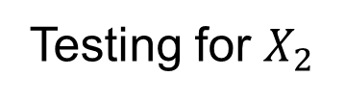
Correlated regressors
Testing for $X_{2}$
Variability described by $X_{1}$
Variability described by $X_{2}$
Variability in Y

Slide 24
Correlated regressors
Variability described by $X_{1}$
Variability described by $X_{2}$
Variability in Y

Slide 25


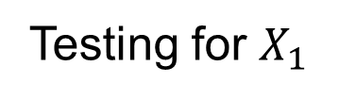
Correlated regressors
Testing for $X_{1}$
Variability described by $X_{1}$
Variability described by $X_{2}$
Variability in Y

Slide 26
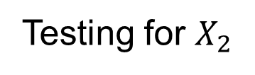
Correlated regressors
Testing for $X_{2}$
Variability described by $X_{1}$
Variability described by $X_{2}$
Variability in Y

Slide 27
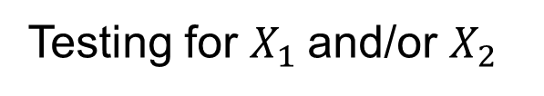
Correlated regressors
Testing for $X_{1}$and/or $X_{2}$
Variability described by $X_{1}$
Variability described by $X_{2}$
Variability in Y

Slide 28
Summary
Mass-univariate GLM:
  Fit GLMs with design matrix, X, to data at different points in space to estimate local effect sizes,
  GLM is a very general approach
  (one-sample, two-sample, paired t-tests, ANCOVAs, …)
Hypothesis testing framework
  Contrasts
  t-tests
  F-tests

Slide 29
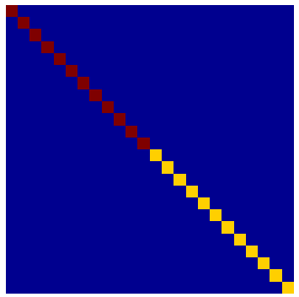


Multiple covariance components
enhanced noise model at voxel i
error covariance components Q and hyperparameters λ
V
Q₁
Q₂
=
λ₁
+ λ₂
Estimation of hyperparameters λ with ReML (Restricted Maximum Likelihood).

Slide 30
Weighted Least Squares (WLS)
Let
Then
WLS equivalent to
OLS on whitened
data and design
where

Slide 31
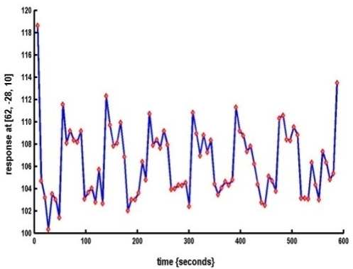

Modelling the measured data
Make inferences about effects of interest
Why?
Decompose data into effects and error
Form statistic using estimates of effects and error
How?
stimulus function
effects estimate
linear
model
statistic
data
error estimate

