Slide 1
Dynamic Causal Modelling
Advanced Topics
SPM Course (fMRI), May 2015
Peter Zeidman
Wellcome Trust Centre for Neuroimaging
University College London

Slide 2
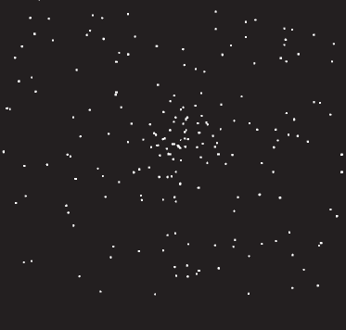
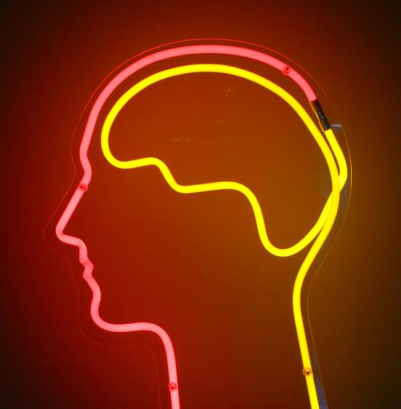
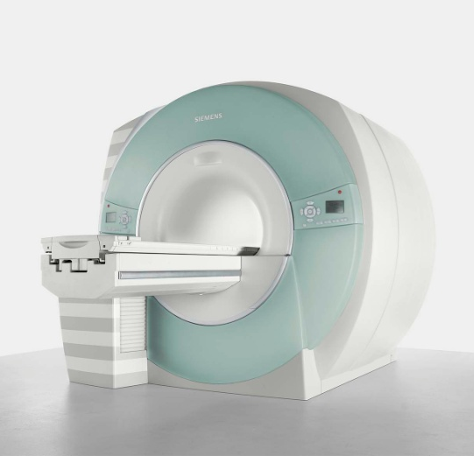
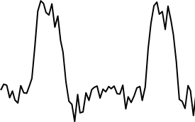
The system of interest
Experimental Stimulus
(Hidden) Neural Activity
Observations (BOLD)
Vector u
Vector y
on
?
BOLD
off
time
time
Stimulus from Buchel and Friston, 1997
Brain by Dierk Schaefer, Flickr, CC 2.0
Notes:
Experimental stimulation causes changes in neural activity. Neural activity in turn causes the BOLD response, which we observe via the scanner. We are interested in the hidden neural activity, which we cannot directly observe - so it must be inferred.

Slide 3
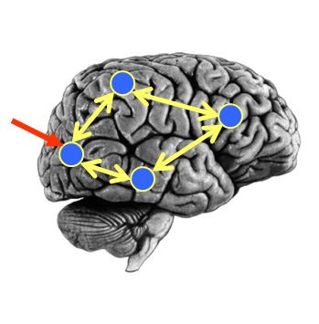
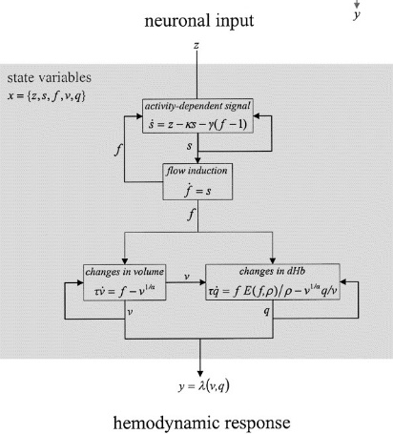

DCM Framework
Neural Model
Observation Model
Experimental Stimulus (u)
Observations (y)
How brain activity z changes over time
What we would see in the scanner, y, given the neural model?
.
z = f(z,u,θ^{n})
y = g(z, θ^{h})
Stimulus from Buchel and Friston, 1997
Figure 3 from Friston et al., Neuroimage, 2003
Brain by Dierk Schaefer, Flickr, CC 2.0

Slide 4
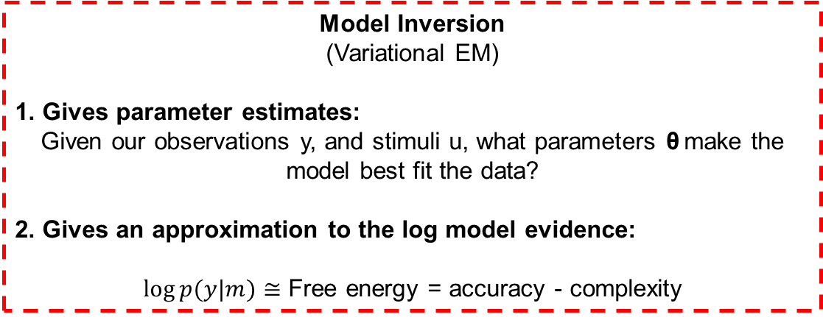
DCM Framework
Neural Model
Observation Model
Experimental Stimulus (u)
Observations (y)
Model Inversion
(Variational EM)
1. Gives parameter estimates:
Given our observations y, and stimuli u, what parameters θ make the model best fit the data?
2. Gives an approximation to the log model evidence:
$log⁡p(y|m)≅$ Free energy = accuracy - complexity

Slide 5
Contents
Creating models
  Preparing data for DCM
Inference over models
  Fixed Effects
  Random Effects
Inference over parameters
  Bayesian Model Averaging
Example
DCM Extensions

Slide 6
Preparing data

Slide 7
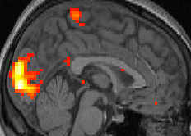
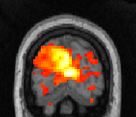
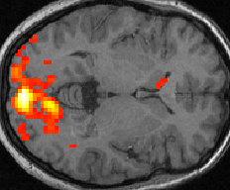

Choosing Regions of Interest
We generally start with SPM results
12
10
8
6
4
2
0

Slide 8
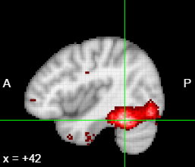
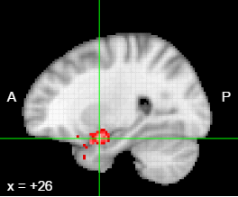
A factorial design translates easily to DCM
A (fictitious!) example of a 2x2 design:
Factor 1:
Stimulus (face or inverted face)
Factor 2:
Valence (neutral or angry)
Main effect of face: FFA
Interaction of
Stimulus x Valence:
Amygdala
Valence
From a factorial design:
Main effects → driving inputs
Interactions → modulatory inputs
Face
FFA
Amy

Slide 9

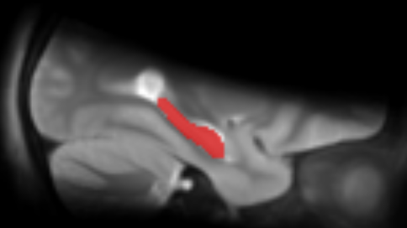
ROI Options
1. A sphere with given radius
2. An anatomical mask
Positioned at the group peak
or
Allowed to vary for each subject, within a radius of the group peak
+

Slide 10
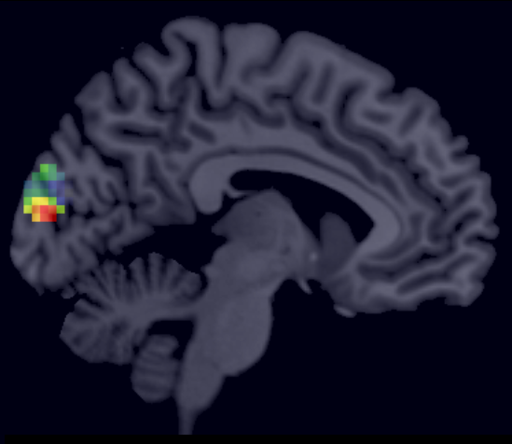
Pre-processing
Regress out nuisance effects (anything not specified in the ‘effects of interest f-contrast’)
Remove confounds such as low frequency drift
Summarise the ROI by performing PCA and retaining the first component
1st eigenvariate: test
3
New in SPM12: VOI_xx_eigen.nii
(When using the batch only)
2
1
0
-1
-2
-3
-4
200
400
600
800
1000
time \{seconds\}
230 voxels in VOI from mask VOI_test_mask.nii
Variance: 81.66%

Slide 11
Interim Summary: Preparing Data
DCM helps us to explain the coupling between regions showing an experimental effect
We can choose our Regions of Interest (ROIs) from any series of contrasts in our GLM
We use Principle Components Analysis (PCA) to summarise the voxels in each ROI as a single timeseries

Slide 12
Contents
Creating models
  Preparing data for DCM
Inference over models
  Fixed Effects
  Random Effects
Inference over parameters
  Bayesian Model Averaging
Example
DCM Extensions

Slide 13
Inference over models

Slide 14



Experimental Stimulus (u)
Neural Model
Observation Model
Observations (y)
Model 1:
Model comparison: Which model best explains my observed data?
Experimental Stimulus (u)
Neural Model
Observation Model
Observations (y)
Model 2:

Slide 15

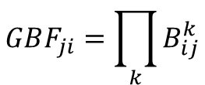

Bayes Factor
How good is model $j$ versus model $i$ in one subject?
$$B_{ji}=\frac{p(y|m=j)}{p(y|m=i)}$$
In practice we subtract the log model evidence:
$$\log{B_{ji}=\log{p(y|m=j)}−\log{p(y|m=i)}}$$
$$≅F_{j}−F_{i}$$
At the group level, over K subjects:
$$GBF_{ji}=\prod_{k}{B_{ij}^{k}}$$

Slide 16
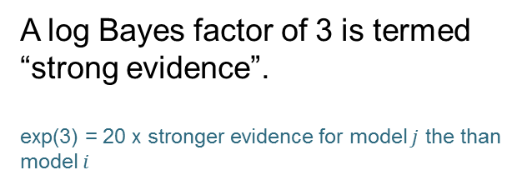
Bayes Factor - Interpretation
A log Bayes factor of 3 is termed “strong evidence”.
exp(3) = 20 x stronger evidence for model $j$ the than model $i$
Kass and Raftery, JASA, 1995.
We can convert the Bayes Factor to a
posterior probability using a sigmoid function
BF of 3 = 95% probability
Will Penny

Slide 17
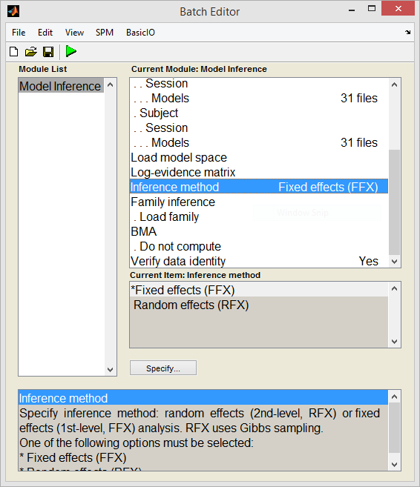
Fixed Effects Bayesian Model Selection (BMS)
Assumption: Subjects’ data arose from
the same underlying model

Slide 18
Random Effects Bayesian Model Selection (BMS)
11 out of 12 subjects favour model 2
But… GBF = 15 in favour of model 1
Stephan et al. 2009, NeuroImage

Slide 19
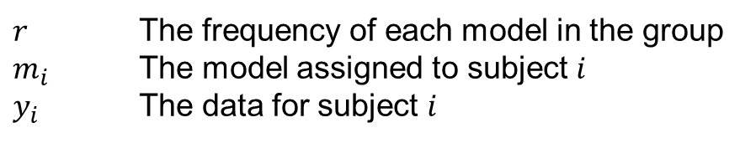


Random Effects Bayesian Model Selection (BMS)
SPM estimates a hierarchical model with variables:
$r$ The frequency of each model in the group
$m_{i}$ The model assigned to subject $i$
$y_{i}$ The data for subject $i$
Outputs:
$$E\left[r_{2} | Y\right]=0.84$$
Expected probability of model 2
$$p\left(r_{2}>r_{1} | Y\right)=0.99$$
Exceedance probability of model 2
Stephan et al. 2009, NeuroImage

Slide 20
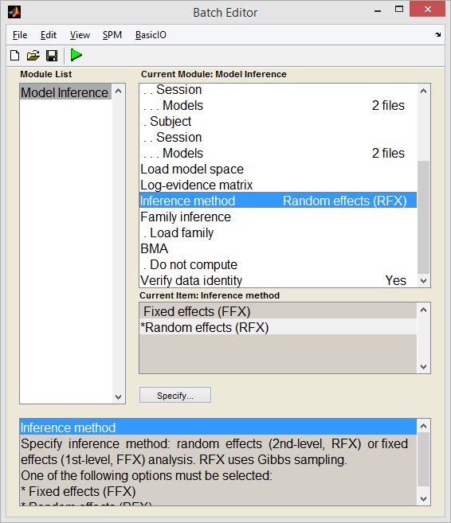
Random Effects Bayesian Model Selection (BMS)
Assumption: Subjects’ data arose from
different models
Stephan et al. 2009, NeuroImage

Slide 21
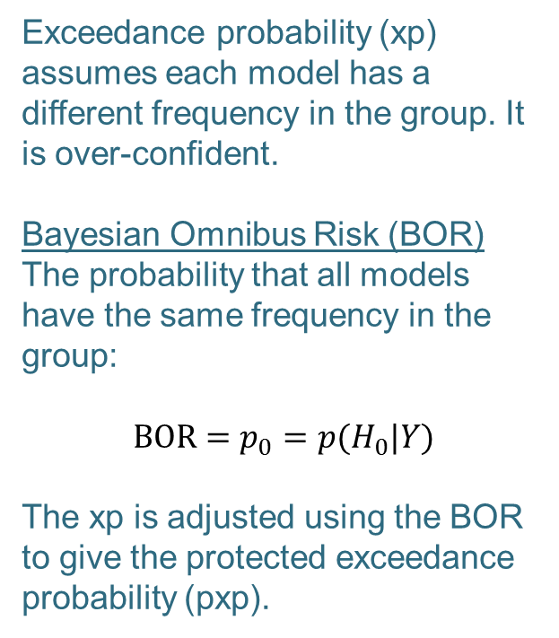
Random Effects Bayesian Model Selection (BMS)
Exceedance probability (xp) assumes each model has a different frequency in the group. It is over-confident.
Bayesian Omnibus Risk (BOR)
The probability that all models have the same frequency in the group:
$$\text{BOR}=p_{0}=p(H_{0}|Y)$$
The xp is adjusted using the BOR to give the protected exceedance probability (pxp).
Prob of Equal Model Frequencies (BOR) = 0.45
0.8
0.7
0.6
0.5
Protected Exceedance Probability
0.4
0.3
0.2
0.1
0
1
2
Models
Rigoux et al. 2014, NeuroImage

Slide 22
Family Inference
Bayesian Model Selection: RFX
0.35
Rather than having one hypothesis per model, we can group models into families.
E.g. we have 9 models which all have a bottom-up connection and 5 models which all have a top-down connection.
0.3
0.25
0.2
Model Expected Probability
0.15
0.1
0.05
0
1
2
3
4
5
6
7
8
9
10
11
12
13
14
Models

Slide 23
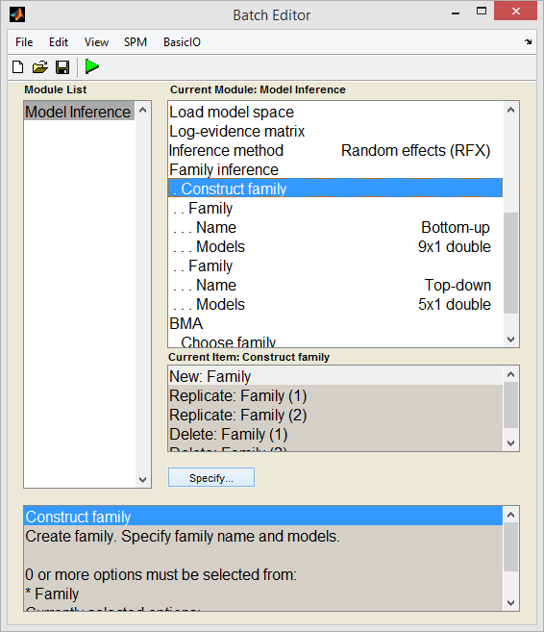
Family Inference
Bayesian Model Selection: RFX
0.8
0.7
0.6
0.5
Family Expected Probability
0.4
0.3
0.2
0.1
0
Bottom-up
Top-down
Families
Bayesian Model Selection: RFX
1
0.9
0.8
0.7
0.6
Family Exceedance Probability
0.5
0.4
0.3
0.2
0.1
0
Bottom-up
Top-down
Families

Slide 24
Interim Summary: Inference over Models
We embody each of our hypotheses as a model or as a family of models.
We can compare models or families using a fixed effects analysis, only if we believe that all subjects have the same underlying model
Otherwise we use a random effects analysis and report the protected exceedance probability and the Bayesian Omnibus Risk.

Slide 25
Contents
Creating models
  Preparing data for DCM
Inference over models
  Fixed Effects
  Random Effects
Inference over parameters
  Bayesian Model Averaging
Example
DCM Extensions

Slide 26
Inference over parameters

Slide 27
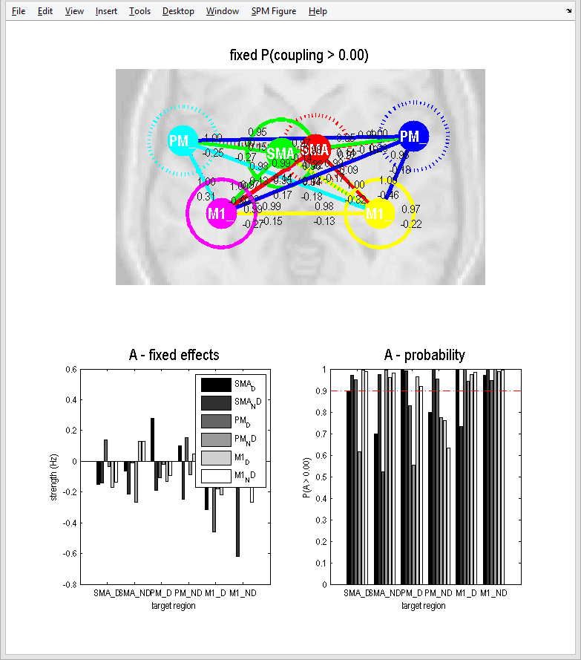
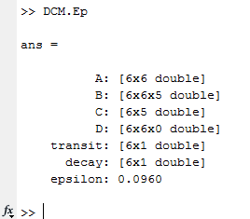
Parameter Estimates
The estimated parameters for a single model can be found in each DCM.mat file
Inspect via the GUI
Inspect via Matlab
Estimated parameter means: DCM.Ep
Estimated parameter variance: DCM.Cp

Slide 28
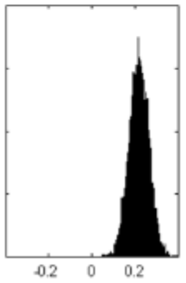
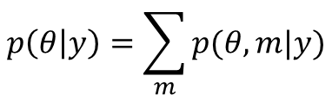
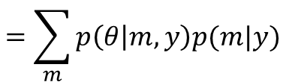
Bayesian Model Averaging
Bayesian Model Selection: RFX
0.35
What are the posterior parameter estimates
for the winning family?
0.3
0.25
0.2
SPM calculates a weighted average of the
parameters over models:
Model Expected Probability
0.15
0.1
$$p\left(θ | y\right)=\sum_{m}{p(θ,m|y)}$$
0.05
0
1
2
3
4
5
6
7
8
9
10
11
12
13
14
Models
$$=\sum_{m}{p\left(θ | m,y\right)p(m|y)}$$
1
0.9
0.8
Region 1 to 2
0.7
0.6
To give a posterior
distribution for each
connection:
Family Exceedance Probability
0.5
0.4
0.3
0.2
0.1
0
Bottom-up
Top-down
Families

Slide 29
Contents
Creating models
  Preparing data for DCM
Inference over models
  Fixed Effects
  Random Effects
Inference over parameters
  Bayesian Model Averaging
Example
DCM Extensions

Slide 30
example

Slide 32
Reading > fixation (29 controls)
Lesion (Patient AH)

Slide 33
1. Extracted regions of interest. Spheres placed at the peak SPM coordinates from two contrasts:
A. Reading in patient > controls
B. Reading in controls
2. Asked which region should receive the driving input
3. Performed fixed effects BMS in the patient and random effects BMS in the controls, and applied Bayesian Model Averaging.

Slide 34
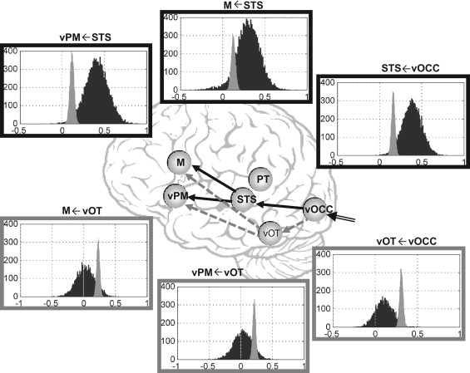
Bayesian Model Averaging
Key:
Controls
Patient
Seghier et al., Neuropsychologia, 2012

Slide 35
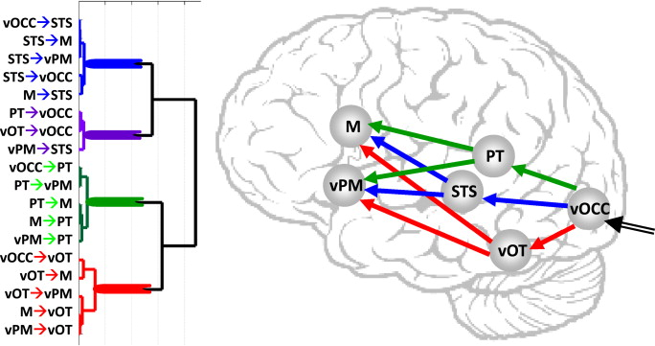
Seghier et al., Neuropsychologia, 2012

Slide 36
Interim Summary: Example
When we don’t know how to model something, we can ‘ask the data’ using a model comparison
Bayesian Model Averaging (BMA) lets us compare connections across patients and controls
Posterior parameter estimates can be used as summary statistics for further analyses

Slide 37
Dcm extensions

Slide 38
DCM Framework
Neural Model
Observation Model
Experimental Stimulus (u)
Observations (y)
How brain activity z changes over time
What we would see in the scanner, y, given the neural model?
.
z = f(z,u,θ^{n})
y = g(z, θ^{h})
Stimulus from Buchel and Friston, 1997
Figure 3 from Friston et al., Neuroimage, 2003
Brain by Dierk Schaefer, Flickr, CC 2.0

Slide 39
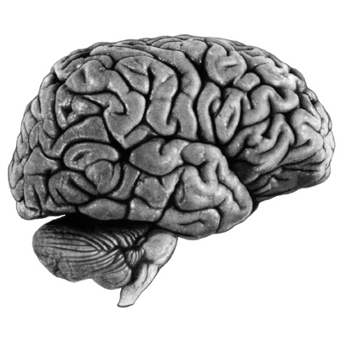
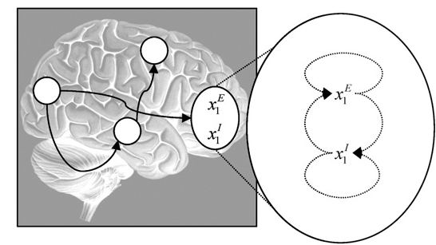
DCM Extensions
Non-Linear DCM
Two-State DCM
modulation
driving
input
Stephan et al. 2008,
NeuroImage
Marreiros et al. 2008,
NeuroImage

Slide 40
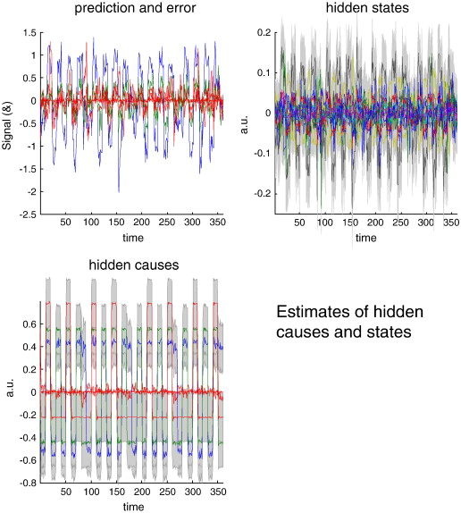
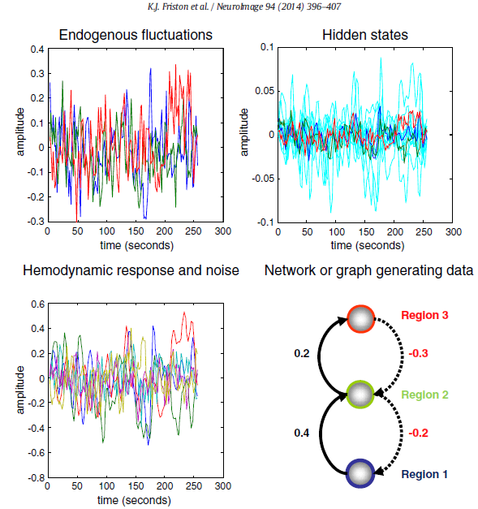
DCM Extensions
Stochastic DCM
DCM for CSD
Li et al. 2011,
NeuroImage
Friston et al. 2014,
NeuroImage

Slide 41
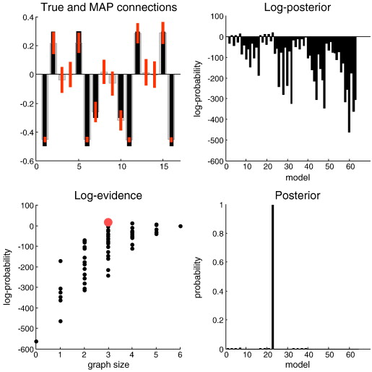
DCM Extensions
Post-hoc DCM
Friston and Penny 2011,
NeuroImage

Slide 42
Further Reading
The original DCM paper | Friston et al. 2003, NeuroImage
Descriptive / tutorial papers
Role of General Systems Theory | Stephan 2004, J Anatomy
DCM: Ten simple rules for the clinician | Kahan et al. 2013, NeuroImage
Ten Simple Rules for DCM | Stephan et al. 2010, NeuroImage
DCM Extensions
Two-state DCM | Marreiros et al. 2008, NeuroImage
Non-linear DCM | Stephan et al. 2008, NeuroImage
Stochastic DCM | Li et al. 2011, NeuroImage Friston et al. 2011, NeuroImage Daunizeau et al. 2012, Front Comput Neurosci
Post-hoc DCM | Friston and Penny, 2011, NeuroImage Rosa and Friston, 2012, J Neuro Methods
A DCM for Resting State fMRI | Friston et al., 2014, NeuroImage

Slide 43
extras

Slide 44


Variational Bayes
Approximates:
The log model evidence:
Posterior over parameters:
The log model evidence is decomposed:
The difference between the true and
approximate posterior
Free energy (Laplace approximation)
Accuracy
-
Complexity

Slide 45
The Free Energy
Accuracy
-
Complexity
Complexity
Distance between
prior and posterior
means
Occam’s factor
Volume of
prior parameters
posterior-prior
parameter means
Prior precisions
Volume of
posterior parameters
(Terms for hyperparameters not shown)

Slide 46
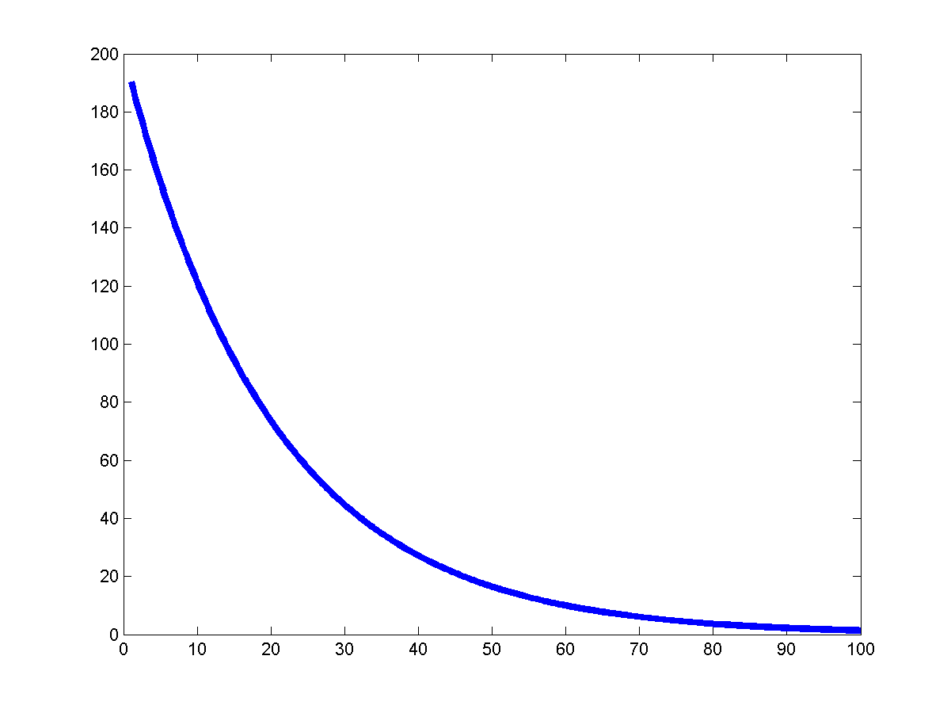
DCM parameters = rate constants
Integration of a first-order linear differential equation gives an
exponential function:
Coupling parameter a is inversely
proportional to the half life τ of z(t):
The coupling parameter a
thus describes the speed of
the exponential change in x(t)

Slide 47
Practical Workshop

Slide 48
DCM – Attention to Motion
Attention to Motion in the visual system
Paradigm
Stimuli 250 radially moving dots at 4.7 degrees/s
Pre-Scanning
5 x 30s trials with 5 speed changes (reducing to 1%)
Task - detect change in radial velocity
Scanning (no speed changes)
F A F N F A F N S ….
  F - fixation
  S - observe static dots + photic
  N - observe moving dots + motion
  A - attend moving dots + attention
Parameters
blocks of 10 scans
- 360 scans total
- TR = 3.22 seconds
Slide by Hanneke den Ouden

Slide 49
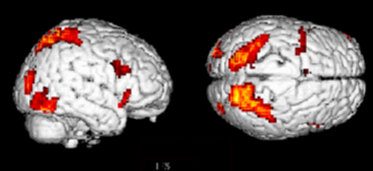
Attention to Motion in the visual system
Paradigm
Results
SPC
V3A
V5+
Attention – No attention
Büchel & Friston 1997, Cereb. Cortex
Büchel et al. 1998, Brain
  - fixation only
  observe static dots + photic → V1
  - observe moving dots + motion → V5
  task on moving dots + attention → V5 + parietal cortex
Slide by Hanneke den Ouden

Slide 50
DCM: comparison of 2 models
Model 1
attentional modulation
of V1→V5: forward
Model 2
attentional modulation
of SPC→V5: backward
Photic
SPC
Attention
Photic
SPC
V1
V1
V5
V5
Motion
Motion
Attention
Bayesian model selection: Which model is optimal?
Slide by Hanneke den Ouden

Slide 51
Attention to Motion in the visual system
DCM – GUI basic steps
1 – Extract the time series (from all regions of interest)
2 – Specify the model
3 – Estimate the model
4 – Review the estimated model
5 – Repeat steps 2 and 3 for all models in model space
6 – Compare models
Slide by Hanneke den Ouden

