Slide 1
M/EEG pre-processing
Holly Rossiter
Wellcome Trust Centre for Neuroimaging
UCL Institute of Neurology

Slide 2
Steps to cover
Conversion
Filtering
Downsampling
Epoching
Re-referencing for EEG
Artefacts
Averaging
Coregistration
Generating scalp x time images
Time-frequency analysis

Slide 3
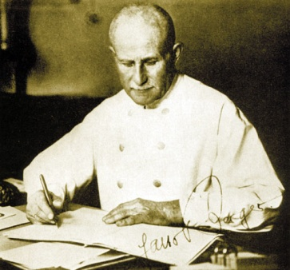
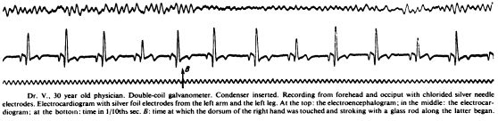
What do we need?
Hans Berger
1873-1941
Events
Possible source
of artefact
M/EEG signals
Time axis
(sampling frequency and onset)
Sensor locations

Slide 4
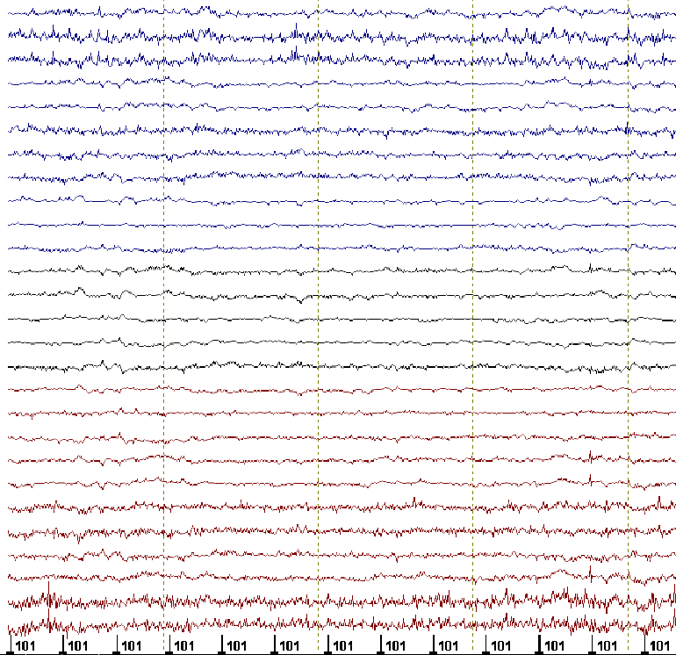
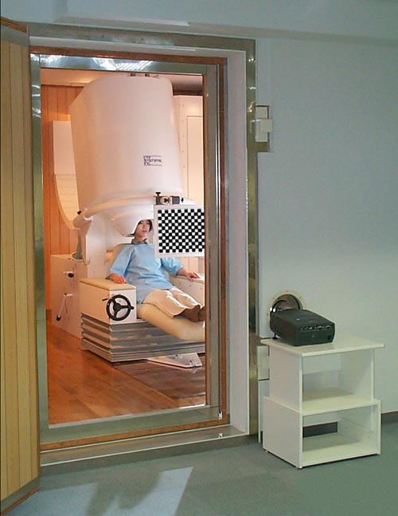
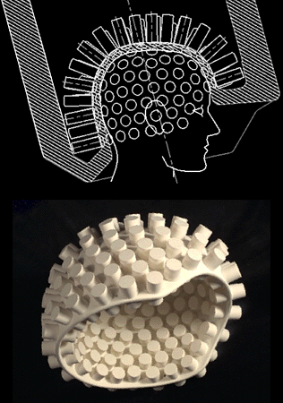
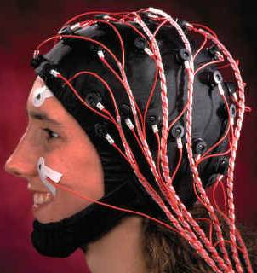
~300 sensors
<128 electrodes

Slide 5
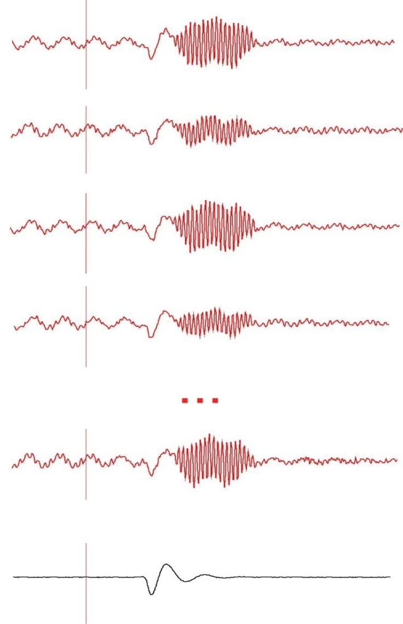
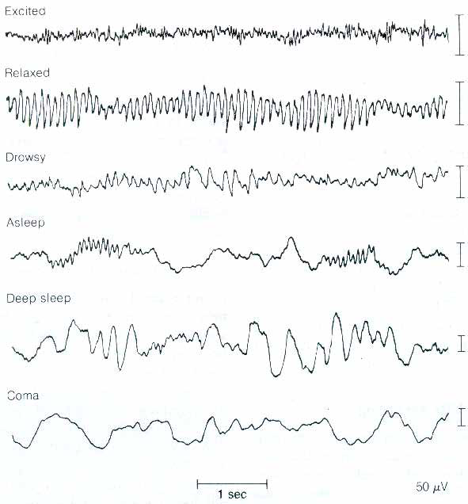
Evoked response vs. spontaneous activity
active
awake state
pre-stim
post-stim
resting state
falling asleep
sleep
deep sleep
coma
50 uV
Averaging
1 sec
evoked response
ongoing rhythms

Slide 6
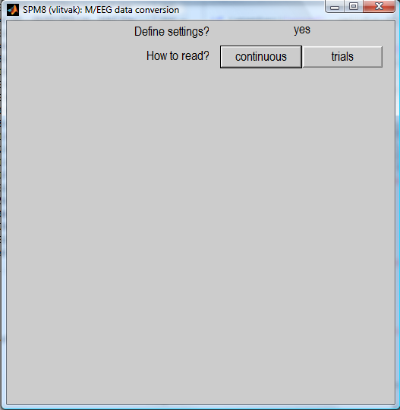
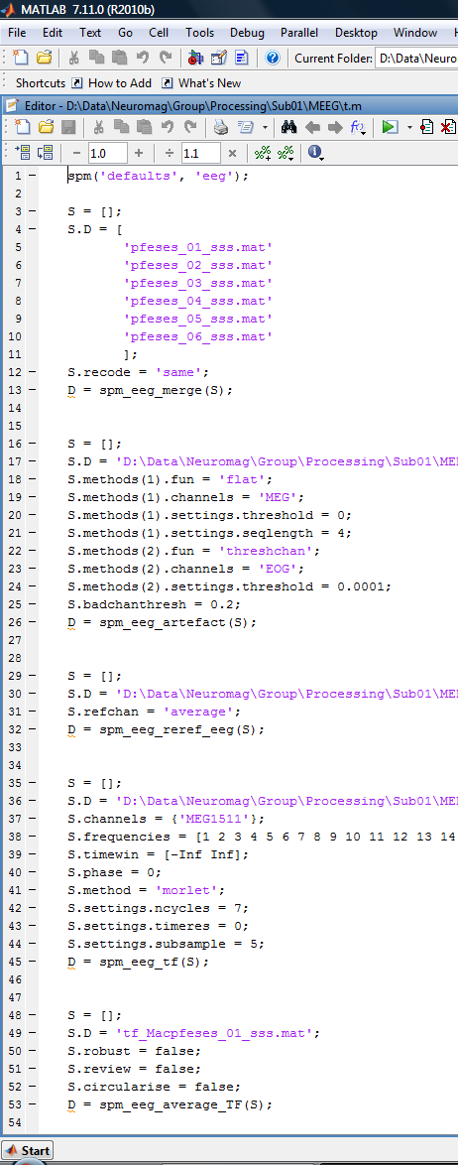
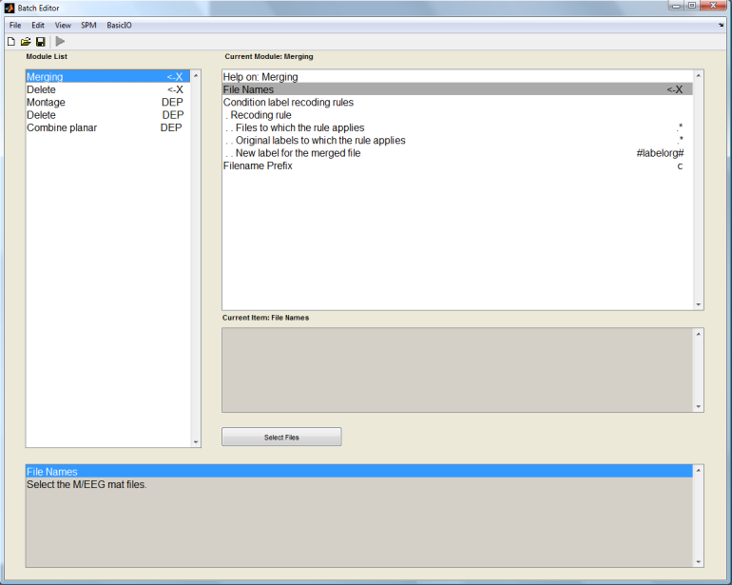
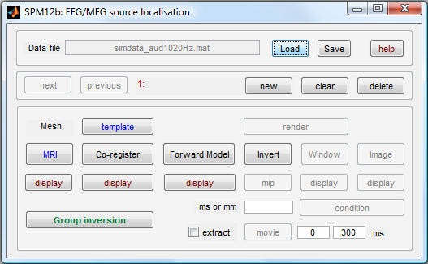
Clarification of terms – SPM speak
GUI
Script
Batch

Slide 7
Why batch?
As opposed to GUI
  - it is easy to reproduce analyses, apply them to different datasets and make modifications.
  - removing interactive GUI elements from the code makes it cleaner and easier to maintain.
As opposed to script
  complex pipelines can be built without programming expertise
  saved pipelines can be examined without deciphering other people’s code
  batch provides uniform interface for scripting to different parts of SPM code.
Disadvantages of batch
  there is no step-by-step guiding of the user
  the need to prepare all the inputs in advance makes some of the operations less intuitive and requires getting used to.

Slide 8
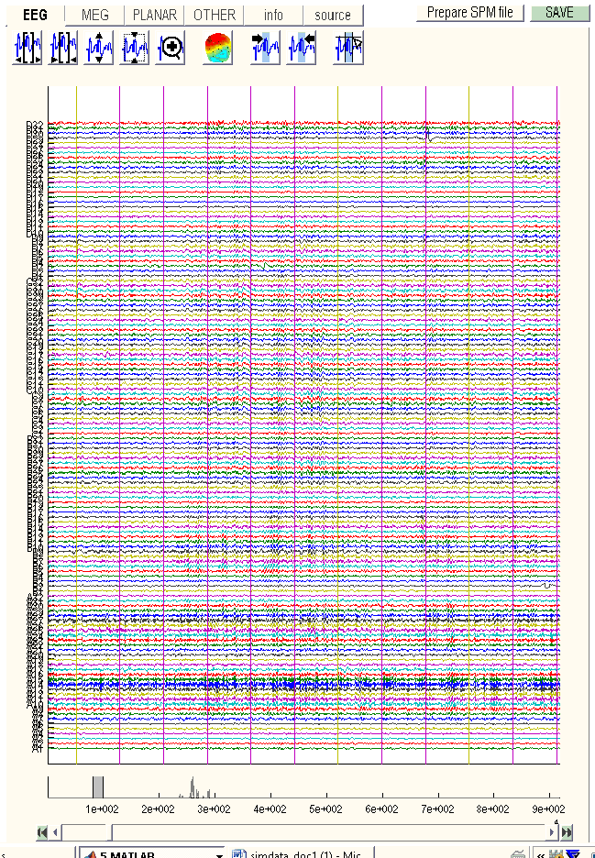
Raw data with triggers

Slide 9
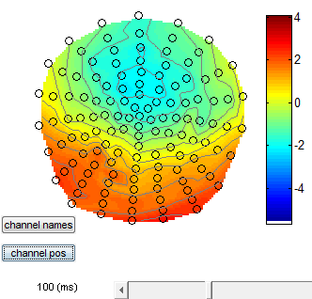
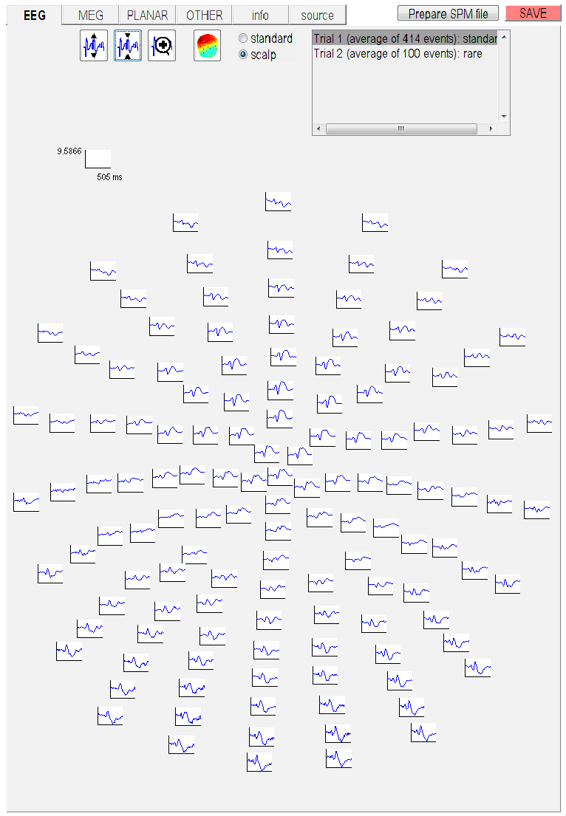
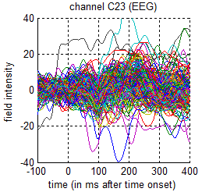
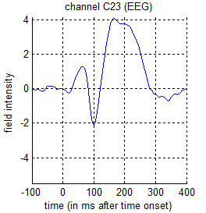
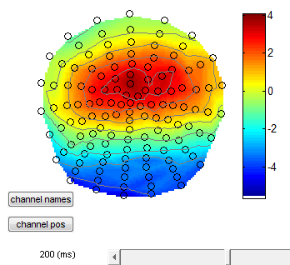

Slide 10
Now lets take a step back

Slide 11
Steps to cover
Conversion
Filtering
Downsampling
Epoching
Re-referencing for EEG
Artefacts
Averaging
Coregistration
Generating scalp x time images
Time-frequency analysis
spm_eeg_convert

Slide 12
Conversion
MEG
CTF
Neuromag
BTi-4D
Yokogawa
EEG
EEGLAB
Biosemi
Brainvision
Neuroscan
EGI
ANT
SPM5
…
Biosig
Arbitrary
ASCII
Matlab
Fieldtrip
raw
timelock
freq
GUI
script
Prepare
(Import from workspace)
+
Reviewing tool
Convert button
(fileio)
spm_eeg_convert
spm_eeg_ft2spm
SPM dataset
*.dat – binary data file
*.mat – header file

Slide 13
Expert’s corner
The *.mat file contains a struct, named D, which is converted to an meeg object by spm_eeg_load.
The *.dat file contains the data and is memory-mapped and linked to the object in order to save memory.

Slide 14
Conversion
In GUI you have the option to define settings or ‘just read’
Settings to define…
  Continuous or epoched
  Which channels to include
  etc

Slide 15
Steps to cover
Conversion
Filtering
Downsampling
Epoching
Re-referencing for EEG
Artefacts
Averaging
Coregistration
Generating scalp x time images
Time-frequency analysis
spm_eeg_filter

Slide 16
Filtering
High-pass – remove the DC offset and slow trends in the data.
Low-pass – remove high-frequency noise. Similar to smoothing.
Notch (band-stop) – remove artefacts limited in frequency, most commonly line noise and its harmonics.
Band-pass – focus on the frequency of interest and remove the rest. More suitable for relatively narrow frequency ranges.

Slide 17
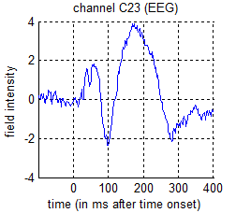
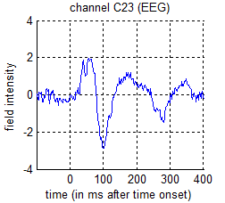
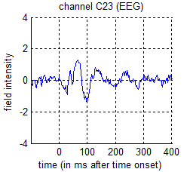
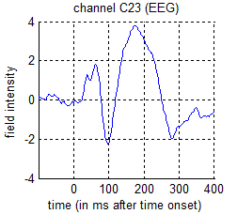
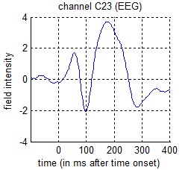
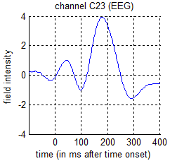
Filtering - examples
Unfiltered
5Hz high-pass
10Hz high-pass
45Hz low-pass
20Hz low-pass
10Hz low-pass

Slide 18
Steps to cover
Conversion
Filtering
Downsampling
Epoching
Re-referencing for EEG
Artefacts
Averaging
Coregistration
Generating scalp x time images
Time-frequency analysis
spm_eeg_downsample

Slide 19
Steps to cover
Conversion
Filtering
Downsampling
Epoching
Re-referencing for EEG
Artefacts
Averaging
Coregistration
Generating scalp x time images
Time-frequency analysis
spm_eeg_epochs

Slide 20
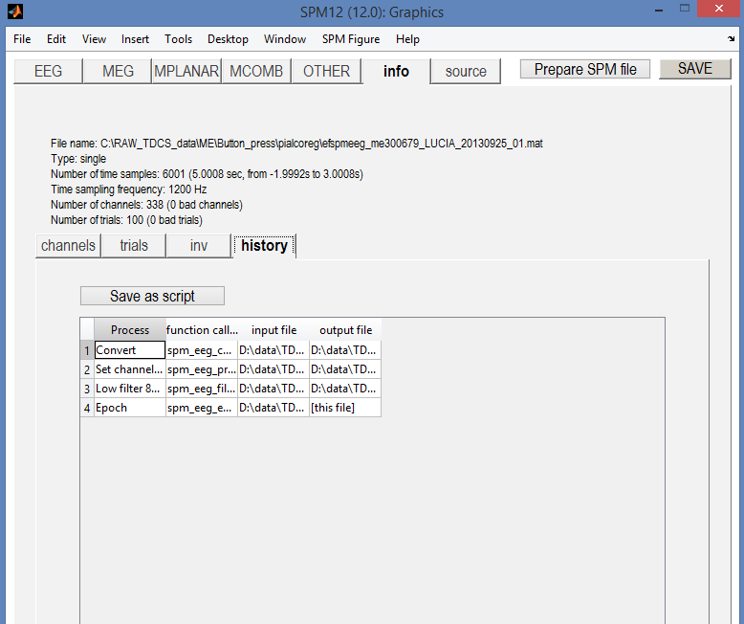
Epoching
Data visualization:
Scroll through trials
Important to understand triggers in data when recording!

Slide 21
Epoching
Definition: Cutting segments around events.
Need to know:
What happens (event type, event value)
When it happens (time of the events)
Need to define:
Segment borders
Trial type (can be different triggers => single trial type)
Shift of time zero of the trial with respect to the trigger (no shift by default).
Note:
SPM only supports fixed length trials
The epoching function also performs baseline correction (using negative times as the baseline). You can also do this separately.

Slide 22
Steps to cover
Conversion
Filtering
Downsampling
Epoching
Re-referencing for EEG
Artefacts
Averaging
Coregistration
Generating scalp x time images
Time-frequency analysis
spm_eeg_montage

Slide 23
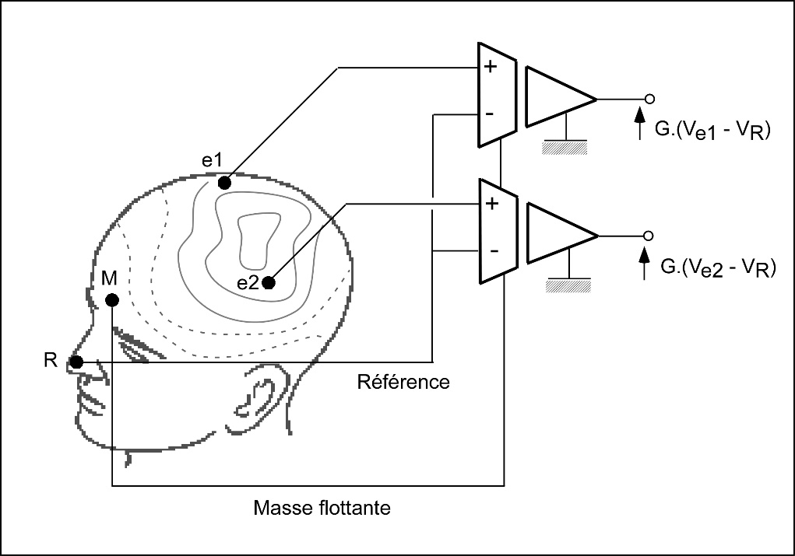
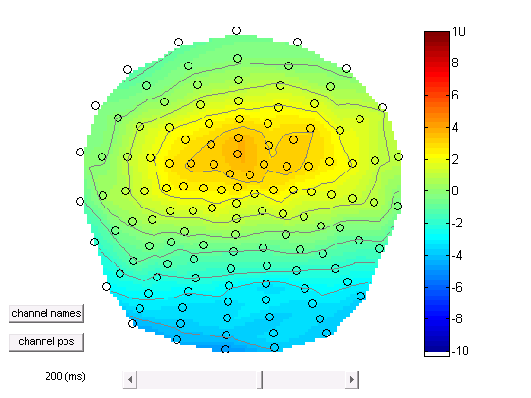
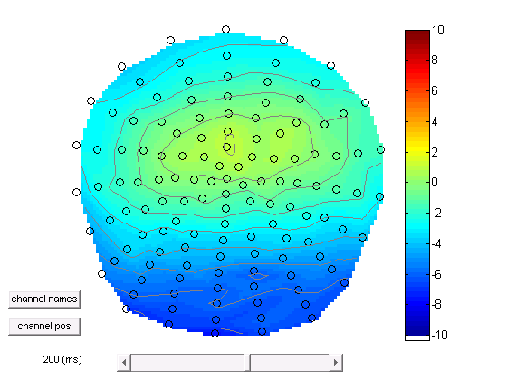
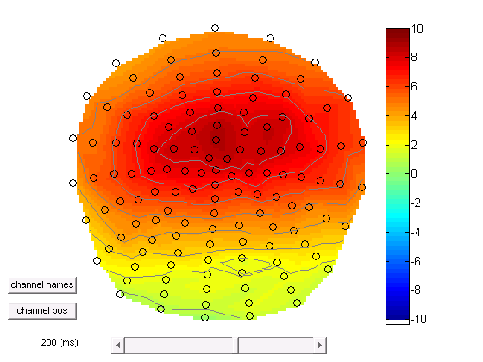
EEG – re-referencing
Average reference

Slide 24
EEG – re-referencing
Re-referencing can be used to sensitize sensor level analysis to particular sources (at the expense of other sources).
For source reconstruction and DCM it is necessary to specify the referencing of the data. This can be done via the ‘Prepare’ tool.
Re-referencing in SPM is done by the Montage function that can apply any linear weighting to the channels and has a wider range of applications.

Slide 25
Steps to cover
Conversion
Filtering
Downsampling
Epoching
Re-referencing for EEG
Artefacts
Averaging
Coregistration
Generating scalp x time images
Time-frequency analysis
spm_eeg_artefact

Slide 26
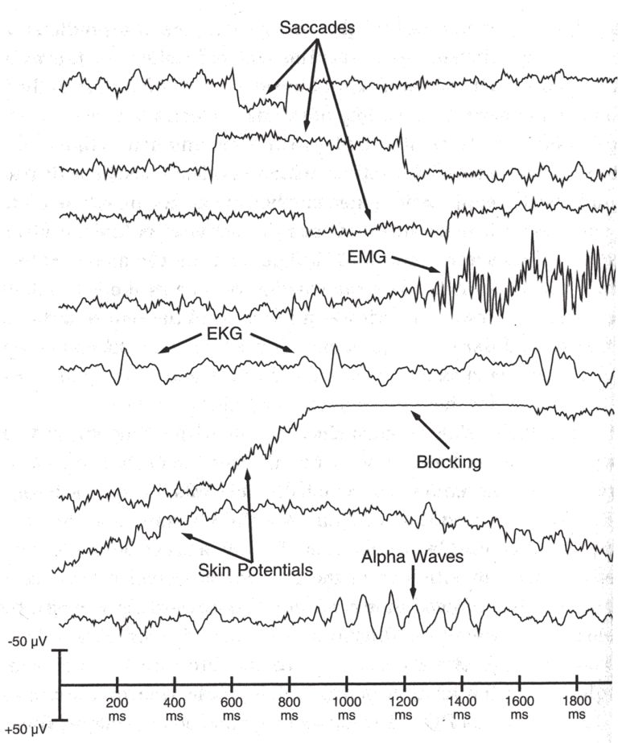
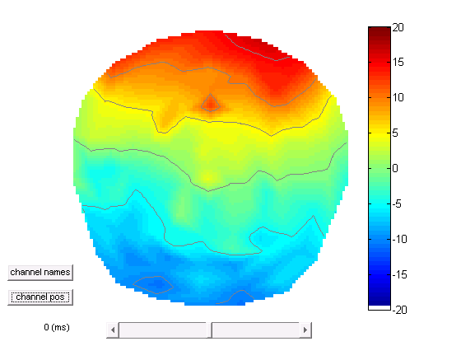
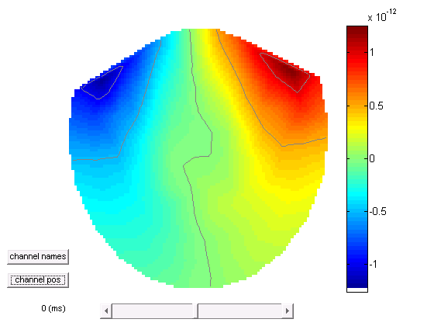
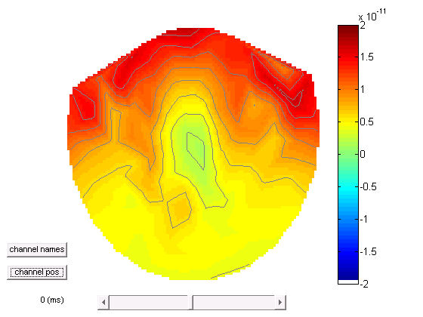
Artefacts
Eye blink
EEG
MEG
Planar

Slide 27
Examples in MEG data muscle artefact, eye blink, sensor jumps

Slide 28
Artefacts
SPM has an extendable artefact detection function where plug-ins implementing different detection methods can be applied to subsets of channels.
A variety of methods are implemented including, amplitude thresholding, jump detection, flat segment detection, ECG and eye blink detection.
In addition, topography-based artefact correction method is available (in MEEGtools toolbox).

Slide 29
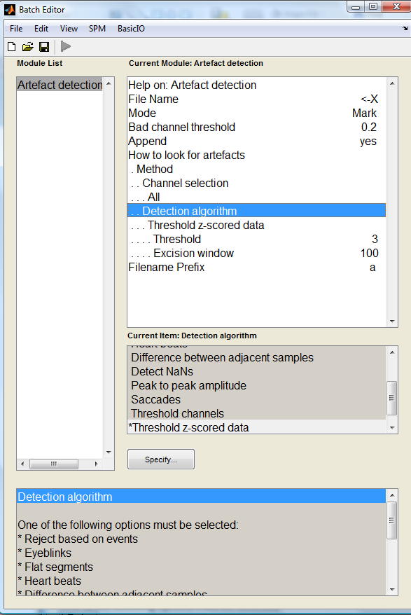
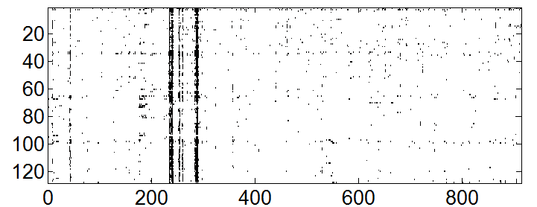
New in SPM12
It is now possible to mark artefacts in continuous data
Marked artefacts are saved as events which are carried over with subsequent processing. So it is possible e.g. to mark artefacts before filtering and keep for later.
Marked artefacts can be used for trial rejection at a later stage (‘Reject based on events’)
>> imagesc(D.badsamples(D.indchantype('EEG'), ':', 1))
Channels
time (s)

Slide 30
Steps to cover
Conversion
Filtering
Downsampling
Epoching
Re-referencing for EEG
Artefacts
Averaging
Coregistration
Generating scalp x time images
Time-frequency analysis
spm_eeg_average

Slide 31
Averaging across trials

Slide 32
Robust averaging
Kilner, unpublished
Wager et al. Neuroimage, 2005

Slide 33
Robust averaging
Robust averaging is an iterative procedure that computes the mean, down-weights outliers, re-computes the mean etc. until convergence.
It relies on the assumption that for any channel and time point most trials are clean.
The number of trials should be sufficient to get a distribution (at least a few tens).
Robust averaging can be used either in combination with or as an alternative to trial rejection.

Slide 34
So that’s how we got to this point
Converted
Filtered
Downsampled
Epoched
Re-referenced for EEG
Removed artefacts
Averaged

Slide 35
A note about order
There is no single correct order of steps, but here are some considerations for order choices
  It is better to filter continuous data prior to epoching to avoid filter ringing artefacts in every trial. Alternatively the epochs of interest can be padded with more data and then cropped after filtering.
  It is better to do high-pass filtering or baseline correction before other filtering steps to reduce filter ringing.
  It is convenient to put downsampling early in the pipeline to make the subsequent steps faster.
  SPM only filters channels with physiological data. So the channel types should be set correctly before filtering.
  Some artefacts (e.g. discontinuous jumps or saturations) are more difficult to detect after filtering.

Slide 36
Steps to cover
Conversion
Filtering
Downsampling
Epoching
Re-referencing for EEG
Artefacts
Averaging
Coregistration
Generating scalp x time images
Time-frequency analysis

Slide 37
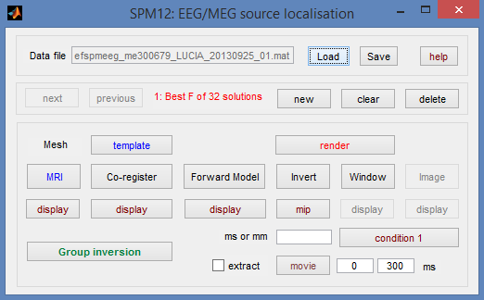
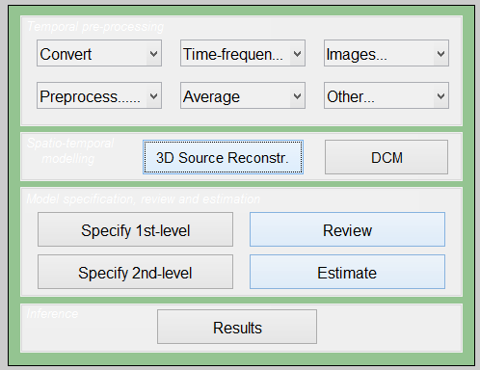
3D Source Reconstruction
Map sensors onto template brain or individual structural MRI
Need template/structural
Need fiducial coordinates if using individual MRI
Need to choose a forward model (e.g. single shell)

Slide 38
Steps to cover
Conversion
Filtering
Downsampling
Epoching
Re-referencing for EEG
Artefacts
Averaging
Coregistration
Generating scalp x time images
Time-frequency analysis

Slide 39
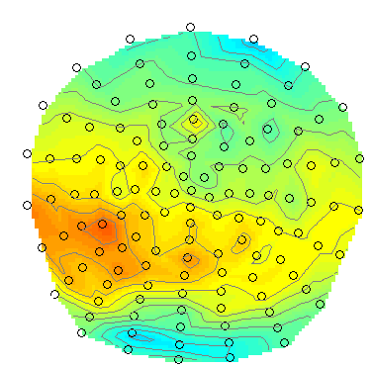
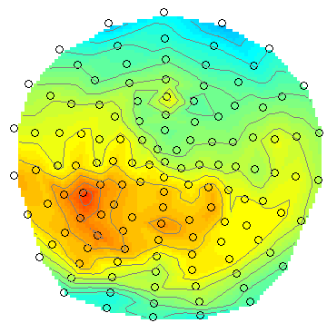
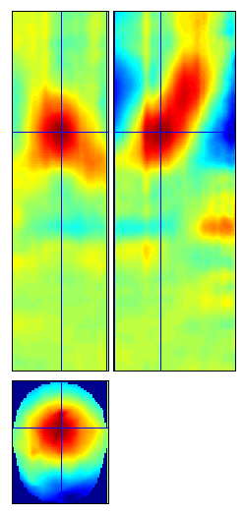
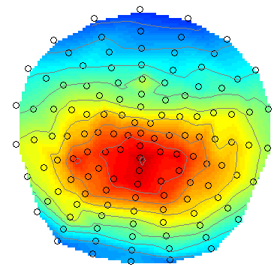
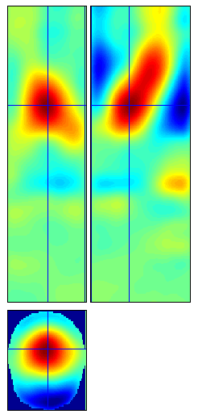
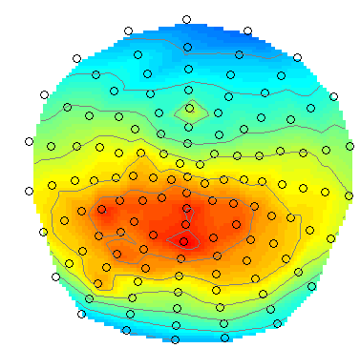
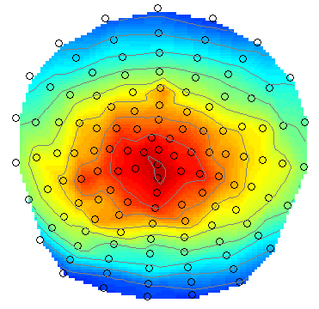
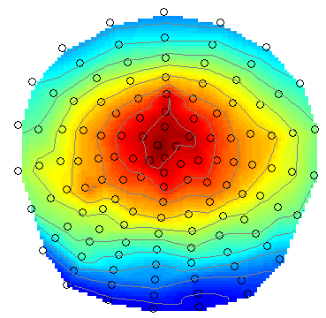
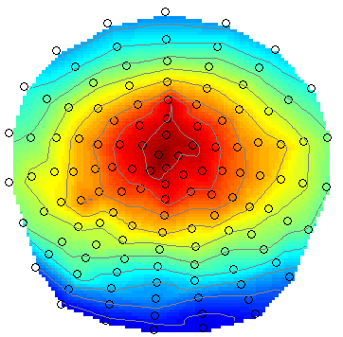
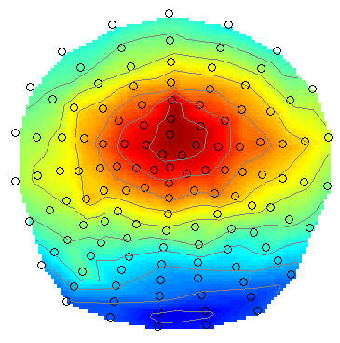
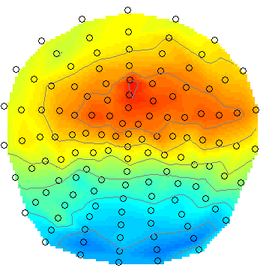
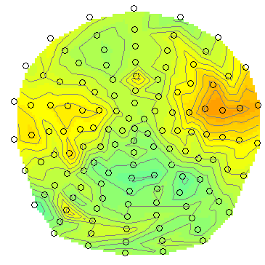
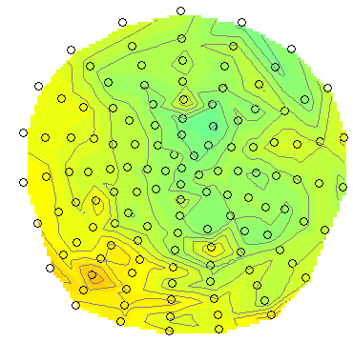




Generating time x scalp images

Slide 40
Steps to cover
Conversion
Filtering
Downsampling
Epoching
Re-referencing for EEG
Artefacts
Averaging
Coregistration
Generating scalp x time images
Time-frequency analysis
spm_eeg_tf

Slide 42
Fourier analysis
Joseph Fourier (1768-1830)
Any complex time series can be broken down into a series of superimposed sinusoids with different frequencies

Slide 43
Fourier analysis
Original
Different amplitude
Different phase

Slide 44


Time-frequency spectrograms

Slide 45



Methods of spectral estimation
Morlet 3 cycles
Morlet 5 cycles
Morlet 5 cycles
Morlet 7 cycles
Boxcar
Hanning
Hillbert transform
Multitaper
Morlet 7 cycles
Morlet 9 cycles

Slide 46


Robust averaging for TF
Unweighted averaging
Robust averaging

Slide 47






TF rescaling
Raw
Log
Rel [-7 -4]s
Diff [-7 -4]s
LogR [-7 -4]s
Rel [-0.5 0.5]s

Slide 48


Changes to TF data handling in SPM12
TF analysis can be done on continuous data.
Continuous TF data can be filtered, epoched and used as input to convolution modelling.

Slide 49
Summary
We have covered all these pre-processing steps:
Conversion – Filtering – Downsampling – Epoching - Re-referencing for EEG -
Artefacts – Averaging – Coregistration - Generating scalp x time images -
Time-frequency analysis
From here you can go on to source analysis and stats…

Slide 50
Thanks to:
Vladimir Litvak
Stefan Kiebel
Jean Daunizeau
Gareth Barnes
James Kilner
Robert Oostenveld
Arnaud Delorme
Laurence Hunt
and all the members of the methods group past and present

