Slide 1
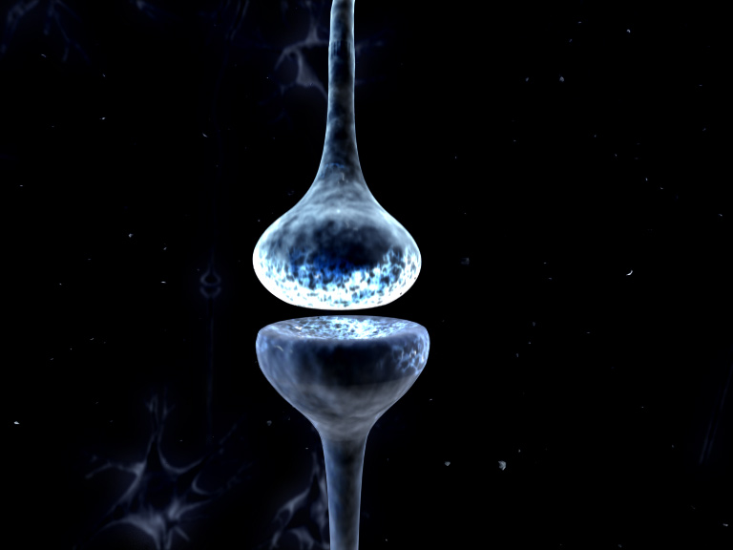
Dynamic Causal Modelling
For Cross-Spectral Densities
Rosalyn Moran
Virginia Tech Carilion Research Institute
Bradley Department of Electrical & Computer Engineering
Department of Psychiatry and Behavioral Medicine, VTC School of Medicine

Slide 2
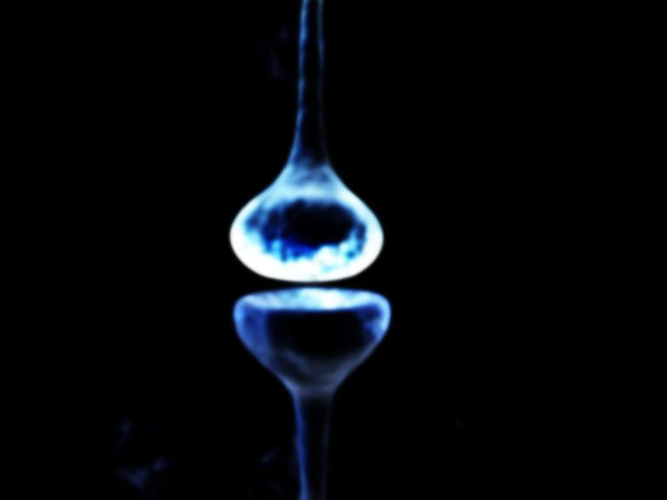
Outline
Data Feature Selection
– Cross-Spectral Densities (CSD)
– Time Frequency Modulation (TFM)
2. Generative Models from the time to frequency domain
3. Bayesian Model Selection & Parameter Testing
– Example from Propofol Modulated EEG
– Example from Ketamine Modulated LFP

Slide 3
Outline
Data Feature Selection
– Cross-Spectral Densities (CSD)
– Time Frequency Modulation (TFM)
2. Generative Models from the time to frequency domain
3. Bayesian Model Selection & Parameter Testing
– Example from Propofol Modulated EEG
– Example from Ketamine Modulated LFP

Slide 4
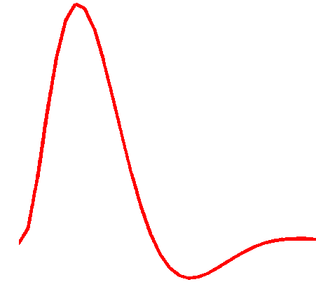
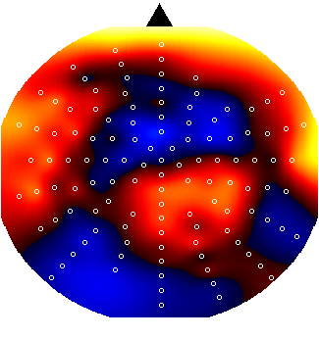
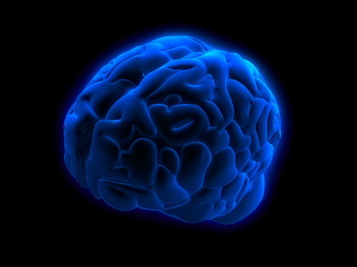
Dynamic Causal Modelling: Generic Framework
Hemodynamic
forward model:
neural activity BOLD
Time Domain Data
Resting State Data
Electromagnetic
forward model:
neural activity EEG
MEG
LFP
Time Domain ERP Data
Phase Domain Data
Time Frequency Data
Spectral Data
Neural state equation:
fMRI
EEG/MEG
detailed neuronal model
(synaptic time scales)
simple neuronal model
(slow time scale)

Slide 5
Dynamic Causal Modelling: Generic Framework
“theta”
Electromagnetic
forward model:
neural activity EEG
MEG
LFP
Time Domain ERP Data
Phase Domain Data
Time Frequency Data
Spectral Data
Hemodynamic
forward model:
neural activity BOLD
Time Domain Data
Resting State Data
Power (mV²)
Frequency (Hz)
Neural state equation:
fMRI
EEG/MEG
detailed neuronal model
(synaptic time scales)
simple neuronal model
(slow time scale)

Slide 6
Definition of DCM for Cross Spectral Densities
Under linearity and stationarity assumptions, the model’s biophysical parameters (e.g. post-synaptic receptor density and time constants) prescribe the cross-spectral density of responses measured directly (e.g. local field potentials) or indirectly through some lead-field (e.g. electroencephalographic and magnetoencephalographic data).

Slide 7
Definition of Stationarity
Statistically: A “Wide Sense Stationary” signal has 1st and 2nd moments that do not vary with respect to time
Dynamically: A system in steady state has settled to some equilibrium after a transient
Data Feature: Quasi-stationary signals that underlie Spectral Densities in the Frequency Domain

Slide 8
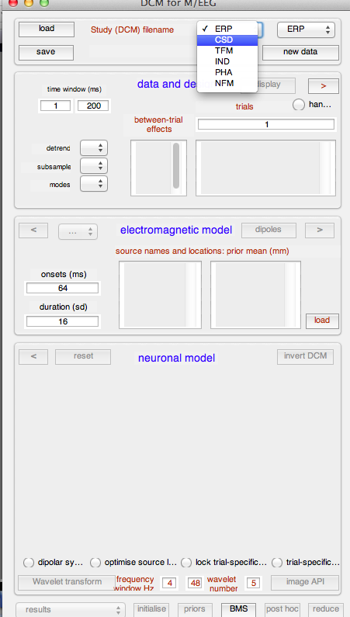
DCM for CSD and TFM: Data Features
Empirical Data
Generative Model
Bayesian Inversion
Model Structure/ Model Parameters

Slide 9
DCM for CSD and TFM: Data Features
Empirical Data
Generative Model
Bayesian Inversion
Model Structure/ Model Parameters

Slide 10

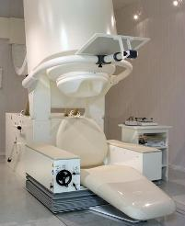

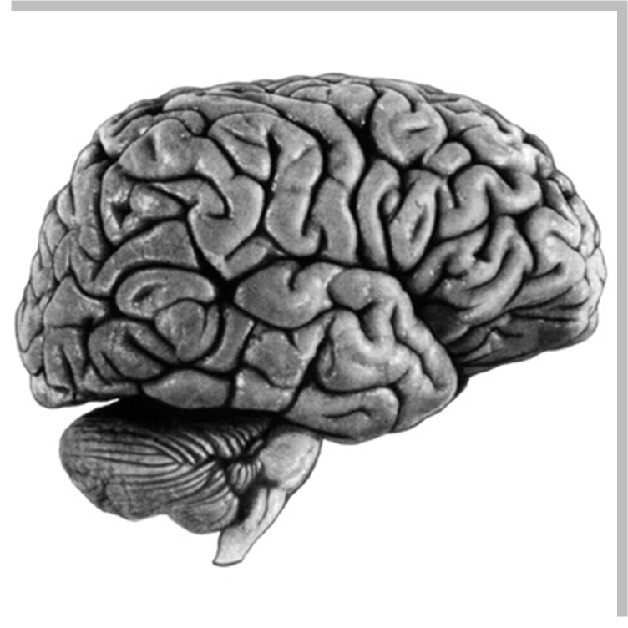
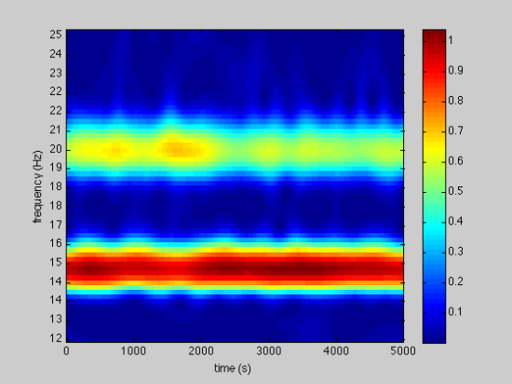
DCM for CSD: Data Features to model
EEG MEG LFP
1. Identify Source to Model
2. Examine Trial Statistics
(Source or Sensor Space)
3. Calculate Spectral Density in Source /Sensor
30
25
20
Absolute CSD/Power
Frequency (Hz)
15
0
5
10
15
20
25
10
5
0
0
5
10
15
20
25
Time (msec)
Frequency (Hz)

Slide 11
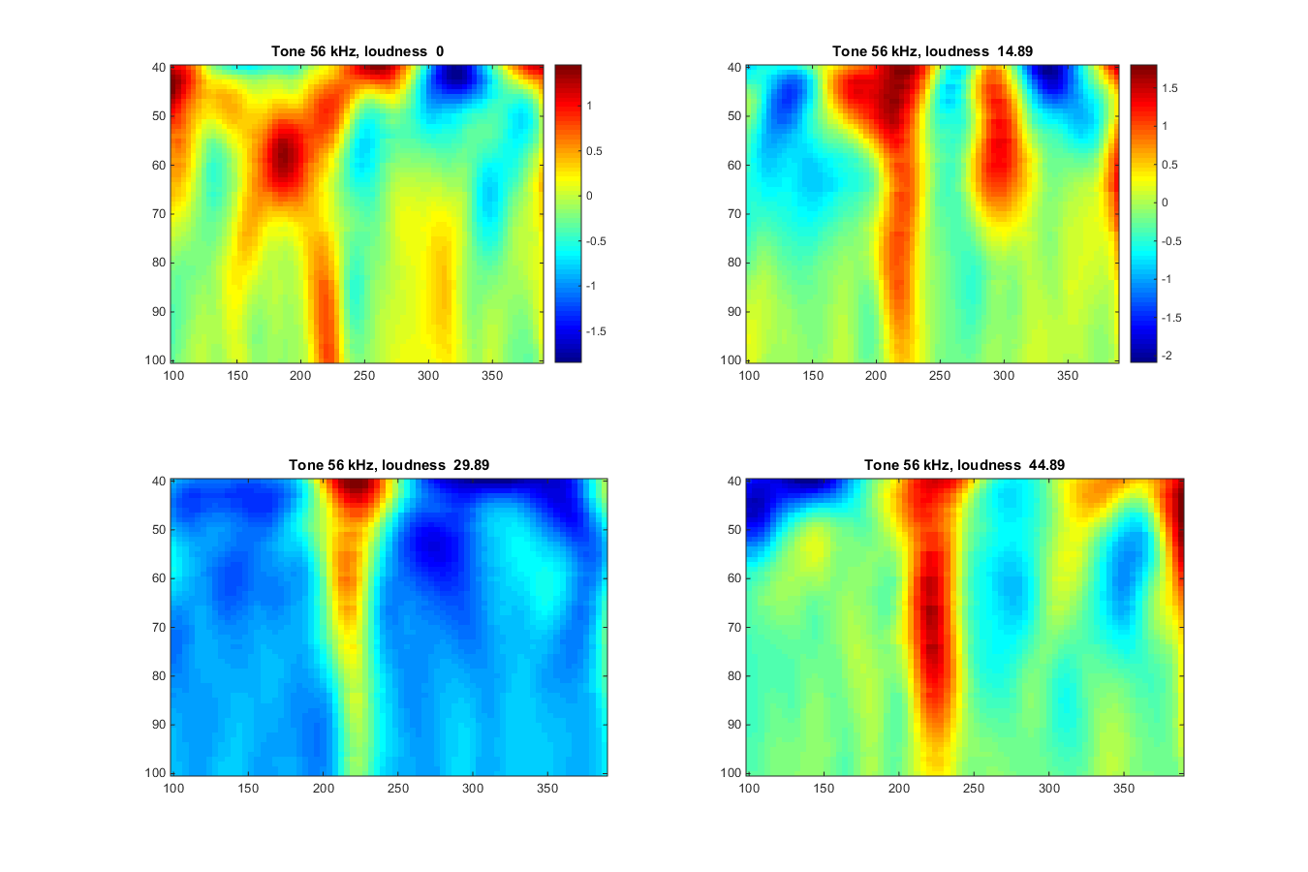
DCM for CSD: Data Features to model
1. Identify Sources to Model
2. Examine Trial Statistics
0
5
10
15
20
25
Frequency (Hz)
Time (msec)
Time (msec)
3. Calculate Complex Cross-Spectral Density Matrix, G
30
30
G(nf,I,j)
25
G(nf,I,i)
25
20
20
15
15
10
10
5
5
0
0
5
10
15
20
25
0
0
5
10
15
20
25
30
25
G(nf,j,j)
Absolute(CSD) /Power
20
15
10
Frequency (Hz)
5
0
0
5
10
15
20
25

Slide 12
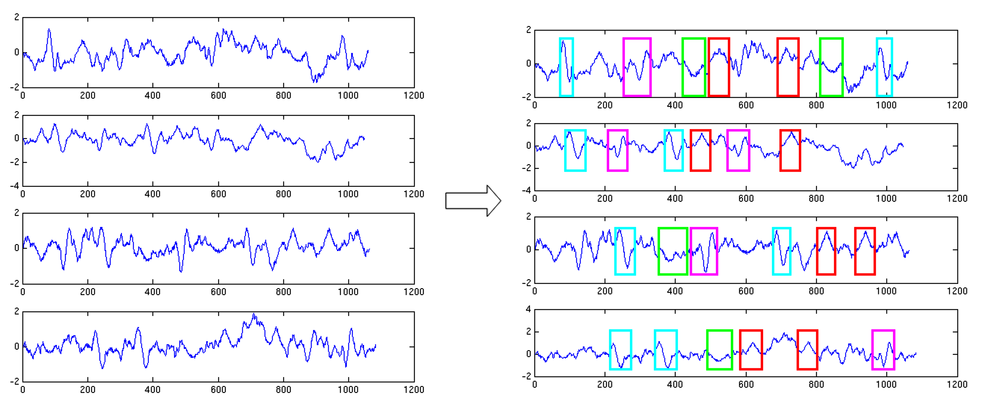
DCM for CSD: Data Features in practice (modes)
Sources in the time domain (via lead field)
1
2
Cross Spectral Density
1
3
2
4
3
1
2
3
4
4
A few LFP channels or EEG/MEG spatial modes

Slide 13
DCM for TFM: Data Features in practice (wavelet toolbox)
Autoregressive Model used to extract spectral representations from data
An autoregressive model of order p (Default order 8)
Cross (k,i) Spectrum AR coefficients prescribe the spectral densities
By definition
Real and Imaginary data features retained, cross spectrum & complex cross spectrum
Average over trials to fill CSD Matrix

Slide 14
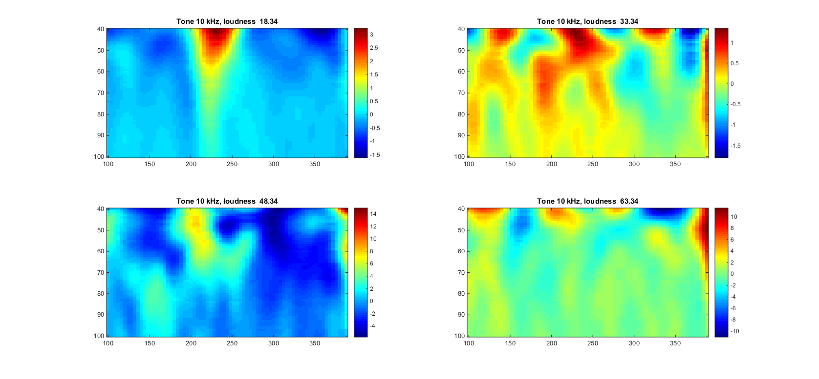
DCM for TFM: Data Features to model
EEG MEG LFP
1. Identify Source to Model
2. Examine Trial Statistics
(Source or Sensor Space)
0
5
10
15
20
25
Frequency (Hz)
Time (msec)

Slide 15
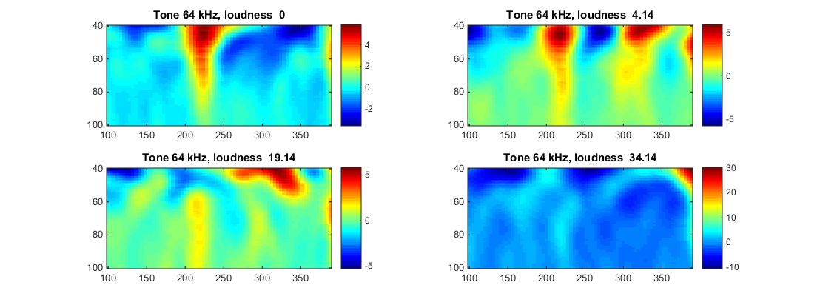
DCM for TFM: Data Features to model
1. Identify Sources to Model
2. Examine Trial Statistics
0
5
10
15
20
25
Frequency (Hz)
Time (msec)
Time (msec)
3. Complex Cross Spectral Wavelet Transformed
G(nt,nf,i,i)
G(nt,nf,i,j)
Cross temporal-spectra
Auto temporal-spectra
G(nt,nf,j,j)
Notes:
Which is faster,
Which is more robust?
When would you choose TFMs

Slide 16
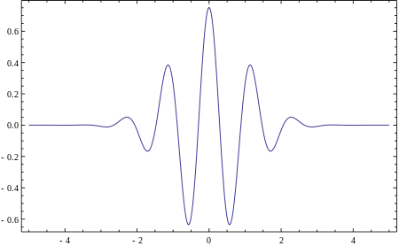
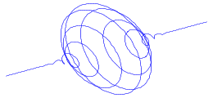
DCM for CSD: Data Features in practice (mar toolbox)
Morlet wavelet basis
A complex exponential multiplies by a Gaussian window
For specified number of of wavelet bases: 6 as default
1
2

i
3
Convolved with time domain responses
4
i
j
Average over trials to fill TFM Matrix

Slide 17
Outline
Data Feature Selection
– Cross-Spectral Densities (CSD)
– Time Frequency Modulation (TFM)
2. Generative Models from the time to frequency domain
3. Bayesian Model Selection & Parameter Testing
– Example from Propofol Modulated EEG
– Example from Ketamine Modulated LFP

Slide 18
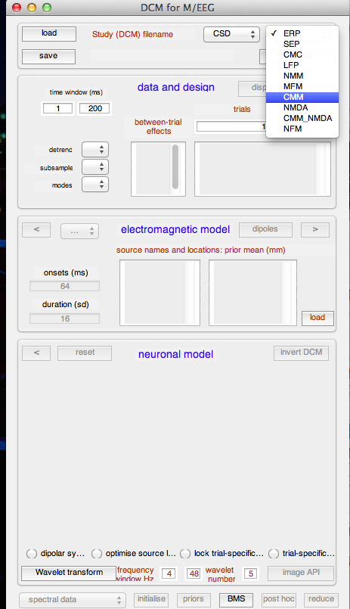
DCM for CSD/TFM: Neural Models
Empirical Data
Generative Model
Bayesian Inversion
Model Structure/ Model Parameters

Slide 19
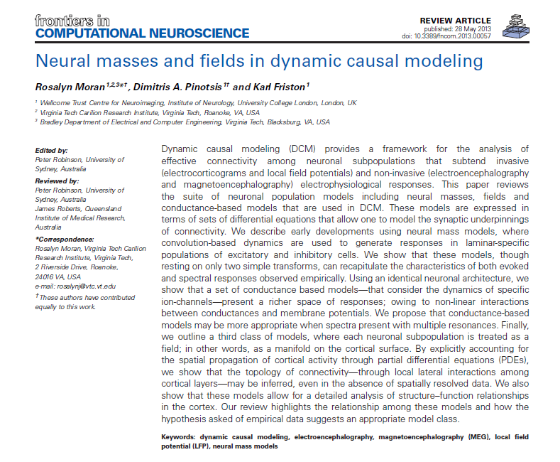
A selection of intrinsic architectures in SPM
A suite of neuronal population models including neural masses, fields and conductance-based models…expressed in terms of sets of differential equations

Slide 20


Neural Mass Models in DCM
EEG/MEG/LFP
signal
Properties of tens of thousands of neurons approximated by their average response
Intrinsic Connections
Supragranular Layer
neuronal (source) model
Granular Layer
Infragranular Layer
Internal Parameters
Extrinsic Connections
State equations

Slide 21
Conductance-Based
Neural Mass Models in DCM
Two governing equations: V = IR ……….. Ohms Law
I = C dV/dt ……. for a capacitor
Conductance
Current in
Potential Difference
Noise Term: Since properties of tens of thousands of neurons approximated by their average response

Slide 22
Conductance-Based
Neural Mass Models in DCM
Two governing equations: V = IR ……….. Ohms Law
I = C dV/dt ……. for a capacitor
Conductance
Current in
Potential Difference
Noise Term: Since properties of tens of thousands of neurons approximated by their average response
Time constant: κ
Afferent Spikes :
Strength of connection x σ
Channels already open: g

Slide 23
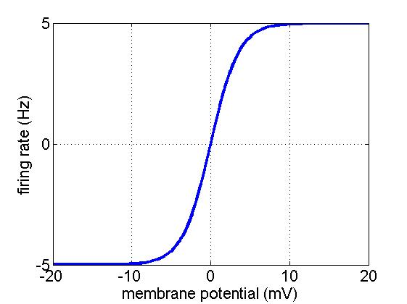
Conductance-Based
Neural Mass Models in DCM
Two governing equations: V = IR ……….. Ohms Law
I = C dV/dt ……. for a capacitor
Conductance
Current in
Potential Difference
Noise Term: Since properties of tens of thousands of neurons approximated by their average response
Time constant: κ
Afferent Spikes :
Strength of connection x σ
Channels already open: g
σ
μ - V

Slide 24

Conductance-Based
Neural Mass Models in DCM
Intrinsic Afferents
Extrinsic Afferents
Notes:
80 – 20 split

Slide 25
Conductance-Based
Neural Mass Models in DCM
Different Neurotransmitters and Receptors?
Different Cell Types in 3/6 Layers?
Notes:
80 – 20 split

Slide 26
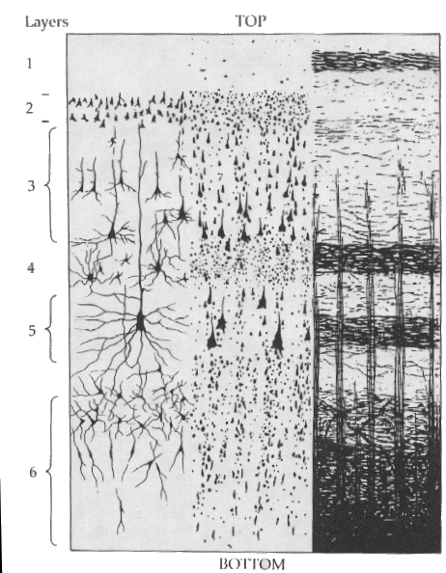
Conductance-Based Neural
Mass Models in DCM
Inhibitory cells in extragranular layers
Inhibitory interneuron
Exogenous input
Excitatory spiny cells in granular layers
Spiny stellate cells
Pyramidal cells
Measured response
Excitatory pyramidal cells in extragranular layers
Current
Conductance
Reversal Pot – Potential Diff
Firing Variance
Unit noise
Conductance
Time Constant
Afferent Firing
No. open channels

Slide 27
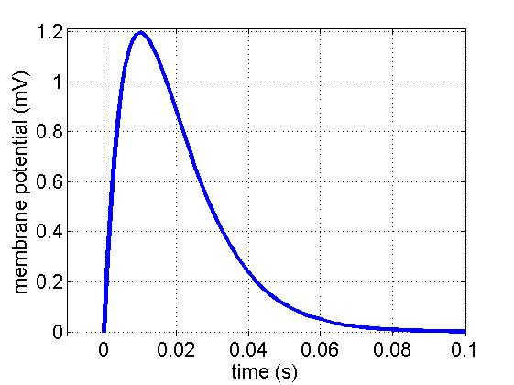
Convolution-Based Neural Mass
Models in DCM
Inhibitory interneuron
Extrinsic Backward Input
Extrinsic Forward Input
Spiny stellate cells
Pyramidal cells
Extrinsic Backward Input
Parameterised Sigmoid
Synaptic Kernel
Maximum
Post Synaptic Potential
H
Intrinsic
connectivity
Inverse
Time
Constant

Slide 28
Convolution-Based Neural Mass
Models in DCM
Inhibitory cells in extragranular layers
Inhibitory interneuron
Extrinsic Backward Input
γ
5
Extrinsic Forward Input
Spiny stellate cells
Excitatory spiny cells being granular layers
Exogenous input
Pyramidal cells
Extrinsic Backward Input
Parameterised Sigmoid
Synaptic Kernel
Maximum
Post Synaptic Potential
H
Excitatory pyramidal
cells in extragranular layers
Intrinsic
connectivity
Measured response
Inverse
Time
Constant

Slide 29
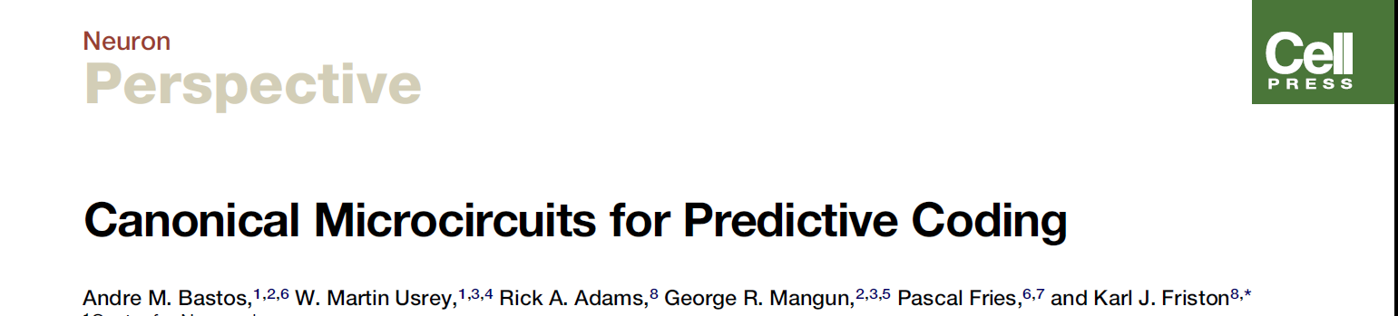
4 population Canonical
Micro-Circuit (CMC)
Inhibitory interneuron
Superficial pyramidal
Forward
Extrinsic Output
Extrinsic Backward Input
Extrinsic Backward Input
Spiny stellate
Extrinsic Forward Input
Extrinsic Forward Input
Spiny stellate
Extrinsic Backward Input
Inhibitory interneuron
Extrinsic Backward Input
Extrinsic Output
Pyramidal cells
Deep pyramidal
Backward
Extrinsic Output
GABA Receptors
AMPA Receptors
NMDA Receptors
4-subpopulation
Canonical Microcircuit
Temporal Derivatives

Slide 30
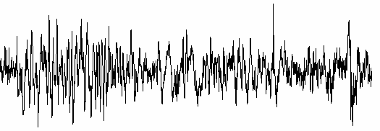
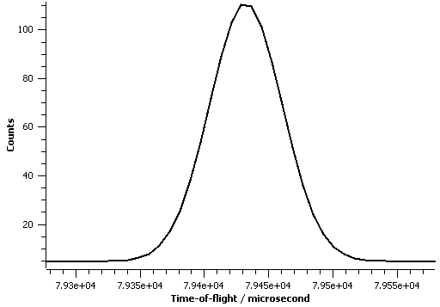
State equations to CSD or TFM
Friston et al, DCM for complex-valued data: Cross-spectra, coherence and phase-delays , 2012
CSD:
For each source
Compute FFT of Volterra Kernel
Compute Cross Spectrum
u: white noise
TFM:
For each source
& point in PST, nt
Compute Cross Spectrum
u: e.g. bump function at time of onset
Compute FFT of Volterra Kernel
Based on expansion with u(t) and Gspy(t)
i.e. one time-dependent parameter

Slide 31
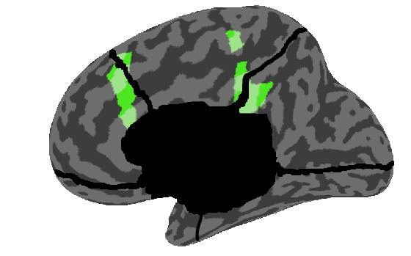
Generative Model of CSDs & TFMs
G(nf,I,i)
G(nf,I,j)
G(nf,j,j)
G(nt,nf,i,j)
G(nt,nf,i,i)
G(nt,nf,j,j)
Trial Specific effects as per DCM for ERP

Slide 32
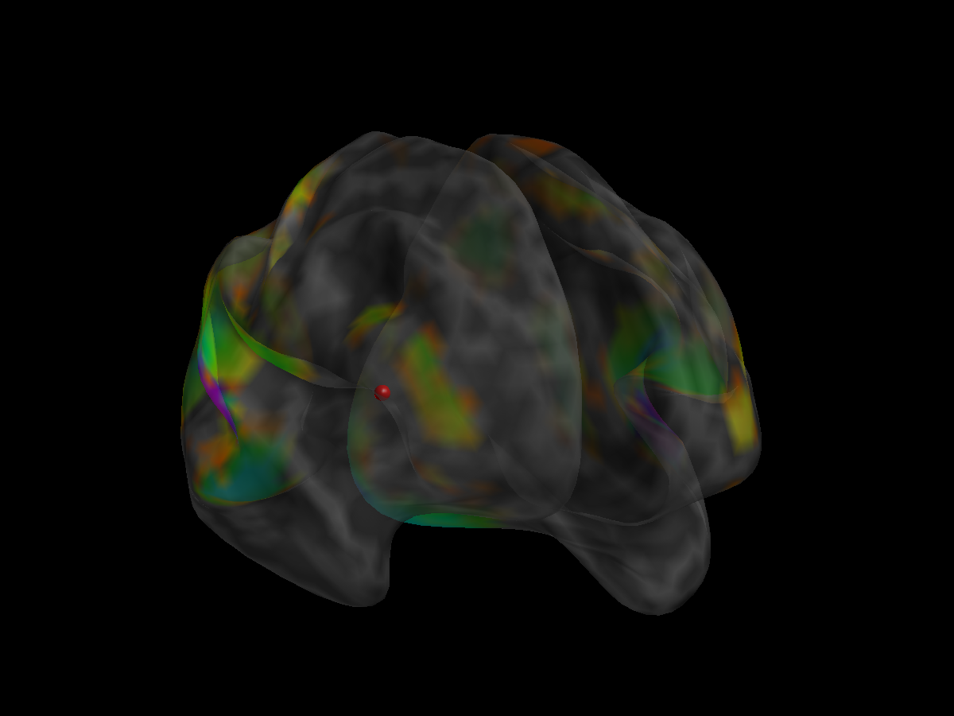
Summary: Neural Mass Models and DCM for CSD, TFM
Sensor Level
Spectral Responses
Lead Field in Kernels
Interconnected
Neural mass models

Slide 33
Outline
Data Feature Selection
– Cross-Spectral Densities (CSD)
– Time Frequency Modulation (TFM)
2. Generative Models from the time to frequency domain
3. Bayesian Model Selection & Parameter Testing
– Example from Propofol Modulated EEG
– Example from Ketamine Modulated LFP

Slide 34
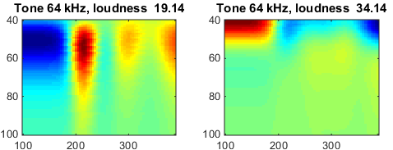
Dynamic Causal Modelling: Inversion & Inference
Empirical Data
Data : A1 response to loud tone
A1 response to quiet tone
Neural state equation:
EEG/MEG
Generative Model
Bayesian Inversion
Model : A1 response to loud tone
A1 response to quiet tone
Model Structure/ Model Parameters

Slide 35


Dynamic Causal Modelling: Inversion & Inference
Bayes’ rules:
Free Energy:
max
Inference on models
Inference on parameters
Bayesian Inversion
Model 1
Model 2
Model 1
Model comparison via Bayes factor:
accounts for both accuracy and complexity of the model
allows for inference about structure (generalisability) of the model

Slide 36
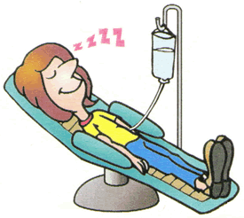
Connectivity changes underlying
spectral EEG changes during propofol-induced loss of consciousness.
Wake
Mild Sedation: Responsive to command
Deep Sedation: Loss of Consciousness
Boly, Moran, Murphy, Boveroux, Bruno, Noirhomme, Ledoux, Bonhomme, Brichant, Tononi, Laureys, Friston, J Neuroscience, 2012

Slide 37
Propofol-induced loss of consciousness
Wake
Mild Sedation: Responsive to command
Deep Sedation: Loss of Consciousness
Precuneus
/Posterior Cingulate
Anterior Cingulate/mPFC

Slide 38
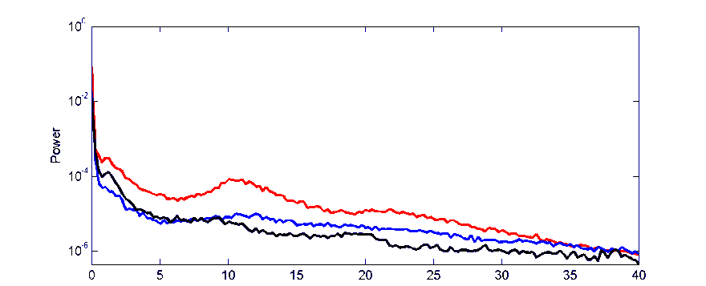
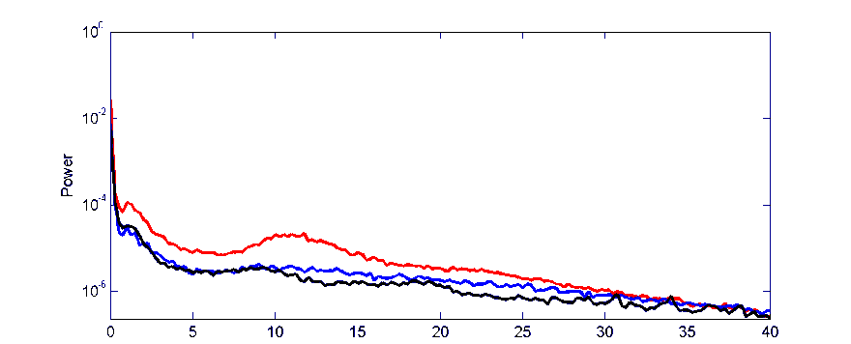
Propofol-induced loss of consciousness
Wake
Mild Sedation: Responsive to command
Deep Sedation: Loss of Consciousness
Precuneus
/Posterior Cingulate
Anterior Cingulate/mPFC
Murphy et al. 2011
Increased gamma power in Propofol vs Wake
Increased low frequency power when consiousness is lost

Slide 39
Bayesian Model Selection
Propofol-induced loss of consciousness
Wake
Mild Sedation
Deep Sedation
ACC
PCC
ACC
PCC
ACC
PCC
Thalamus
Thalami

Slide 40
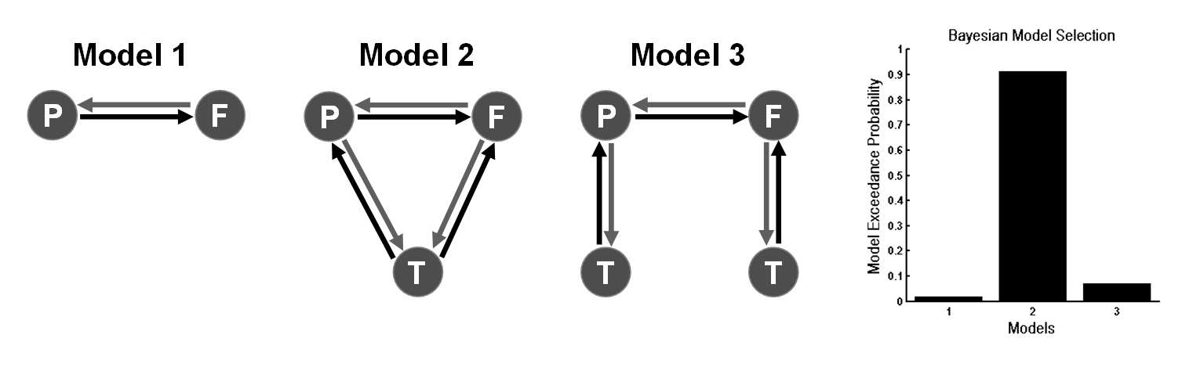
Propofol-induced loss of consciousness
Wake
Mild Sedation
Deep Sedation
ACC
PCC
ACC
PCC
ACC
PCC
Thalamus
Thalami

Slide 41
Parameters of Winning Model
Propofol-induced loss of consciousness
ACC
PCC
Wake
Thalamus

Slide 42
Propofol-induced loss of consciousness
ACC
PCC
Wake
Thalamus
ACC
PCC
Mild Sedation
Thalamus
:Increase in thalamic excitability

Slide 43
Propofol-induced loss of consciousness
ACC
PCC
Wake
Thalamus
ACC
PCC
ACC
PCC
Mild Sedation
Thalamus
:Increase in thalamic excitability
Thalamus
Loss of Consciousness
:Breakdown in Cortical Backward Connections

Slide 44
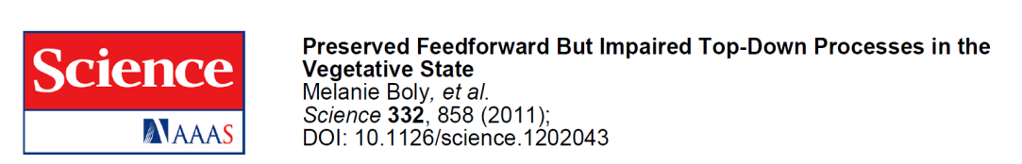
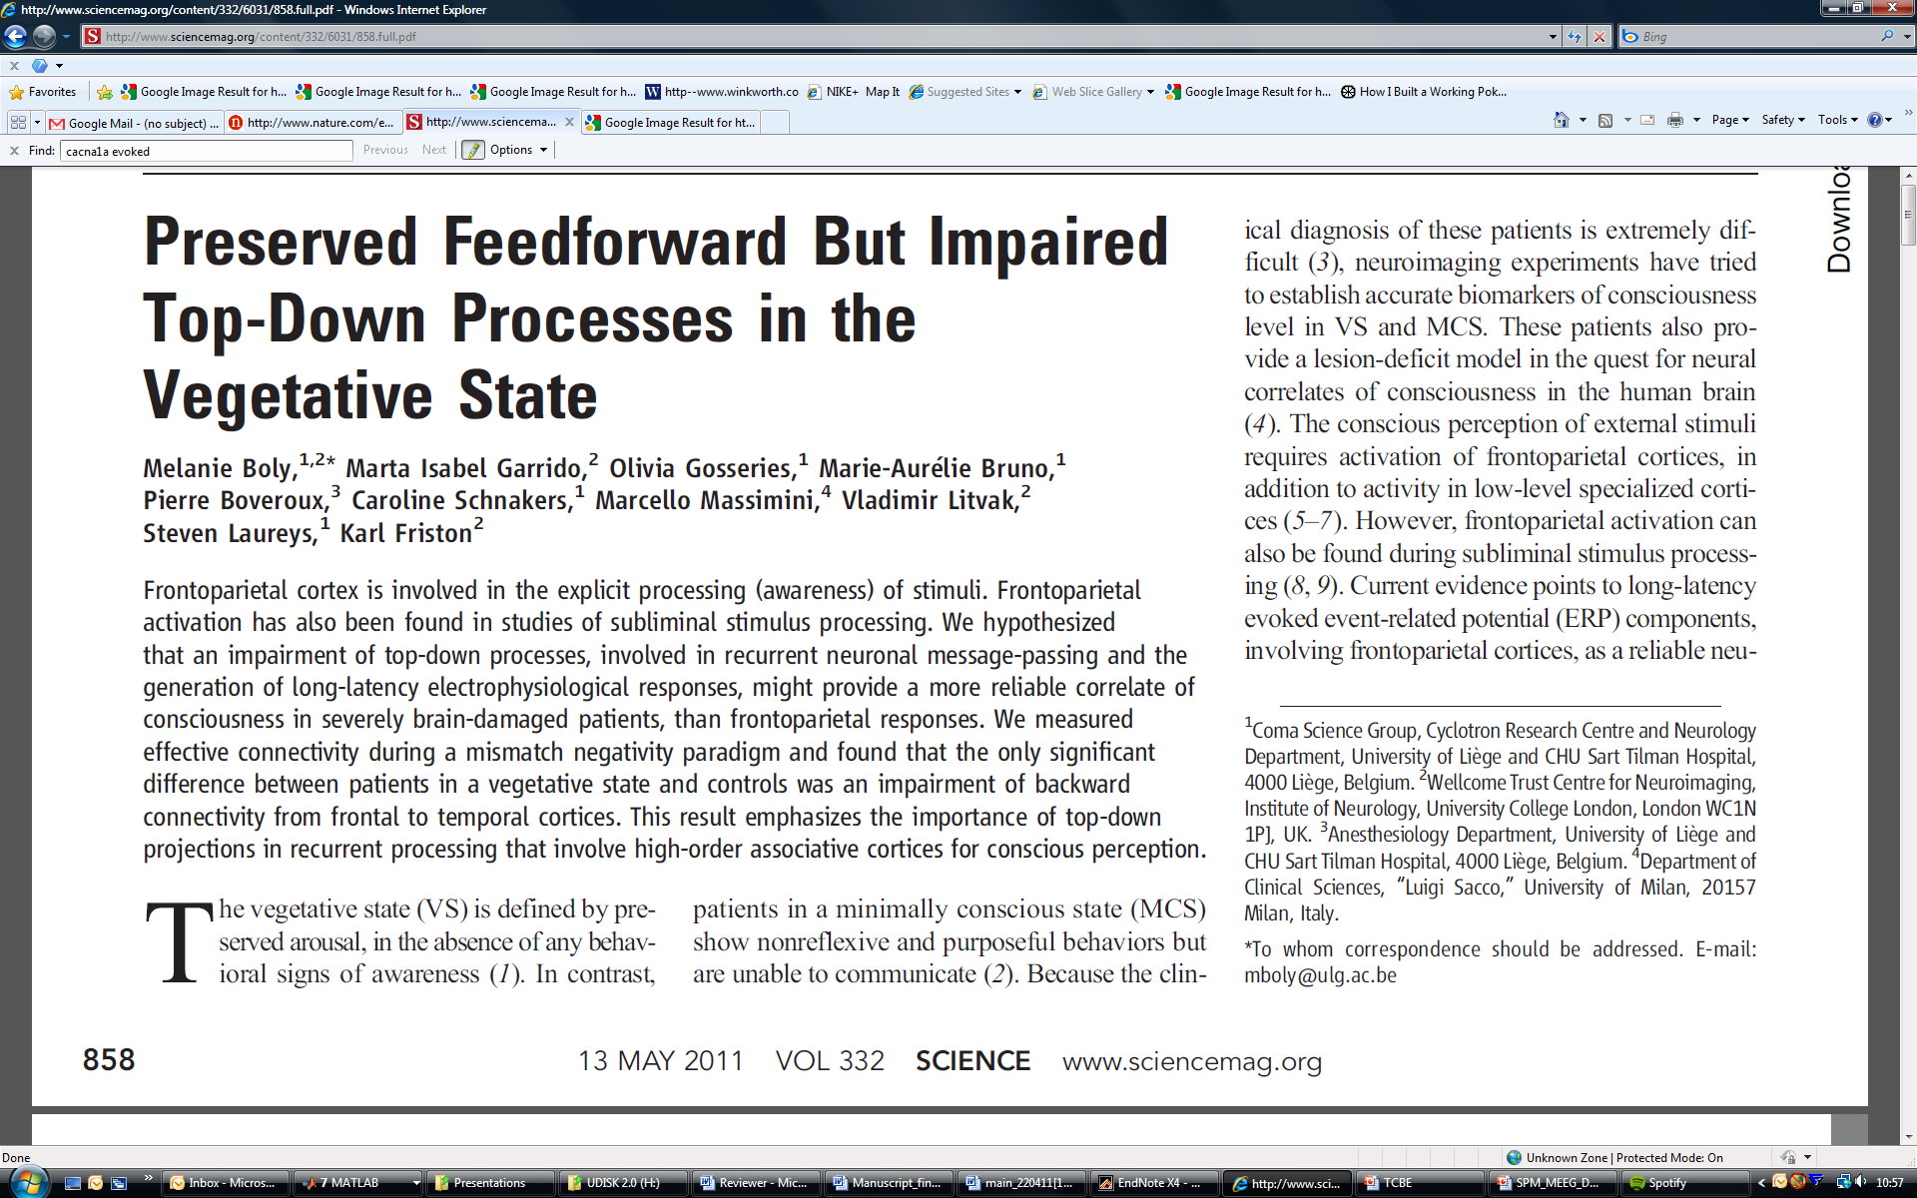
Propofol-induced loss of consciousness
ACC
PCC
Thalamus
Loss of Consciousness
:Breakdown in Cortical
Backward Connections
Boly, Moran, Murphy,
Boveroux, Bruno, Noirhomme,
Ledoux, Bonhomme, Brichant,
Tononi, Laureys, Friston, J Neuroscience, 2012

Slide 45
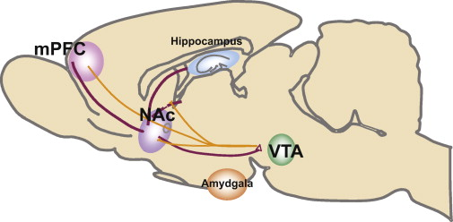
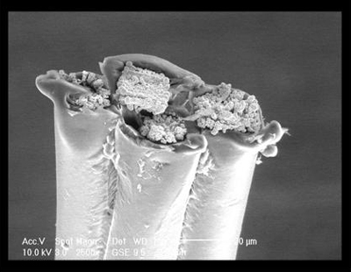
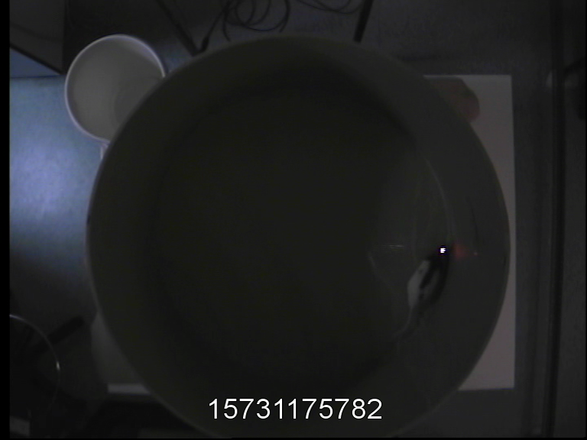
The Ketamine Model of Psychosis
& Schizophrenia
Bowers et al. 2010
Ketamine Dose: 0, 2, 4, 8, 30 mgkg-1
Hippocampal & Prefrontal Recordings
5 mins of recordings from freely moving rat: tetrodes in dCA1 & mPFC
Notes:
Add tetrode pic

Slide 46
The Ketamine Model of Psychosis & Schizophrenia
Noncompetitive NMDA-r antagonist
Dissociative anaesthetic:
"... a peculiar anaesthetic state in which marked sensory loss and analgesia as well as amnesia is not accompanied by actual loss of consciousness.” (Bonta, 2004)
Subanaesthetic Doses:
Model of psychosis in animals, producing hyperlocomotion and disruption of PPI
Reproduces in humans both positive and negative symptoms of schizophrenia along with associated cognitive deficits.
Notes:
Faces appear convex when they are concave

Slide 47
The Ketamine Model of Psychosis & Schizophrenia
Effects on Oscillations:
Theta reduction in the hippocampus and Gamma enhancement in hippocampus and neocortex.
Antipsychotic drugs (D2 antagonists) acutely reduce cortical gamma oscillations in rats (Jones et al. 2011).
Aberrant beta and gamma synchrony observed in patient populations (Uhlhaas et al. 2008).
Reduced or enhanced gamma depending on state late/prodromal ( Sun et al. 2011).
Connectivity
Behaviour
Receptor Neurochemistry
Notes:
Faces appear convex when they are concave

Slide 48
Behavioural Phenotype
Hyper-locomotion
**
**
20
18
16
14
Speed of movement
12
10
8
6
mean ± std
4
2
4
8
0
Mg Ketamine/kg
Notes:
P_corrected -ttest=
0.3251 3.5992 0.0024 0.3981 0.0024
P – WRS
0.1349 0.8016 0.0079 0.2222 0.0079

Slide 49
Oscillatory Characteristics
40
HPC-HPC
5
35
4.5
HPC-PFC
30
4
*
**
3.5
25
Power a.u.
Power a.u.
3
20
2.5
15
2
10
1.5
1
*
5
0.5
0
0
10
20
30
40
50
60
70
80
0
0
10
20
30
40
50
60
70
80
Frequency (Hz)
Frequency (Hz)
15
Recorded
PFC-PFC
Veh (13)
2mg (8)
4mg (8)
8mg (13)
30 mg (5)
10
Power a.u.
5
*
p < 0.005 **
p < 0.05 *
5 minutes : freely moving
0
0
10
20
30
40
50
60
70
80
Frequency (Hz)
Notes:
Log 6Hz: p = 0.0049 in HPC , p = 0.0155 in cross and p = 0.61 in PFC
Log 40-60Hz : p = 0.0026 in HPC , p = 0.0166 in cross and p = 0.0008 in PFC
Log 50Hz: p = 0.073 HPC, p= 0.04 cross, p =0.0067 PFC

Slide 50
Hypothesis, Data & Model-based analysis:
NMDA
Frontal Regions
Temporal Cortex
Glutamate &
NMDA Receptor
Dopamine
Gamma
Gaba
Glutamate &
AMPA Receptor
“Bottom-up”
Hippocampal & Prefrontal Recordings
5 mins of recordings from freely moving rat: tetrodes in dCA1 & mPFC
Ketamine Dose: 0, 2, 4, 8, 30 mgkg-1
Notes:
Add tetrode pic

Slide 51
Hypothesis, Data & Model-based analysis:
40
HPC-HPC
5
35
4.5
HPC-PFC
30
4
*
What Cortico-Limbic Connectivity Changes are responsible for theta and gamma changes under ketamine?
What Intrinsic Connectivity Changes are responsible for theta and gamma changes?
What Receptors are involved at these extrinsic & intrinsic synapses?
**
3.5
25
Power a.u.
Power a.u.
3
20
2.5
15
2
10
1.5
1
*
5
0.5
0
0
10
20
30
40
50
60
70
80
0
0
10
20
30
40
50
60
70
80
Frequency (Hz)
Frequency (Hz)
15
Recorded
PFC-PFC
Veh (13)
2mg (8)
4mg (8)
8mg (13)
30 mg (5)
10
Power a.u.
5
*
p < 0.005 **
p < 0.05 *
5 minutes : freely moving
0
0
10
20
30
40
50
60
70
80
Frequency (Hz)

Slide 52
Proposed Architecture
Pyramidal Cells
Inhibitory Interneurons
AMPA Receptor
NMDA Receptor
GABA_{A} Receptor
mPFC
CA1
mPFC
HPC
Notes:
Add tetrode pic

Slide 53
Model Comparison
Model 4
Pyramidal Cells
Inhibitory Interneurons
Extrinsic Input
Model 1
Model 2
Model 5
AMPA Receptor
NMDA Receptor
GABA_{A} Receptor
Model 3
Extrinsic Output
HPC
Tetrode Placement
SPy
mPFC
CA1
CA3
DPy
10000
Bayesian Model Selection: FFX
9000
8000
7000
6000
Log-evidence (relative)
5000
4000
3000
2000
1000
0
1
2
3
4
5
Models

Slide 54
Model Fits
Gamma in dCA1
Gamma in dCA1-mPFC
0.35
0.06
0.3
0.05
0.25
0.04
Spectral density
(modulus)
0.2
0.03
0.15
0.02
0.1
0.01
0.05
0
0
40
45
50
55
60
65
70
75
40
45
50
55
60
65
70
75
frequency (Hz)
Gamma in mPFC
0.35
0.3
0.25
0.2
0.15
0.1
0.05
0
40
45
50
55
60
65
70
75
frequency (Hz)
Theta in dCA1
Theta in dCA1-mPFC
1.4
0.15
1.2
Spectral density
(modulus)
0.1
1
0.8
0.6
0.05
0.4
0.2
0
0
predicted: saline vehicle
2
4
6
8
10
2
4
6
8
10
observed: saline vehicle
frequency (Hz)
Theta in mPFC
predicted: 2 mgkg⁻¹
0.25
observed: 2 mgkg⁻¹
0.2
predicted: 4 mgkg⁻¹
observed: 4 mgkg⁻¹
0.15
observed: 8 mgkg⁻¹
0.1
observed: 8 mgkg⁻¹
0.05
predicted: 30 mgkg⁻¹
0
observed: 30 mgkg⁻¹
2
4
6
8
10
frequency (Hz)

Slide 55
Extrinsic Connectivity Changes
under Ketamine
Theta Model
Gamma Model
NMDA-mediated input to HPC from mPFC
100
100
strength (%)
50
50
0
0
dCA1
mPFC
NMDA-mediated input to PFC from dCA1
100
100
strength (%)
50
50
0
0
AMPA-mediated input to PFC from dCA1
200
200
150
150
strength (%)
100
100
50
50
0
0
0
2
4
0
2
4
8
30
Ketamine Dose
Ketamine Dose

Slide 56

Intrinsic Connectivity
Changes under Ketamine
Theta Model
Gamma Model
NMDA-mediated excitation of hippocampal Interneurons
100
100
strength (%)
50
50
dCA1
0
0
1/Signal to Noise Ratio in the Hippocampus
2000
400
1500
300
strength (%)
1000
200
500
100
0
0
0
2
4
0
2
4
8
30
Ketamine Dose
Ketamine Dose
Notes:
Spinning its wheels

Slide 57
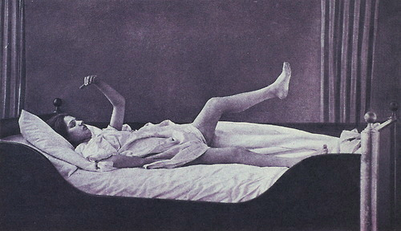

Losing Control Under Ketamine
Moran et al. Neuropsychopharmacology, 2014
Reduced Theta
Without NMDA
Frontal Regions
Temporal Cortex
Enhanced Gamma
With AMPA
Reduced Cortico-Limbic Control mediated by NMDA
Enhanced Limbic-Cortico Drive via AMPA:
Runaway bottom-up sensory-driven processing : disorganised cognition & environmental interactions
Large difference in intrinsic processing: early dopaminergic D2 problem in schizophrenia?

Slide 58
Summary
DCM is a generic framework for asking mechanistic questions of neuroimaging data
Neural mass models parameterise intrinsic and extrinsic ensemble connections and synaptic measures
DCM for CSD/TFM are compact characterisations of multi-channel LFP or M/EEG data in the Frequency Domain
Bayesian inversion provides parameter estimates and allows model comparison for competing hypothesised architectures
Empirical results suggest valid physiological predictions

Slide 59
Thank You
FIL Methods Group

