Slide 1
Spatial Preprocessing
Ged Ridgway, FMRIB/FIL
With thanks to John Ashburner
and the FIL Methods Group

Slide 2
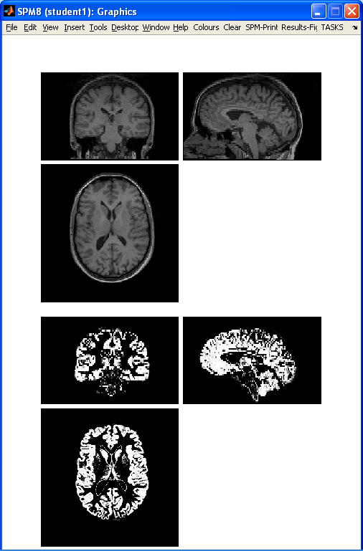
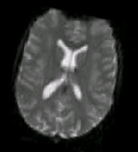
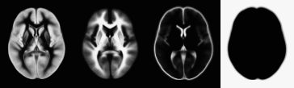
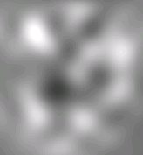

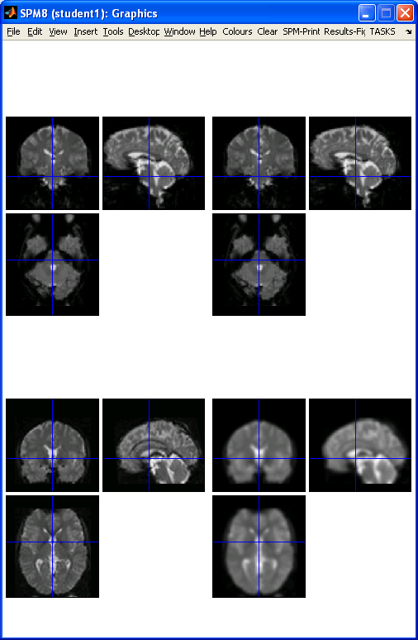
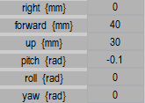
Preprocessing overview
Input
Output
fMRI time-series
Anatomical MRI
TPMs
Segmentation
Transformation
(e.g. y_Blah)
Kernel
REALIGN
COREG
SEGMENT
NORM WRITE
SMOOTH
Mean functional
(Headers changed)
Motion corrected
MNI Space
ANALYSIS

Slide 3
Reorientation and registration demo
Now to SPM…
… for a more conventional slide-based talk, please see the video (with accompanying slides available) at
www.fil.ion.ucl.ac.uk/spm/course/video/

Slide 4
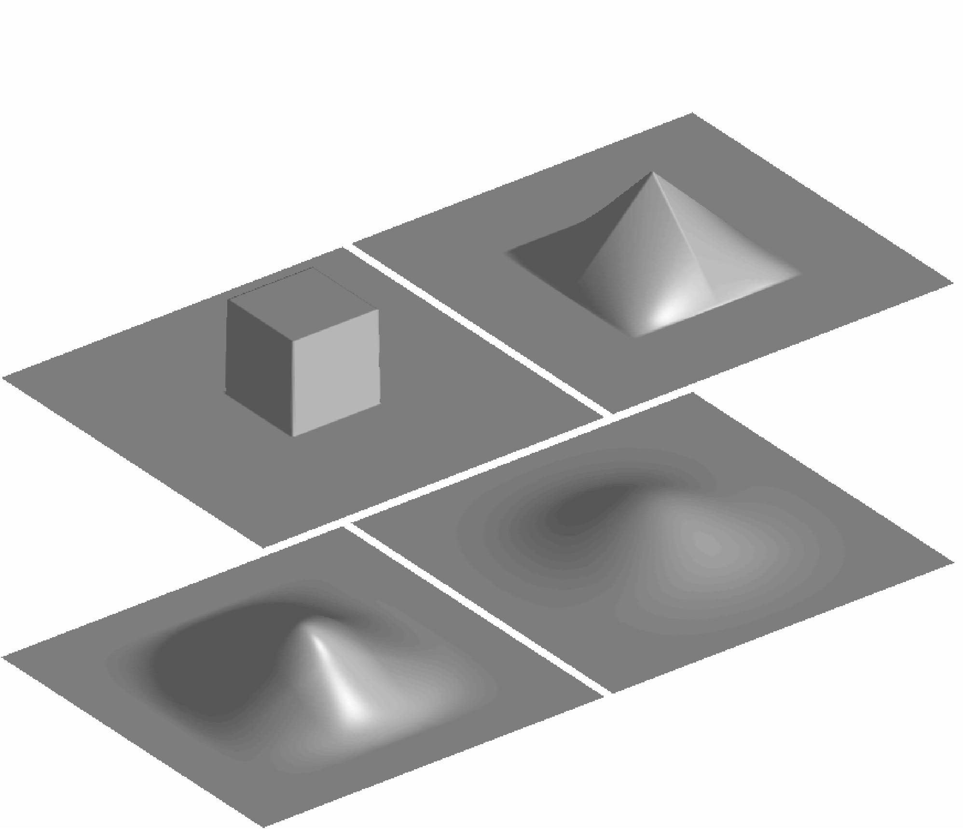
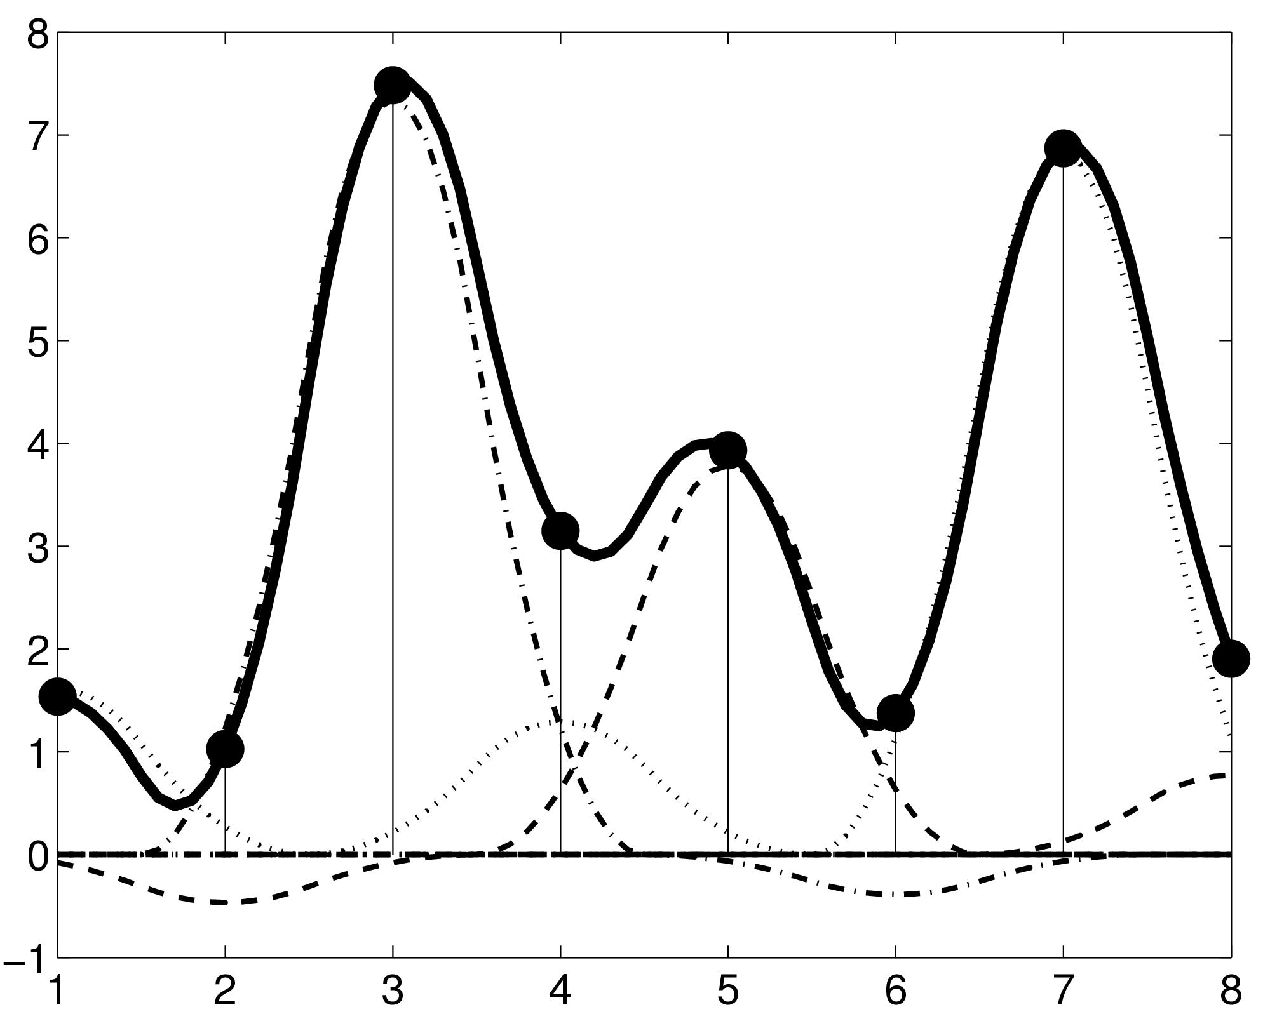
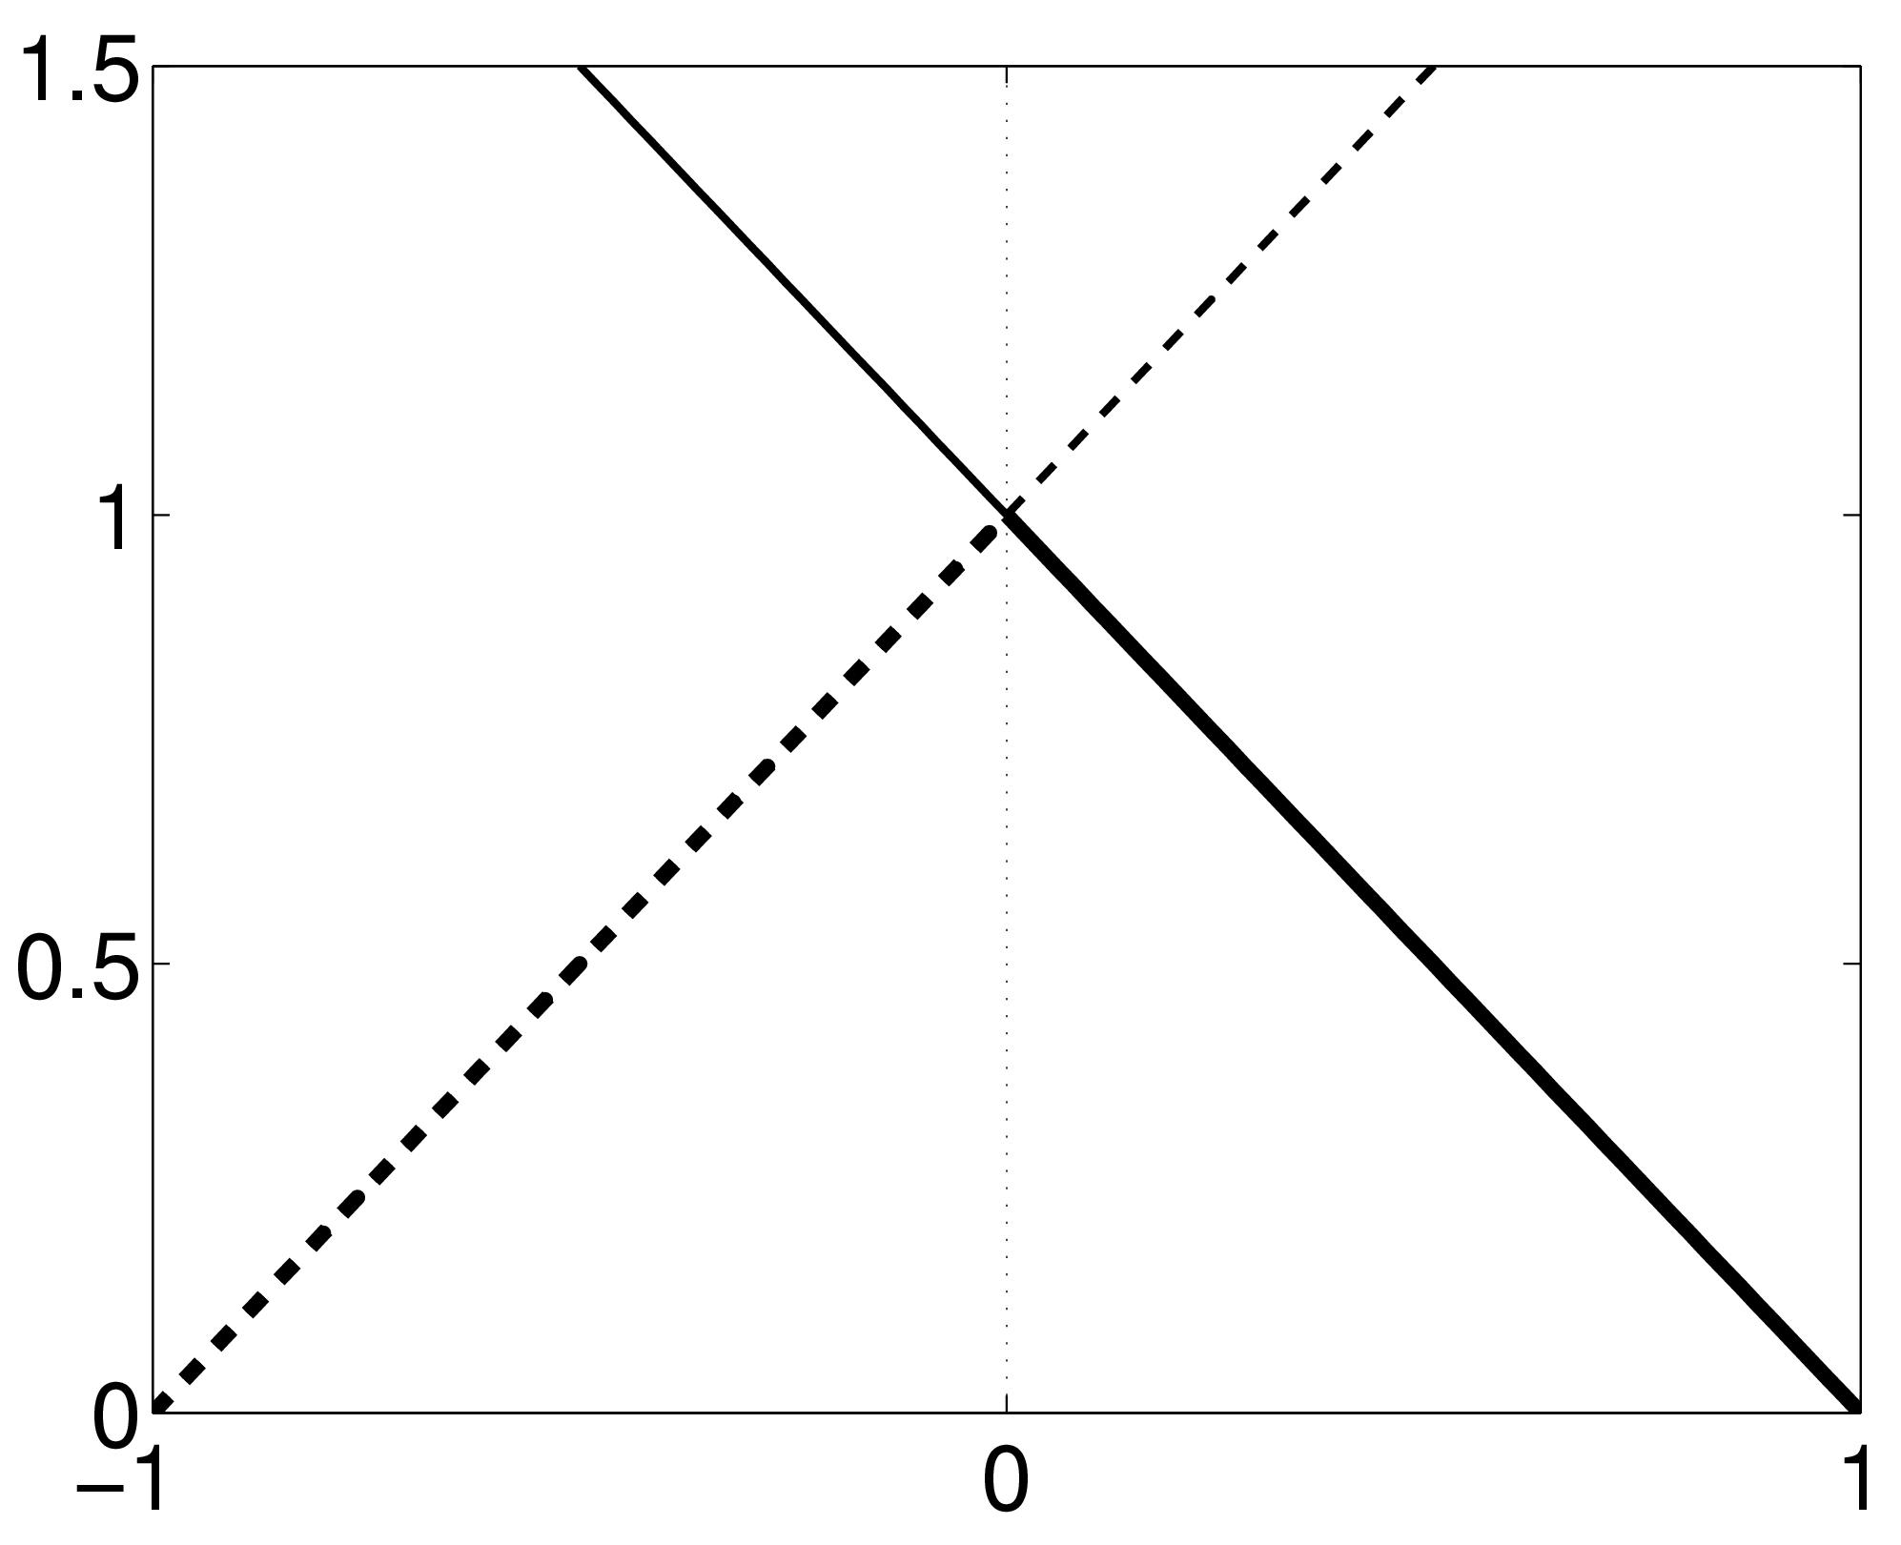
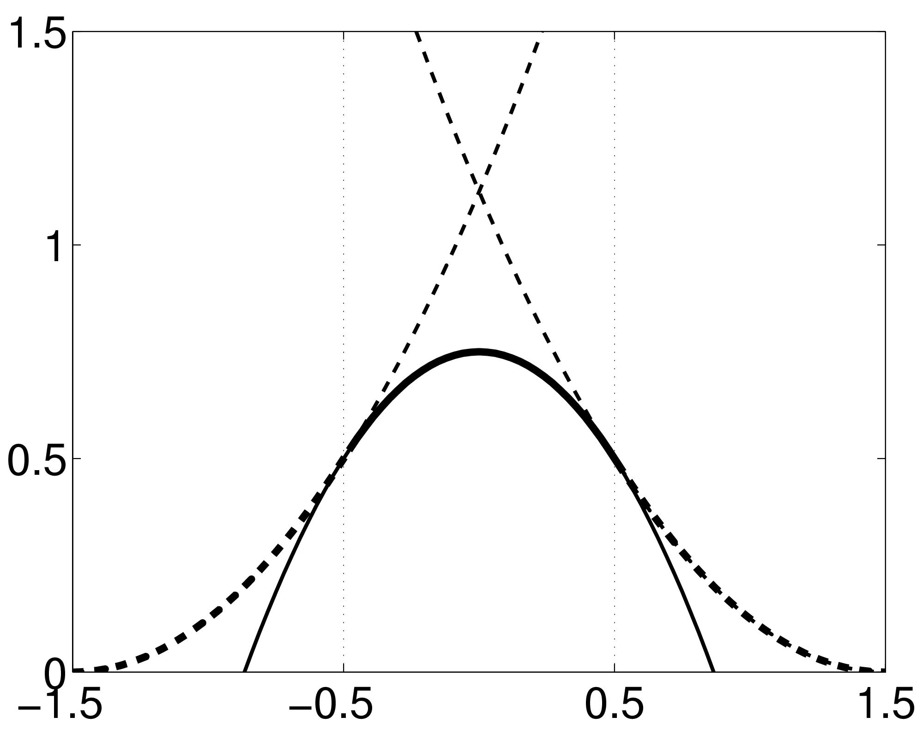
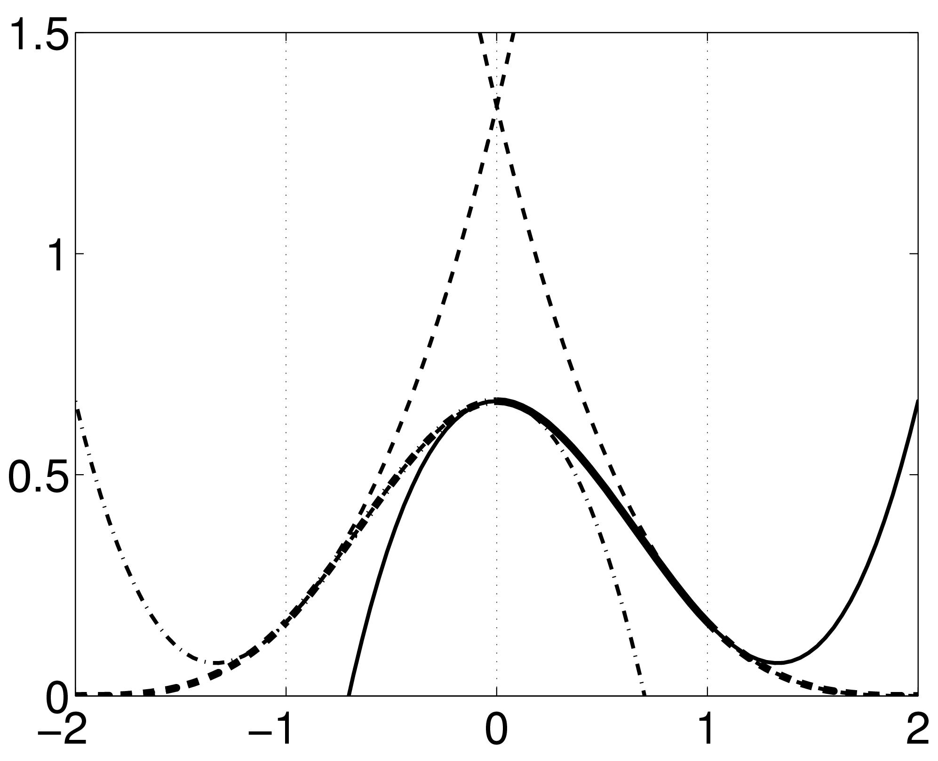
B-spline Interpolation
A continuous function is represented by a linear combination of basis functions
2D B-spline basis functions of degrees 0, 1, 2 and 3
B-splines are piecewise polynomials
Nearest neighbour and trilinear interpolation are
the same as B-spline interpolation with degrees
of 0 and 1.
Notes:
Note to self – redo this slide with separate 1D plots for nn, linear, spline, explaining that voxels should be thought of as samples at their centres rather than as cuboids.

Slide 5
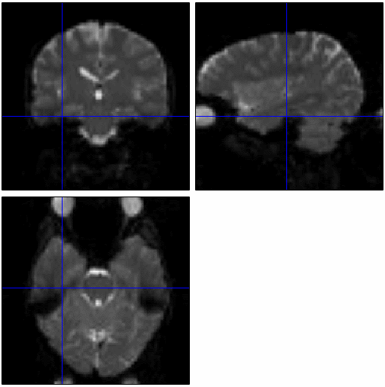
fMRI time-series movie
Notes:
Auditory example data

Slide 6
Motion in fMRI
Is important!
  Increases residual variance and reduces sensitivity
  Data may get completely lost with sudden movements
  Movements may be correlated with the task
  Try to minimise movement (don’t scan for too long!)
Motion correction using realignment
  Each volume rigidly registered to reference
  Least squares objective function
Realign “estimate” – updates header information
Reslice – interpolate images to match reference voxels
Notes:
Even tiny head movements can induce major artefacts in your data, so motion correction is very important.
-The t-test that is used by SPM (and that will be discussed in the next lecture) is based on the signal change relative to the residual variance. This signal is computed from the sum of squared differences between the data and the linear model to which it is fitted. Movement artefacts will add up to the residual variance and therefore reduce the sensitivity of your test.
-
-A lot of fMRI studies have paradigms in which the subject could be moving in a way that is correlated to the different experimental conditions, for example, when you would move your head each time you press a button. If you do not correct for this, these systematic differences might appear as activations in your data.

Slide 7
Residual Errors from aligned fMRI
Slices are not acquired simultaneously
  rapid movements not accounted for by rigid body model
Gaps between slices can cause aliasing artefacts
Re-sampling can introduce interpolation errors
  Though higher degree spline interpolation mitigates
Image artefacts may not move according to a rigid body model
  image distortion, image dropout, Nyquist ghost
Functions of the estimated motion parameters can be modelled as confounds in subsequent analyses

Slide 8
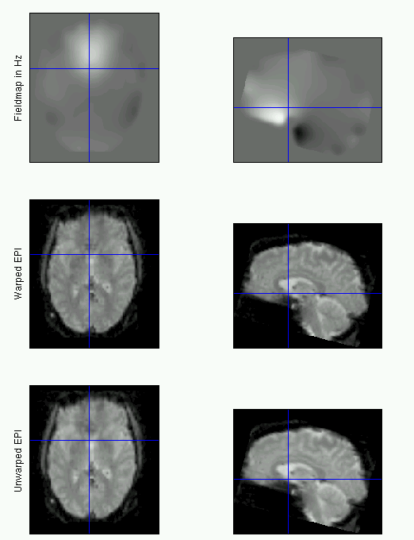
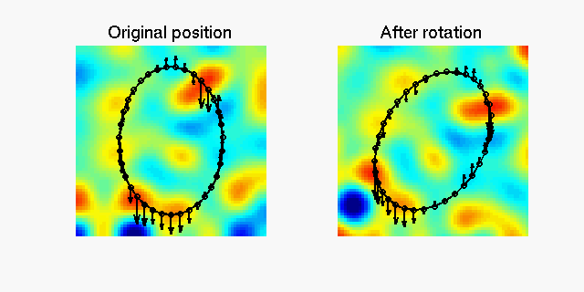
fMRI movement by distortion interaction
Subject disrupts B0 field, rendering it inhomogeneous
  distortions occur along the phase-encoding direction
Subject moves during EPI time series
  Distortions vary with subject position
  shape varies (non-rigidly)

Slide 9
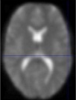
Correcting for distortion changes using Unwarp
Estimate reference from mean of all scans.
Estimate new distortion fields for each image:
estimate rate of change of field with respect to the current estimate of movement parameters in pitch and roll.
Unwarp time series.
Estimate movement parameters.
Δϕ
+Δθ
Andersson et al, 2001

Slide 10
Preprocessing overview
Input
Output
fMRI time-series
Anatomical MRI
TPMs
Segmentation
Transformation
(seg_sn.mat)
Kernel
REALIGN
COREG
SEGMENT
NORM WRITE
SMOOTH
Mean functional
(Headers changed)
Motion corrected
MNI Space
ANALYSIS

Slide 11
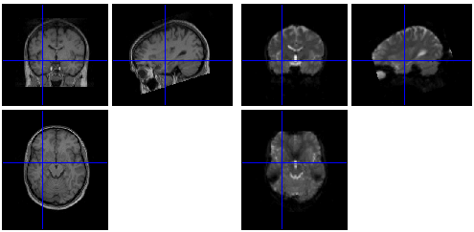
Coregistration (intra-subject, inter-modal)
Alignment might not correspond to least squared diff!

Slide 12
Coregistration (intra-subject, inter-modal)
Alignment might not correspond to least squared diff!
Quantify how well one image predicts the other
  How much shared info: (normalised) mutual information
“Information” is measured by entropy (Shannon)
  From joint (and marginal) probability distributions
Where probability distributions are estimated from e.g. (joint) histograms…

Slide 13
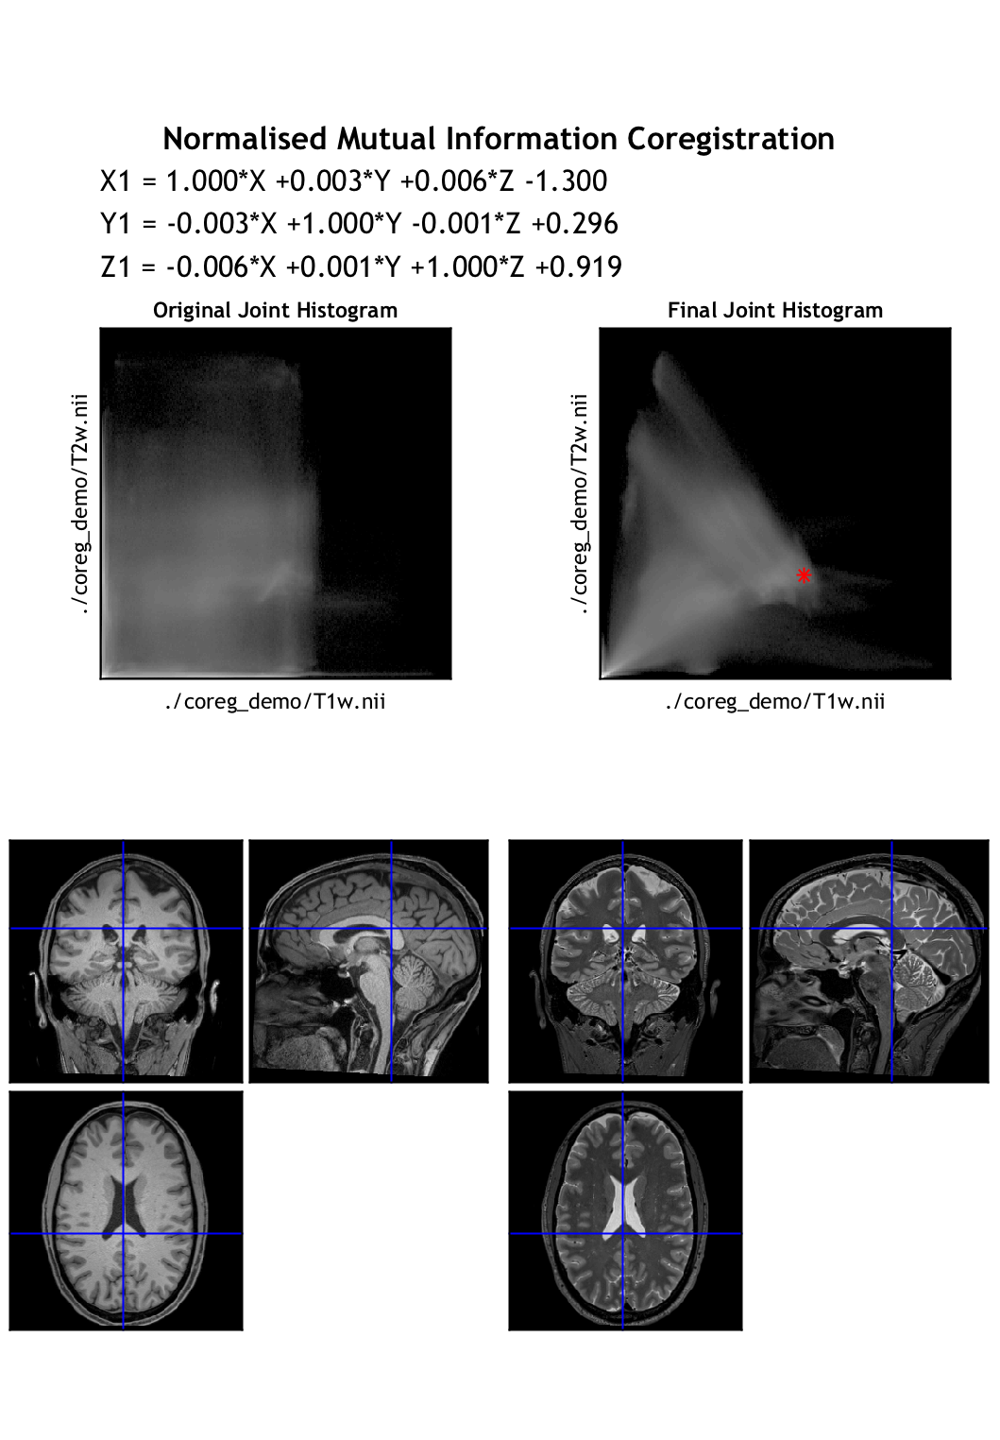
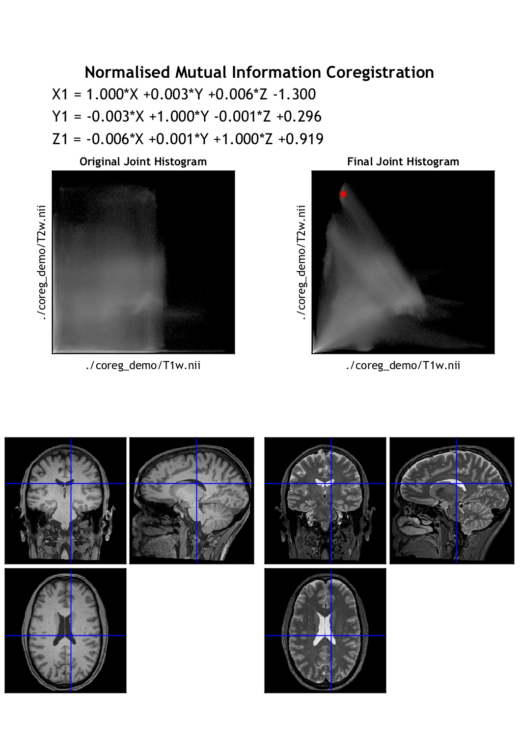
Coregistration: joint histogram

Slide 14
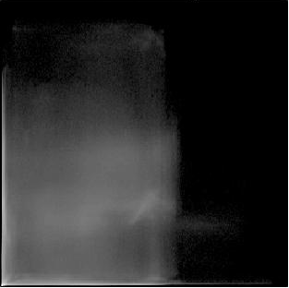
Coregistration: joint histogram

Slide 15
Preprocessing overview
Input
Output
fMRI time-series
Anatomical MRI
TPMs
Segmentation
Transformation
(seg_sn.mat)
Kernel
REALIGN
COREG
SEGMENT
NORM WRITE
SMOOTH
Mean functional
(Headers changed)
Motion corrected
MNI Space
ANALYSIS

Slide 16
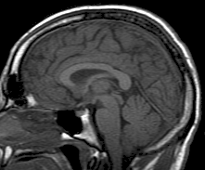
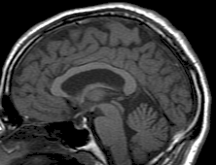
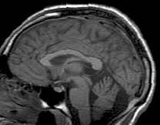
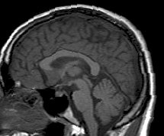
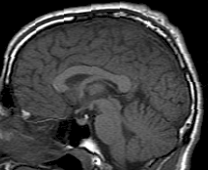
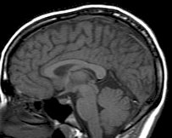
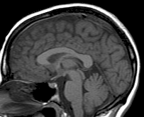
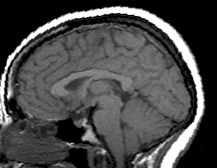
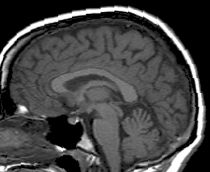
Spatial Normalisation

Slide 17
Spatial Normalisation - Reasons
Inter-subject averaging
  Increase sensitivity with more subjects
    Fixed-effects analysis
  Extrapolate findings to the population as a whole
    Mixed-effects analysis
Make results from different studies comparable by aligning them to standard space
  e.g. The T&T convention, using the MNI template

Slide 18
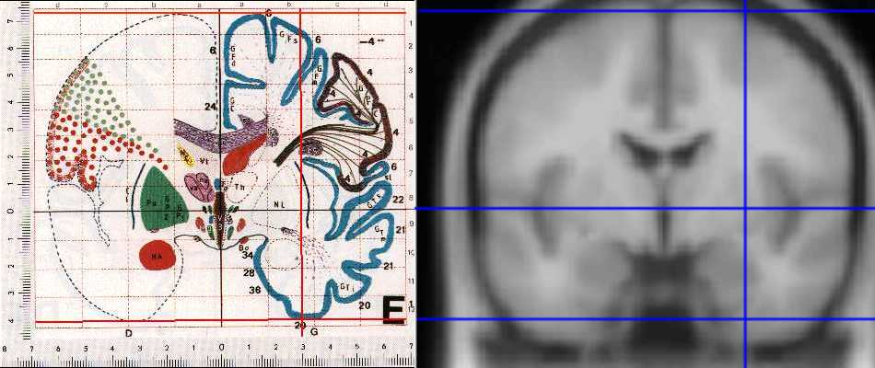
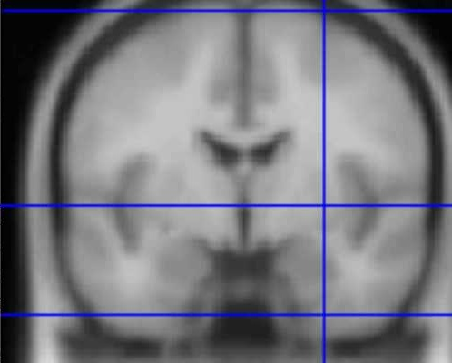
Standard spaces
The Talairach Atlas
The MNI/ICBM AVG152 Template
The MNI template follows the convention of T&T, but doesn’t match the particular brain
Recommended reading: http://imaging.mrc-cbu.cam.ac.uk/imaging/MniTalairach
Notes:
Also DICOM scanner-based voxel-world mapping

Slide 19
Normalisation via unified segmentation
MRI imperfections make normalisation harder
  Differences between sequences, artefacts
  Intensity inhomogeneity or “bias” field
Normalising segmented tissue maps should be more robust and precise than using the original images ...
… Tissue segmentation benefits from spatially-aligned prior tissue probability maps (from other segmentations)
This circularity motivates simultaneous segmentation and normalisation in a unified model

Slide 20
Summary of the unified model
SPM12 implements a generative model
  Principled Bayesian probabilistic formulation
Gaussian mixture model segmentation with deformable tissue probability maps (priors)
  The inverse of the transformation that aligns the TPMs can be used to normalise the original image
Bias correction is included within the model

Slide 21
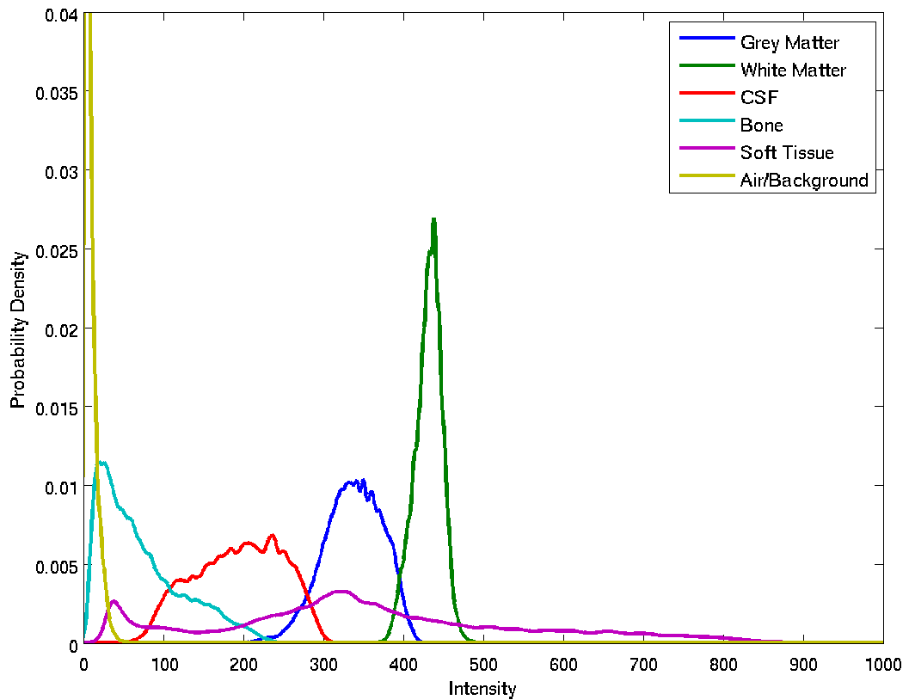
Tissue intensity distributions (T1-w MRI)

Slide 22
Mixture of Gaussians (MOG)
Classification is based on a Mixture of Gaussians model (MOG), which represents the intensity probability density by a number of Gaussian distributions.
Frequency
Image Intensity

Slide 23
Non-Gaussian Intensity Distributions
Multiple Gaussians per tissue class allow non-Gaussian intensity distributions to be modelled.
  E.g. accounting for partial volume effects

Slide 24
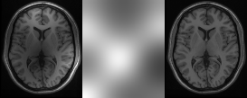
Modelling inhomogeneity
A multiplicative bias field is modelled as a spatially smooth image
Corrupted image
Bias Field
Corrected image

Slide 25
Tissue Probability Maps
Tissue probability maps (TPMs) are used as the prior, instead of just the proportion of voxels in each class
SPM12’s TPMs are derived from the IXI data-set, initialised with the ICBM 452 atlas and other data

Slide 26
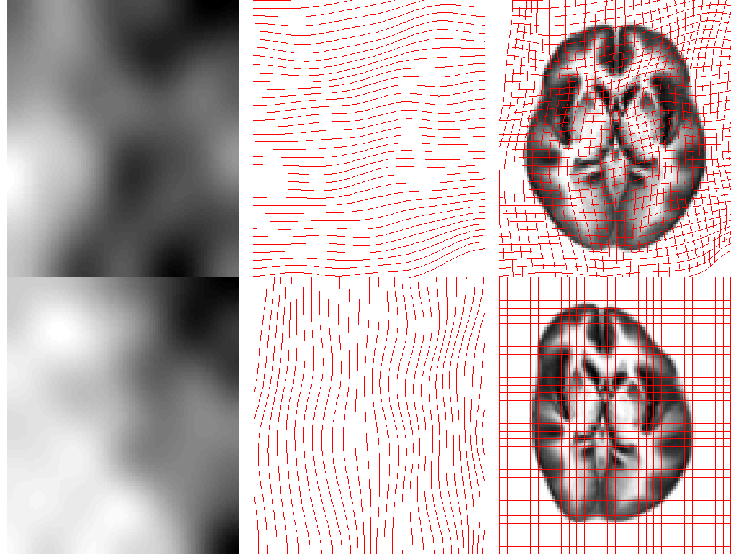
Deforming the Tissue Probability Maps
Tissue probability images are warped to match the subject
The inverse transform warps to the TPMs
Warps are constrained to be reasonable by penalising various distortions (energies)

Slide 27
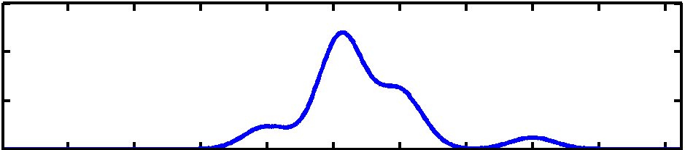
Optimisation
Find the “best” parameters according to an “objective function” (minimised or maximised)
Objective functions can often be related to a probabilistic model (Bayes -> MAP -> ML -> LSQ)
Global optimum
(most probable)
Objective function
Local optimum
Local optimum
Value of parameter

Slide 28
Optimisation of multiple parameters
Optimum
Contours of a two-dimensional objective function “landscape”

Slide 29
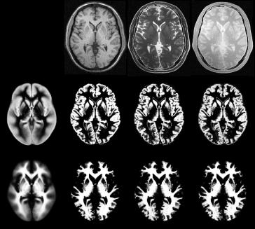
Segmentation results
Spatially normalised BrainWeb phantoms
(T1, T2, PD)
Tissue probability maps of GM and WM
Cocosco, Kollokian, Kwan & Evans. “BrainWeb: Online Interface to a 3D MRI Simulated Brain Database”. NeuroImage 5(4):S425 (1997)

Slide 30
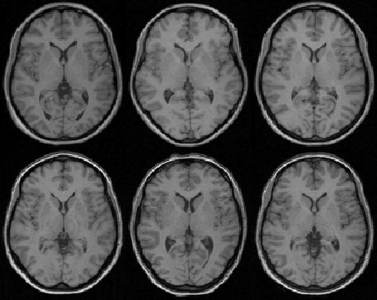
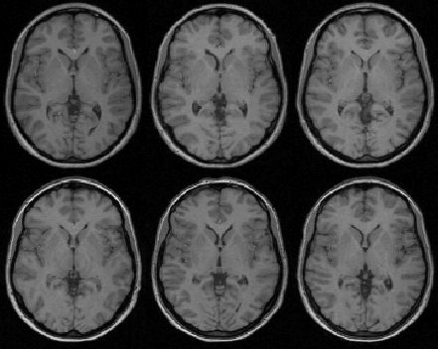
Spatial normalisation results
Affine registration
Non-linear registration

Slide 31
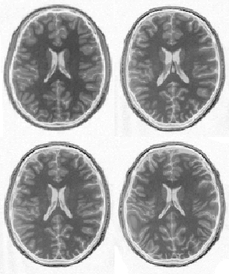
Spatial normalisation – Overfitting
Without regularisation, the non-linear spatial normalisation can introduce unwanted deformation
Affine registration
(error = 472.1)
Template
image
Non-linear
registration
without
regularisation
(error = 287.3)
Non-linear
registration
using
regularisation
(error = 302.7)

Slide 32
Spatial normalisation – regularisation
The “best” parameters according to the objective function may not be realistic
In addition to similarity, regularisation terms or constraints are often needed to ensure a reasonable solution is found
  Also helps avoid poor local optima
  Can be considered as priors in a Bayesian framework, e.g. converting ML to MAP:
    log(posterior) = log(likelihood) + log(prior) + c

Slide 33
Spatial normalisation – Limitations
Seek to match functionally homologous regions, but...
  Challenging high-dimensional optimisation, many local optima
  Different cortices can have different folding patterns
  No exact match between structure and function
  [See e.g. Amiez et al. (2013), PMID:23365257 ]
Compromise
  Correct relatively large-scale variability (sizes of structures)
  Smooth over finer-scale residual differences

Slide 34
Preprocessing overview
Input
Output
fMRI time-series
Anatomical MRI
TPMs
Segmentation
Transformation
(seg_sn.mat)
Kernel
REALIGN
COREG
SEGMENT
NORM WRITE
SMOOTH
Mean functional
(Headers changed)
Motion corrected
MNI Space
ANALYSIS

Slide 35
Smoothing
Why would we deliberately blur the data?
  Improves spatial overlap by blurring over minor anatomical differences and registration errors
  Averaging neighbouring voxels suppresses noise
    matched filter theorem
  Makes data more normally distributed (central limit theorem)
  Reduces the effective number of multiple comparisons
How is it implemented?
  Convolution with a 3D Gaussian kernel, of specified full-width at half-maximum (FWHM) in mm
Notes:
Spatial normalisation is never exact, so homologous regions can never be precisely registered. Furthermore, due to the noisy nature of the BOLD signal, activations from different scans can be slightly offset, thereby cancelling each other out. Smoothing spreads out the different areas and reduces the discrepancy.

Slide 36
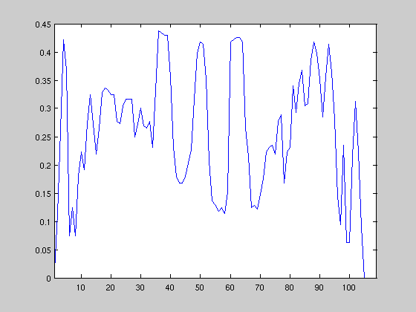
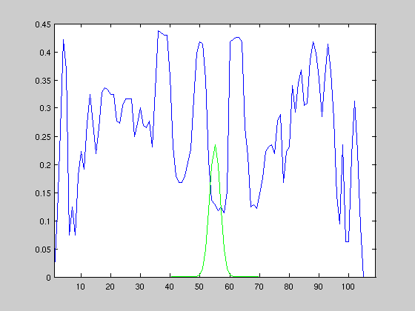
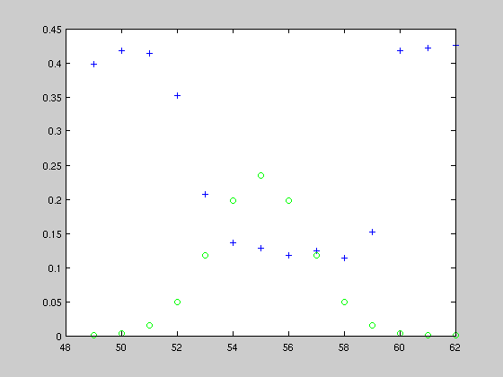
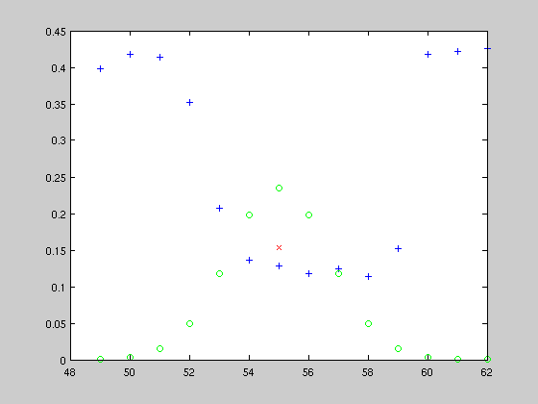
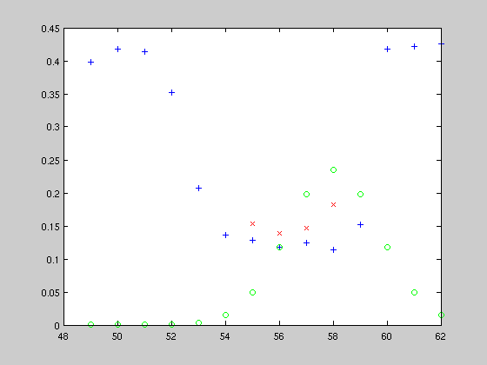
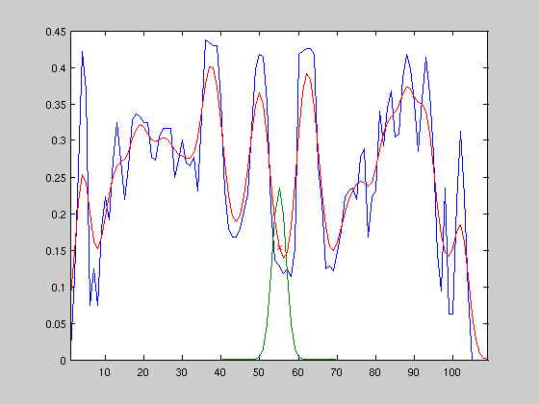
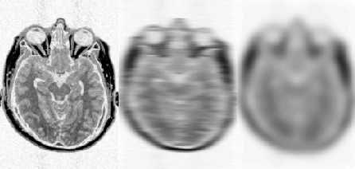
Example of
Gaussian smoothing in one-dimension
The Gaussian kernel is separable we can smooth 2D data with two 1D convolutions.
Generalisation to 3D is simple and efficient
A 2D Gaussian Kernel
Notes:
(A convolution is a kind of very general moving average.) First you convolve in one direction, than in the other two directions.
A general rule of thumb is to use a smoothing kernel of 6 mm for single subject analyses and a smoothing kernel of 8 or 10 mm when you are going to do a group analysis.

Slide 37
Preprocessing overview
Input
Output
fMRI time-series
Anatomical MRI
TPMs
Segmentation
Transformation
(seg_sn.mat)
Kernel
REALIGN
COREG
SEGMENT
NORM WRITE
SMOOTH
Mean functional
(Headers changed)
Motion corrected
MNI Space
ANALYSIS

Slide 38
References
Friston et al. Spatial registration and normalisation of images.
Human Brain Mapping 3:165-189 (1995).
Collignon et al. Automated multi-modality image registration based on information theory. IPMI’95 pp 263-274 (1995).
Ashburner et al. Incorporating prior knowledge into image registration.
NeuroImage 6:344-352 (1997).
Ashburner & Friston. Nonlinear spatial normalisation using basis functions.
Human Brain Mapping 7:254-266 (1999).
Thévenaz et al. Interpolation revisited.
IEEE Trans. Med. Imaging 19:739-758 (2000).
Andersson et al. Modeling geometric deformations in EPI time series.
Neuroimage 13:903-919 (2001).
Ashburner & Friston. Unified Segmentation.
NeuroImage 26:839-851 (2005).
Ashburner. A Fast Diffeomorphic Image Registration Algorithm. NeuroImage 38:95-113 (2007).
See also Lars Kasper’s Zurich slides & PhysIO Toolbox http://www.translationalneuromodeling.org/spmcourse/

Slide 39
Preprocessing overview
Input
Output
fMRI time-series
Anatomical MRI
TPMs
Segmentation
Transformation
(seg_sn.mat)
Kernel
REALIGN
COREG
SEGMENT
NORM WRITE
SMOOTH
Mean functional
(Headers changed)
Motion corrected
MNI Space
ANALYSIS

Slide 40
Preprocessing (fMRI only)
Input
Output
fMRI time-series
TPMs
Segmentation
Transformation
(seg_sn.mat)
Mean functional
Kernel
REALIGN
SEGMENT
NORM WRITE
SMOOTH
Motion corrected
MNI Space
ANALYSIS

Slide 41
Preprocessing overview
Input
Output
fMRI time-series
Anatomical MRI
TPMs
Segmentation
Transformation
(seg_sn.mat)
Kernel
REALIGN
COREG
SEGMENT
NORM WRITE
SMOOTH
Mean functional
(Headers changed)
Motion corrected
MNI Space
ANALYSIS

Slide 42
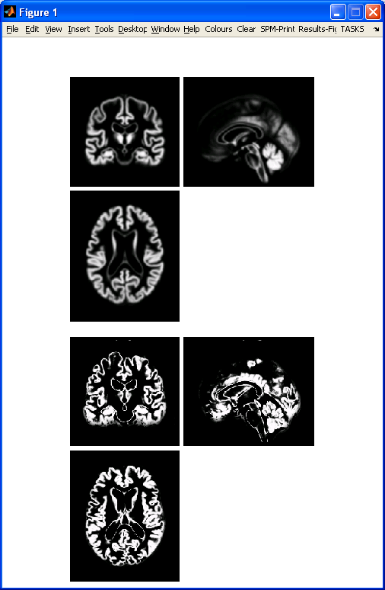
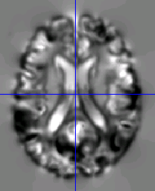
Preprocessing with Dartel
...
fMRI time-series
Anatomical MRI
TPMs
DARTEL CREATE TEMPLATE
REALIGN
COREG
SEGMENT
DARTEL NORM 2 MNI & SMOOTH
Mean functional
(Headers changed)
Motion corrected
ANALYSIS

