Slide 1
Convolution modelling
Advanced applications of the GLM,
SPM MEEG Course 2017
Ashwani Jha, UCL

Slide 2
Outline
Experimental Scenario (stop-signal task)
Difficulties arising from experimental design
  Baseline correction
  Temporally overlapping neural responses
  Systematic differences in response timings
Using a convolution GLM to deal with these problems*
*just like first level fMRI

Slide 4
What is the problem we’re trying to address?
  Baseline correction
  Temporally overlapping neural responses
  Systematic differences in response timings
  ... an example

Slide 5
The task: stop-signal task
What is the EEG correlate of ‘stopping a planned movement’?
Parameterise behaviour:
stop-signal task
Record neural activity:
MEG
Behavioural contrast of interest:
Isolate stopping
Apply equivalent contrast to MEG data
MEG correlate of stopping

Slide 6

The task: stop-signal task
GO trial
STOP trial
trial n
+
trial n+1
+
>
<
Go signal
Go signal
X
SOA
Stop signal
time
time
X
response
response
‘Error’
‘Correct’

Slide 7

The task: stop-signal task
X
<
+

Slide 8
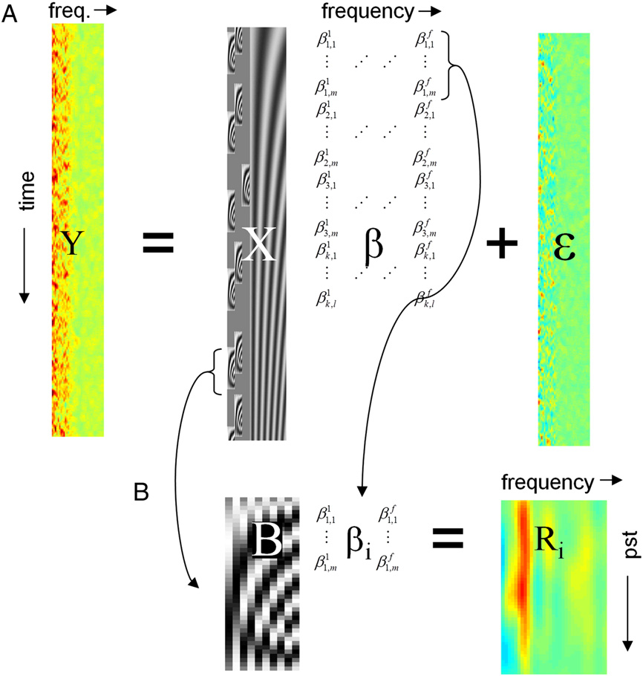

What is the neural correlate of a successful stop-signal?
TF MEG
+
>
+
+
>
+
+
>
>
+
>
X
>
‘Correct’
+
>
+
+
>
>
X
+
+
>
+
>
>
‘Error’

Slide 9
What is the neural correlate of a successful stop-signal?
TF MEG
+
>
+
+
>
+
+
>
>
+
>
X
>
‘Correct’
+
>
+
+
>
>
X
+
+
>
+
>
>
‘Error’
A: Trial-based method
Cut into trials
Average response over trials
Compare with another trial

Slide 10
What is the neural correlate of a successful stop-signal?
TF MEG
+
>
+
+
>
+
+
>
>
+
>
X
>
‘Correct’
+
>
+
+
>
>
X
+
+
>
+
>
>
‘Error’
A: Trial-based method
Cut into trials
Average response over trials
Compare with another trial
All sorts of problems:
Temporally overlapping neural responses
Where do you put the baseline?
Variable (absent) response timings

Slide 11
How do we address these problems?
  Baseline correction
  Temporally overlapping neural responses
  Systematic differences in response timings
  ... A convolution model?

Slide 12

Concept of convolution model
TF MEG
+
>
+
X
+
X
+
>
All trials
+
>
X
PST

Slide 13
Concept of convolution model
TF MEG
+
>
+
X
+
X
+
>
All trials
+
>
X
X
PST
Accounts for temporally overlapping responses and differences in response timings
(beware of correlation)

Slide 14

The Convolution model (half way)
X
β
+
ε
Y

Slide 15
The Convolution model (half way)
X
β
+
ε
Y
At different frequencies

Slide 16
The Convolution model (full model)
* Note baseline drift

Slide 17
Example output of convolution model
GO signal
0.1
RMS amplitude (a.u.)
0
-0.1
Button press
Notes:
Mean regressor images

Slide 18


Heirarchical model analysis
Subject
First-level convolution model
+
>
X
1
2
3

Slide 19
Heirarchical model analysis
Take contrasts of interest to second level
Subject
First-level convolution model
+
>
X
>
1
>
2
3

Slide 20
Example results of stop-signal task
Mean
Succ - unsucc
Left M1
The model has accounted for:
Slow drifting baseline
Temporarily overlapping induced responses
Systematic differences in reaction time between conditions
0.1
SMA
Frequency (Hz)
pre-SMA
RMS amplitude (a.u.)
0
Right IFG
-0.1
Left IFG
Time relative to stop/change signal (s)
Notes:
TRIGGERED TO CHANGE SIGNAL

Slide 21
Summary
Sometimes the standard trigger-based epoching approach doesn’t work, especially if:
  No well-defined baseline period
  Temporally overlapping neural responses (i.e. ‘long’ responses such as induced response and fMRI BOLD)
  Systematic differences in reaction times (probably a lot of studies!)
A hierarchical convolution model is better in these circumstances (but be careful of correlated regressors in trial-design)
Other advantages include the potential to model parametric regressors and continuous regressors.
References:
1) Litvak V, Jha A, Flandin G, Friston K. Convolution models for induced electromagnetic responses. Neuroimage. 2013 Jan 1;64:388-98. doi: 10.1016/j.neuroimage.2012.09.014
2) Jha A, Nachev P, Barnes G, Husain M, Brown P, Litvak V. The Frontal Control of Stopping. Cereb Cortex. 2015 Nov;25(11):4392-406. doi: 10.1093/cercor/bhv027

Slide 22
a
1
0.6
0.2
M1L
LIFG
SMA
M1R
RIFG
Pre-SMA
b
M1L | M1R | SMA | pre-SMA | RIFG | LIFG
1.000 | 0.012 | 0.038 | 0.023 | 0.002 | 0.015 | M1L
 | 1.000 | 0.038 | 0.015 | 0.011 | 0.001 | M1R
 |  | 1.000 | 0.050 | 0.007 | 0.005 | SMA
 |  |  | 1.000 | 0.010 | 0.008 | pre-SMA
 |  |  |  | 1.000 | 0.009 | RIFG
 |  |  |  |  | 1.000 | LIFG
Notes:
First image at level of premotor regions ( 0, 26, 14), second at level of M1 (0 -18 53) %%No preSMA, just SMA and ApreSMA

Slide 23
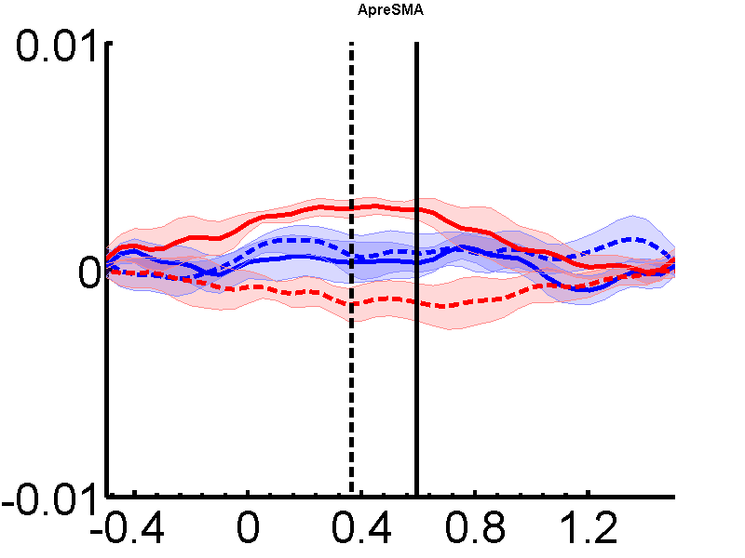
a
b
pre-SMA
Frequency (Hz)
Previous trial
Unsuccessful
Go only
Successful
Go trials
Median reaction time (ms)
Time relative to go signal (s)
Stop
|
Stop
>
Change
|
Change
>
-0.05
0
0.05
RMS amplitude (a.u.)
c
pre-SMA
Gamma RMS amplitude (a.u.)
Time relative to go signal (s)
Notes:
Beta = 20-40, gamma = 40-60

Slide 24
Mean
Succ - unsucc
Left M1
0.1
SMA
Frequency (Hz)
pre-SMA
RMS amplitude (a.u.)
0
Right IFG
-0.1
Left IFG
Time relative to stop/change signal (s)
Notes:
TRIGGERED TO CHANGE SIGNAL

Slide 25
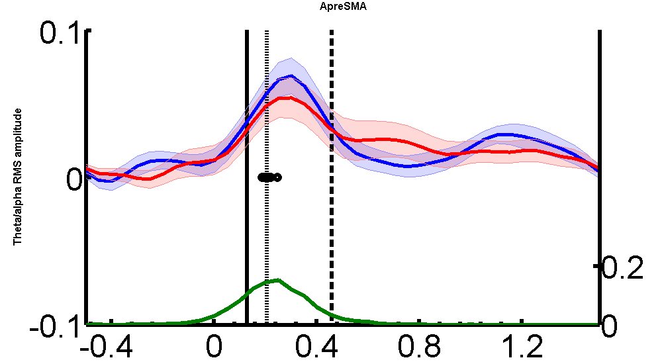
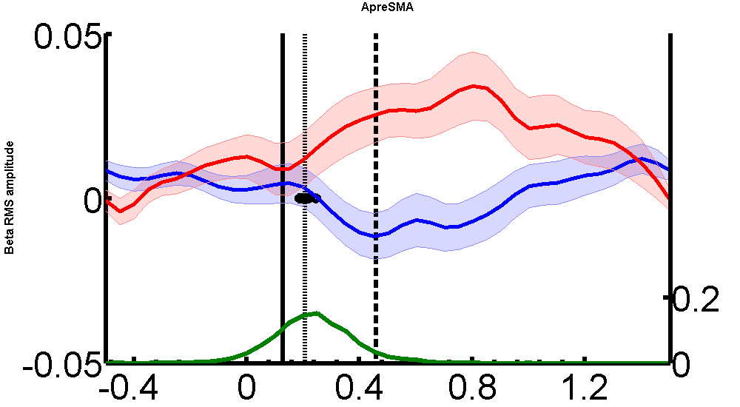
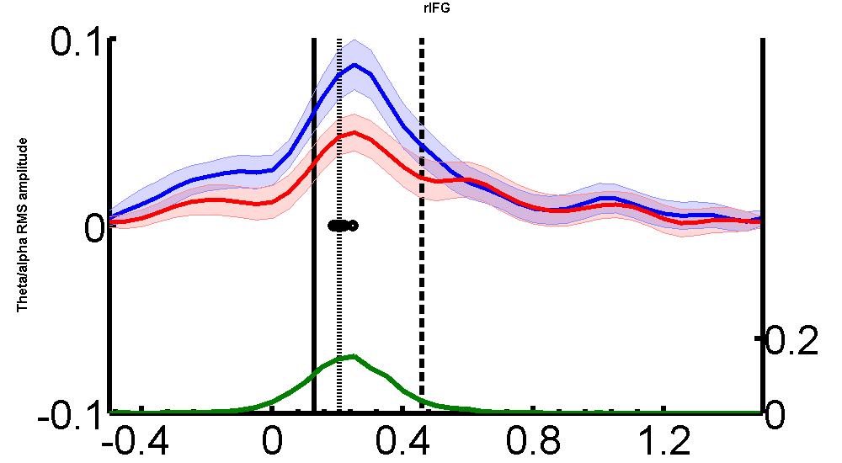
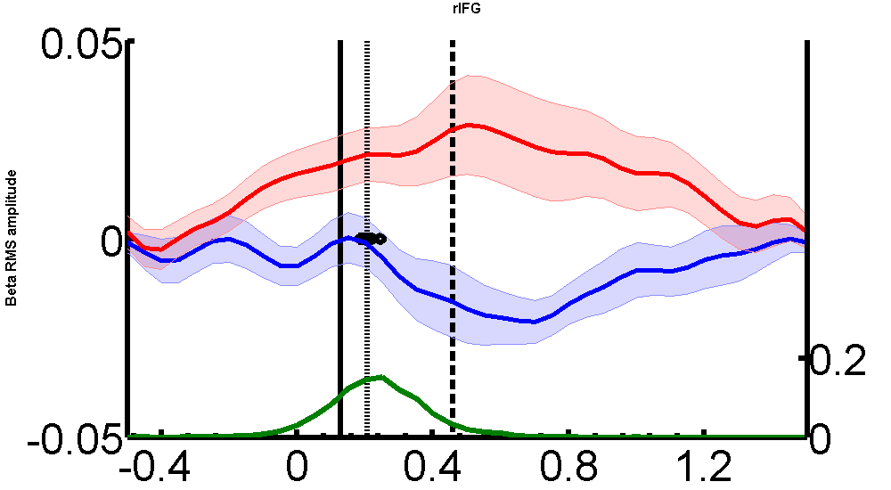
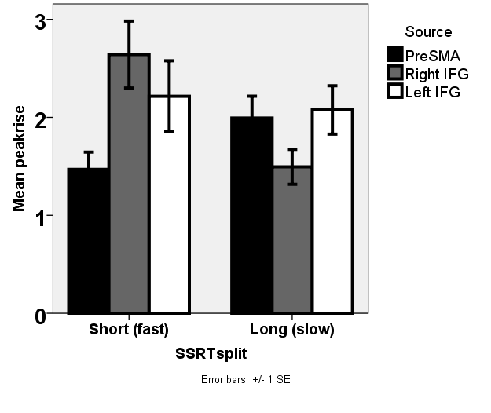
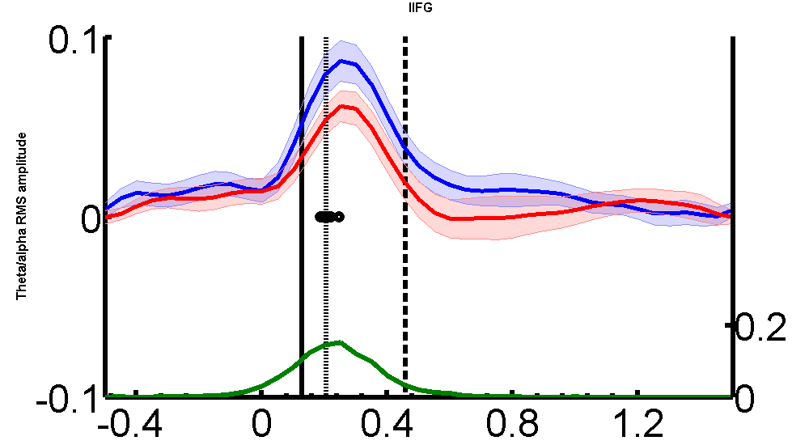
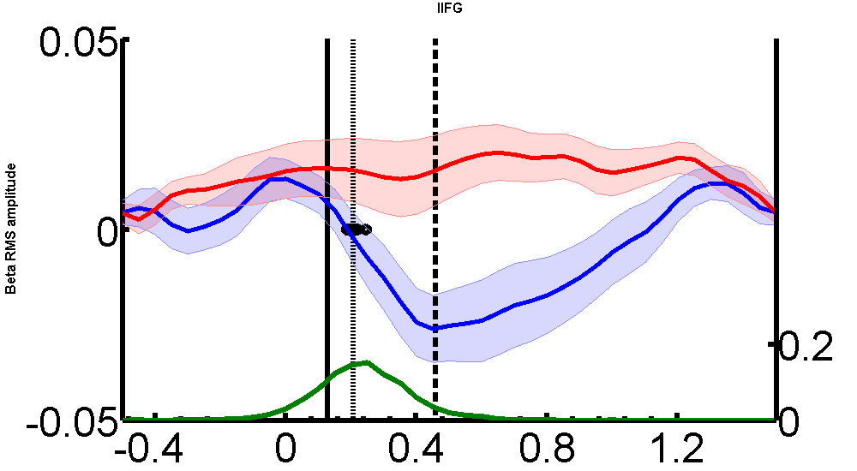
a
Theta/alpha
Beta
pre-SMA
pre-SMA
Successful
Unsuccessful
b
Right IFG
Right IFG
Theta/alpha
RMS amplitude (a.u.)
**
pre-SMA
Right IFG
Left IFG
Peak rate of rise x 10⁻² (a.u./s)
Left IFG
Left IFG
Short Long
SSRT
Time relative to stop/change signal (s)
Notes:
Gamma = 40-60, theta/alpha = 2-12, beta =15-35

Slide 26
a
b
success x response
Previous trial
Unsuccessful
Successful
pre-SMA
Mean RT adjustment post stop/change signal (ms)
Frequency (Hz)
Right IFG
Stop
Change
Response
c
Time relative to stop/change signal (s)
Stop
-0.1
0
0.1
RMS amplitude (a.u.)
Pre-SMA:
RMS beta amplitude (a.u.)
Unsuccessful
Successful
Change
Time relative to stop/change signal (s)

Slide 27
What is the neural correlate of a successful stop-signal?
EEG
+
>
+
+
>
+
>
+
>
>
X
‘Correct’
A: Trial-based method
Trigger to stop-signal
Cut into trials
Average response over trials
Problems:
EEG activity could also be due to neighbouring ‘GO’ signal, movement preparation…
Where to baseline?
…need a control condition..

