Slide 1
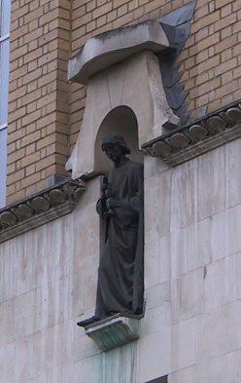
Segmentation and VBM
John Ashburner
Wellcome Trust Centre for Neuroimaging,
12 Queen Square, London, UK.

Slide 2
Overview
Voxel-Based Morphometry
  Morphometry in general
  Volumetrics
  VBM preprocessing followed by SPM
Tissue Segmentation
Diffeomorphic Registration
Longitudinal Registration

Slide 3
Measuring differences with MRI
What are the significant differences between populations of subjects?
What effects do various genes have on the brain?
What changes occur in the brain through development or aging?
A significant amount of the difference (measured with MRI) is anatomical.

Slide 4
There are many ways to model differences.
Usually, we try to localise regions of difference.
  Univariate models.
  Using methods similar to SPM
  Typically localising volumetric differences
Some anatomical differences can not be localised.
  Need multivariate models.
  Differences in terms of proportions among measurements.
  Where would the difference between male and female faces be localised?
Need to select the best model of difference to use, before trying to fill in the details.

Slide 5
Voxel-Based Morphometry
Based on comparing regional volumes of tissue.
Produce a map of statistically significant differences among populations of subjects.
  e.g. compare a patient group with a control group.
  or identify correlations with age, test-score etc.
The data are pre-processed to sensitise the tests to regional tissue volumes.
  Usually grey or white matter.
Suitable for studying focal volumetric differences of grey matter.

Slide 6
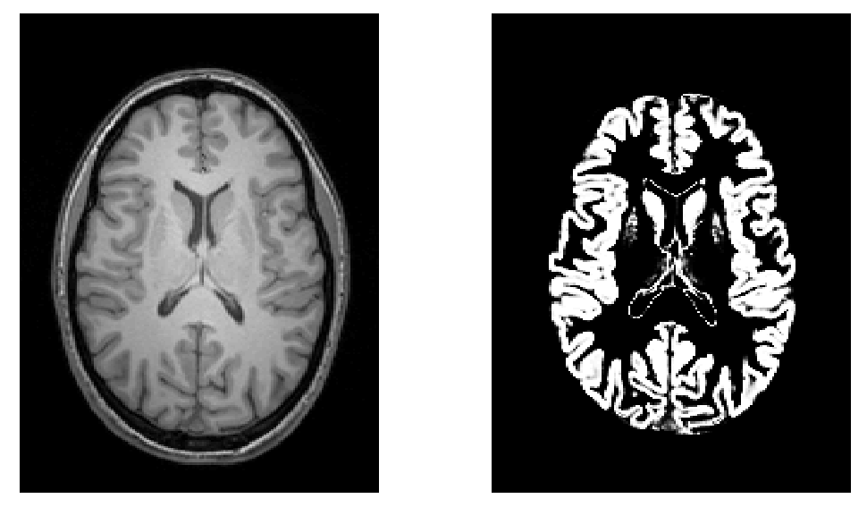
Volumetry
T1-Weighted MRI
Grey Matter

Slide 7
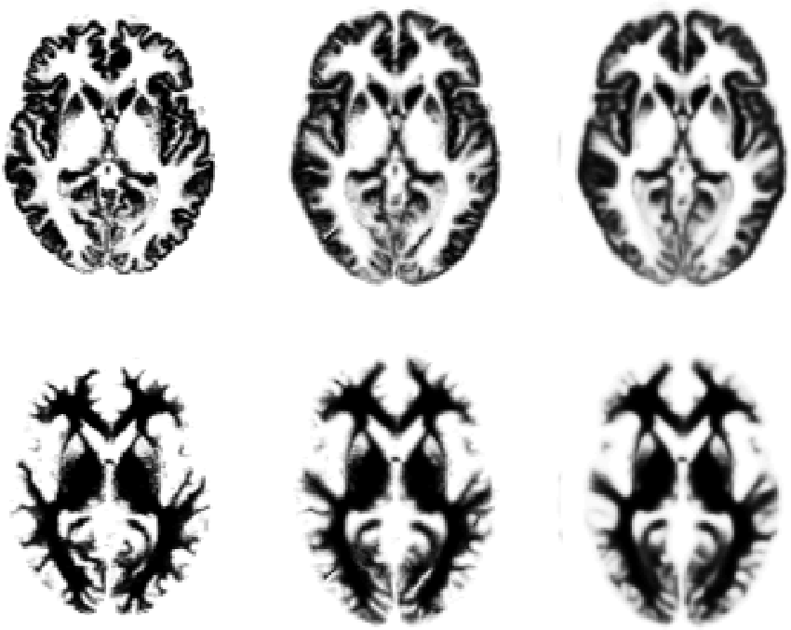
Original
Warped
Template

Slide 8
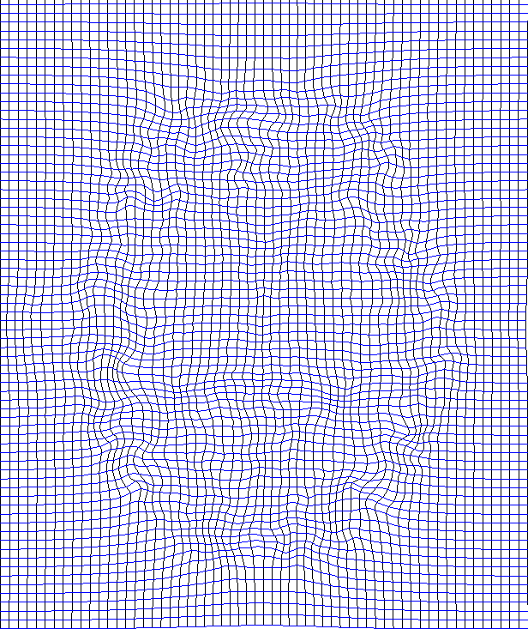
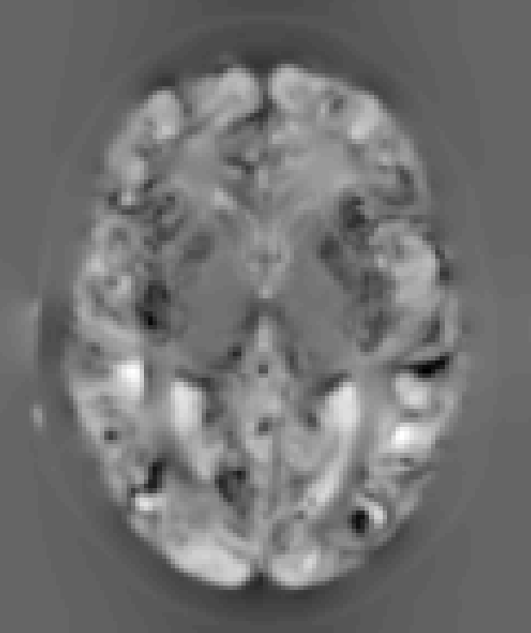
“Modulation” – change of variables.
Deformation Field
Jacobians determinants
Encode relative volumes.

Slide 9

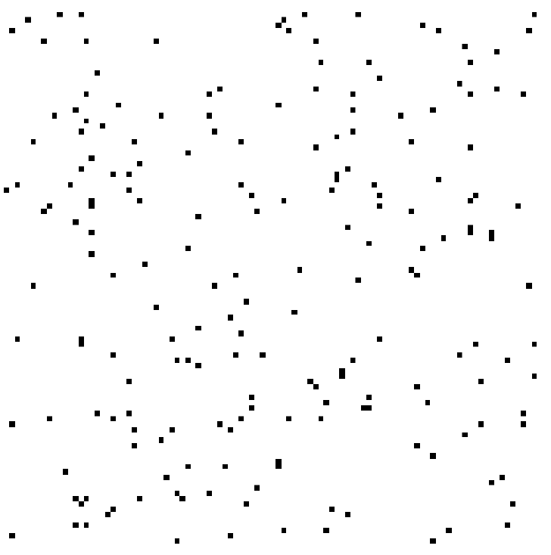

Smoothing
Each voxel after smoothing effectively becomes the result of applying a weighted region of interest (ROI).
Before convolution
Convolved with a circle
Convolved with a Gaussian

Slide 10
VBM Pre-processing in SPM12
Use Segment for characterising intensity distributions of tissue classes, and writing out “imported” images that Dartel can use.
Run Dartel to estimate all the deformations.
Dartel warping to generate smoothed, “modulated”, warped grey matter.
Statistics.

Slide 11
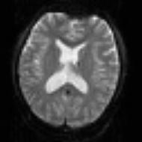
SPM for group fMRI
Group-wise
statistics
fMRI time-series
Preprocessing
Spatially Normalised
“Contrast” Image
spm T
Image
Analysis
fMRI time-series
Preprocessing
Spatially Normalised
“Contrast” Image
fMRI time-series
Preprocessing
Spatially Normalised
“Contrast” Image

Slide 12
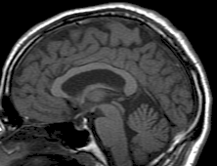
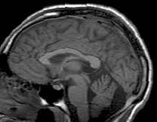
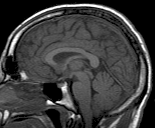
SPM for Anatomical MRI
Group-wise
statistics
Anatomical MRI
Preprocessing
Spatially Normalised
Grey Matter Image
Anatomical MRI
Preprocessing
Spatially Normalised
Grey Matter Image
Anatomical MRI
Preprocessing
Spatially Normalised
Grey Matter Image

Slide 13
“Globals” for VBM
Shape is really a multivariate concept
  Dependencies among different regions
SPM is mass univariate
  Combining voxel-wise information with “global” integrated tissue volume provides a compromise
  Either ANCOVA or proportional scaling.
(ii) is globally thicker, but locally thinner than (i) – either of these effects may be of interest to us.
Total intracranial volume (TIV) integrates GM, WM and CSF, or attempts to measure the skull-volume directly
  Can still identify global brain shrinkage (skull is fixed!)
  Can give more powerful and/or more interpretable results
  See also Pell et al (2009) doi:10.1016/j.neuroimage.2008.02.050
Notes:
Note globals don’t help distinguish the thickened or folded cortex...

Slide 14
Some Explanations of the Differences
Mis-classify
Mis-register
Folding
Thinning
Thickening
Mis-register
Mis-classify

Slide 15
Overview
Voxel-Based Morphometry
Tissue Segmentation
  Gaussian mixture model
  Intensity non-uniformity correction
  Deformed tissue probability maps
Diffeomorphic Registration
Longitudinal Registration

Slide 16
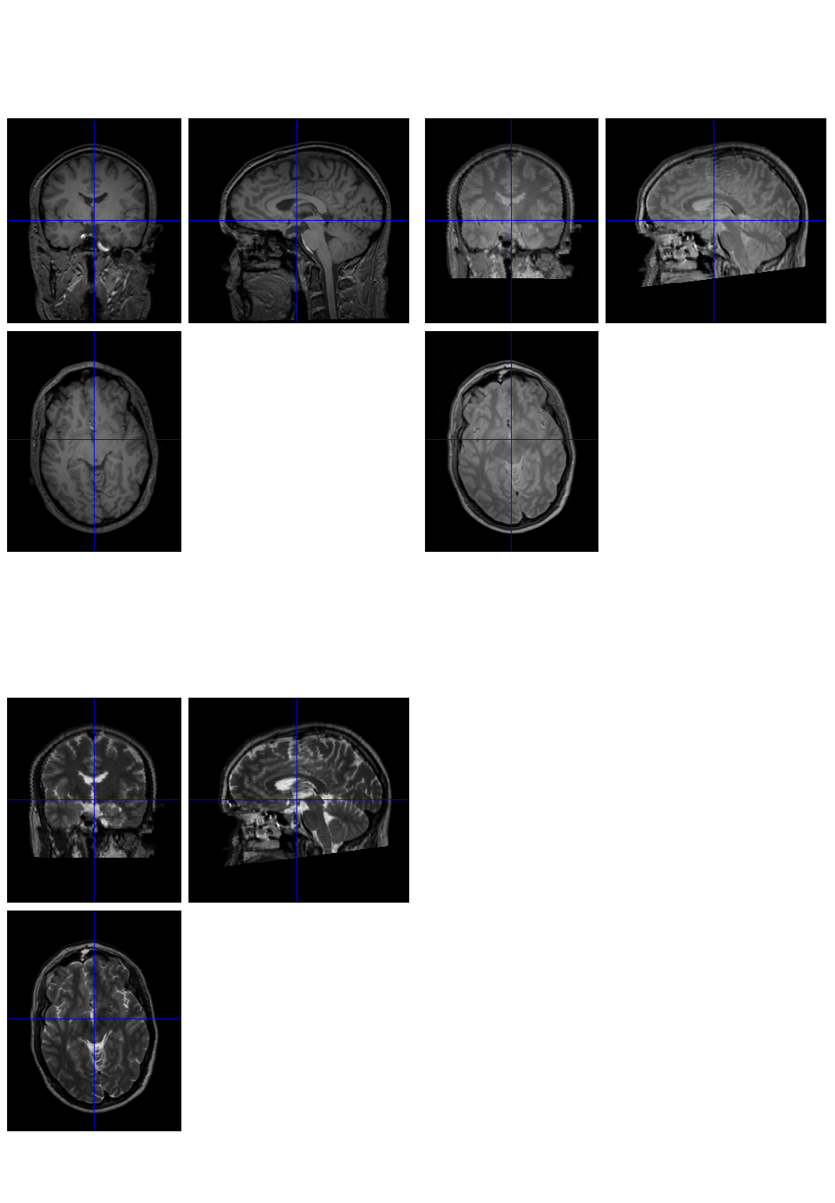
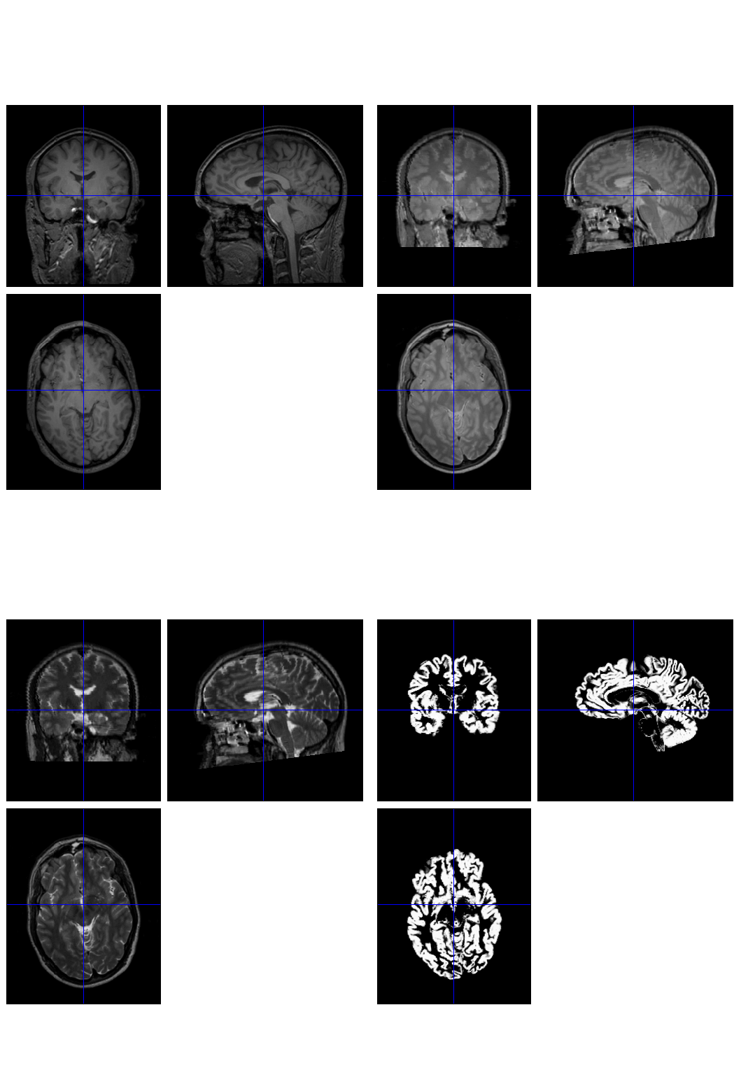
Tissue Segmentation
It uses a generative model, which involves:
  Mixture of Gaussians (MOG)
  Bias Correction Component
  Warping (Non-linear Registration) Component

Slide 17
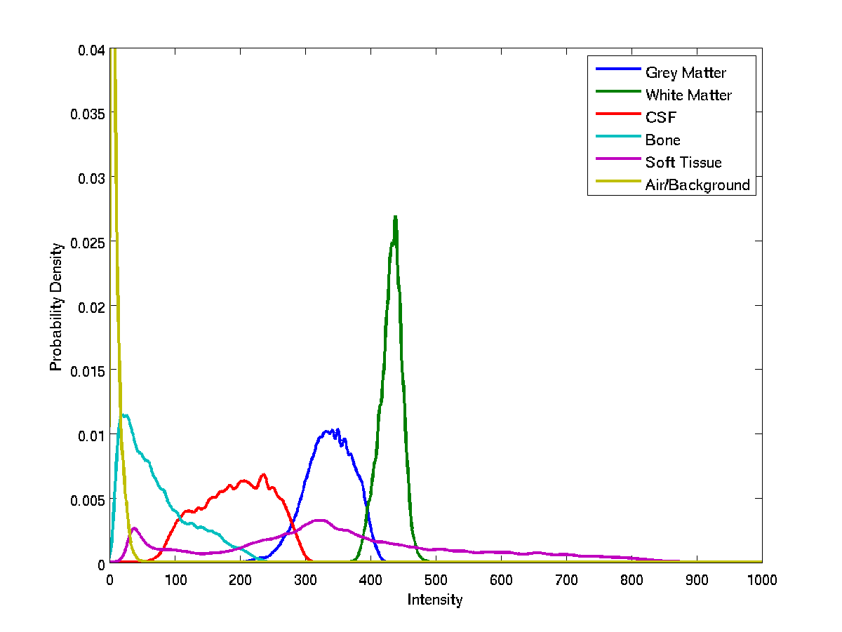
Image Intensity Distributions (T1-weighted MRI)

Slide 18
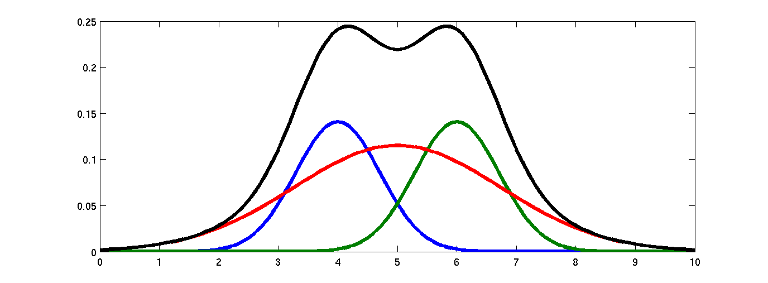
Belonging Probabilities
Belonging probabilities are assigned by normalising to one.

Slide 19
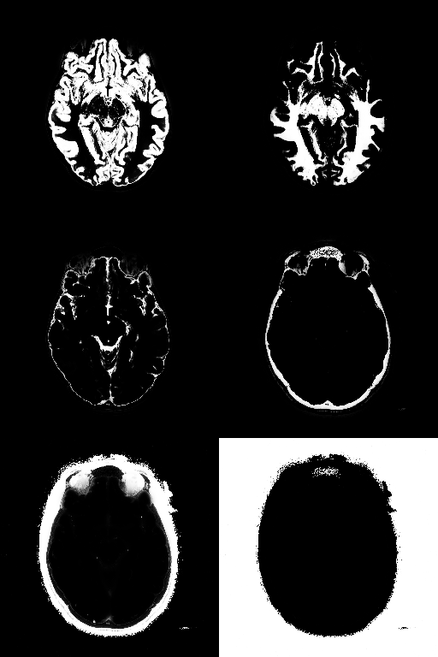
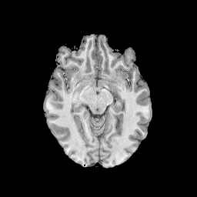
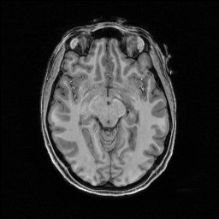
Belonging Probabilities
Skull-stripping not needed because information outside the brain is modelled.

Slide 20
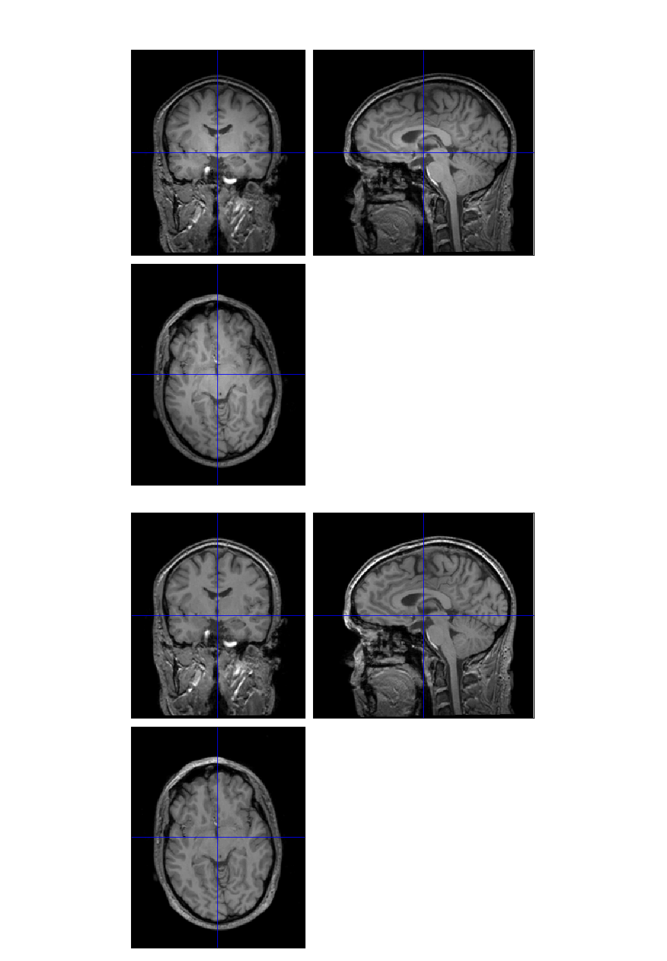
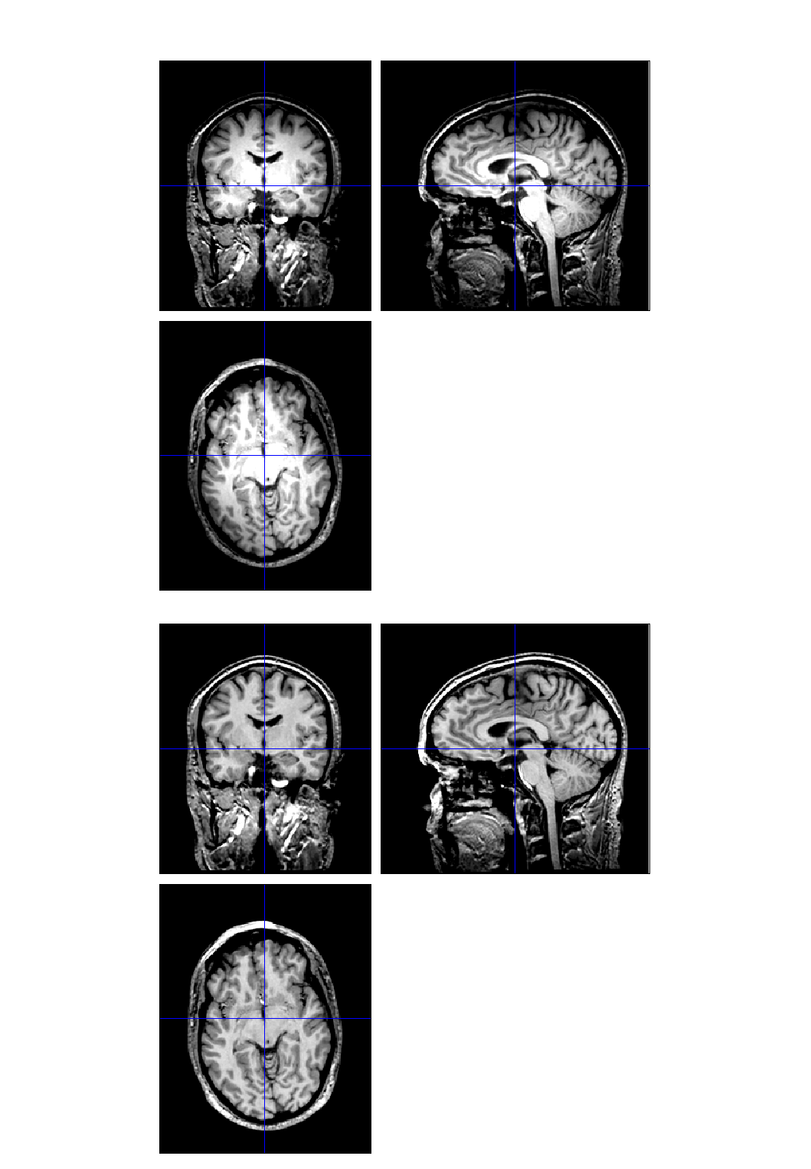


Modelling a bias field

Slide 21
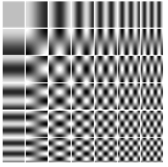
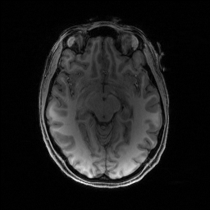

Modelling a bias field

Slide 22
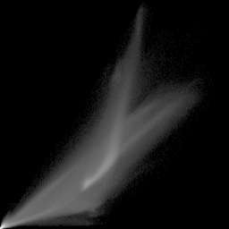
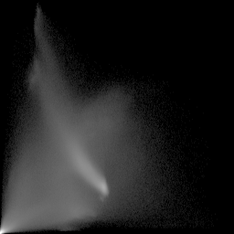
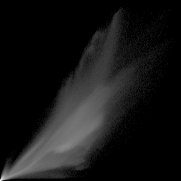
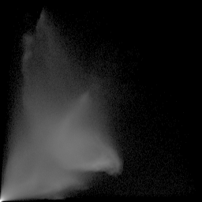
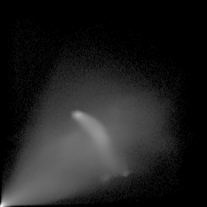
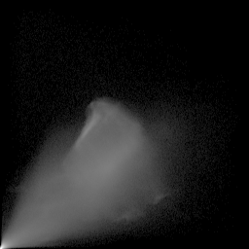
Modelling a bias field
With bias correction
Without bias correction
T2
T2
T2
T2
PD
T1
PD
T1
T1
T1
PD
PD

Slide 23
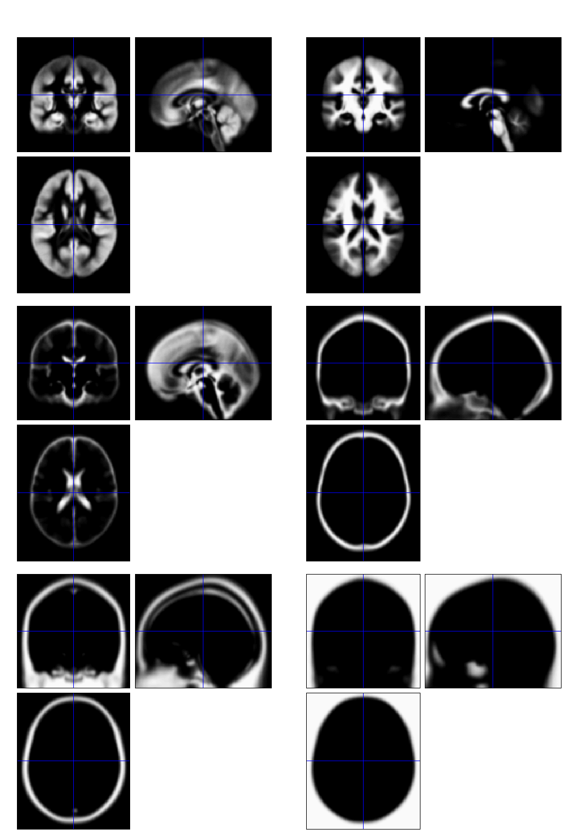
Tissue probability priors in SPM12
Includes additional non-brain tissue classes (bone, and soft tissue)

Slide 24
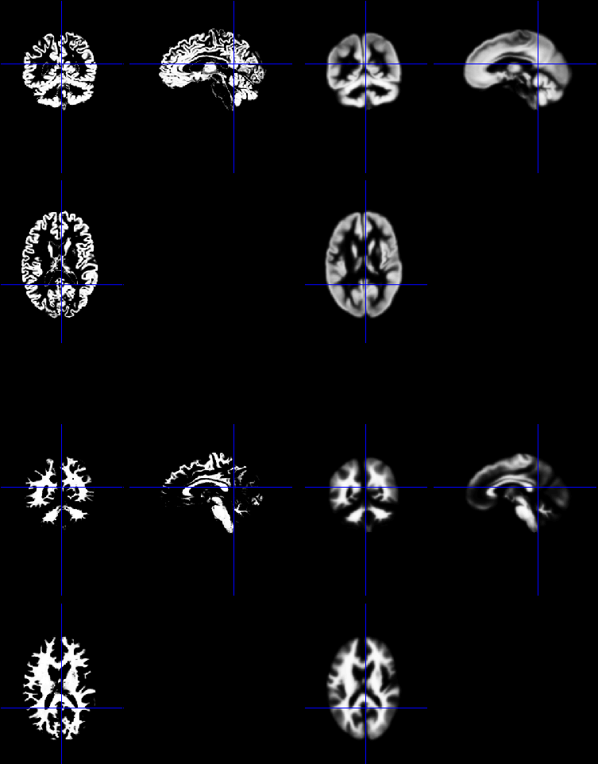
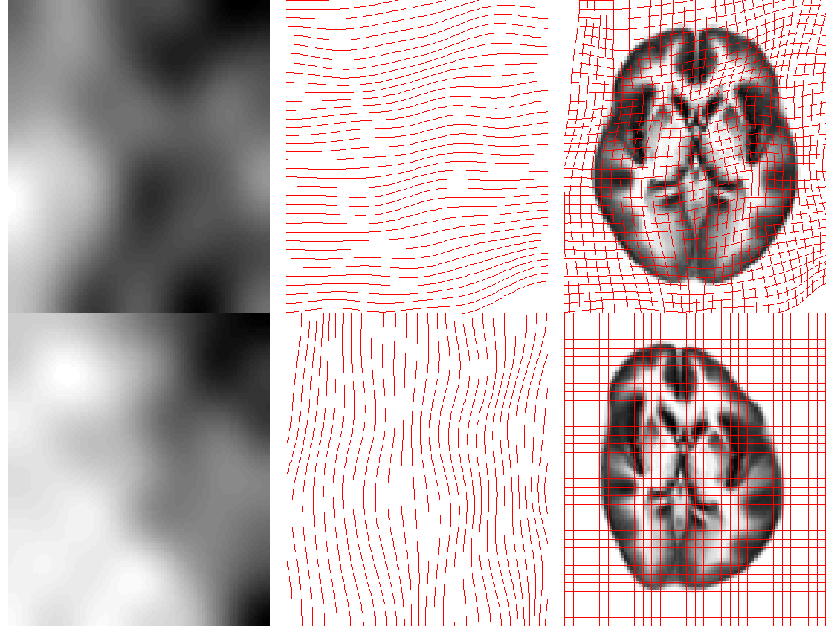
Deformable tissue probability priors
Tissue priors are warped to align with tissues identified in image.

Slide 25
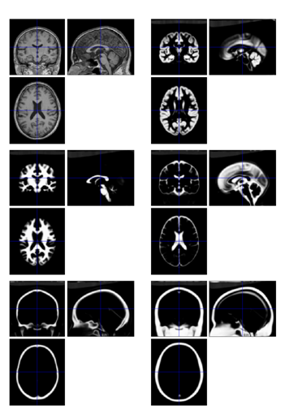
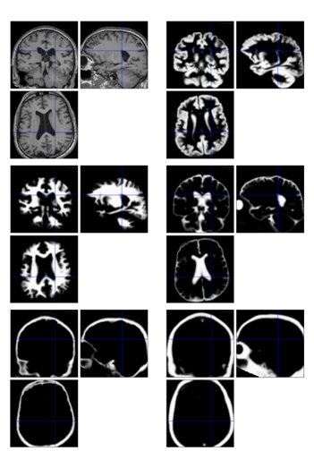
Warping individual to match atlas (spatial normalisation)
Warping atlas to match individual

Slide 26
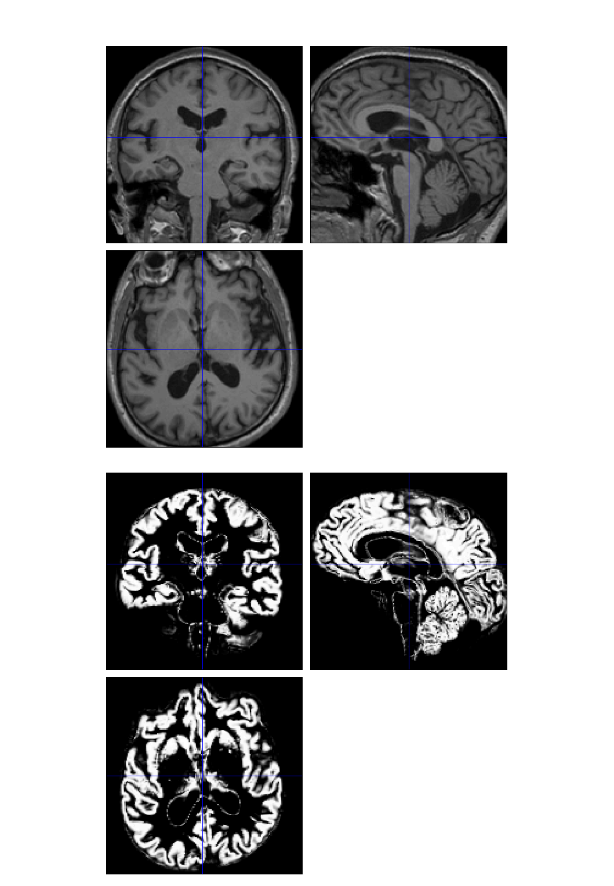
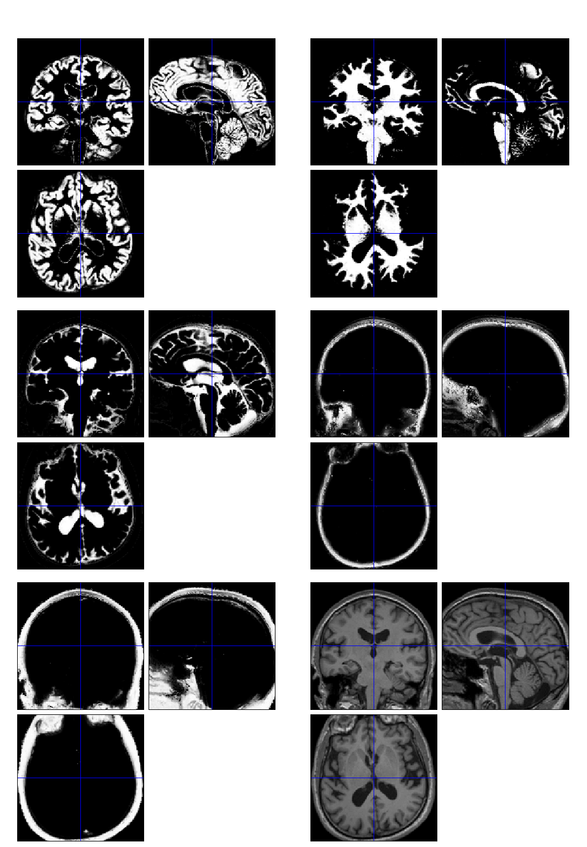

Slide 27
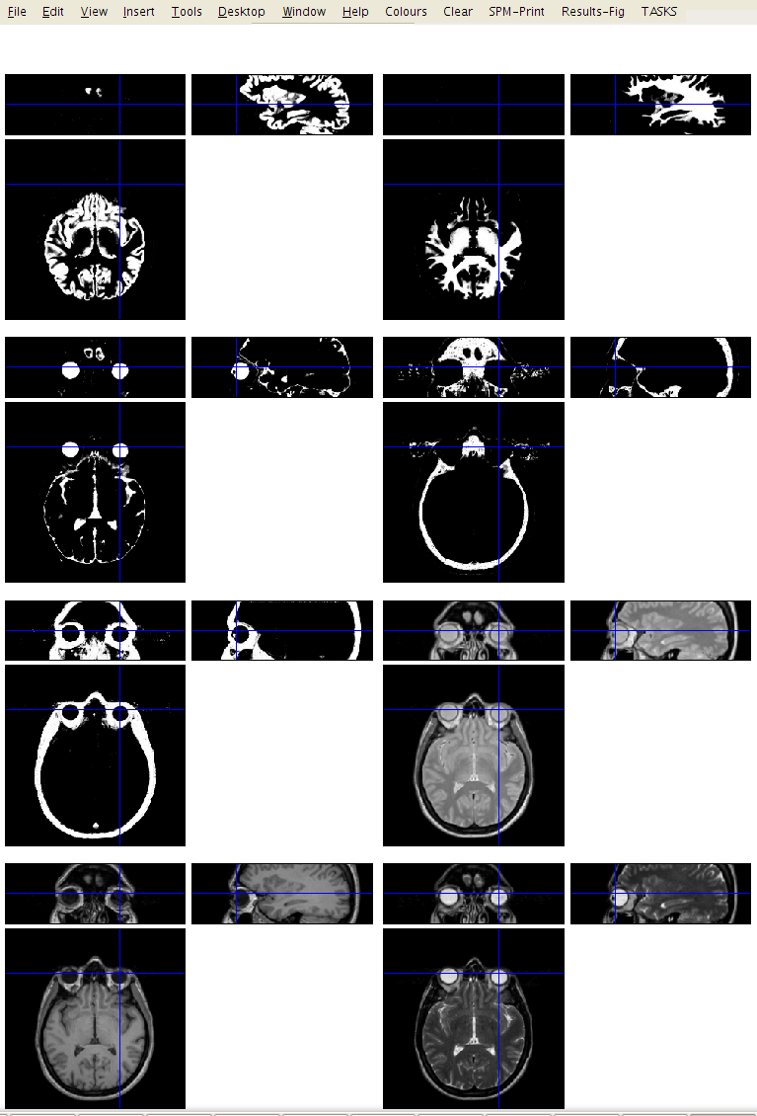
Multi-spectral
T2
T2
PD
T1
T1
PD

Slide 28
Optimisation
The “best” parameters are those that minimise this objective function.
Optimisation involves finding them.
Begin with starting estimates, and repeatedly change them so that the objective function decreases each time.

Slide 29
Descent scheme
Start
Optimum
Alternate between optimising different groups of parameters

Slide 30
Limitations of the current model
Assumes that the brain consists of only the tissues modelled by the TPMs
  No spatial knowledge of lesions (stroke, tumours, etc)
Prior probability model is based on healthy brains (IXI dataset from London).
  Less accurate for subjects outside this population
Needs reasonable quality images to work with
  No severe artefacts
  Good separation of intensities
  Reasonable initial alignment with TPMs.

Slide 31
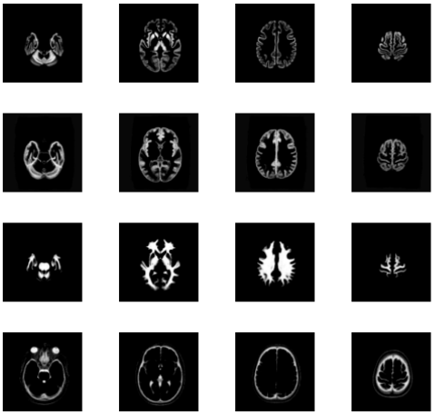
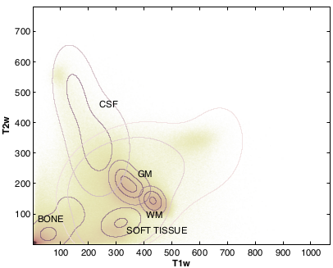
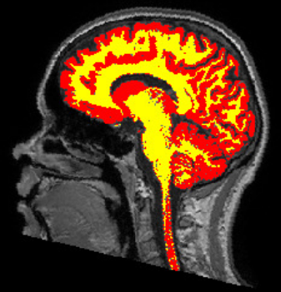
Planned extensions
Thanks to PhD work of Claudia Blaiotta and with help from Mikael Brudfors.
Tissue Spatial Priors
Tissue Intensity Priors
Blaiotta C, Cardoso MJ, Ashburner J. Variational inference fo medical image segmentation. Computer Vision and Image Understanding. 2016 Oct 31;151:14-28.

Slide 32
Overview
Morphometry
Voxel-Based Morphometry
Tissue Segmentation
Diffeomorphic Registration
  Compositions
  Objective function
  Template creation
Longitudinal Registration

Slide 33
Diffeomorphic Deformations

Slide 34
Composition

Slide 35
Small Deformation Approximation
The composition:
ϑ ° φ
Would be approximated with:
Id +((ϑ-Id) + (φ-Id))
The inversion:
φ⁻¹
Would be approximated with:
Id -(φ-Id)
Not good approximations for large deformations.

Slide 36
Diffeomorphic Image Registration
Minimises two terms:
A measure of distance between images
A measure of the amount of distortion.
Because we can not simply add displacement fields, large deformations are generated by composing many small deformations.
The amount of distortion is computed by summing up the distortion measures from the small displacements.

Slide 37
Effect of Different Distortion Measures

Slide 38
Two diffeomorphic approaches in SPM
Dartel.
Geodesic Shooting
Uses the same small deformation composed multiple times.
Faster than Geodesic Shooting.
Gives similar deformations to Geodesic Shooting.
Currently more additional utilities.
Uses the optimal series of small deformations, which are composed together.
More mathematically correct than Dartel.
Gives nicer maps of volume change than Dartel.
Likely to replace Dartel in future.

Slide 39
Dartel & GS Compared
Dartel
Geodesic Shooting

Slide 40
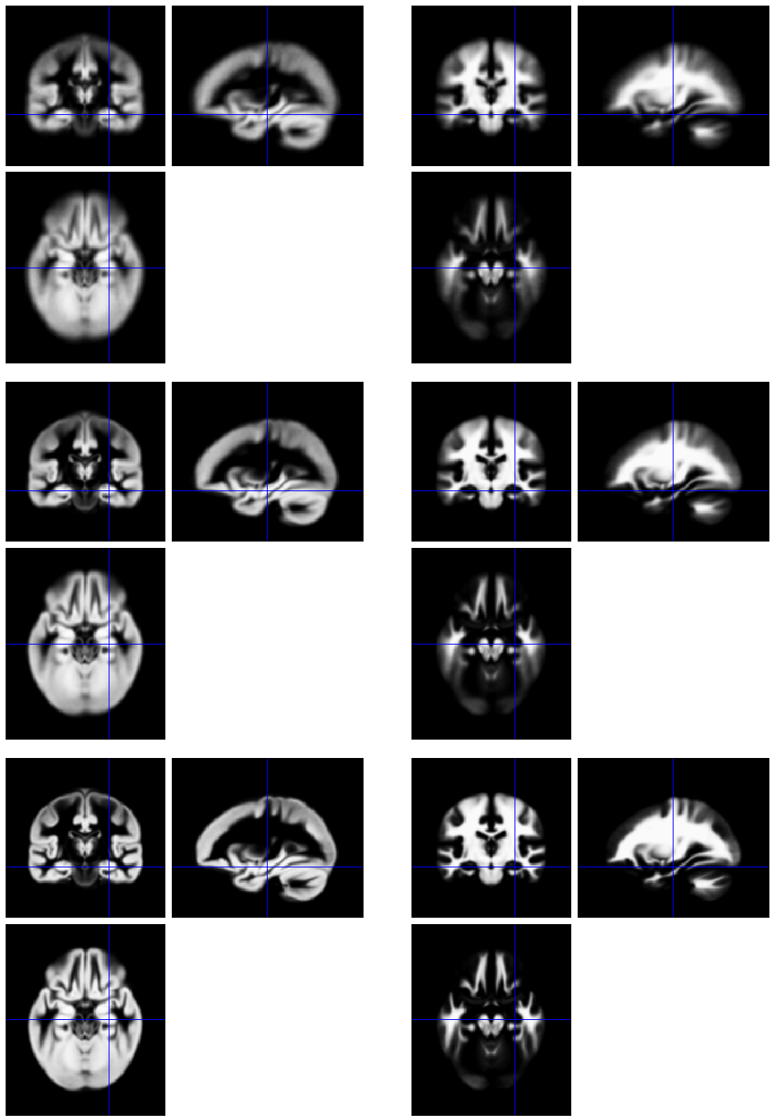
Group-wise alignment
Initial Average
Template implicitly generated from data in study.
Findings less biased by choice of template.
After a few iterations
Final template

Slide 41
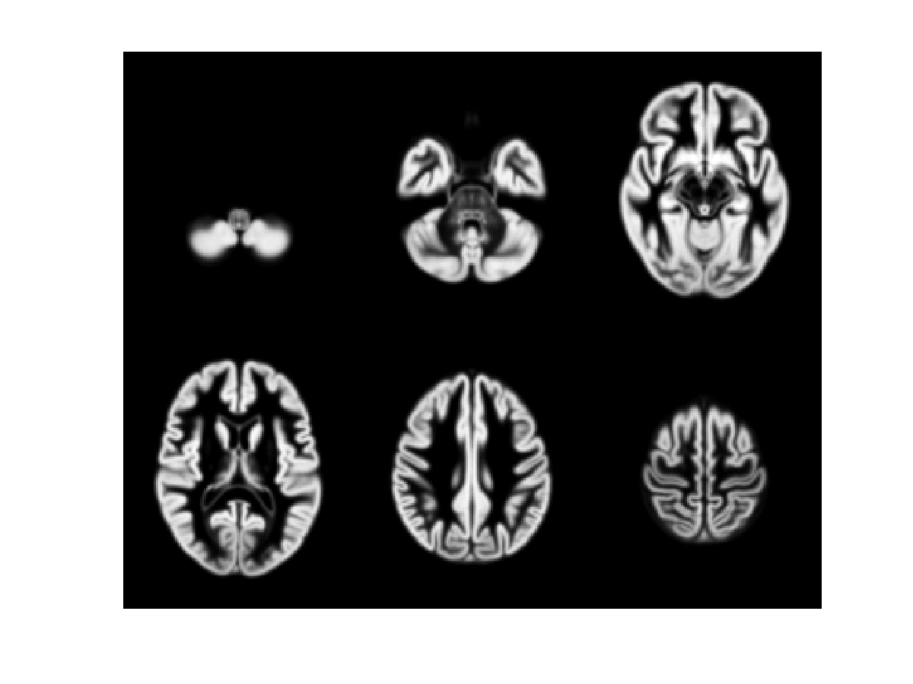
471 Subject Average

Slide 42
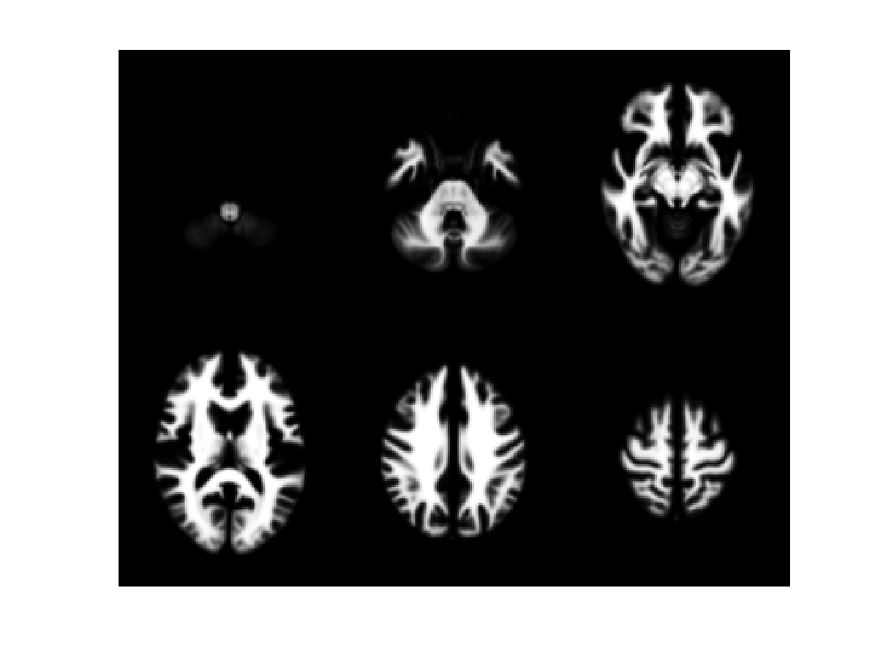
471 Subject Average

Slide 43
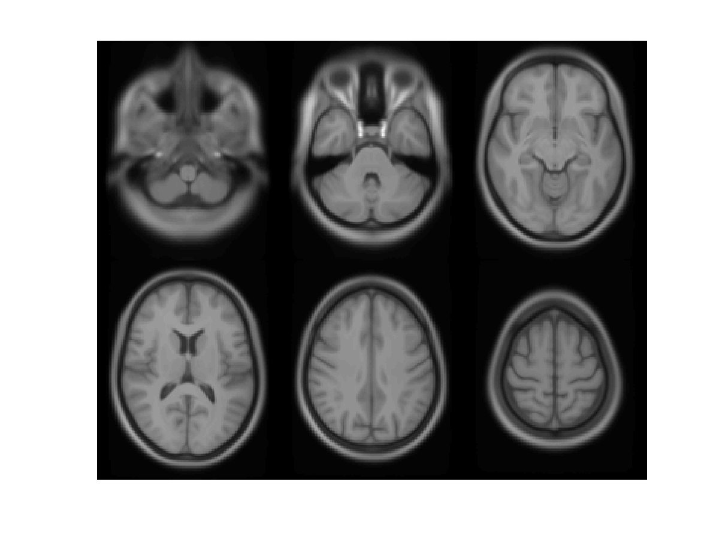
471 Subject Average

Slide 44
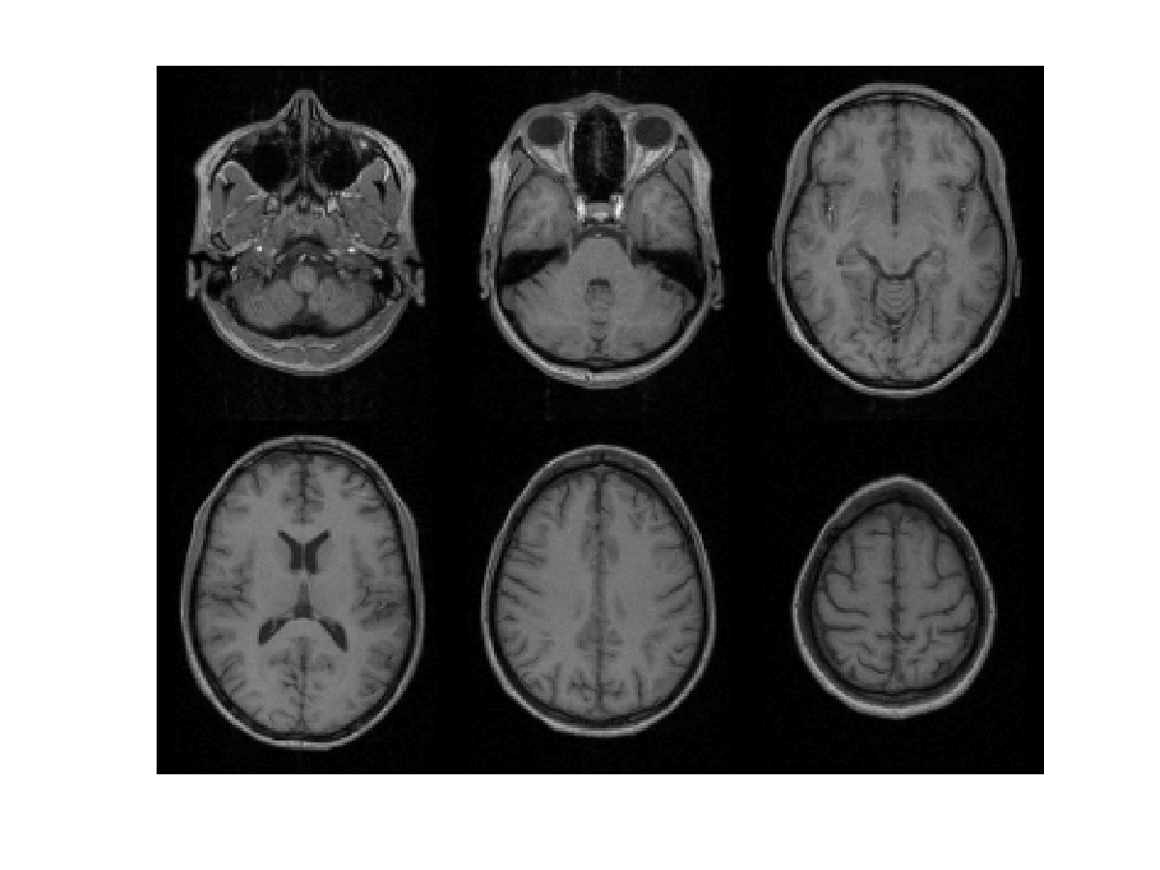
Subject 1

Slide 45
471 Subject Average

Slide 46
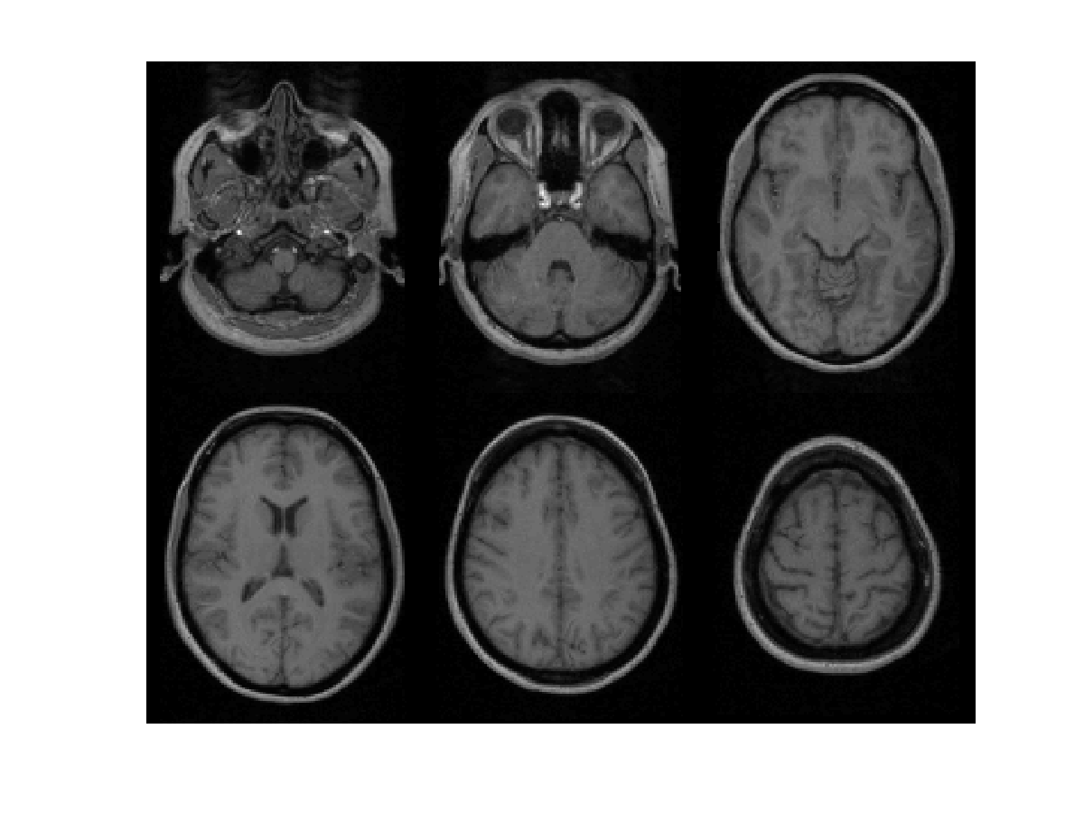
Subject 2

Slide 47
471 Subject Average

Slide 48
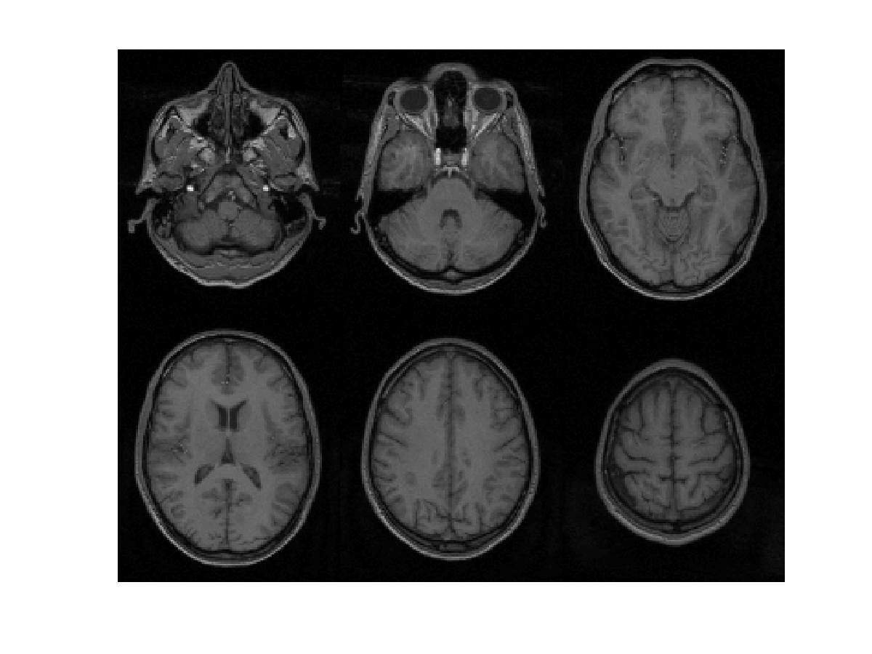
Subject 3

Slide 49
471 Subject Average

Slide 50
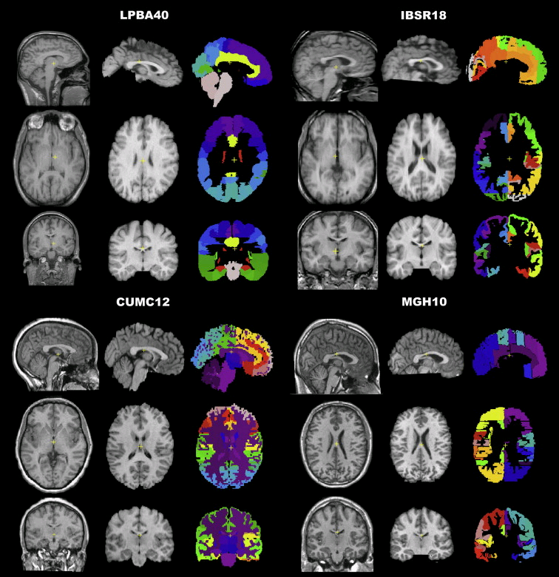
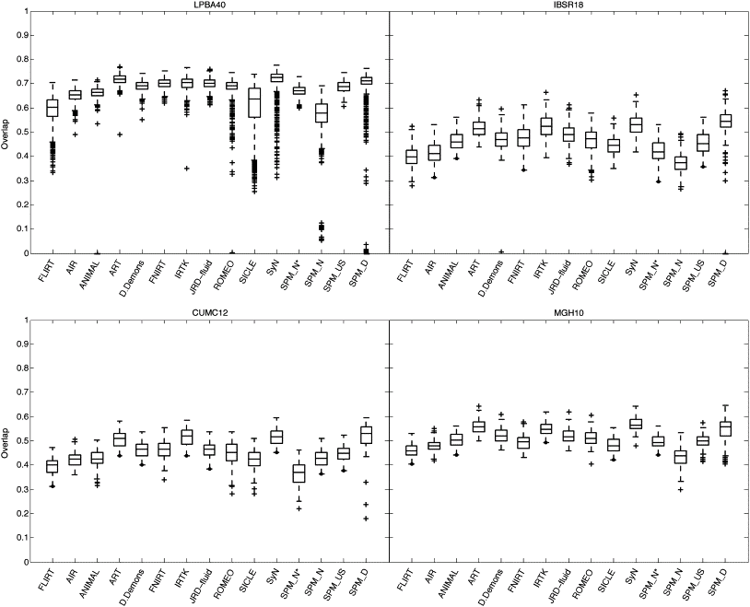
Evaluations of nonlinear registration algorithms
Klein et al (2009).
Ashburner & Friston (2011).

Slide 51
Overview
Morphometry
Voxel-Based Morphometry
Tissue Segmentation
Diffeomorphic Registration
Longitudinal Registration

Slide 52
Longitudinal Registration
Unified model combines:
  Nonlinear diffeomorphic registration.
  Rigid-body registration.
  Intensity inhomoheneity correction.

Slide 53
Two Longitudinal Scans
Two scans taken 6 years apart (after rigid registration).
Average and difference images.
Shape average and map of expansion/contraction
(after nonlinear registration)

Slide 54
Oasis Data
OAS2 0002
75 year old male, with MCI (MMSE=22, CDR=0.5).

Slide 55
Oasis Data
OAS2 0002
75 year old male, with MCI (MMSE=22, CDR=0.5).

Slide 56
Oasis Data
OAS2 0048
66 year old male, with MCI (MMSE=19, CDR=1).

Slide 57
Oasis Data
Data from first 82 subjects (OAS2 0001 to OAS2 0099).
Computed average expansion/contraction rates for each subject.
Warped all data to common anatomical space.
Generated averages.
Mean image intensity
Control subjects
Dementia subjects

Slide 58
Selected References
Wright et al (1995). “A voxel-based method for the statistical analysis of gray and white matter density applied to schizophrenia”. Neuroimage 2(4):244-252.
Ashburner & Friston (2000). “Voxel-based morphometry-the methods”. Neuroimage 11(6):805-821.
Mechelli et al. (2005) “Voxel-based morphometry of the human brain: Methods and applications”. Current Medical Imaging Reviews 1(2):105-103.
Ashburner & Friston (2005). “Unified Segmentation”. NeuroImage 26:839-851.
Ashburner (2007). “A Fast Diffeomorphic Image Registration Algorithm”. NeuroImage 38:95-113.
Ashburner & Friston (2009). “Computing Average Shaped Tissue Probability Templates”. NeuroImage 45:333-341.
Ashburner (2009). “Computational Anatomy with the SPM software”. Magnetic Resonance Imaging 27(8):1163-1174.
Klein et al (2009). “Evaluation of 14 nonlinear deformation algorithms applied to human brain MRI registration”. NeuroImage 46(3):786-802.
Ashburner & Friston (2011). “Diffeomorphic registration using geodesic shooting and Gauss-Newton optimisation”. NeuroImage 55(3):954-967
Fox, Ridgway & Schott (2011). “Algorithms, atrophy and Alzheimer's disease: cautionary tales for clinical trials”. Neuroimage 57(1):15-18.
Ashburner & Ridgway (2013). “Symmetric diffeomorphic modelling of longitudinal structural MRI”. Frontiers in Neuroscience 6(197).

Slide 59
