Slide 1
Bayesian Model Selection and Averaging
SPM for MEG/EEG course
Peter Zeidman

Slide 2
Contents
DCM recap
Comparing models
Bayes rule for models, Bayes Factors, Bayesian Model Reduction
Investigating the parameters
Bayesian Model Averaging
Comparing DCMs across subjects
Fixed effects, model of models (random effects)
Parametric Empirical Bayes
Models of parameters

Slide 3
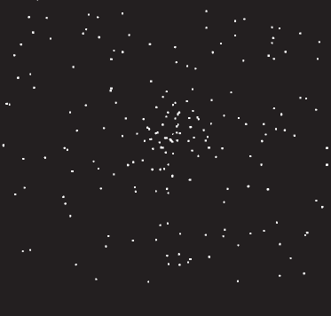

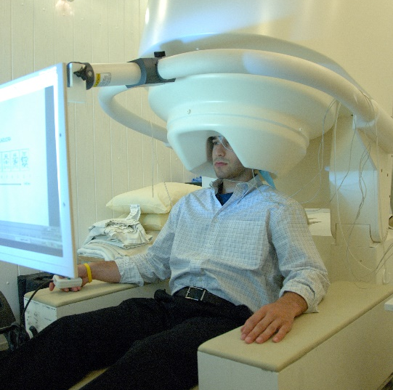
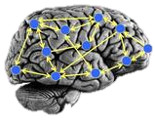
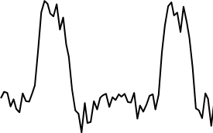
The system of interest
Experimental Stimulus
(Hidden) Neural Circuitry
Observations (EEG/MEG)
Vector u
Measurement y
on
?
off
time
time
Stimulus from Buchel and Friston, 1997
Brain by Dierk Schaefer, Flickr, CC 2.0
Notes:
Experimental stimulation causes changes in neural activity. Neural activity in turn causes the BOLD response, which we observe via the scanner. We are interested in the hidden neural activity, which we cannot directly observe - so it must be inferred.

Slide 4
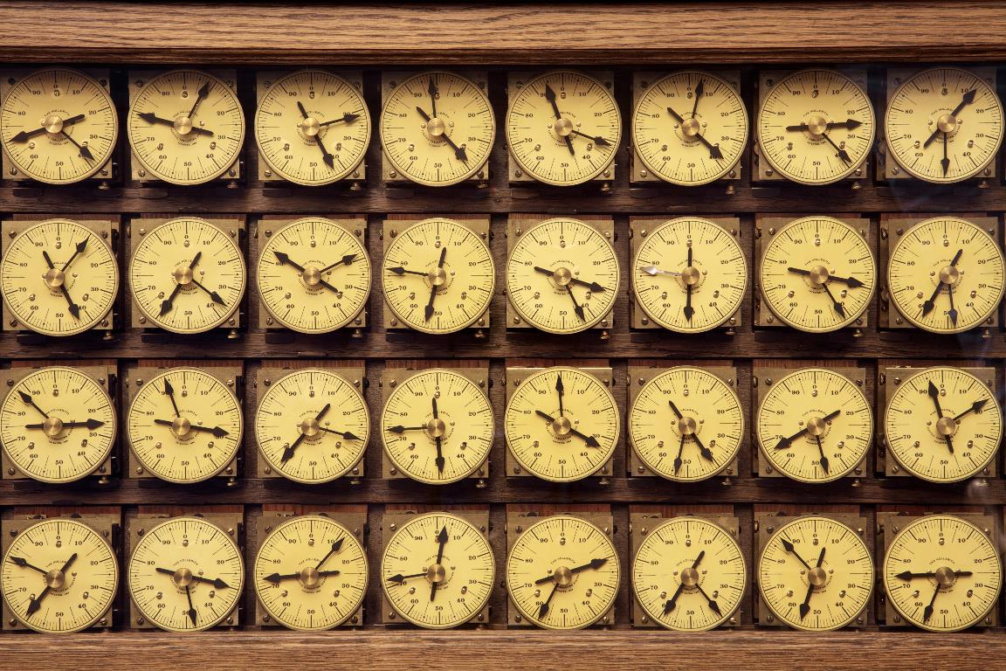

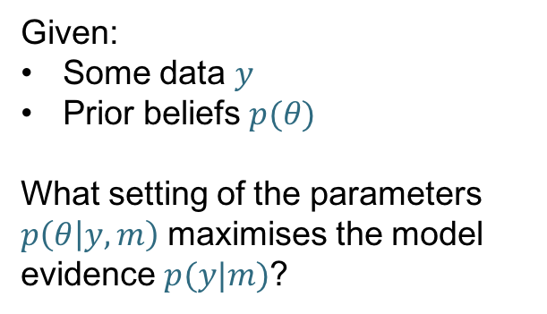


Timing of stimulus
Generative model (DCM) $m$
time
Forward problem
What data would we expect to measure given this model and a particular setting of the parameters?
$$p(y|m,θ)$$
Inverse Problem
Given:
Some data $y$
Prior beliefs $p(θ)$
What setting of the parameters $p\left(θ | y,m\right)$ maximises the model evidence $p(y|m)$?
Parameter $θ_{(i)}$
e.g. the strength of
a connection
Predicted data (e.g. ERP)
Image credit: Marcin Wichary, Flickr

Slide 5
DCM Recap
Priors determine the structure of the model
Stimulus
R1
R2
Stimulus
R1
R2
Connection ‘on’
Connection ‘off’
Probability
0
0
Prior Connection strength (Hz)
Prior Connection strength (Hz)

Slide 6

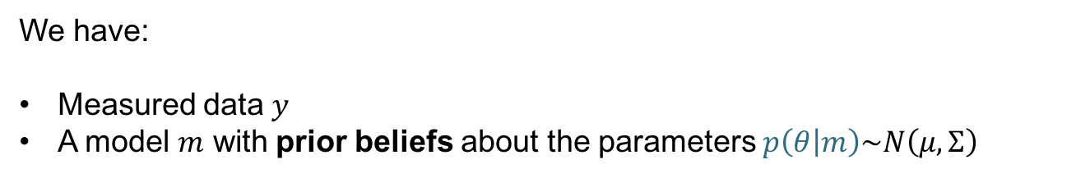
DCM Recap
We have:
Measured data $y$
A model $m$ with prior beliefs about the parameters $p\left(θ | m\right)\sim N\left(μ,Σ\right)$
Model estimation (inversion) gives us:
A score for the model, which we can use to compare it against other models
$F≅\log{p\left(y | m\right)=\text{accuracy}−\text{complexity}}$
Free energy
2. Estimated parameters – i.e. the posteriors $p(θ|m,y)\sim N\left(μ,Σ\right)$
$μ$: DCM.Ep – expected value of each parameter
$Σ$: DCM.Cp – covariance matrix

Slide 7
DCM Framework
We embody each of our hypotheses in a generative model. Each model differs in terms of connections that are present are absent (i.e. priors over parameters).
We perform model estimation (inversion)
We inspect the estimated parameters and / or we compare models to see which best explains the data.

Slide 8
Contents
DCM recap
Comparing models (within subject)
Bayes rule for models, Bayes Factors, odds ratios
Investigating the parameters
Bayesian Model Averaging
Comparing models across subjects
Fixed effects, random effects
Parametric Empirical Bayes
Based on slides by Will Penny

Slide 9
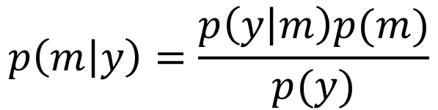
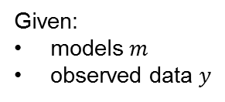

Bayes Rule for Models
Question: I’ve estimated 10 DCMs for a subject. What’s the posterior probability that any given model is the best?
Model evidence
Probability of each model given the data
Prior on each model

Slide 10
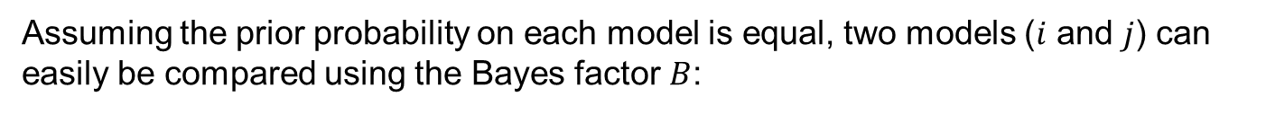
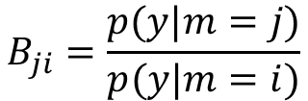

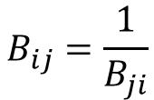

Bayes Factors
Ratio of model evidence
From Raftery et al. (1995)
Note: The free energy approximates the log of the model evidence. So the log Bayes factor is:

Slide 11
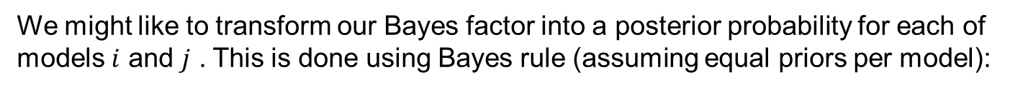

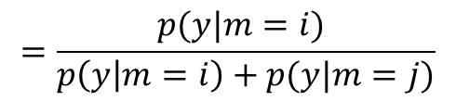
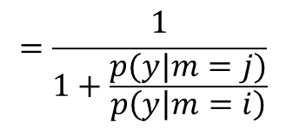



Bayes Factors cont.
Posterior probability of a model is
the sigmoid function of the log Bayes factor

Slide 12
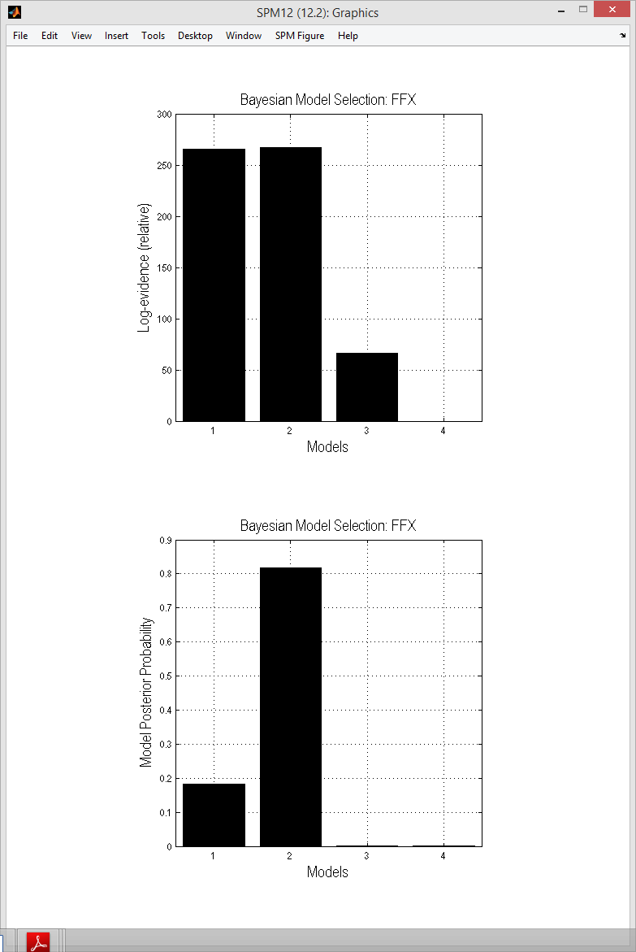




Log BF relative to worst model
Posterior probabilities

Slide 13







Bayesian Model Reduction
Full model
Model inversion (VB)
Priors:
Nested / reduced model
X
Bayesian Model Reduction (BMR)
Priors:

Slide 14




Bayesian model reduction (BMR)
Each competing model does not need to be separately estimated
Can reduce local optima and enables searching over large model spaces
Stimulus
R1
R2
“Full” model
“Reduced” model
Stimulus
R1
R2
$$F_{\text{full}}$$
BMR
$$F_{\text{reduced}}$$
$$θ_{\text{full}}$$
$$θ_{\text{reduced}}$$
Friston et al., Neuroimage, 2016

Slide 15
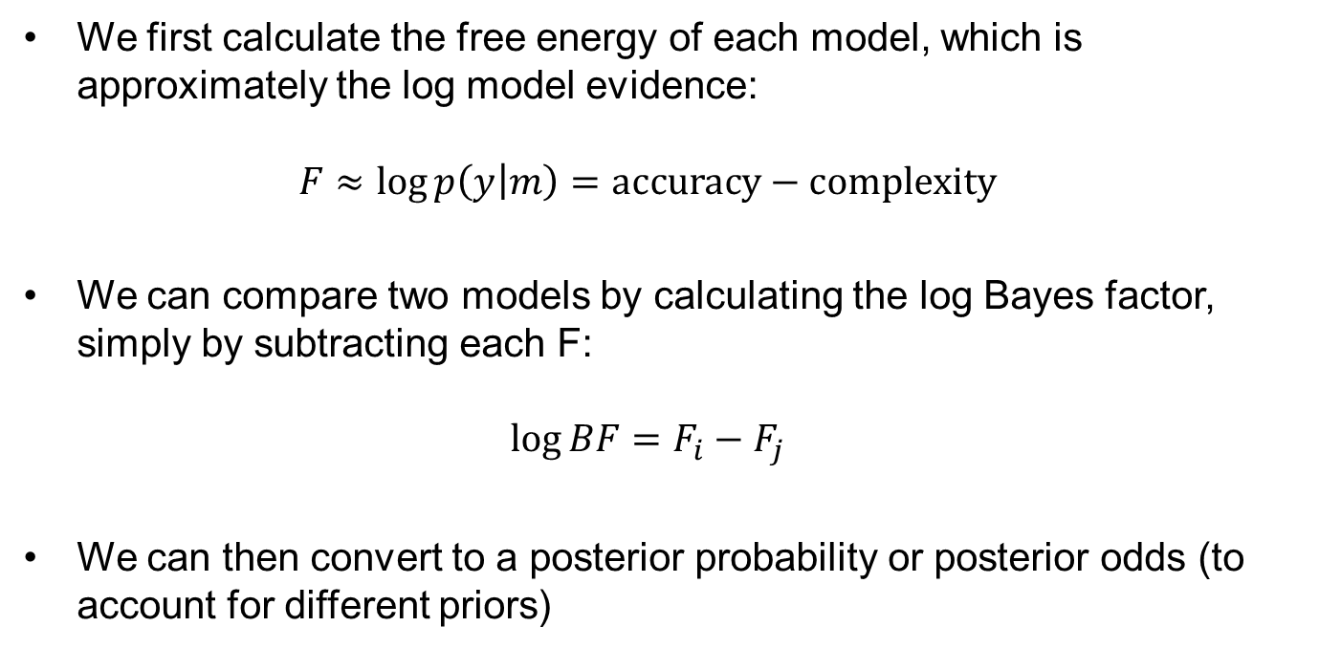
Interim summary

Slide 16
Contents
DCM recap
Comparing models (within subject)
Bayes rule for models, Bayes Factors, odds ratios
Investigating the parameters
Bayesian Model Averaging
Comparing models across subjects
Fixed effects, random effects
Parametric Empirical Bayes
Based on slides by Will Penny

Slide 17

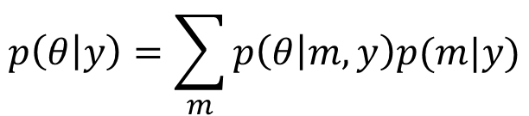
Bayesian Model Averaging (BMA)
Having compared models, we can look at the parameters (connection strengths). We average over models, weighted by the posterior probability of each model. This can be limited to models within the winning family.
SPM does this using sampling

Slide 18
Contents
DCM recap
Comparing models (within subject)
Bayes rule for models, Bayes Factors, odds ratios
Investigating the parameters
Bayesian Model Averaging
Comparing models across subjects
Fixed effects, random effects
Parametric Empirical Bayes
Based on slides by Will Penny

Slide 19
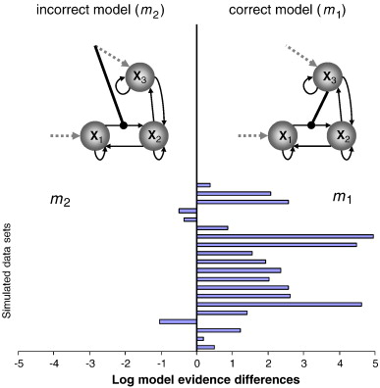
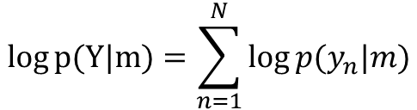
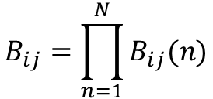
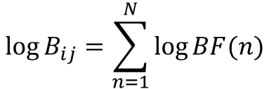
Fixed effects (FFX)
FFX summary of the log evidence:
Group Bayes Factor (GBF):
Stephan et al., Neuroimage, 2009

Slide 20
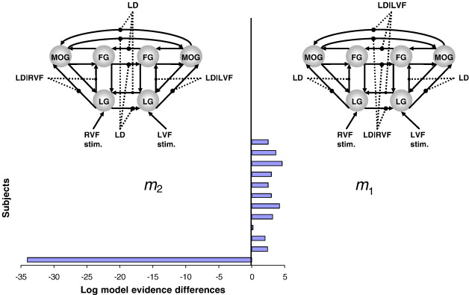
Fixed effects (FFX)
11 out of 12 subjects favour model 1
GBF = 15 (in favour of model 2).
So the FFX inference disagrees with most subjects.
Stephan et al., Neuroimage, 2009

Slide 21
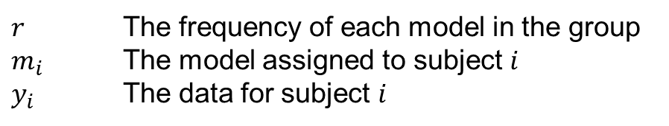


Random effects (RFX)
SPM estimates a hierarchical model with variables:
Outputs:
This is a model of models
Expected probability of model 2
Exceedance probability of model 2
Stephan et al., Neuroimage, 2009

Slide 22
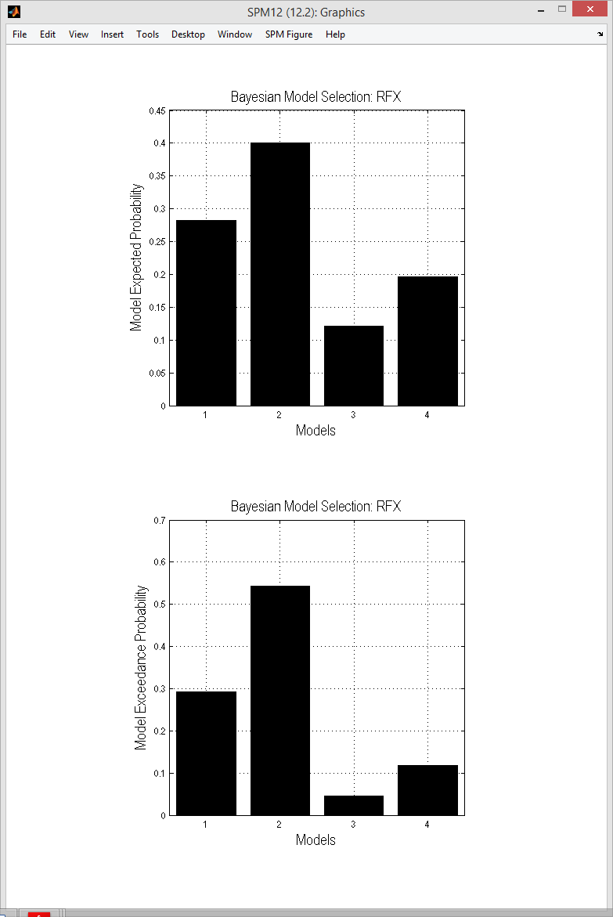
Expected probabilities
Exceedance probabilities

Slide 23
Contents
DCM recap
Comparing models (within subject)
Bayes rule for models, Bayes Factors, odds ratios
Investigating the parameters
Bayesian Model Averaging
Comparing models across subjects
Fixed effects, random effects
Parametric Empirical Bayes
Based on slides by Will Penny

Slide 24




Hierarchical model of parameters
Group
Mean
Disease
First level DCM
Image credit: Wilson Joseph from Noun Project

Slide 25



Hierarchical model of parameters
Parametric Empirical Bayes
Priors on second level parameters
Second level
Between-subject error
Second level (linear) model
First level
Measurement noise
DCM for subject i
Image credit: Wilson Joseph from Noun Project

Slide 26







Hierarchical model of parameters
$$Γ^{\left(2\right)}\left(θ^{\left(2\right)}\right)=Xβ$$
Design matrix
(covariates)
Group level parameters
Mean
Covariate 1
Covariate 2
Between-subjects effects
5
1
1
10
2
2
15
3
=
3
Subject
Connection
Connection
$$×$$
20
4
4
25
5
5
30
6
6
1
2
3
5
10
15
Covariate
Group-level effects
$$θ^{(1)}$$
$$X$$
$$β$$

Slide 27

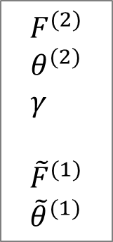
PEB Estimation
First level
Second level
DCMs
Subject 1
.
PEB Estimation
.
Subject N
First level free
energy / parameters
with empirical priors

Slide 28
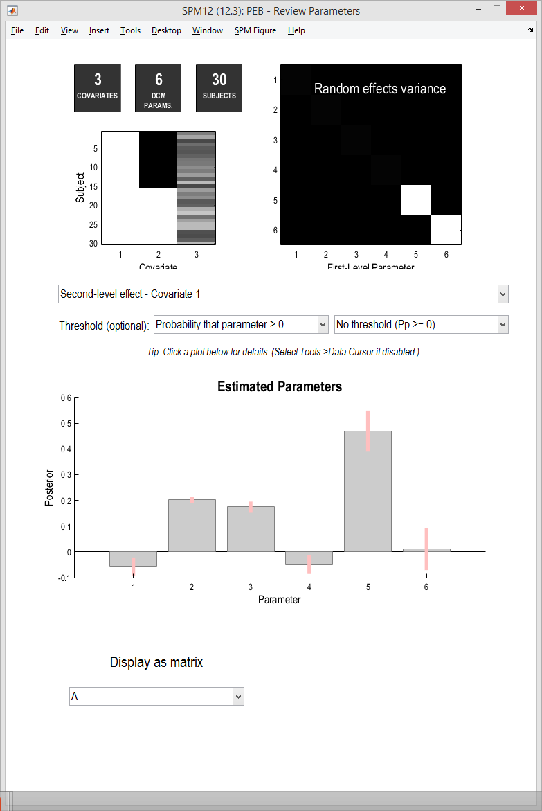
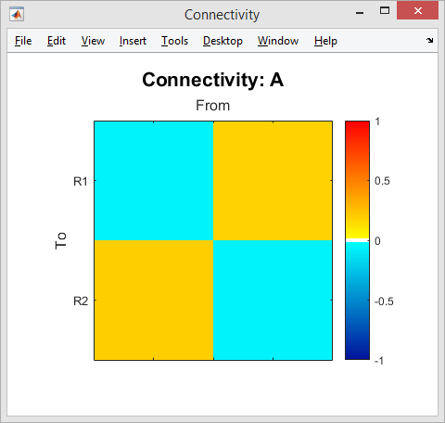
spm_dcm_peb_review

Slide 29
Model comparison at the group level
Step 1: Estimate a DCM for each subject
Step 3: Specify reduced (nested) PEB models
DCMs
Certain parameters ‘turned off’
e.g. all those pertaining to one covariate or connection
spm_dcm_peb_bmc
subjects
Bayesian Model Average
spm_dcm_peb
PEB
Step 2: Estimate a PEB model
Has parameters representing the effect of each covariate on each connection

Slide 30
PEB Applications
Improved first level DCM estimates
Compare specific nested models (switch off combinations of connections)
Search over nested models
Prediction (leave-one-out cross validation)

Slide 31
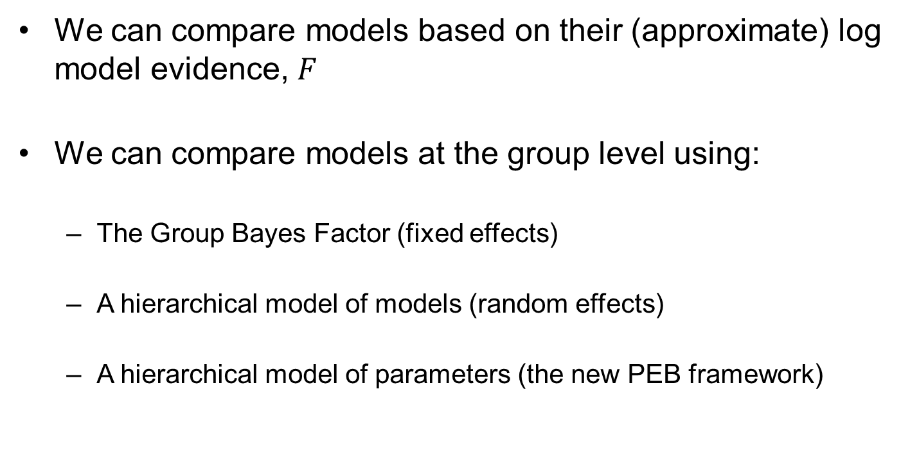
Summary
We can compare models based on their (approximate) log model evidence, $F$
We can compare models at the group level using:
  The Group Bayes Factor (fixed effects)
  A hierarchical model of models (random effects)
  A hierarchical model of parameters (the new PEB framework)

Slide 32

Further reading
Overview:
Stephan, K.E., Penny, W.D., Moran, R.J., den Ouden, H.E., Daunizeau, J. and Friston, K.J., 2010. Ten simple rules for dynamic causal modeling. NeuroImage, 49(4), pp.3099-3109.
Free energy:
Penny, W.D., 2012. Comparing dynamic causal models using AIC, BIC and free energy. Neuroimage, 59(1), pp.319-330.
Random effects model:
Stephan, K.E., Penny, W.D., Daunizeau, J., Moran, R.J. and Friston, K.J., 2009. Bayesian model selection for group studies. NeuroImage, 46(4), pp.1004-1017.
Parametric Empirical Bayes (PEB):
Friston, K.J., Litvak, V., Oswal, A., Razi, A., Stephan, K.E., van Wijk, B.C., Ziegler, G. and Zeidman, P., 2015. Bayesian model reduction and empirical Bayes for group (DCM) studies. NeuroImage.
PEB tutorial:
https://en.wikibooks.org/wiki/SPM/Parametric_Empirical_Bayes_(PEB)
Thanks to Will Penny for his lecture notes on which these slides are based. http://www.fil.ion.ucl.ac.uk/~wpenny/

Slide 33
extras

Slide 34
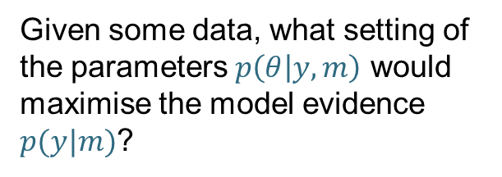
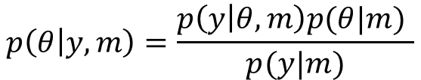
Inverse Problem
Given some data, what setting of the parameters $p\left(θ | y,m\right)$ would maximise the model evidence $p(y|m)$?
Solution: Bayes rule
Model prediction (forward problem)
Prior
$$p\left(θ | y,m\right)=\frac{p\left(y | θ,m\right)p(θ|m) }{p(y|m)}$$
Model evidence
How good is the model?
Posterior
Our belief about the parameters (e.g. connection strengths) after seeing the data

Slide 35


Variational Bayes
Approximates:
The log model evidence:
Posterior over parameters:
The log model evidence is decomposed:
The difference between the true and
approximate posterior
Free energy (Laplace approximation)
Accuracy
-
Complexity

Slide 36
The Free Energy
Accuracy
-
Complexity
Complexity
Distance between
prior and posterior
means
Occam’s factor
Volume of
prior parameters
posterior-prior
parameter means
Prior precisions
Volume of
posterior parameters
(Terms for hyperparameters not shown)

Slide 37




Bayes Factors cont.
If we don’t have uniform priors, we can easily compare models i and j using odds ratios:
The Bayes factor is still:
The prior odds are:
The posterior odds are:
So Bayes rule is:
eg. priors odds of 2 and Bayes factor of 10 gives posterior odds of 20
“20 to 1 ON” in bookmakers’ terms

Slide 38
Dilution of evidence
If we had eight different hypotheses about connectivity, we could embody each hypothesis as a DCM and compare the evidence:
Problem: “dilution of evidence”
Similar models share the probability mass, making it hard for any one model to stand out
Models 5 to 8 have ‘bottom-up’ connections
Models 1 to 4 have ‘top-down’ connections

Slide 39
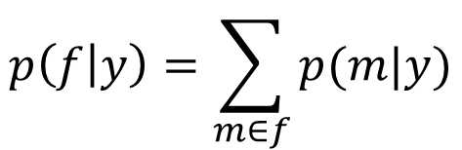
Family analysis
Grouping models into families can help. Now, one family = one hypothesis.
Family 1: four “top-down” DCMs
Posterior family probability:
Family 2: four “bottom-up” DCMs
Comparing a small number of models or a small number of families helps avoid the dilution of evidence problem

Slide 40
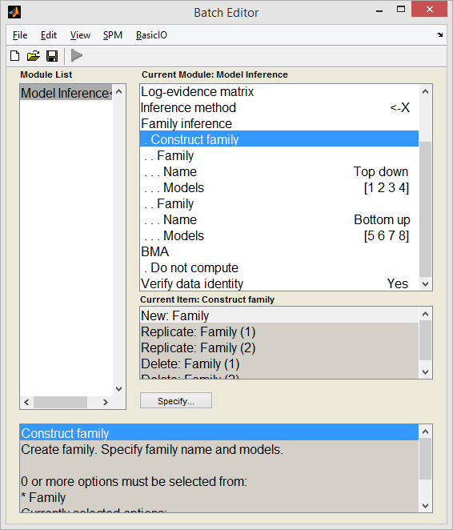
Family analysis

