Slide 1

Group Analyses
Tobias Hauser
Max Planck UCL Centre for Computational Psychiatry and Ageing Research
Wellcome Centre for Human Neuroimaging
University College London
With many thanks to G. Flandin, W. Penny, S. Kiebel, T. Nichols, R. Henson, J.-B. Poline, F. Kherif
SPM Course
London, October 2018

Slide 2



Image time-series
Spatial filter
Design matrix
Statistical Parametric Map
Realignment
Smoothing
General Linear Model
Statistical
Inference
RFT
Normalisation
Anatomical
reference
p <0.05
Parameter estimates

Slide 3

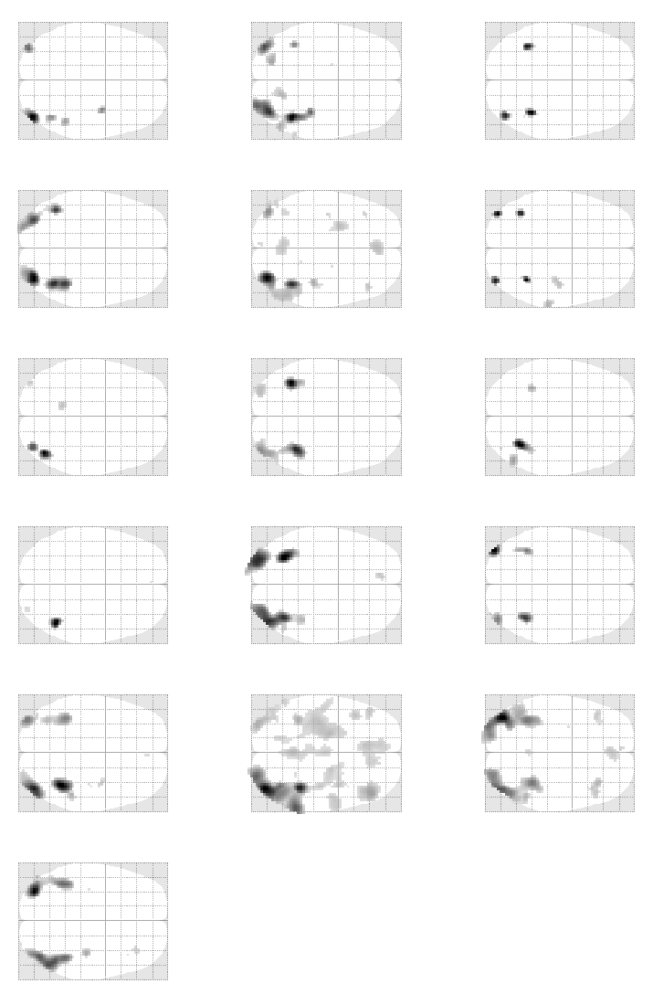

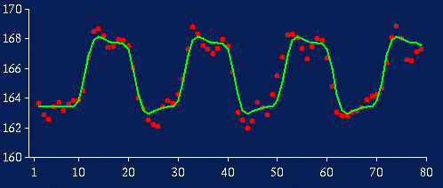
Donald Trump area
Effect size, c ~ 4
Within subject variability, s_{w}~0.9

Slide 4
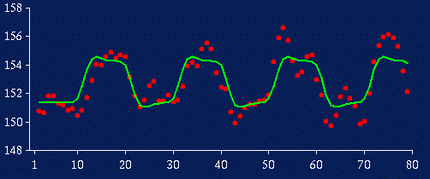
Subject N
Effect size, c ~ 2
Within subject variability, s_{w}~1.5

Slide 5
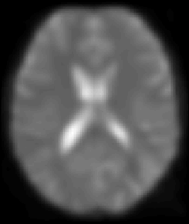
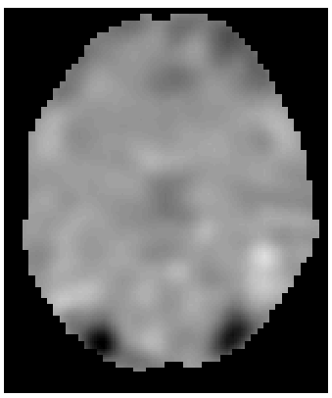
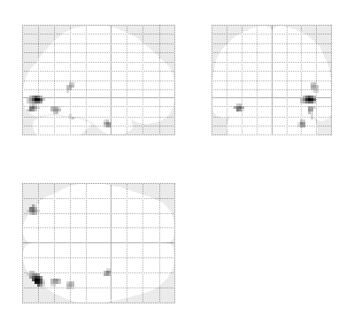
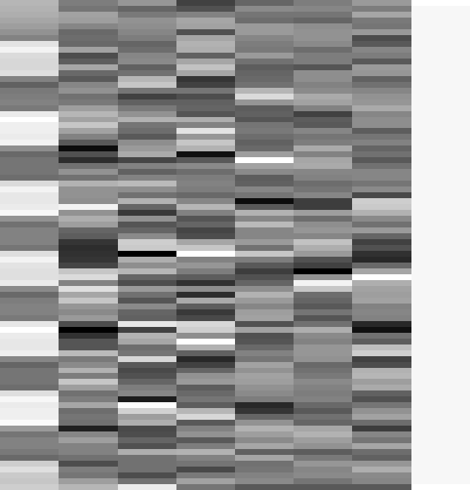
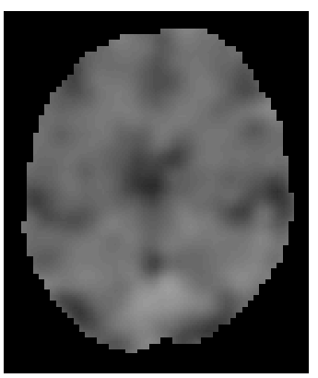
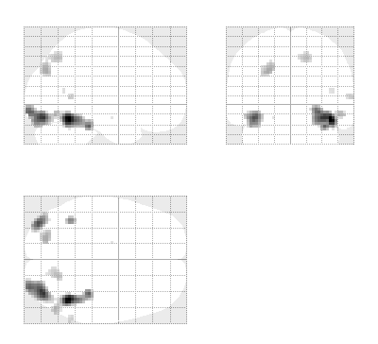
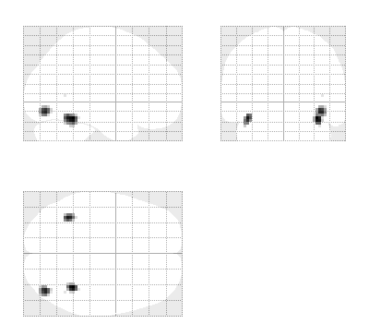
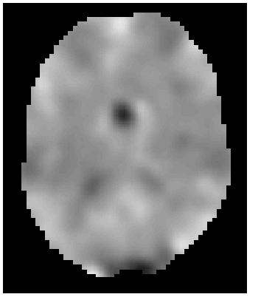
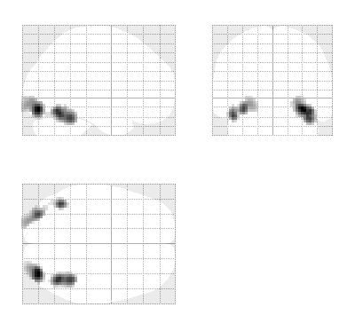
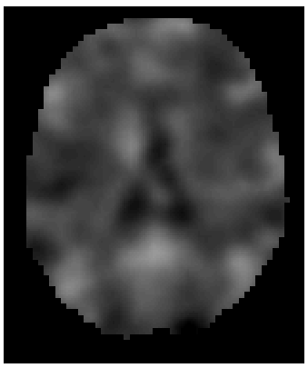
GLM: repeat over subjects
fMRI data
Design Matrix
Contrast Images
SPM{t}
Subject 1
Subject 2
…
Subject N

Slide 6
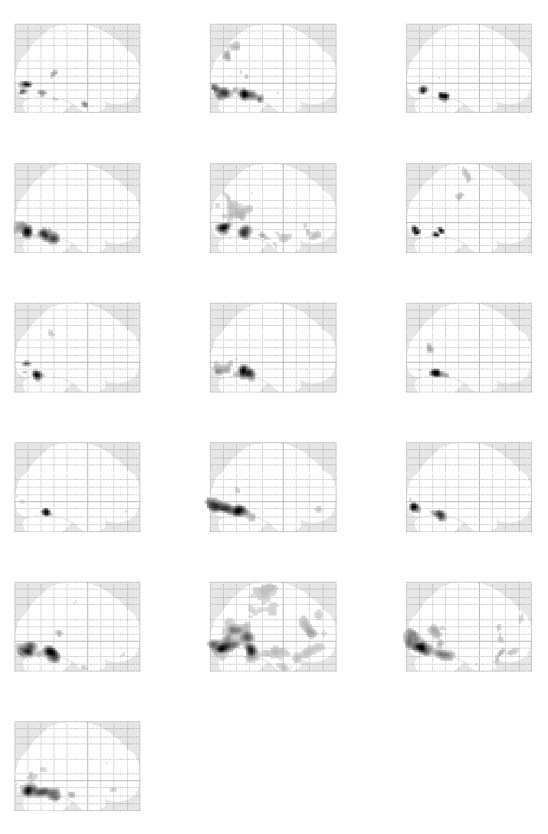
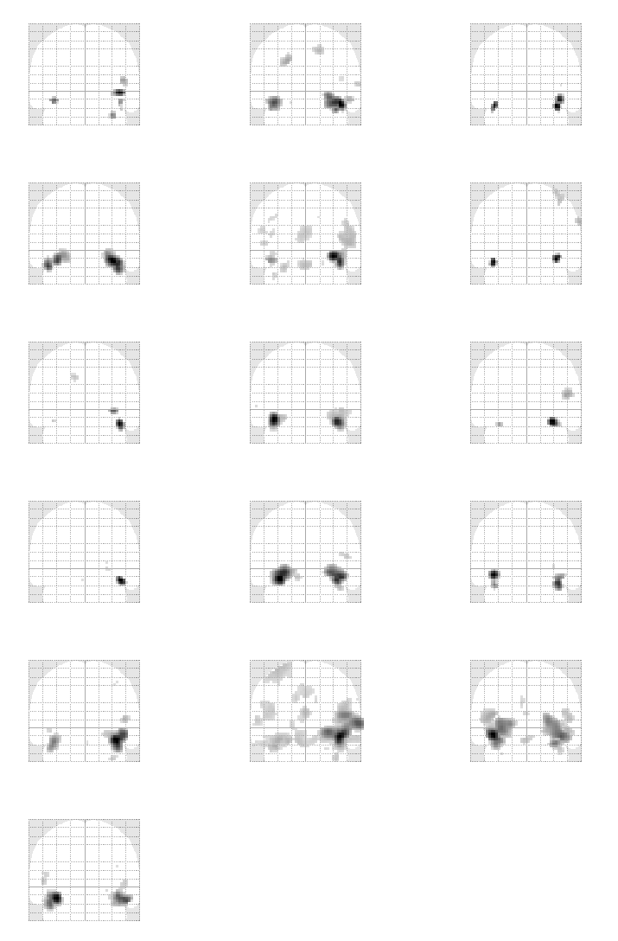
First level analyses (p<0.05 FWE):
Data from R. Henson

Slide 7
How to assess these different subjects?
Fixed Effects Analysis (FFX)
Random Effects Analysis (RFX)
  Summary Statistics approach
  Mixed Effects Analysis (MFX)

Slide 8
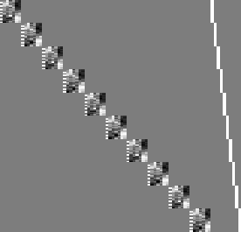
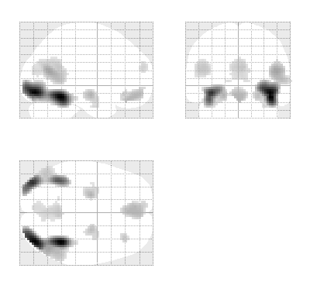
Fixed effects analysis (FFX)
Subject 1
Modelling all subjects at once
Subject 2
Subject 3
…
Subject N

Slide 9
Fixed Effects Analysis (FFX)
Time series are effectively concatenated – as though we had one subject with N=50x12=600 scans.
s_{w} = [0.9, 1.2, 1.5, 0.5, 0.4, 0.7, 0.8, 2.1, 1.8, 0.8, 0.7, 1.1]
Mean effect, m=2.67
Average within subject variability (stand dev), s_{w} =1.04
Standard Error Mean (SEM_{W}) = s_{w} /sqrt(N)=0.04
Is effect significant at voxel v?
t=m/SEM_{W}=62.7
p=10⁻⁵¹

Slide 10

Fixed effects analysis (FFX)
Modelling all subjects at once
Simple model
Lots of degrees of freedom
Large amount of data
Assumes common variance over subjects at each voxel
=
+

Slide 11
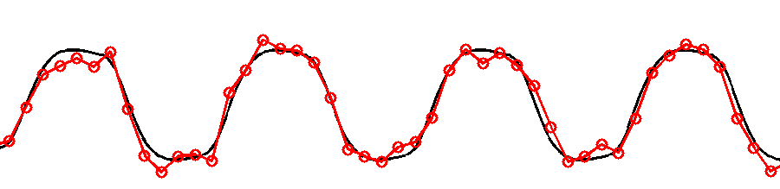
Fixed effects
Only one source of random variation (over sessions):
  measurement error
True response magnitude is fixed.
Within-subject Variance
➔ How consistent is the response within this group of people, no inference about the population

Slide 12
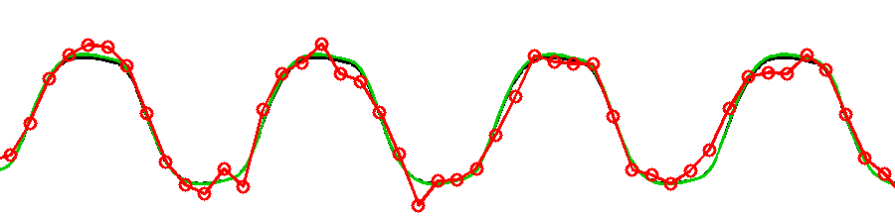
Random effects
Two sources of random variation:
  measurement errors
  response magnitude (over subjects)
Response magnitude is random
  each subject/session has random magnitude
Within-subject Variance
Between-subject Variance

Slide 13
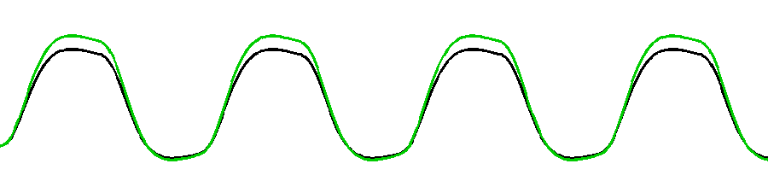
Random effects
Two sources of random variation:
  measurement errors
  response magnitude (over subjects)
Response magnitude is random
  each subject/session has random magnitude
  but population mean magnitude is fixed.
Within-subject Variance
Between-subject Variance

Slide 14
Random Effects Analysis (RFX)
For group of N=12 subjects effect sizes are
c = [4, 3, 2, 1, 1, 2, 3, 3, 3, 2, 4, 4]
Group effect (mean), m=2.67
Between subject variability (stand dev), s_{b} =1.07
Standard Error Mean (SEM) = s_{b} /sqrt(N)=0.31
Is effect significant at voxel v?
t=m/SEM=8.61
p=10⁻⁶

Slide 15
Random Effects Analysis (RFX)
For group of N=12 subjects effect sizes are
c= [3, 4, 2, 1, 1, 2, 3, 3, 3, 2, 4, 4]
Group effect (mean), m=2.67
Between subject variability (stand dev), s_{b} =1.07
This is called a Random Effects Analysis because we are comparing the group effect to the between-subject variability.

Slide 16
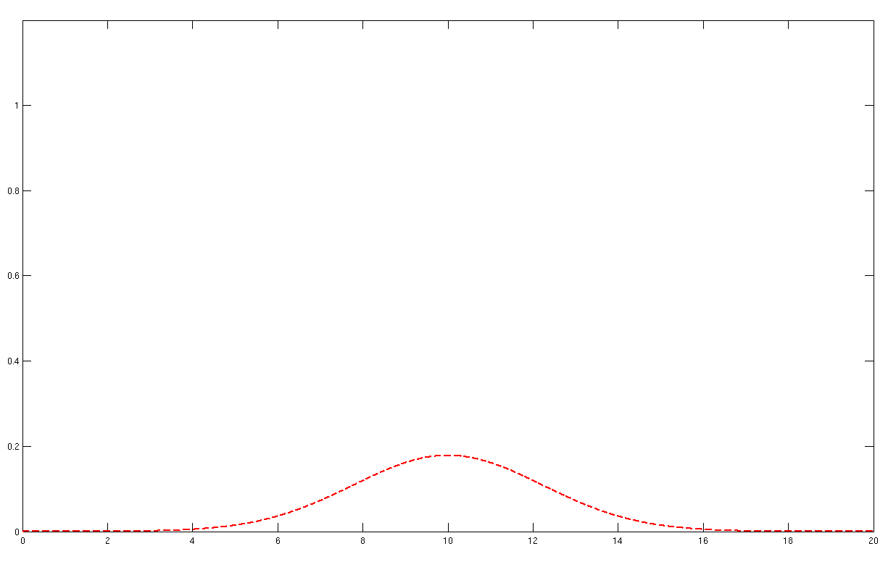
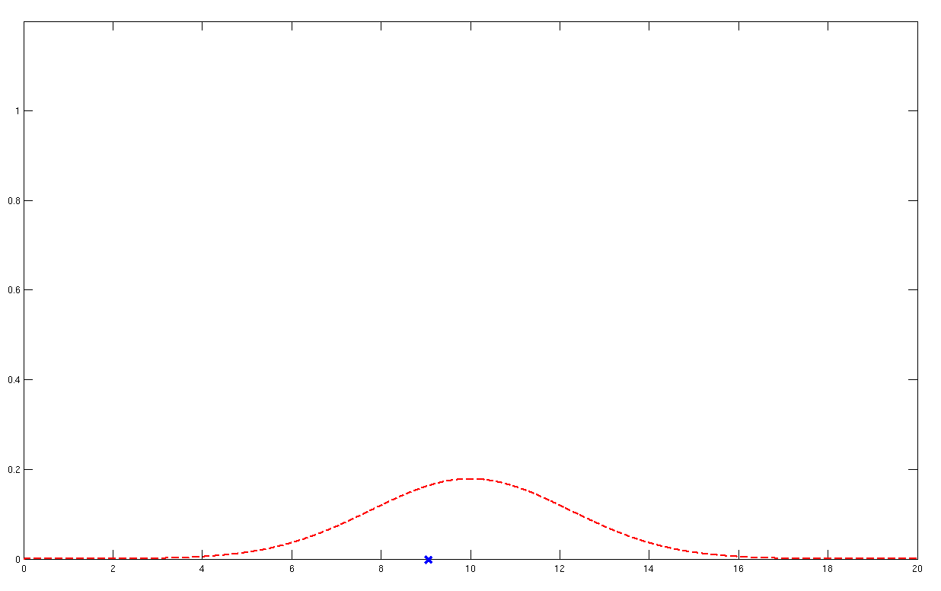
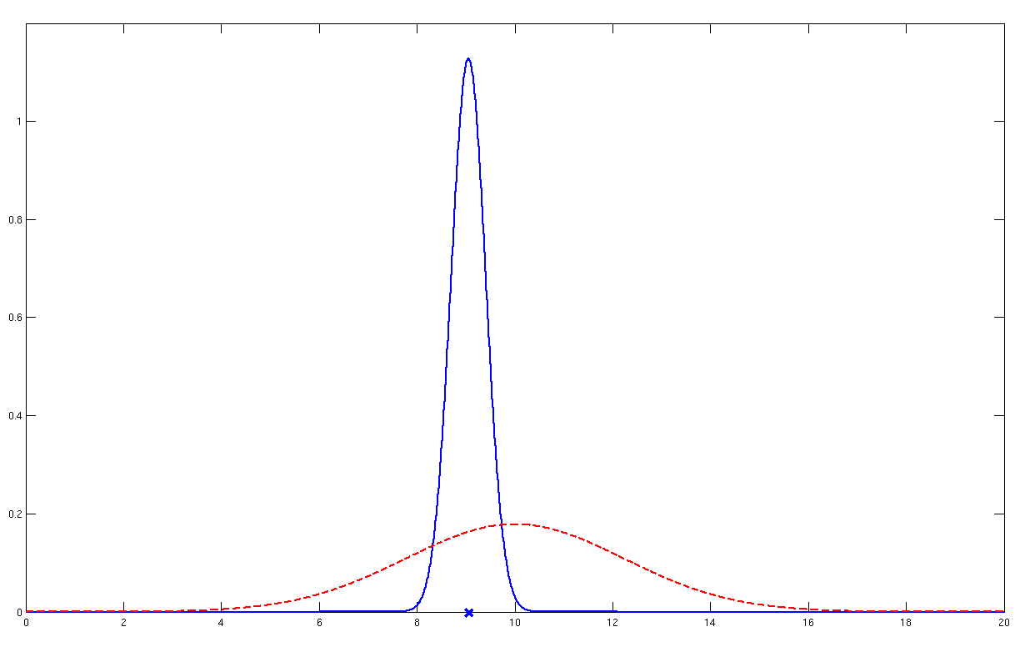
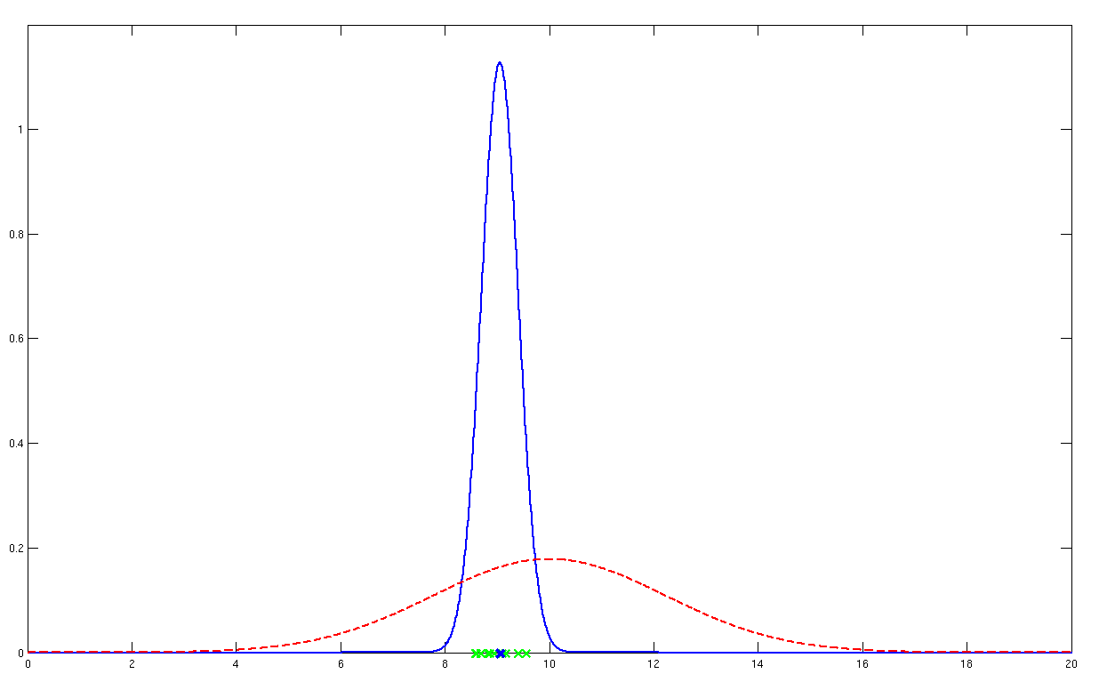
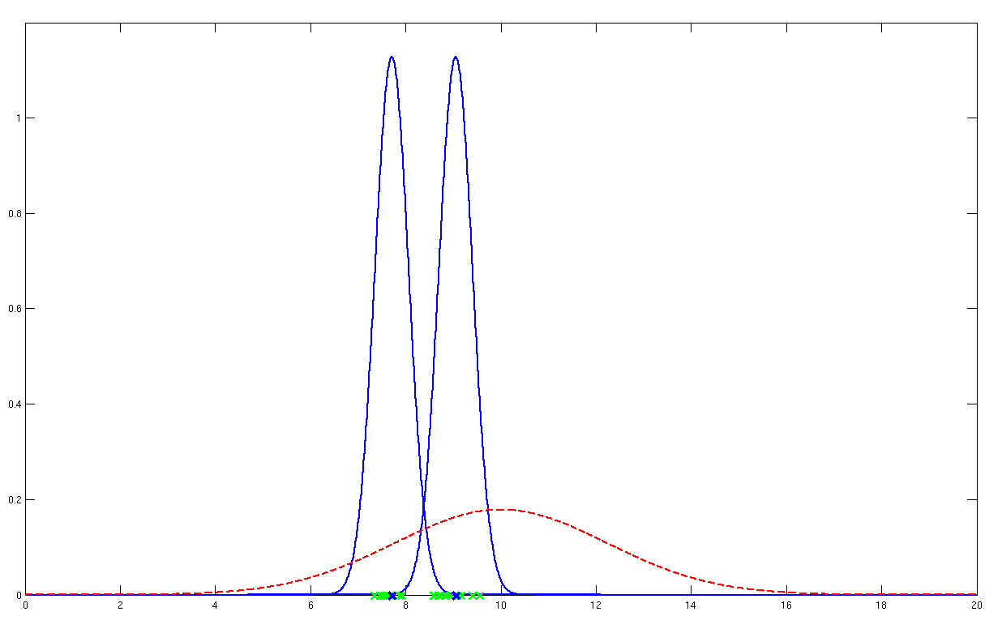
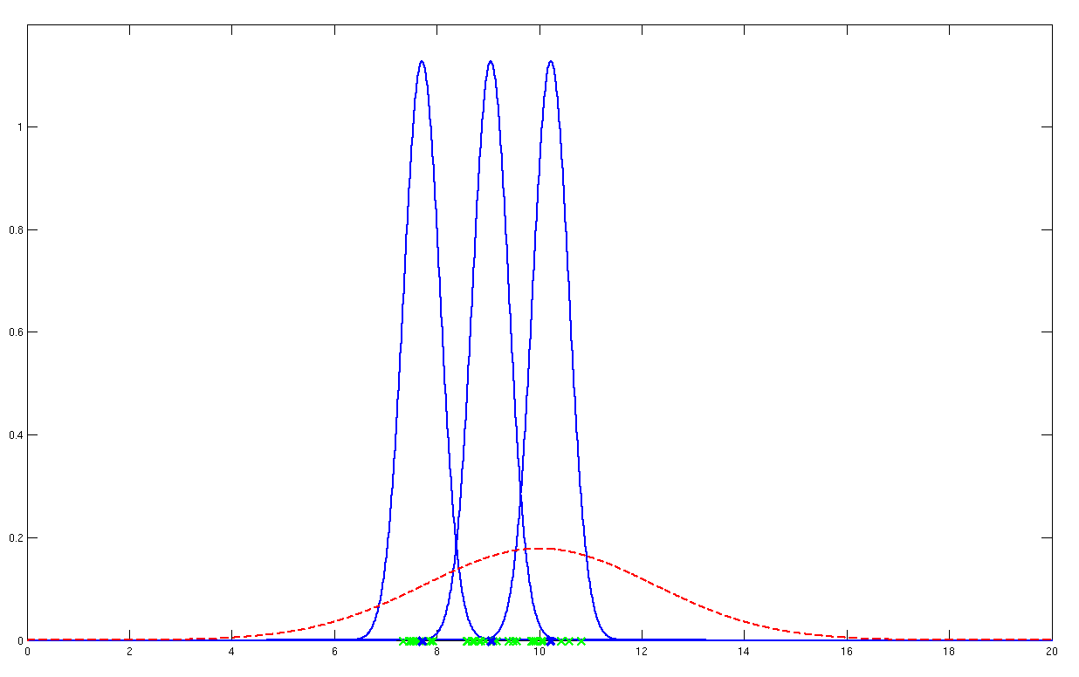
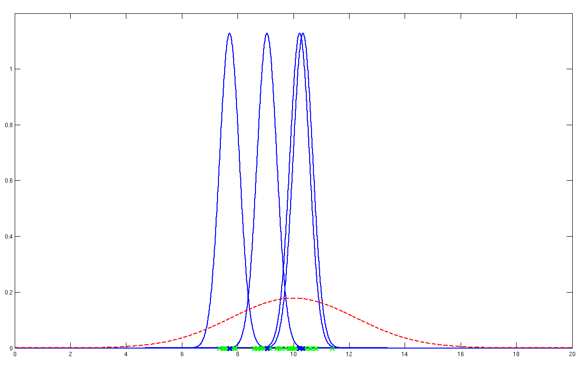
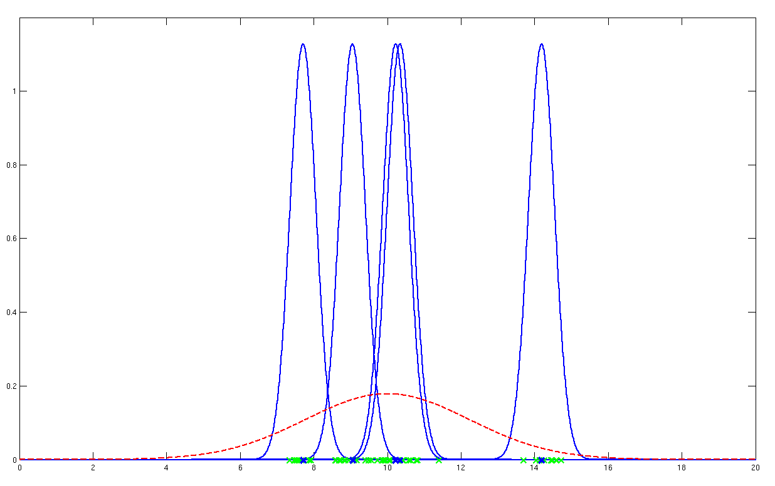


Random effects
$σ_{w}^{2}$
$σ_{b}^{2}$
Probability model underlying random effects analysis

Slide 17
Fixed vs random effects
With Fixed Effects Analysis (FFX) we compare the group effect to the within-subject variability. It is not an inference about the population from which the subjects were drawn.
With Random Effects Analysis (RFX) we compare the group effect to the between-subject variability. It is an inference about the population from which the subjects were drawn. If you had a new subject from that population, you could be confident they would also show the effect.

Slide 18
Fixed vs random effects
Fixed isn’t “wrong”, just usually isn’t of interest.
Summary:
  Fixed effects inference:
  “I can see this effect in this cohort”
  Random effects inference:
  “If I were to sample a new cohort from the same
  population I would get the same result”

Slide 19
How to assess these different subjects?
Fixed Effects Analysis (FFX)
Random Effects Analysis (RFX)
  Summary Statistics approach
  Mixed Effects Analysis (MFX)

Slide 20
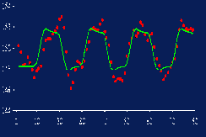
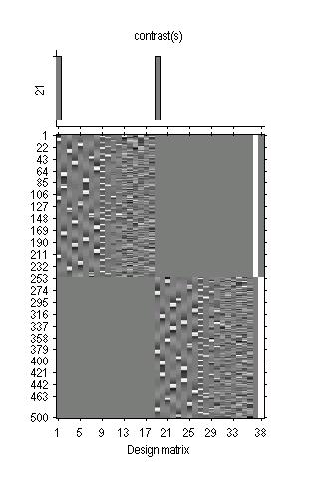
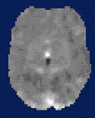
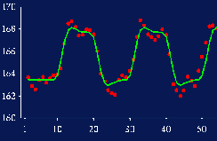
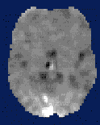

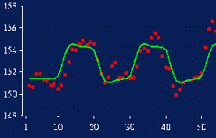
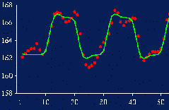
Summary Statistics Approach
First level
Data Design Matrix Contrast Images

Slide 21
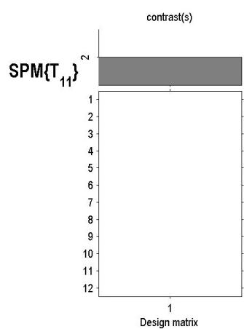
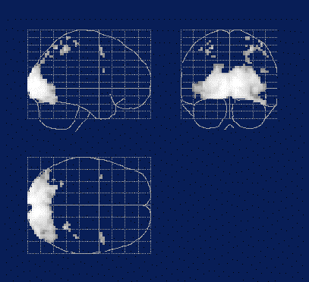

Summary Statistics Approach
First level
Second level
Data Design Matrix Contrast Images
SPM(t)
One-sample
t-test @ 2nd level

Slide 22
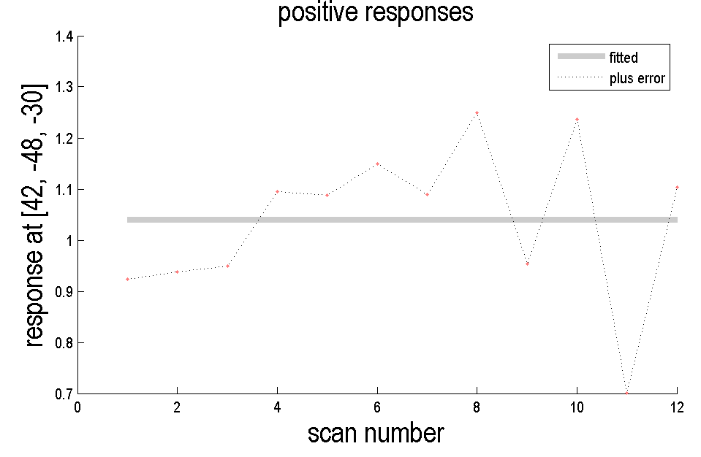
plotting data
Go to a voxel and press “PLOT” -> “Plot against scan or time”

Slide 23
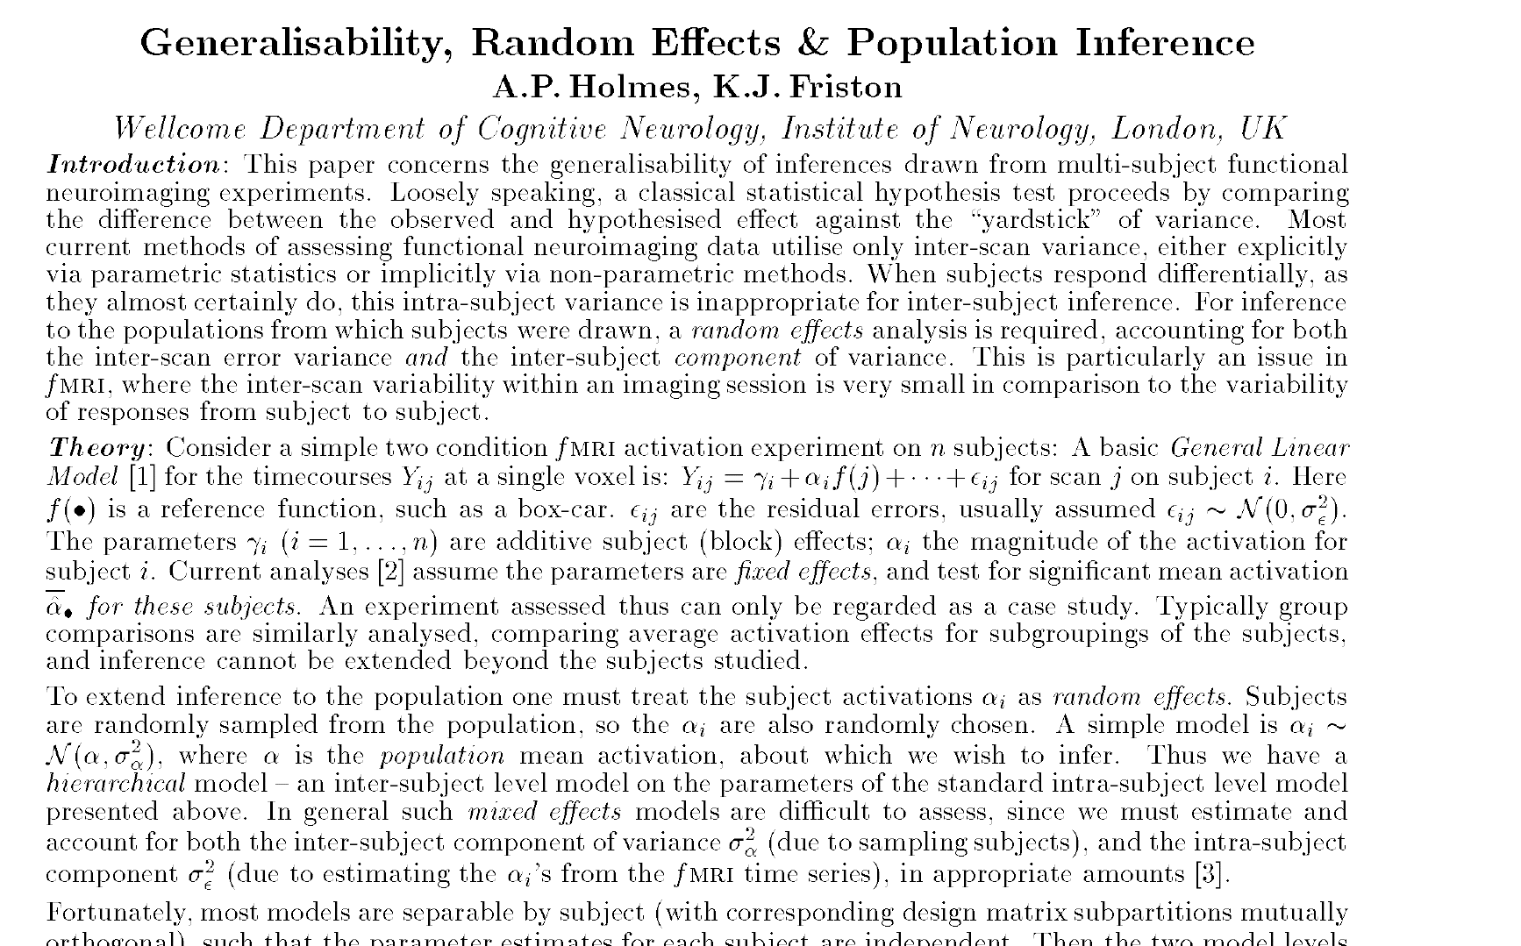
Holmes & Friston, 1998

Slide 24
Summary Statistics RFX Approach
Assumptions
The summary statistics approach is exact if for each session/subject:
  Within-subjects variances the same
  First level design the same (e.g. number of trials)
Other cases: summary statistics approach is robust against typical violations.
Mixed-effects and fMRI studies. Friston et al., NeuroImage, 2005.
Statistical Parametric Mapping: The Analysis of Functional Brain Images. Elsevier, 2007.
  Simple group fMRI modeling and inference. Mumford & Nichols. NeuroImage, 2009.
Notes:
Might use a hierarchical model in epilepsy research where number of seizures is not under experimental control and is highly variable over subjects.
Balanced designs

Slide 25
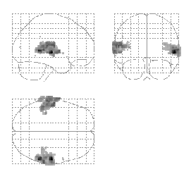
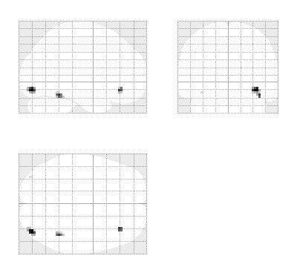

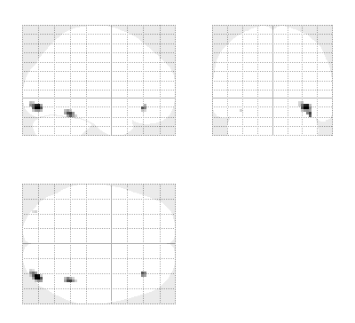
Summary Statistics RFX Approach
Robustness
Summary
statistics
Hierarchical
Model
Listening to words
Viewing faces
Mixed-effects and fMRI studies. Friston et al., NeuroImage, 2005.

Slide 26
Terminology
Hierarchical linear models:
Random effects models
Mixed effects models
Nested models
Variance components models
… all the same
… all alluding to multiple sources of variation
(in contrast to fixed effects)

Slide 27
Hierarchical models
Example: Two level model
=
+
=
+
Second level
First level

Slide 28
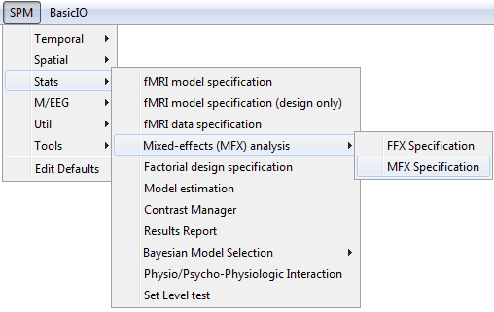
Hierarchical models
Restricted Maximum Likelihood (ReML)
Parametric Empirical Bayes
Expectation-Maximisation Algorithm
But:
Many two level models are just too big to compute.
And even if, it takes a long time!
Any approximation?
spm_mfx.m
Mixed-effects and fMRI studies. Friston et al., NeuroImage, 2005.

Slide 29
Do MFX models when…
...Summary statistics assumptions are violated
  Largely different subject-level designs
  Within-subject variances are different
(in practice:
  … you don’t trust your results
  … benefit from more precise variance estimates
  … you have a lot of computing power and time)

Slide 30
How to assess these different subjects?
Fixed Effects Analysis (FFX)
Random Effects Analysis (RFX)
  Summary Statistics approach
  Mixed Effects Analysis (MFX)
Beyond one-sample t-tests
  Paired t-tests
  ANOVAs

Slide 31
ANOVA & non-sphericity
One effect per subject:
  Summary statistics approach
  One-sample t-test at the second level
More than one effect per subject or multiple groups:
  Non-sphericity modelling
  Covariance components and ReML

Slide 32
ANOVA
Condition 1 Condition 2 Condition3
Sub1 Sub13 Sub25
Sub2 Sub14 Sub26
... ... ...
Sub12 Sub24 Sub36
ANOVA at second level (eg clinical populations). If you have two conditions this is a two-sample t-test.

Slide 33
ANOVA within subject
Condition 1 Condition 2 Condition3
Sub1 Sub1 Sub1
Sub2 Sub2 Sub2
... ... ...
Sub12 Sub12 Sub12
ANOVA within subjects at second level (eg same subjects on placebo, drug1, drug2).
This is an ANOVA but with subject effects removed. If you have two conditions this is a paired t-test.

Slide 34
SPM interface: factorial design specification
Many options…
  One-sample t-test
  Two-sample t-test
  Paired t-test
  Multiple regression
  One-way ANOVA
  One-way ANOVA – within subject
  Full factorial
  Flexible factorial

Slide 35
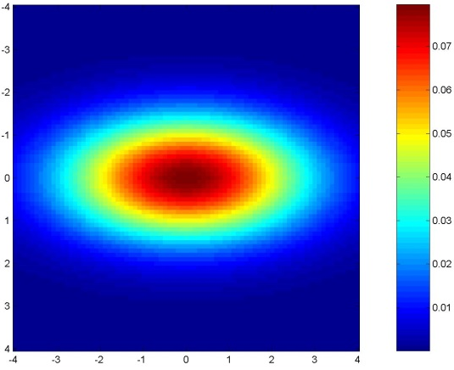
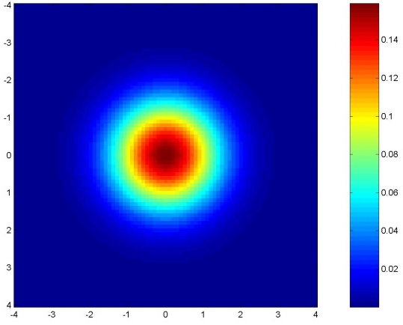
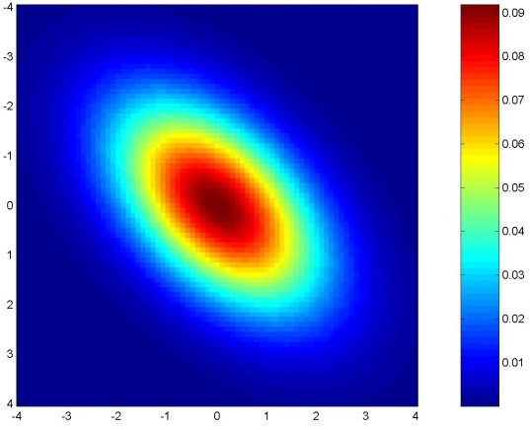
GLM assumes Gaussian “spherical” (i.i.d.) errors
sphericity = iid:
error covariance is scalar multiple of identity matrix:
Cov(e) = σ²I
Examples for non-sphericity:
non-identically
distributed
non-independent

Slide 36
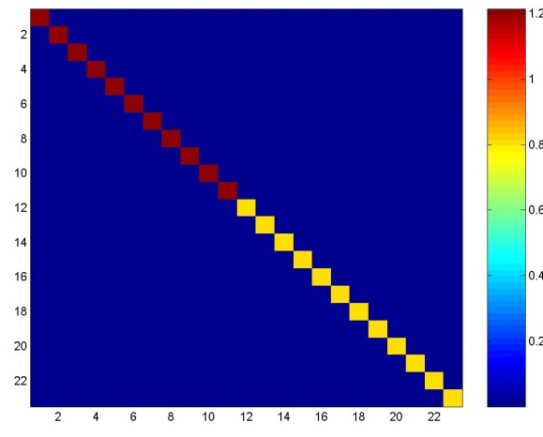
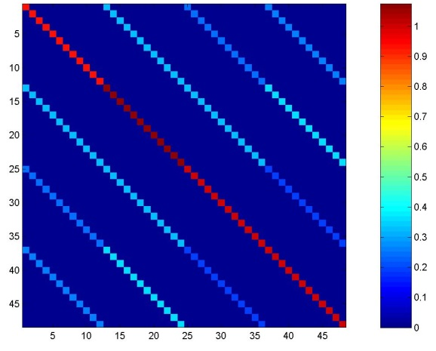
2nd level: Non-sphericity
Error covariance matrix
Errors are independent
but not identical
(e.g. different groups (patients, controls))
Errors are not independent
and not identical
(e.g. repeated measures for each subject (multiple basis functions, multiple conditions, etc.))
Notes:
Clinical populations
same subjects on placebo, drug1, drug2

Slide 37
Summary
Group Inference usually proceeds with RFX analysis, not FFX. Group effects are compared to between rather than within subject variability.
Hierarchical models provide a gold-standard for RFX analysis but are computationally intensive.
Summary statistics approach is a robust method for RFX group analysis.
Can also use ‘ANOVA’ or ‘ANOVA within subject’ at second level for inference about multiple experimental conditions or multiple groups.

Slide 38

Bibliography:
Statistical Parametric Mapping: The Analysis of Functional Brain Images. Elsevier, 2007.
  Generalisability, Random Effects & Population Inference.
  Holmes & Friston, NeuroImage,1998.
Classical and Bayesian inference in neuroimaging: theory.
Friston et al., NeuroImage, 2002.
Classical and Bayesian inference in neuroimaging: variance component estimation in fMRI.
Friston et al., NeuroImage, 2002.
Mixed-effects and fMRI studies.
Friston et al., NeuroImage, 2005.
  Simple group fMRI modeling and inference.
  Mumford & Nichols, NeuroImage, 2009.

