Slide 1
DCM for fMRI – Applications & Illustrations
Rosalyn Moran, King’s College London

Slide 2
Overview
Connecting Theory & Practice, Worked Examples
Translational Neuromodeling
New Advances
With many thanks for slides to Peter Zeidman & Klaas Enno Stephan

Slide 3
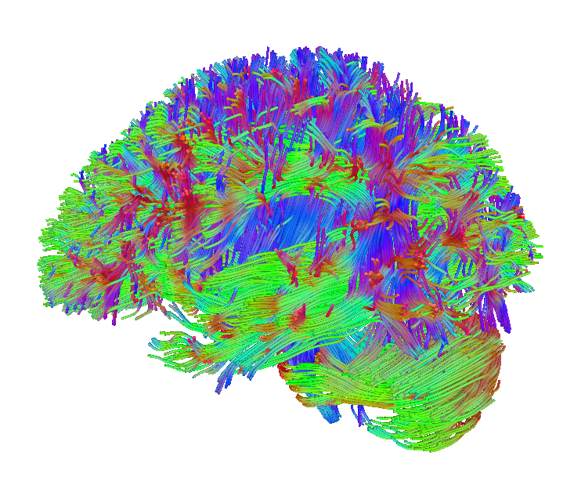
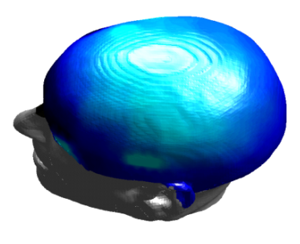
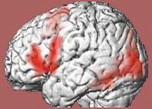
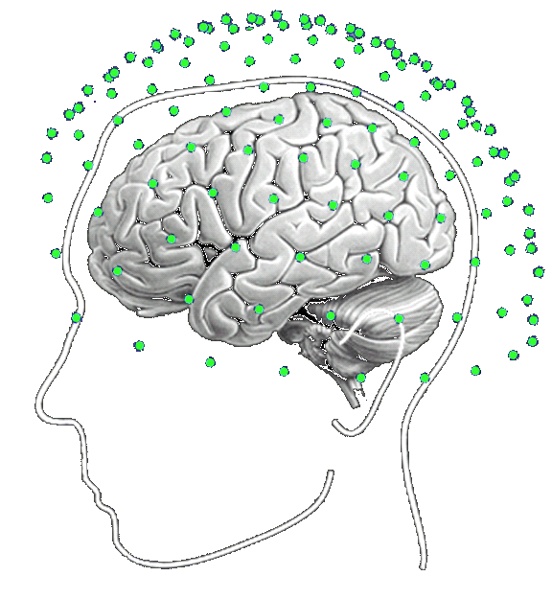
Dynamic causal modeling (DCM)
dwMRI
EEG, MEG
fMRI
structural priors
structural priors
Model inversion:
Estimating neuronal mechanisms
Forward model:
Predicting measured activity
Friston et al. 2003, NeuroImage
Notes:
Grand aim

Slide 4
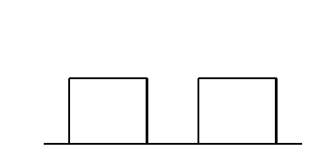
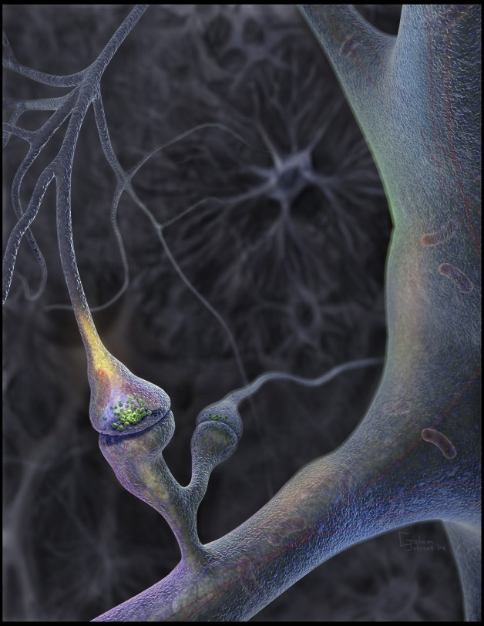
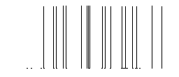
Neural population activity
u₂
u₁
x₃
fMRI signal change (%)
x₁
x₂
The Model Parameters (A, B, C, D) that represent cause of dynamical changes in the neural activity underlying the BOLD response

Slide 5
Generative models & model selection
any DCM = a particular generative model of how the data (may) have been caused
generative modelling: comparing competing hypotheses about the mechanisms underlying observed data
  a priori definition of hypothesis set (model space) is crucial
  determine the most plausible hypothesis (model), given the data
model selection ≠ model validation!
  model validation requires external criteria (external to the measured data)

Slide 6
Worked Example 1

Slide 7
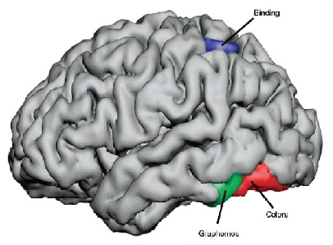
Brain Connectivity in Synesthesia
Study: van Leeuwen, den Ouden & Hagoort, 2011
Specific sensory stimuli lead to unusual, additional experiences
Grapheme-color synesthesia: color
Involuntary, automatic; stable over time, prevalence ~4%
Potential cause: aberrant cross-activation between brain areas
  grapheme encoding area (letter-shape area)
  color area V4
  superior parietal lobule (SPL)
Hubbard, 2007
Notes:
7
Music can elicit a sensation of color and shapes can elicit tastes

Slide 8
fMRI Design & ROIs
Idiosyncratic stimuli for each synesthete. Synesthesia-inducing graphemes (SG) noninducing control graphemes (NC) colored control graphemes (CG)
false font symbols (F)
The phenomenal experience of synaesthetic colour for synesthetes: Regions with a positive additive interaction for synaesthetes compared to controls, for the contrast of SG and NC: Right fusiform gyrus, V4 (MNI coordinates 36,76, 26), and in left SPL (MNI 24, 58, 46).
F
T
L
△

Slide 9
The A, B, C of the DCM
Stimuli:
Graphemes (G)
SPL
V4
LSA
C
Notes:
9
Music can elicit a sensation of color and shapes can elicit tastes

Slide 10
The A, B, C of the DCM
Stimuli:
Graphemes (G)
Colored Control graphemes (CG)
SPL
V4
LSA
C
C
Notes:
10
Music can elicit a sensation of color and shapes can elicit tastes

Slide 11
The A, B, C of the DCM
Stimuli: Graphemes (G)
Colored Control graphemes (CG)
Synesthesia-inducing graphemes (SG)
SPL
B
A
V4
LSA
A
B
C
C
Notes:
11
Music can elicit a sensation of color and shapes can elicit tastes

Slide 12
Two putative mechanisms (models)
Stimuli: Graphemes (G)
Synesthesia-inducing graphemes (SG)
Colored Control graphemes (CG)
Competing Model Hypotheses
Model 1 Grapheme color synesthesia induced
by direct cross-activation in ventral-occipital cortex
SPL
B
A
V4
LSA
A
B
C
C
Notes:
12
Music can elicit a sensation of color and shapes can elicit tastes

Slide 13
Two putative mechanisms (models)
Stimuli: Graphemes (G)
Synesthesia-inducing graphemes (SG)
Colored Control graphemes (CG)
Competing Model Hypotheses
Model 1 Grapheme color synesthesia induced
by direct cross-activation in ventral-occipital cortex
Model 2 Disinhibition feedback hypothesis, aberrant feedback from multimodal region SPL, activating V4
SPL
B
A
V4
LSA
A
B
C
C
Notes:
13
Music can elicit a sensation of color and shapes can elicit tastes

Slide 14
Two putative mechanisms (models)
Stimuli: Graphemes (G)
Synesthesia-inducing graphemes (SG)
Colored Control graphemes (CG)
Competing Model Hypotheses
Model 1 Grapheme color synesthesia induced
by direct cross-activation in ventral-occipital cortex
Model 2 Disinhibition feedback hypothesis, aberrant feedback from multimodal region SPL, activating V4
SPL
B
A
V4
LSA
A
B
C
C
SPL
B
A
A
A
V4
LSA
B
C
C
Initially no winning model
Notes:
14
Music can elicit a sensation of color and shapes can elicit tastes

Slide 15
Brain Connectivity in Synesthesia
SPL
Top Down
SPL
V4
LSA
V4
LSA
Bottom up
Notes:
15
Excedance probabilities

Slide 16
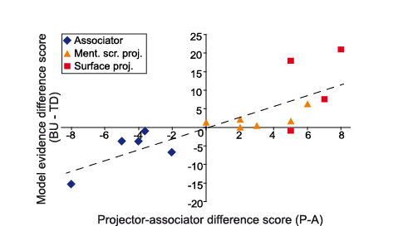
Brain Connectivity in Synesthesia
Van Leeuwen, den Ouden, Hagoort (2011) JNeurosci
Notes:
Important to point out that model comparison can be a conclusion

Slide 17
Worked Example 2

Slide 18
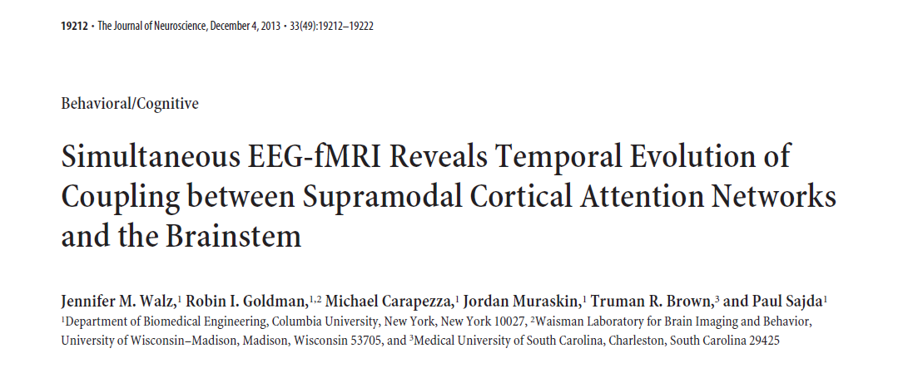
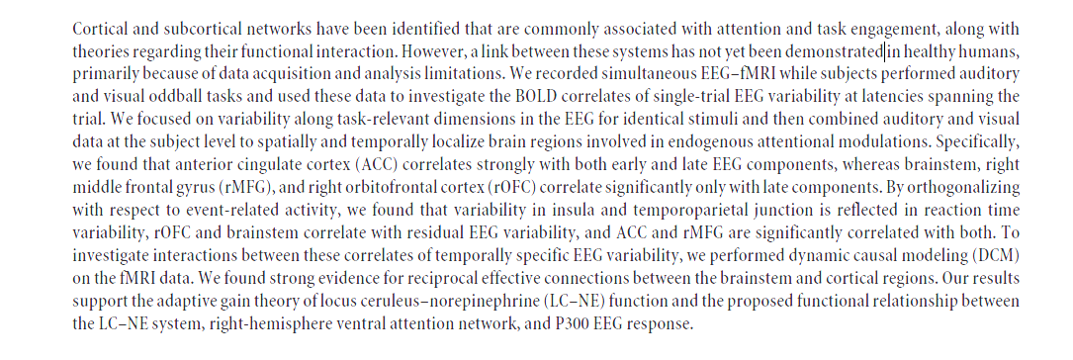
Brainstem interactions
To investigate interactions between correlates of temporally specific EEG variability, we performed dynamic causal modeling (DCM) on the fMRI data. We found strong evidence for reciprocal effective connections between the brainstem and cortical regions. Our results support the adaptive gain theory of locus ceruleus–norepinephrine (LC–NE) function and the proposed functional relationship between
the LC–NE system, right-hemisphere ventral attention network, and P300 EEG response.

Slide 19



Building the DCM hypothesis
Rationale: Despite extensive study, the mechanism of P300 generation is still not completely understood, although invasive animal studies suggest that it is deeply rooted in the brainstem (BS), involving the locus ceruleus (LC)
Study Design: A visual and auditory oddball paradigm with button press to target using contemporaneous EEG fMRI
Notes:
we do not investigate the
discriminating projection of the EEG data itself but instead the
BOLD correlates of STV along that projection.

Slide 20
ROIs for DCM from GLM
Regions correlated with projected EEG variability in discrimination
Notes:
BOLD fMRI correlate of EEG STV detected in the BS. EEG discriminating component
variability in the 450 ms window correlated negatively with a 21-voxel cluster in the midbrain.
Minimum FWE-corrected p value of 0.0018 was located at MNI coordinates (0,28,20).

Slide 21
ROIs for DCM from GLM
A subgraph based on p values
and previous findings/hypotheses
Notes:
BOLD fMRI correlate of EEG STV detected in the BS. EEG discriminating component
variability in the 450 ms window correlated negatively with a 21-voxel cluster in the midbrain.
Minimum FWE-corrected p value of 0.0018 was located at MNI coordinates (0,28,20).

Slide 22
A, B and C for DCM
Input indicates onset of target and stimulus
Notes:
Model space was partitioned for family analysis based on ACC–BS connectivity. ACC to BS: Models 1, 2, 7, 10, 11, and 12; BS to ACC: Models 3, 6,
and 8; bidirectional connectivity: Models 4, 5, and 9. The optimal model is noted with a gray box.

Slide 23
A, B and C for the optimal model
Bayesian Parameter Average
(weighted mean)
Notes:
Model space was partitioned for family analysis based on ACC–BS connectivity. ACC to BS: Models 1, 2, 7, 10, 11, and 12; BS to ACC: Models 3, 6,
and 8; bidirectional connectivity: Models 4, 5, and 9. The optimal model is noted with a gray box.

Slide 24
Their Conclusions
Connectivity parameter magnitudes and signs (determined by BPA) suggest that the role of the BS in these modulations is excitatory across the duration of the trial and multiple cortical regions, whereas the rOFC plays an inhibitory role late in the trial.
The integral role of the ACC in attentional modulations is likely more complex, with dependencies in both space (bilateral ACC vs right paracingulate/ACC region) and time (early 200 ms vs later 425 ms poststimulus). Specifically, activity within bilateral ACC may act to inhibit evoked BS activations early in the trial, but then rACC may drive this activity later in the trial.
Our DCM results further support the adaptive gain theory of the LC–NE system, and together with the EEG-based GLM results they expand on it by providing additional information regarding the timing of involvement of these regions

Slide 25
Worked Example 3

Slide 26
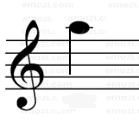

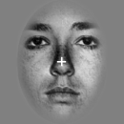
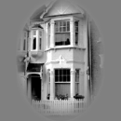
Learning of dynamic audio-visual associations
Conditioning Stimulus
Target Stimulus
1
CS
1
CS
2
0.8
or
or
0.6
p(face)
0.4
CS
TS
Response
0.2
0
200
400
600
800
2000 ± 650
Time (ms)
0
0
200
400
600
800
1000
trial
den Ouden et al. 2010, J. Neurosci.
Notes:
How I intend to study these questions in the future is perhaps best illustrated using a previously published study. Subjects performed a simple discrimination task on faces and houses. They could speed up their responses by learning the predictive strength of immediately preceding auditory cues. To enforce ongoing learning, the associative strength of the auditory cues were changing unpredictably over time.

Slide 27
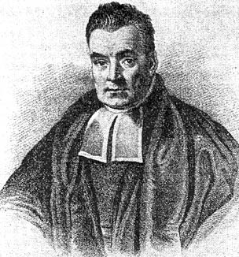
Hierarchical Bayesian learning model
prior on volatility
k
volatility
v_{t-1}
v_{t}
probabilistic association
r_{t}
r_{t+1}
observed events
u_{t}
u_{t+1}
Behrens et al. 2007, Nat. Neurosci.
Mathys et al. Front. Hum. Neurosci., 2014

Slide 28
Explaining RTs by different learning models
Reaction times
1
True
450
Bayes Vol
0.8
HMM fixed
440
HMM learn
RW
430
p(F)
0.6
RT (ms)
420
410
0.4
400
0.2
390
0.1
0.3
0.5
0.7
0.9
0
p(outcome)
400
440
480
Trial
520
560
600
5 alternative learning models:
categorical probabilities
hierarchical Bayesian learner
Rescorla-Wagner
Hidden Markov models
(2 variants)
Bayesian model selection:
hierarchical Bayesian model performs best
den Ouden et al. 2010, J. Neurosci.
Notes:
The behavioral data showed a very nice learning effect: responses accelerated significantly with increasing predictive strengths of the cues. Using Bayesian model selection, we tested which of five commonly used learning models best explained the trial-by-trial reaction times. We found that a hierarchical Bayesian model performed best across the group.

Slide 29
Prediction error (PE) activity in the putamen (previous findings)
PE during incidental
sensory learning
den Ouden et al. 2009, Cerebral Cortex
PE = “teaching signal” for synaptic plasticity during learning
PE during
reinforcement learning
O'Doherty et al. 2004, Science

Slide 30
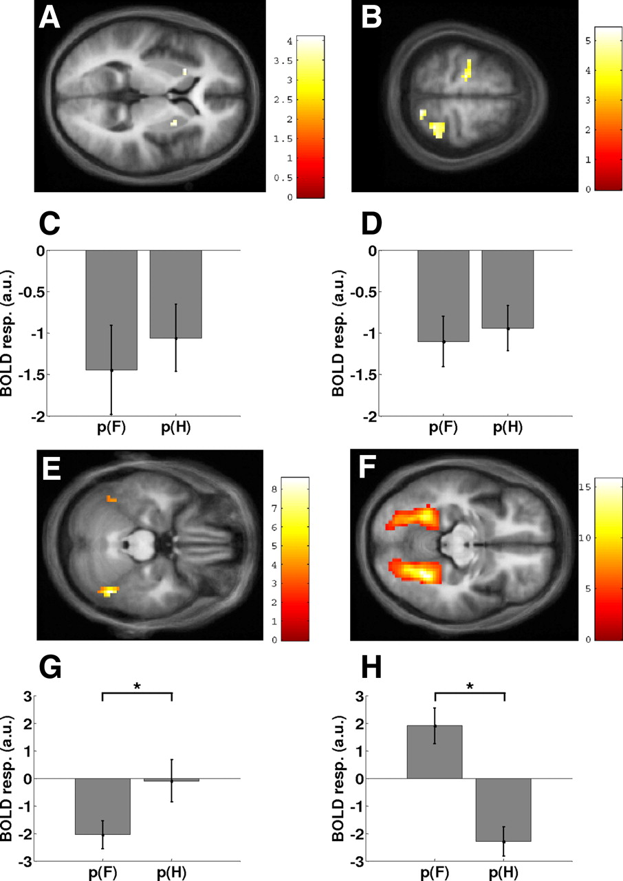
Prediction error (PE) activity in the putamen (BOLD here)
>
>

Slide 31


DCM: Prediction errors control plasticity during adaptive cognition
Modulation of visuo-motor connections by striatal prediction error activity
Influence of visual areas on premotor cortex:
  stronger for surprising stimuli
  weaker for expected stimuli
Hierarchical Bayesian learning model input
PUT
p = 0.010
p = 0.017
PMd
PPA
FFA
den Ouden et al. 2010, J. Neurosci .
Notes:
There is a longstanding hypothesis by several learning theories that synaptic plasticity should be determined by prediction errors. We tested this hypothesis by embedding the computational learning model into a DCM of interactions between visual and motor cortex. Specifically, we used the Bayesian model to represent how trial-by-trial prediction error activity in the putamen gated the information flow from stimulus-specific visual areas to the premotor cortex.
Indeed, we found that the strength of the visuo-motor connections increased with trial-specific prediction error.

Slide 32
Overview
Connecting Theory & Practice, Worked Examples
Translational Neuromodeling
New Advances

Slide 33
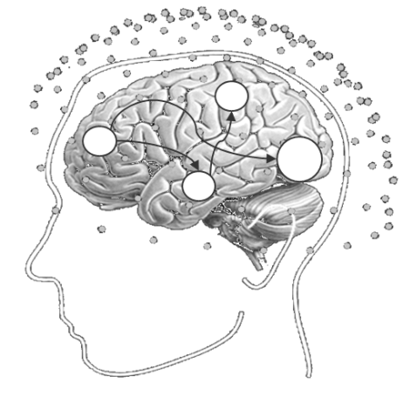





❶
Computational assays:
Models of disease mechanisms
Translational Neuromodeling
❹
Individual treatment prediction
❸
Detecting physiological subgroups
(based on inferred mechanisms)
❷
Application to brain activity and behaviour of individual patients
• disease mechanism A
• disease mechanism B
• disease mechanism C
Stephan et al. 2015, Neuron

Slide 34
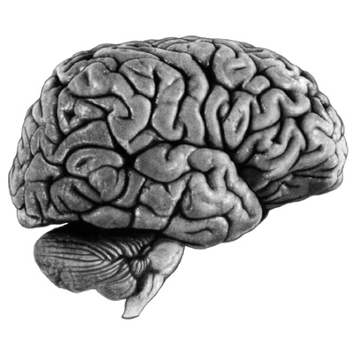
Model-based predictions for single patients
model structure
DA
BMS
parameter estimates
model-based decoding
(generative embedding)
Notes:
Overall, Bayesian model selection is a generic and powerful procedure that has found widespread application in machine learning and neuroimaging. However, as every method, it has limitations and there are cases when it cannot be used at all. For these cases, we have been developing a new approach which we colloquially refer to as “model-based decoding”. This approach rests on using a model for theory-guided dimensionality reduction and selecting those data features which are used subsequently for classification. Here, different models can be compared, by cross-validation, in terms of how well their parameters preserve information about the relevant class labels.

Slide 35
Model-based differential diagnosis
SYMPTOM
(behaviour
or physiology)
HYPOTHETICAL
MECHANISM
...
...
Stephan et al. 2017, NeuroImage

Slide 36
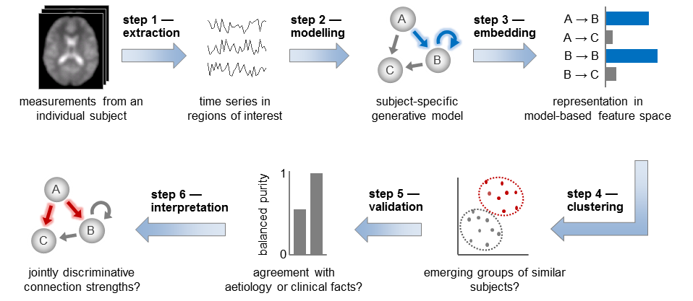
Generative embedding (unsupervised): detecting patient subgroups
Brodersen et al. 2014, NeuroImage: Clinical

Slide 37
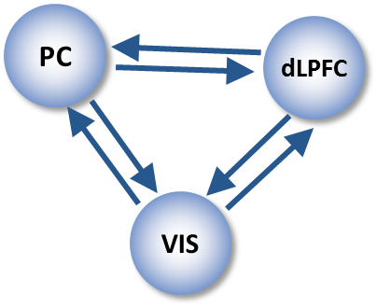
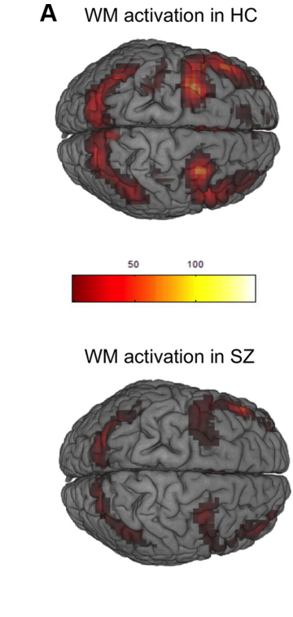
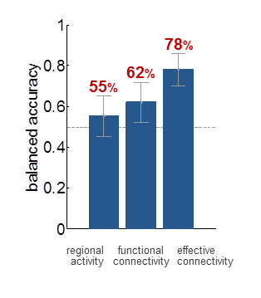
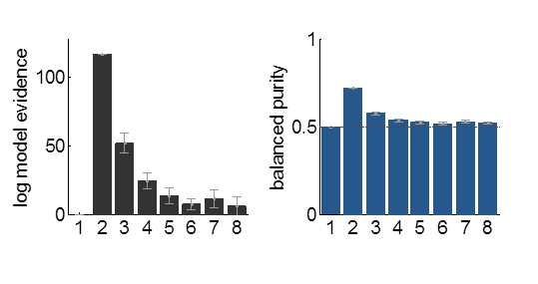
Generative embedding of variational Gaussian Mixture Models
42 controls vs. 41 schizophrenic patients
fMRI data from working memory task (Deserno et al. 2012, J. Neurosci)
Supervised:
SVM classification
Unsupervised:
GMM clustering
71%
number of clusters
number of clusters
Brodersen et al. (2014) NeuroImage: Clinical
Notes:
*** Get images from Deserno
for 2-back versus 0-back in healthy controls (top panel) and schizophrenia patients (bottom panel),
No main effect but group x performance x task effect

Slide 38
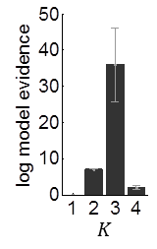
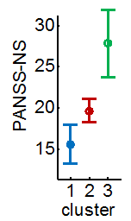
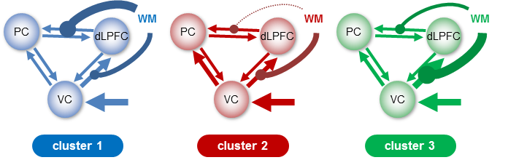
Detecting subgroups of patients in schizophrenia
Optimal cluster solution
three distinct subgroups (total N=41)
subgroups differ (p < 0.05) wrt. negative symptoms on the positive and negative symptom scale (PANSS)
Brodersen et al. (2014) NeuroImage: Clinical

Slide 39
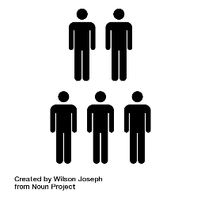
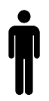


Parametric Empirical Bayes (PEB)
Group
Mean
Disease
First level DCM
Image credit: Wilson Joseph from Noun Project
Friston et al. 2016, NeuroImage

Slide 40



Parametric Empirical Bayes (PEB)
Priors on second level parameters
Second level
Between-subject error
Second level (linear) model
First level
Measurement noise
DCM for subject i
Friston et al. 2016, NeuroImage

Slide 41


Parametric Empirical Bayes (PEB)
Design matrix
(covariates)
Matrix of DCM
connections
Between-subjects (X)
Within-subjects (W)
5
1
10
2
3
15
Connection
Subject
20
4
25
5
30
6
1
2
3
2
4
6
Covariate
Connection
X (between-subject): overall mean, group differences, age etc.
W (within-subject): parameters that show random effects
Notes:
** check convoluation

Slide 42

Parametric Empirical Bayes (PEB)
Design matrix
(covariates)
Matrix of DCM
connections
Between-subjects (X)
Within-subjects (W)
(1)
⊗
X
K
5
1
1
10
2
2
3
3
15
Connection
Connection
Subject
20
4
4
25
5
5
30
6
6
1
2
3
2
4
6
5
10
15
Covariate
Connection
PEB Parameter
X (between-subject): overall mean, group differences, age etc.
W (within-subject): parameters that show random effects

Slide 43
Parametric Empirical Bayes (PEB)
Bayesian model reduction:
  analytic equations for the log evidence of any submodel, once the full model has been inverted
model space = all models that are nested within a full model
Note:
random effects approach in parameters, not models (random parametric effects)
Litvak et al. 2016,
Frontiers

Slide 44
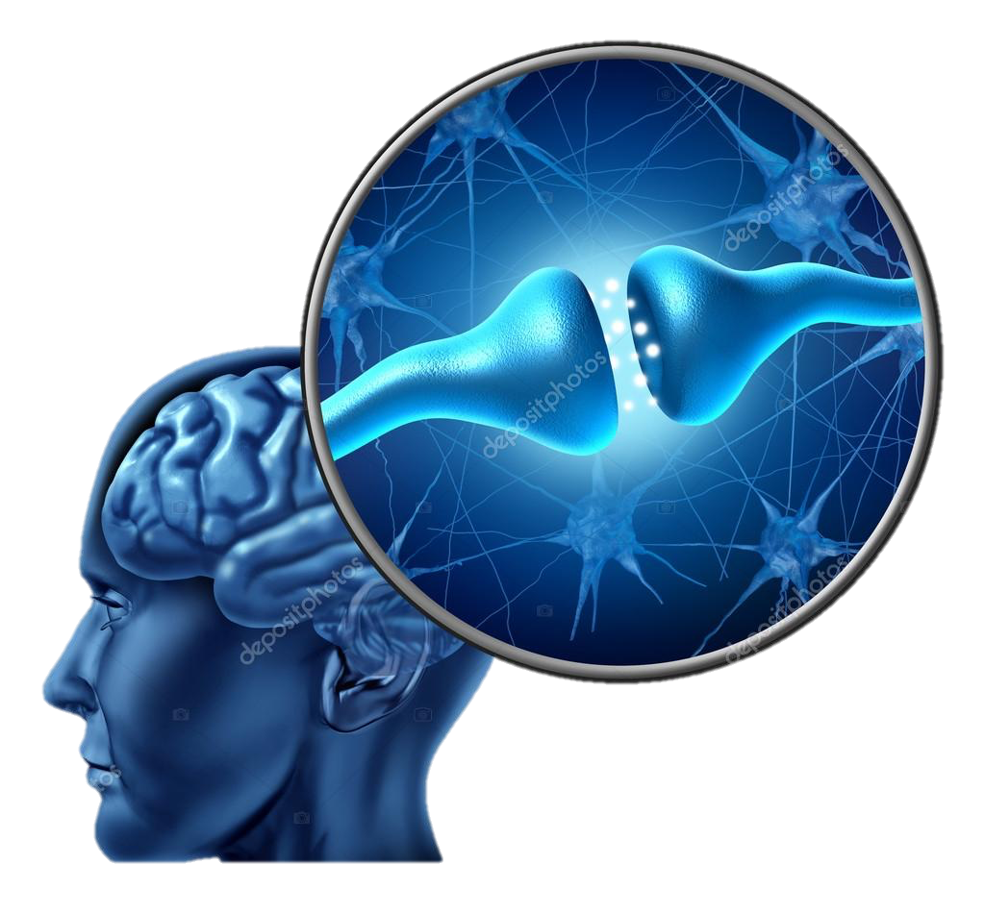

Using PEB to dissociate mechanisms of autoimmune ‘psychosis’
“I was walking through Times Square, during which colors appeared aggressively bright. I remember thinking: “I’m seeing everything in a sinister light now. Everything is dripping in terrible meaning.”.”
“In the spring of 2009, I was the 217th person ever to be diagnosed with anti-NMDA-receptor autoimmune encephalitis. Just a year later, that figure had doubled. Now the number is in the thousands. Yet Dr. Bailey, considered one of the best neurologists in the country, had never heard of it.”
...
...

Slide 45
Anti-NMDA Receptor Encephalitis
“A severe, multistage, treatable disorder presenting with psychosis” (Wandinger, Dalmua, 2011)
Autoimmune disorder – including a paraneoplastic syndrome from teratoma or other tumors
Autoantibodies attenuate NMDAR function through the internalization of NMDAR
Symptoms
Diagnosis: A positive antibody titer
Treatment: Tumor removal, intravenous corticosteroids
and intravenous immunoglobulins
Prognosis: 75% Recovery, 6 – 25% mortality
Memory / Perceptual
Disturbances
Emotional Disturbances
Dyskinesias
Dysautonomia
Psychosis
Seizures
+ve
-ve
Notes:
80:20 women to men
Tumors can be lung, breast, thyroid …thought the body produced antibodies to something like and NMDA protien in the tumor
Immunoflourescent test

Slide 46
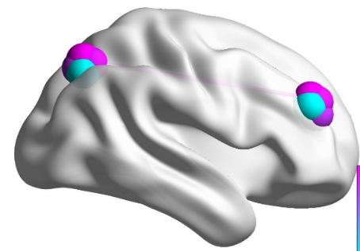
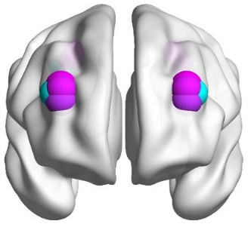
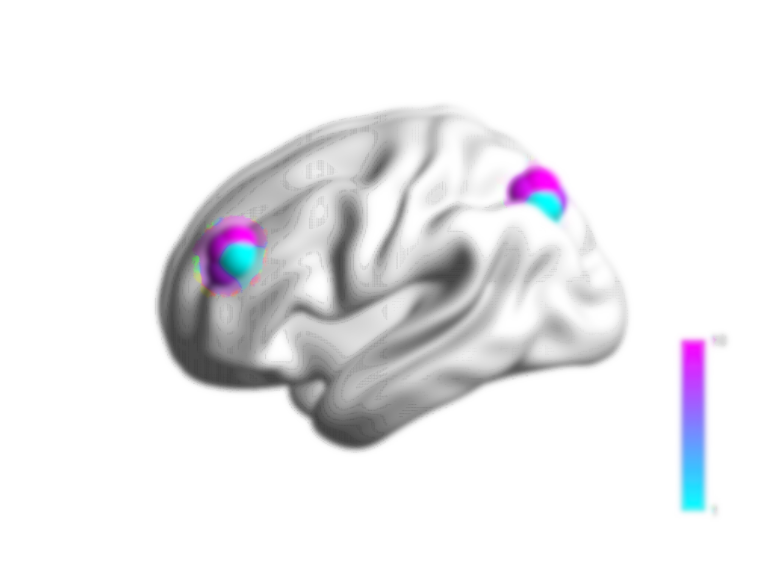
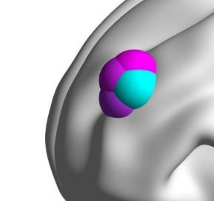
DCM: Anti-NMDA Receptor Encephalitis – from EEG to fMRI?
Superficial
Pyramidal Cells
Inhibitory
Interneurons
Bilateral network with frontoparietal connections and regional Neural Mass Models
Layer IV
Stellates
Layer IV
Stellates
Superficial
Pyramidal Cells
Deep
Pyramidal
Cells
Inhibitory
Interneurons
NMDA Receptor
AMPA Receptor
GABA_{A} Receptor
Deep
Pyramidal Cells
Canonical Microcircuit
Model Fits
NMDA Encephalitis
Other Encephalopathy
Neurological Patient Control
Beta/Gamma DCMs
Delta/Theta DCMs
0.09
0.09
0.15
n.s.
1
Data
DCM
1
Power (a.u.)
0.1
0.8
0.8
0.06
0.06
0.6
0.6
% Variance Explained
0.03
0.03
0.05
0.4
0.4
0
0
0
0.2
0.2
20
25
30
35
40
45
20
25
30
35
40
45
20
25
30
35
40
45
0
N E C
0
N E C
Frequency (Hz)
Frequency (Hz)
Frequency (Hz)

Slide 47
Group Effects (PEB)
Anti-NMDA Receptor Encephalitis +ve Serum titer | Encephalopathy (Brain slowing)
N = 31, Age 28 yrs +/- 16, (22 Female) | N = 18, Age 28 +/- 5, (11 Female)
12 minutes Resting State 32-channel EEG | 12 minutes Resting State 32-channel EEG
Acute, Subacute Recovering or Chronic | Etiology: Metabolic, Infectious & Hypoxic Cause
Treatment: steroids, plasma exchange, IVG
Neurological Patient Controls
N = 18, Age 31 +/- 6, (10 Female)
12 minutes Resting State 32-channel EEG
Symmonds, Moran, Leite, Irani, Buckley, Stephan, Friston & Moran, Brain, (2018)

Slide 48
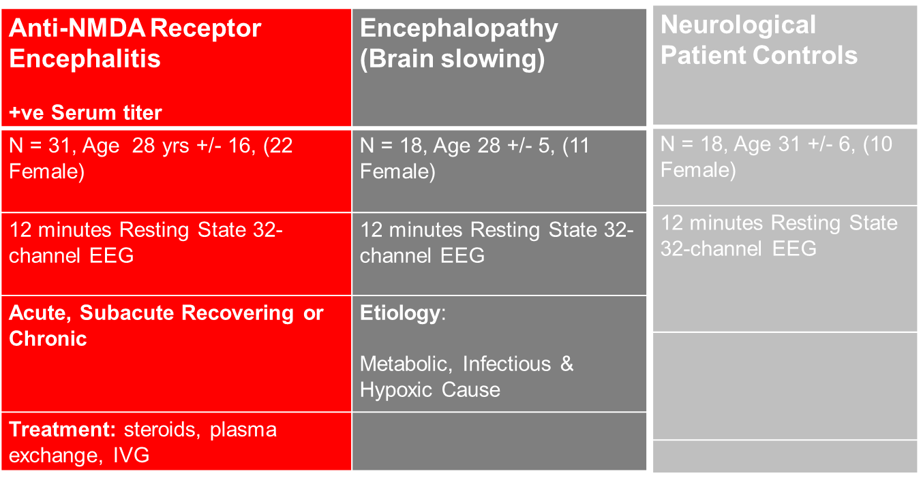
Group Effects in a DM for PEB
Stack individual DCMs
DCM{1}…
…
…
…
…
…
DCM{N}
1
0
Anti-NMDA Patients Enceph patients Controls
Group
Effect
Encephalopathy
Effect
NMDAR
Effect

Slide 49
Group Effects (PEB)
Effect of Encephalopathy
Effect of anti-NMDAR Encephalitis
0.5
0.4
0.2
Effect Size
Effect Size
0
0
-0.2
-0.5
-0.4
-0.6
-1
0
5
10
15
20
25
30
35
-0.8
0
5
10
15
20
25
30
35
Parameter
*
Parameter
*
*
****
**
** * * **** * * *
1
1
0.9
The Average Effect / Model +
0.9
0.8
0.8
0.7
0.7
0.6
Probability of Effect
Probability of Effect
0.6
0.5
0.5
0.4
0.4
0.3
0.3
0.2
0.2
0.1
0.1
0
0
0
5
10
15
20
25
30
35
0
5
10
15
20
25
30
35
Parameter
Parameter
Receptor
Summary
Receptor Summary
NMDA Receptor*
AMPA Receptor*
GABA_{A} Receptor*
NMDA Receptor*
AMPA Receptor
GABA_{A} Receptor
*
*
*
n.s.
*
n.s.
Symmonds, Moran, Leite, Irani, Buckley, Stephan, Friston & Moran, Brain, (2018)

Slide 50
Comparison of RFX BMS and PEB
RFX BMS (spm_bms) | PEB (spm_dcm_peb)
treats models as random effects in the population | treats parameters (of a full model) as random effects in the population
implementation works for any type of model (incl. models of behaviour) | currently implemented for models in SPM
can deal with non-nested models (structurally different likelihoods) | restricted to nested models
pre-defined model space | exhaustive comparison of all submodels nested within a full model
fully Bayesian approach (flat Dirichlet prior on model frequency, informed priors on model parameters) | empirical Bayesian approach (informed prior on between-subject variability)
VB or MCMC | VB
usually slow at 1st level, fast at 2nd level | fast
Notes:
Also:
RFX BMS can use either MCMC or VB (at subject- and group-level)
RFX BMS has established procedures to deal with overfitting problems (in model space); overfitting in models space may be a problem for PEB (a very large number of models is tested implicitly)

Slide 51
Overview
Connecting Theory & Practice, Worked Examples
Translational Neuromodeling
New Advances

Slide 52
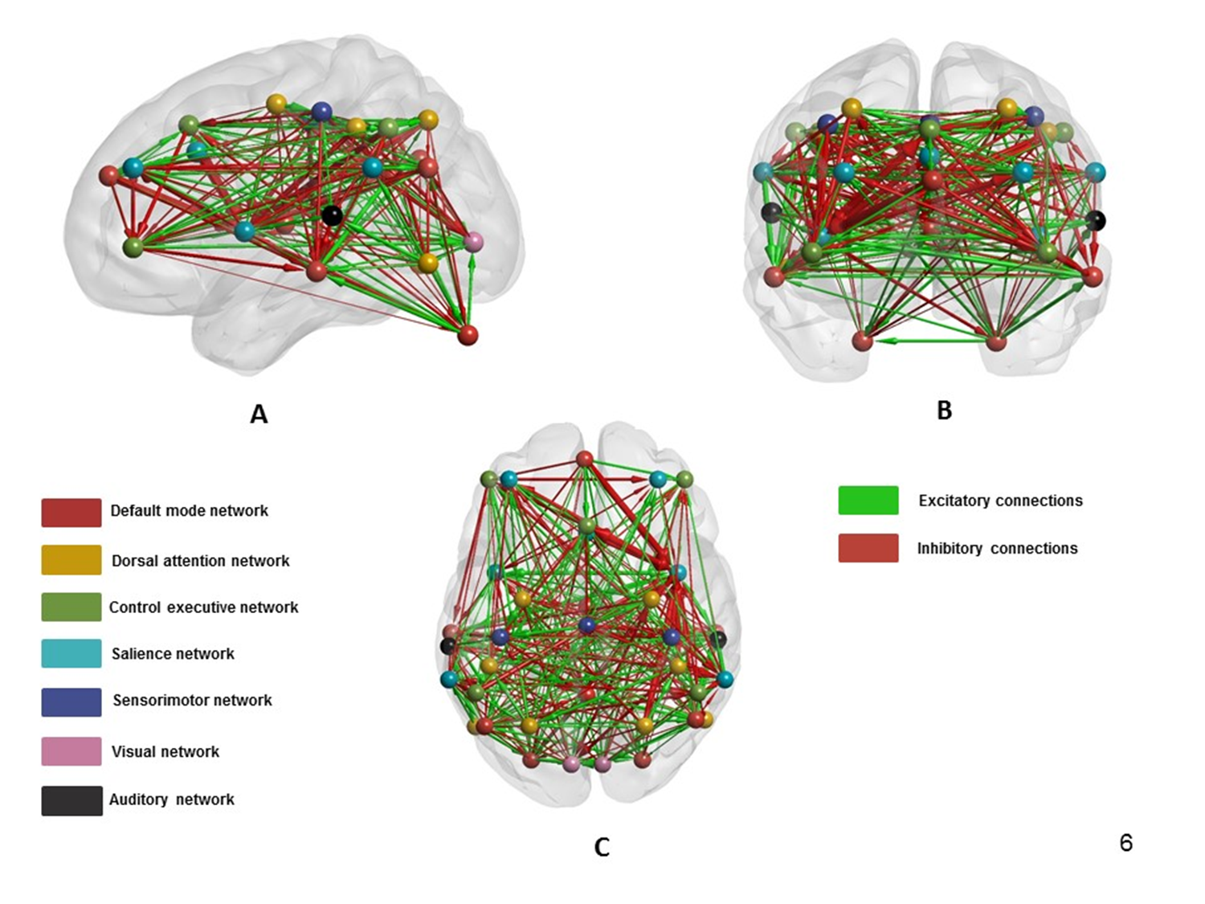
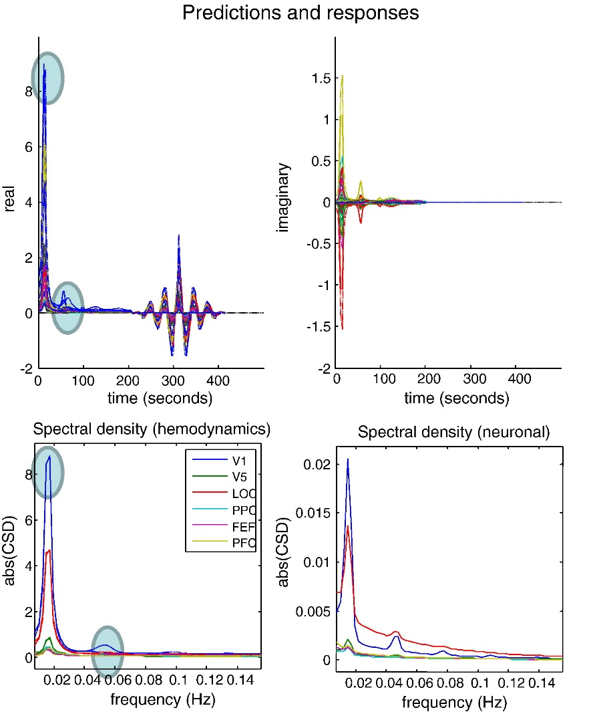
Spectral DCMs for resting state modeling
Razi et al. 2017, Network Neuroscience
Patterns of functional connectivity (modes) as constraints (Seghier & Friston 2013) - replacing priors on coupling among nodes with priors on coupling among modes (where modes correspond to the principal components of the functional connectivity matrix)
Reduced the rank of the prior covariance and hence the effective number of parameters, overcoming overfitting
Operated via the ‘spectral option’ – efficient and accurate scheme
Friston et al. 2014, Neuroimage
Notes:
Putting Bayes & Priors to work

Slide 53
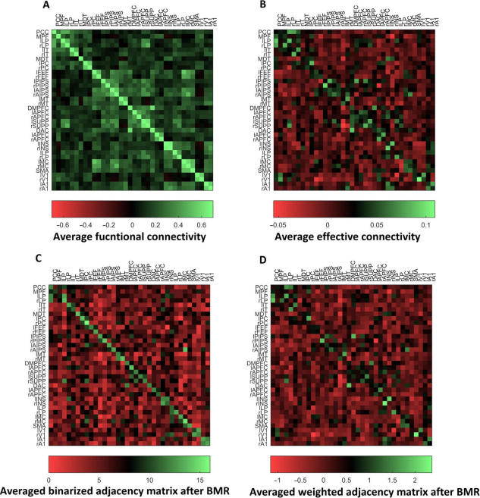
Spectral DCMs for resting state modeling
Noise processes accounted for
Directed Graphs
Signed Connections
Different topologies to traditional rsfMRI
And…Bayesian Model Reduction reveals sparser graphs
Remove edges from parent graph and assess change in Free Energy
Principled pruning
Razi et al. 2017, Network Neuroscience
Notes:
Result from a single subject

Slide 54
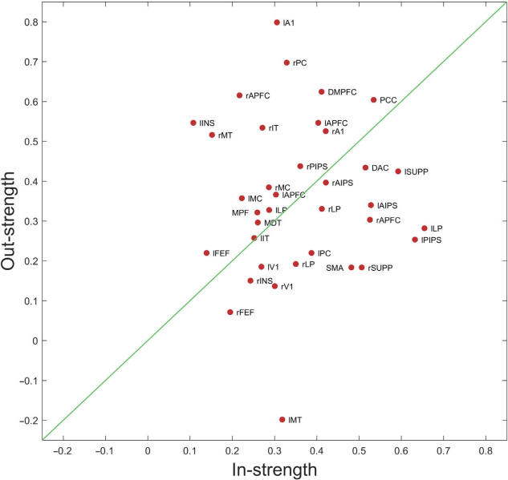
Spectral DCMs for resting state modeling
Who’s talking to who?
In node and out node deconstruction

Slide 55
Spectral DCMs for resting state modeling
Who’s talking to who?
In node and out node deconstruction
Senders vs receivers
Insula
Medial PFC
PCC

Slide 56
Spectral DCMs for resting state modeling
Who’s talking to who?
In node and out node deconstruction
Senders vs receivers
Insula
Medial PFC
PCC
Supplementary motor area
V1
Frontal eye field

Slide 57
Spectral DCMs for resting state modeling
Who’s talking to who?
In node and out node deconstruction
Senders vs receivers
Is there a hierarchy in your data?
Insula
Medial PFC
PCC
Supplementary motor area
V1
Frontal eye field

Slide 58
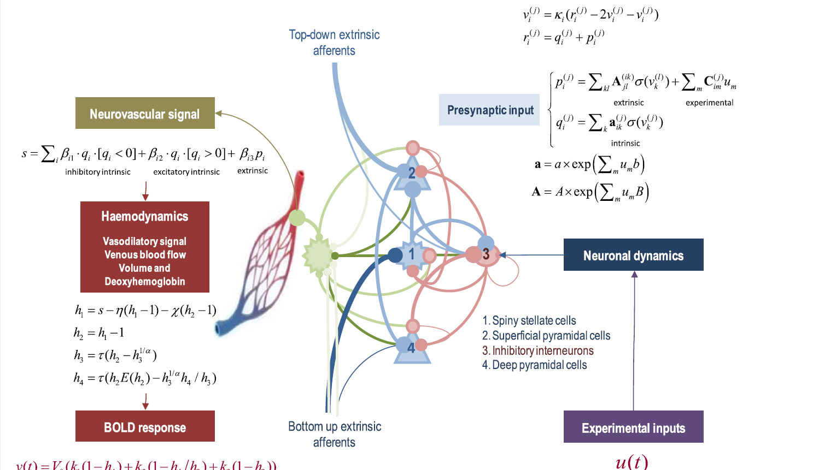
DCM for fMRI using a canonical microcircuit
Distinct contributions to neurovascular effectors
Replace Taylor expansion with convolutional operators at population synapses
Experimental inputs & modulators at particular cell types
Similar forward model – no superfast sampling required – inference based on regional amplitudes
Friston et al. 2017, NeuroImage
Notes:
Neurovascular signal from calcium in astrocytes – drives vasodilation through NO – subject to autoregulation – h2 – blood flow in response to vasodilatory signal – changes volume & deoxyhemoglobin
Here there is a laminar specific drive to the neurovascular (astrocytic) signal – via presynaptic activity .. preserving the distinct contributions from within and amongst nodes

Slide 59
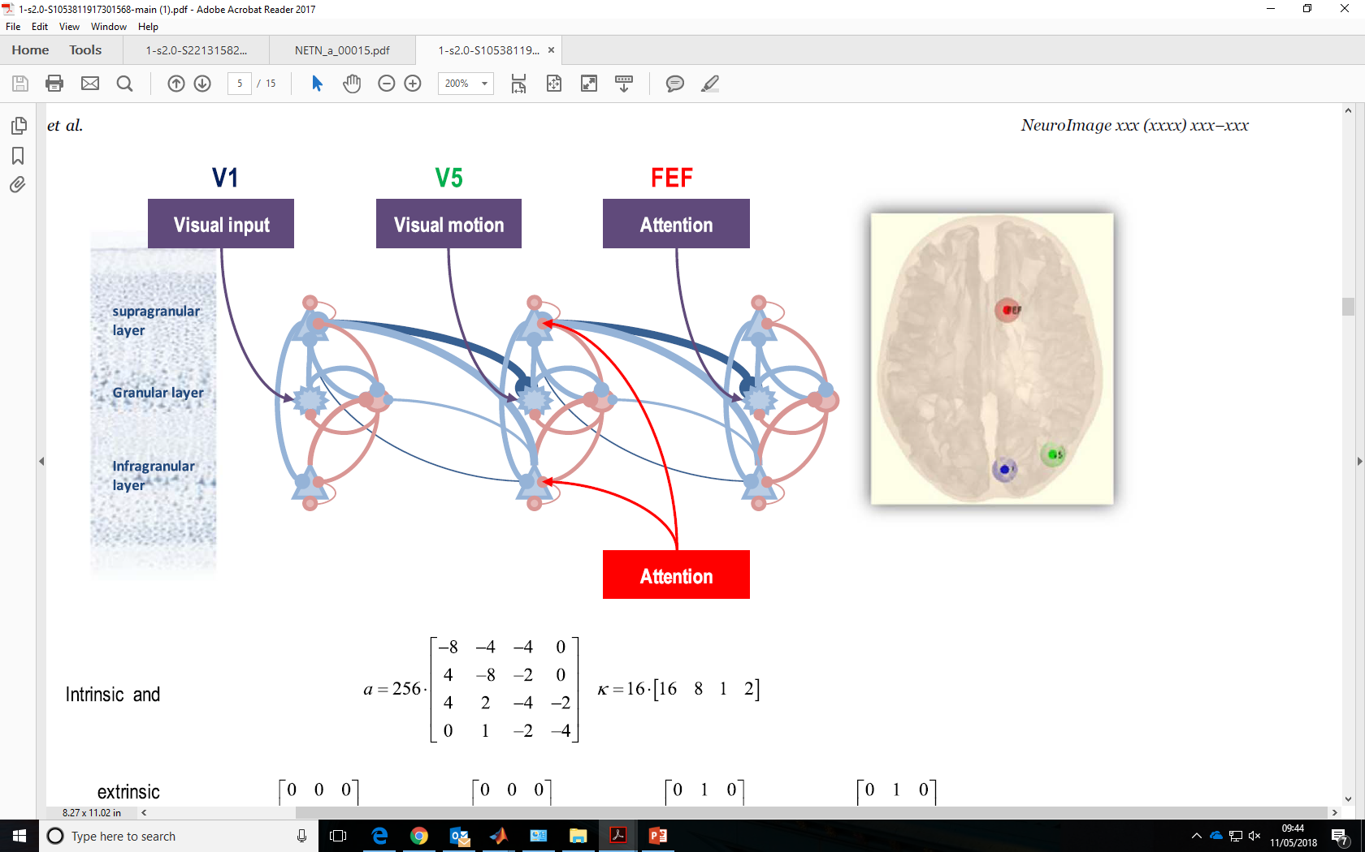
DCM for fMRI using a canonical microcircuit
Do haemodynamic responses reflect afferent input or intrinsic activity?
What is the neurovascular response at different induced frequencies?
Is there a hierarchy present in these fMRI?
Friston et al. 2017, NeuroImage

Slide 60
DCM for fMRI using a canonical microcircuit
Do haemodynamic responses reflect afferent input or intrinsic activity?
What is the neurovascular response at different induced frequencies?
Is there a hierarchy present in these fMRI?
Which layer of cells is modulated by attention/brain stem inputs
Friston et al. 2017, NeuroImage

Slide 61
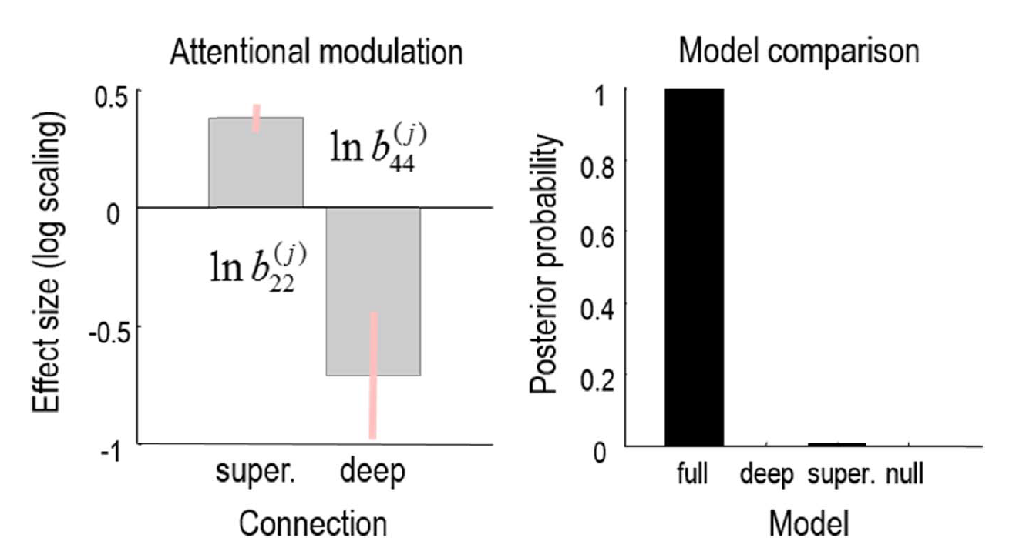
DCM for fMRI using a canonical microcircuit
Do haemodynamic responses reflect afferent input or intrinsic activity?
What is the neurovascular response at different induced frequencies?
Is there a hierarchy present in these fMRI?
Which layer of cells is modulated by attention/brain stem inputs
Friston et al. 2017, NeuroImage

Slide 62
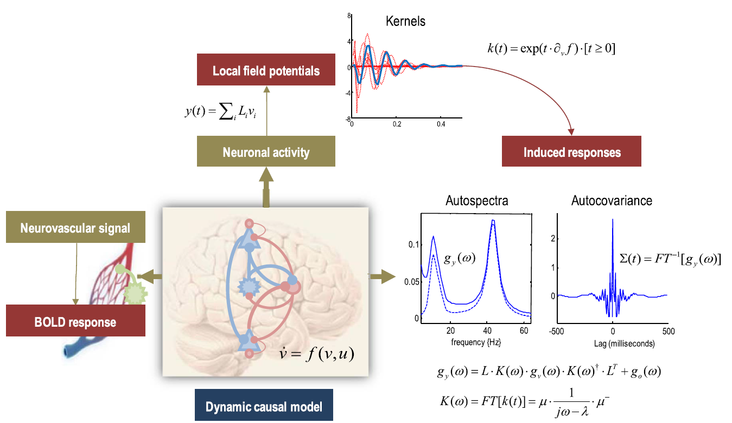
Multimodal fusion
possible strategy:
standard SPM of fMRI to detect local activations
use activations as spatial priors for inferring neuronal parameters from EEG
Optimize based on both LFP/EEG and fMRI
Friston et al. 2017, NeuroImage
Notes:
Just add L!

Slide 63
Further reading: DCM for fMRI and BMS – part 1
Aponte EA, Raman S, Sengupta B, Penny WD, Stephan KE, Heinzle J (2016) mpdcm: A toolbox for massively parallel dynamic causal modeling. J Neurosci Methods 257:7-16.
Brodersen KH, Schofield TM, Leff AP, Ong CS, Lomakina EI, Buhmann JM, Stephan KE (2011) Generative embedding for model-based classification of fMRI data. PLoS Computational Biology 7: e1002079.
Brodersen KH, Deserno L, Schlagenhauf F, Lin Z, Penny WD, Buhmann JM, Stephan KE (2014) Dissecting psychiatric spectrum disorders by generative embedding. NeuroImage: Clinical 4: 98-111
Daunizeau J, David, O, Stephan KE (2011) Dynamic Causal Modelling: A critical review of the biophysical and statistical foundations. NeuroImage 58: 312-322.
Daunizeau J, Stephan KE, Friston KJ (2012) Stochastic Dynamic Causal Modelling of fMRI data: Should we care about neural noise? NeuroImage 62: 464-481.
Frässle S, Lomakina EI, Razi A, Friston KJ, Buhmann JM, Stephan KE (2017) Regression DCM for fMRI. NeuroImage 155:406-421.
Friston KJ, Harrison L, Penny W (2003) Dynamic causal modelling. NeuroImage 19:1273-1302.
Friston K, Stephan KE, Li B, Daunizeau J (2010) Generalised filtering. Mathematical Problems in Engineering 2010: 621670.
Friston KJ, Li B, Daunizeau J, Stephan KE (2011) Network discovery with DCM. NeuroImage 56: 1202–1221.
Friston K, Penny W (2011) Post hoc Bayesian model selection. Neuroimage 56: 2089-2099.
Friston KJ, Litvak V, Oswal A, Razi A, Stephan KE, van Wijk BC, Ziegler G, Zeidman P (2016) Bayesian model reduction and empirical Bayes for group (DCM) studies. NeuroImage 128:413-431.
Friston KJ, Preller KH, Mathys C, Cagnan H, Heinzle J, Razi A, Zeidman P (2017) Dynamic causal modelling revisited. NeuroImage, doi: 10.1016/j.neuroimage.2017.02.045.
Heinzle J, Koopmans PJ, den Ouden HE, Raman S, Stephan KE (2016) A hemodynamic model for layered BOLD signals. Neuroimage 125:556-570.
Kiebel SJ, Kloppel S, Weiskopf N, Friston KJ (2007) Dynamic causal modeling: a generative model of slice timing in fMRI. NeuroImage 34:1487-1496.
Li B, Daunizeau J, Stephan KE, Penny WD, Friston KJ (2011) Stochastic DCM and generalised filtering. NeuroImage 58: 442-457
Lomakina EI, Paliwal S, Diaconescu AO, Brodersen KH, Aponte EA, Buhmann JM, Stephan KE (2015) Inversion of Hierarchical Bayesian models using Gaussian processes. NeuroImage 118: 133-145.
Marreiros AC, Kiebel SJ, Friston KJ (2008) Dynamic causal modelling for fMRI: a two-state model. NeuroImage 39:269-278.

Slide 64
Further reading: DCM for fMRI and BMS – part 2
Penny WD, Stephan KE, Mechelli A, Friston KJ (2004a) Comparing dynamic causal models. NeuroImage 22:1157-1172.
Penny WD, Stephan KE, Mechelli A, Friston KJ (2004b) Modelling functional integration: a comparison of structural equation and dynamic causal models. NeuroImage 23 Suppl 1:S264-274.
Penny WD, Stephan KE, Daunizeau J, Joao M, Friston K, Schofield T, Leff AP (2010) Comparing Families of Dynamic Causal Models. PLoS Computational Biology 6: e1000709.
Penny WD (2012) Comparing dynamic causal models using AIC, BIC and free energy. Neuroimage 59: 319-330.
Raman S, Deserno L, Schlagenhauf F, Stephan KE (2016) A hierarchical model for integrating unsupervised generative embedding and empirical Bayes. J Neurosci Methods 269: 6-20.
Rigoux L, Stephan KE, Friston KJ, Daunizeau J (2014) Bayesian model selection for group studies – revisited. NeuroImage 84: 971-985.
Stephan KE, Weiskopf N, Drysdale PM, Robinson PA, Friston KJ (2007) Comparing hemodynamic models with DCM. NeuroImage 38:387-401.
Stephan KE, Kasper L, Harrison LM, Daunizeau J, den Ouden HE, Breakspear M, Friston KJ (2008) Nonlinear dynamic causal models for fMRI. NeuroImage 42:649-662.
Stephan KE, Penny WD, Daunizeau J, Moran RJ, Friston KJ (2009a) Bayesian model selection for group studies. NeuroImage 46:1004-1017.
Stephan KE, Tittgemeyer M, Knösche TR, Moran RJ, Friston KJ (2009b) Tractography-based priors for dynamic causal models. NeuroImage 47: 1628-1638.
Stephan KE, Penny WD, Moran RJ, den Ouden HEM, Daunizeau J, Friston KJ (2010) Ten simple rules for Dynamic Causal Modelling. NeuroImage 49: 3099-3109.
Stephan KE, Iglesias S, Heinzle J, Diaconescu AO (2015) Translational Perspectives for Computational Neuroimaging. Neuron 87: 716-732.
Stephan KE, Schlagenhauf F, Huys QJ, Raman S, Aponte EA, Brodersen KH, Rigoux L, Moran RJ, Daunizeau J, Dolan RJ, Friston KJ, Heinz A.(2017) Computational neuroimaging strategies for single patient predictions. Neuroimage 145: 180-199.

Slide 65
Thank you

