Slide 1
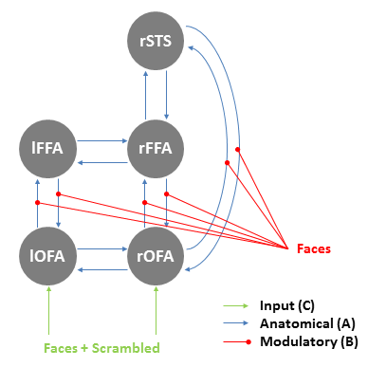

DCM Demo –
Model Specification, Inversion and 2nd Level Inference
Richard Rosch and Tim West

Slide 2
What questions can I ask with DCM?
What is the best model with the dynamics suited to cause my data?
Does model A explain my data better than model B?
What parameters of a model are important in explaining an effect between experimental conditions?
How can I make inference from parameters inferred at the group level?
Notes:
DCM in essence is a way to ask what is the best
Assess performance of one model over another
What parameter? – connections? Intrinsic or extrinsic?

Slide 3
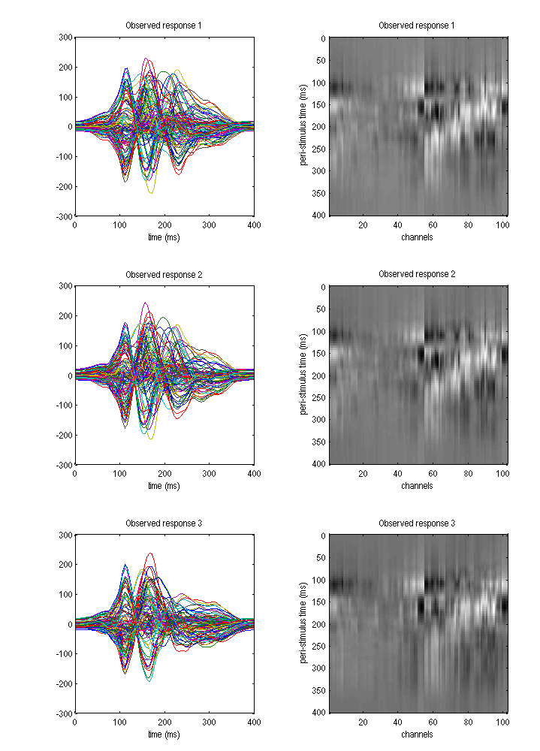
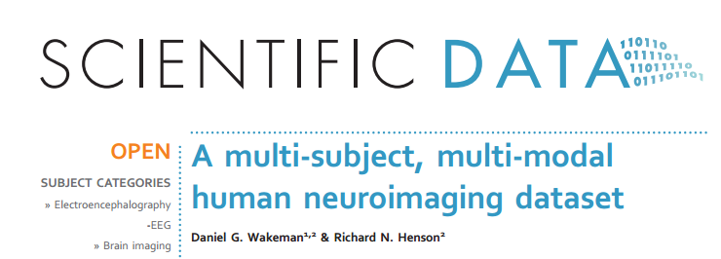
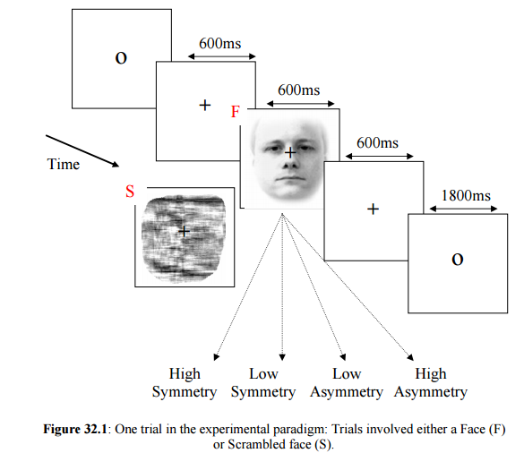
Start with the experimental data:
16 Subjects,
3 conditions
Multimodal data set
Select MEG –event relate potentials
Collapse famous and scrambled faces into one analysis
Notes:
For this demonstration we will be using a dataset that has been made openly available on the web
Multimodal data-set (MEG/EEG) and we investigate event related potentials

Slide 4
Generative Model
Hierarchical network including the fusiform face area (FFA), occipital face area(OFA), and superior temporal sulcus (STS)
Linked by forwards, backwards and lateral connections
What is the importance of backward and forwards connections in the cognitive processing of faces?
We can compare performance of the initial full model with subsets of reduced models in order to determine which properties can best explain the data
Notes:
Hierichical model of cortical regions,
Fusiform face area
Occipital face area
Superior temporal sulcus
What are the significance of forwards and backwards projections

Slide 5
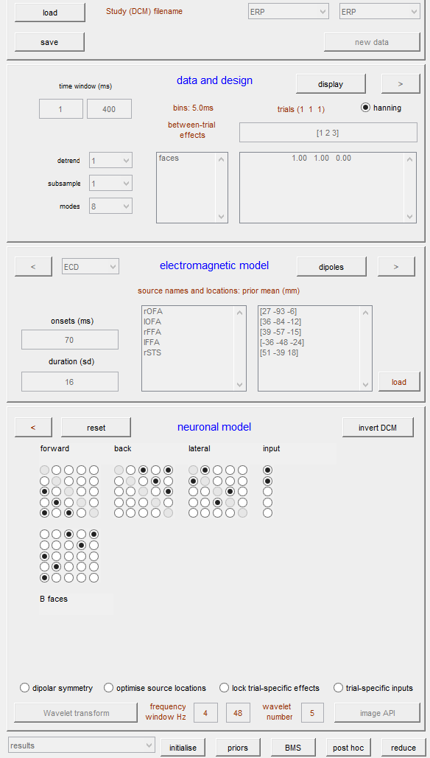
1
Load or Save DCM, specify DCM model types or load new data
Specify experimental data and design- ERP time widow, trial conditions as well as data reduction
2
Specify electromagnetic “observer” model, as well as simulation of ERP parameters
3
Specify the connectivity of the underlying neuronal model.
4
Additional constraints on dipole fitting.
5
6
Inspect the outcomes of model inversion

Slide 6
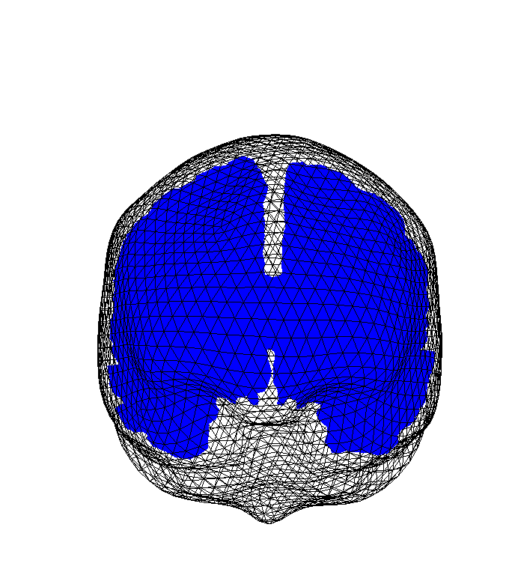
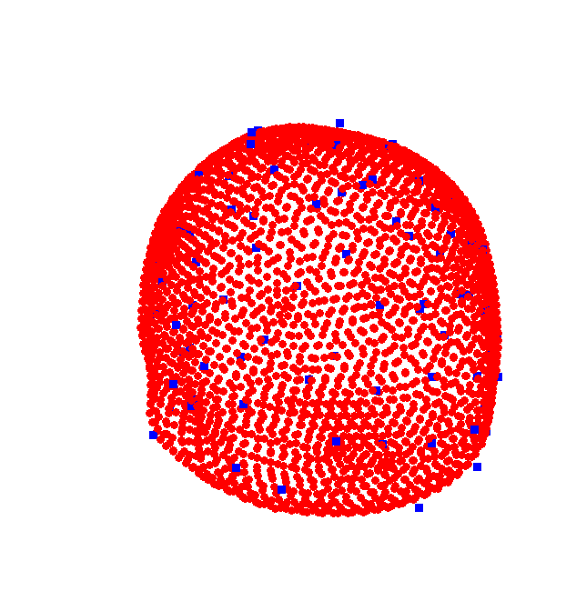
Specifying the Electromagnetic Model
Computing the Head Model mapping from source space to sensor space
Here we use the template model which specifies a “normal” cortical mesh
Coregister using Nasion as well as LPA and RPA fiducial points
Use 3-Shell head sphere for EEG head model and single shell for the MEG head model.

Slide 7
FROM
a
b
c
d
A Matrix- Connection strengths
a
B Matrix- Between condition modulations of connection Strengths
b
TO
c
d
C Matrix- Input connections (modelling sensory input)
Notes:
If I want to specify a link from rOFA to rFFA – this is a forward connection
From the 1st column to the 3rd row

Slide 8
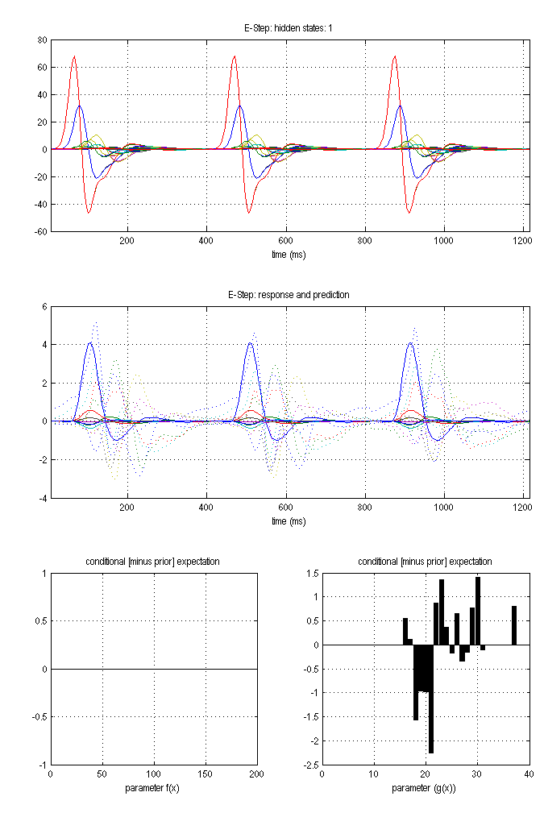
Iterative fitting scheme – “Variational Bayes”
Find parameters that minimize the free energy of the model fit
After several iterations the model should converge.

Slide 9
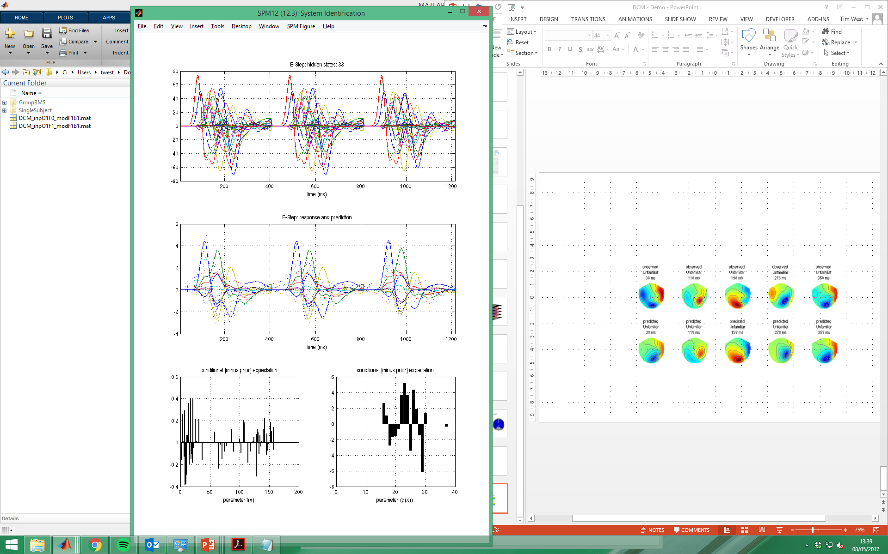
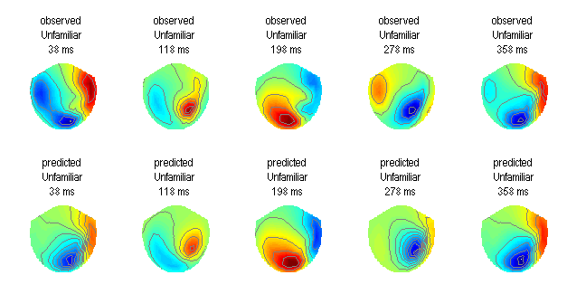
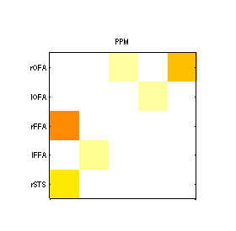
Condition dependent modulation of connections (B Matrix)
Notes:
Visually inspect the actual (data) ERPs and those predicted from model

Slide 10
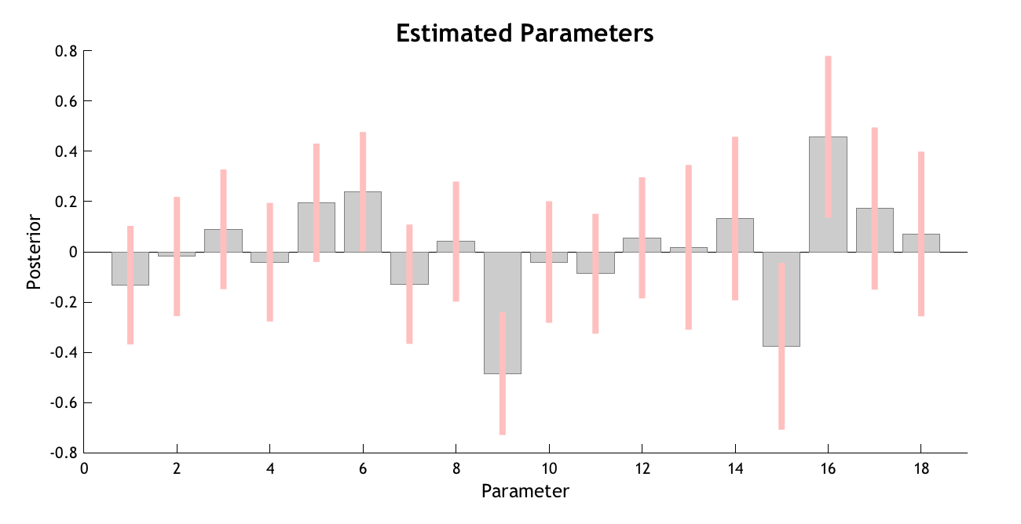
Inversion
Reduction
Selection / Comparison
Averaging
participants
2nd level inversion
models
Family-wise selection
fixed effects
random effects
[exhaustive search]
Bayesian parameter average
Classical statistics (t-tests)
Reduction and Averaging
Model selection

Slide 11
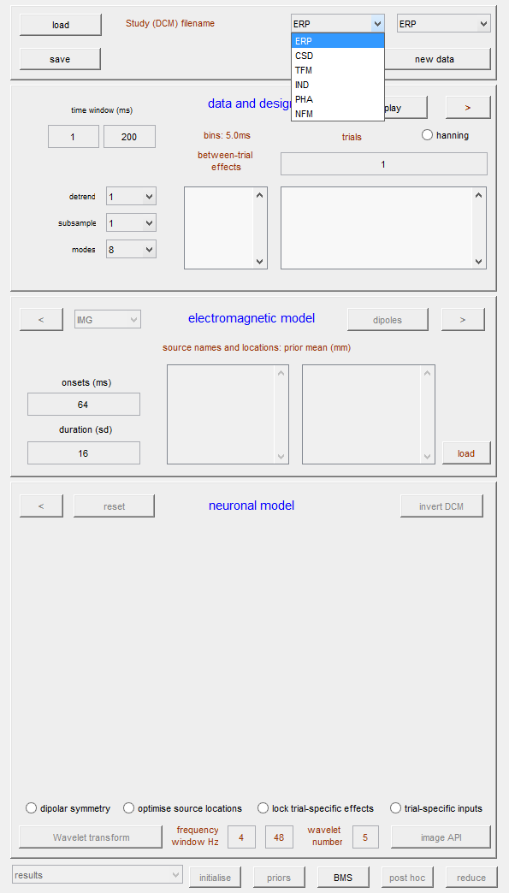
Specify Electromagnetic model

Slide 12
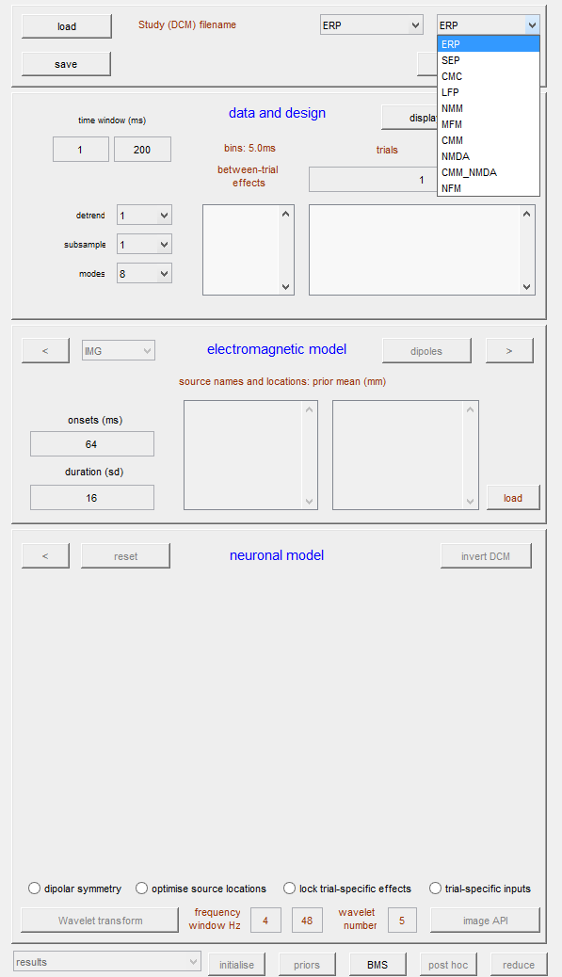
Specify Neuronal Model

Slide 13
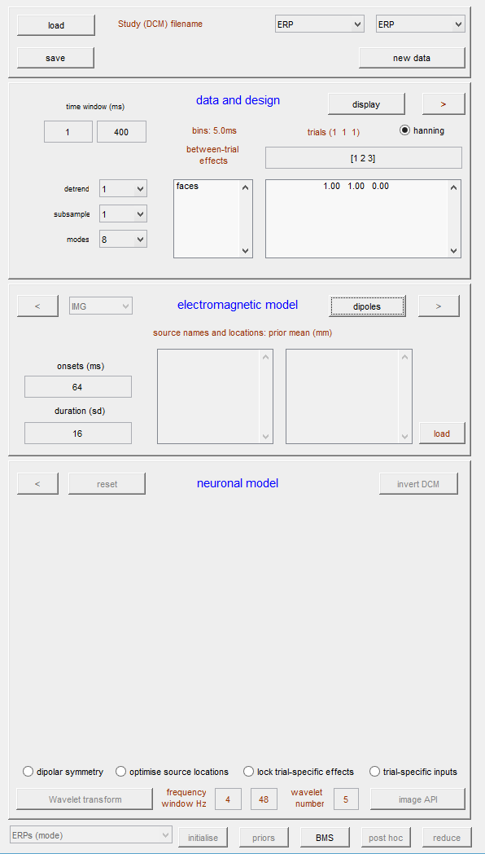

Slide 14
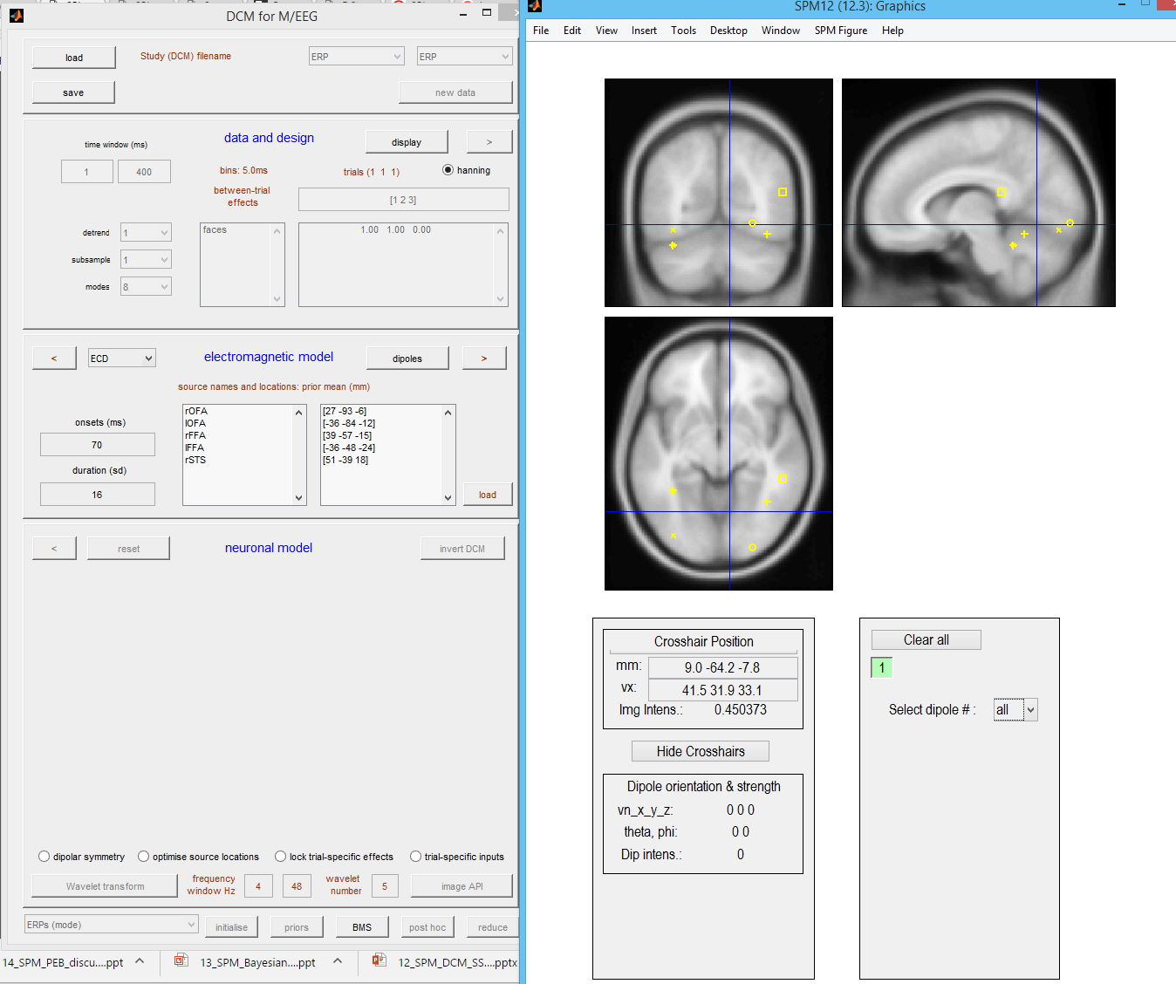

Slide 15
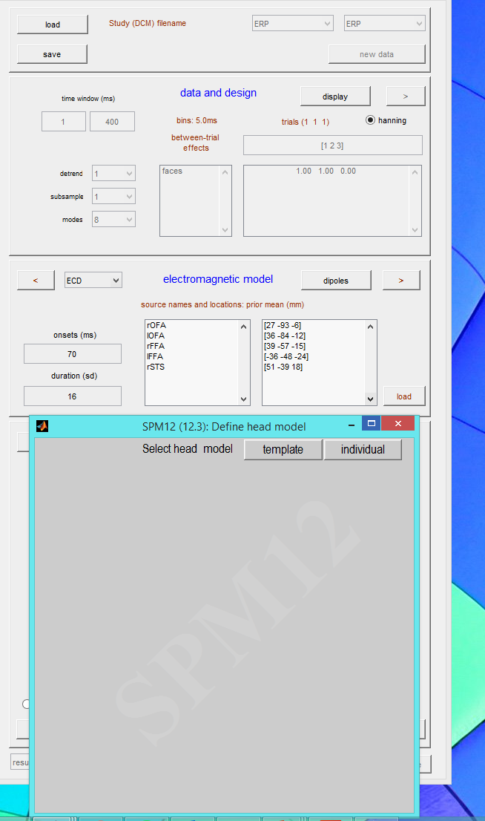

Slide 16
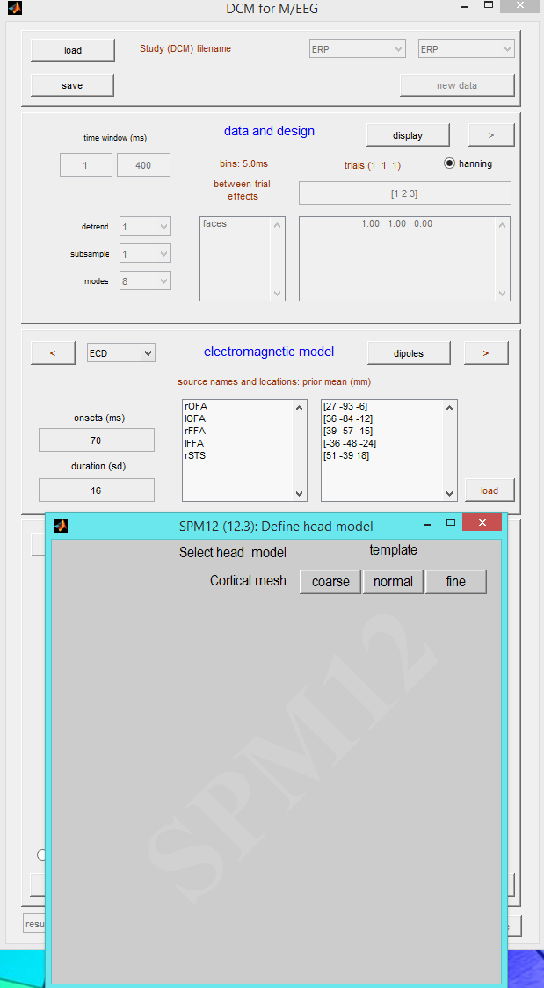
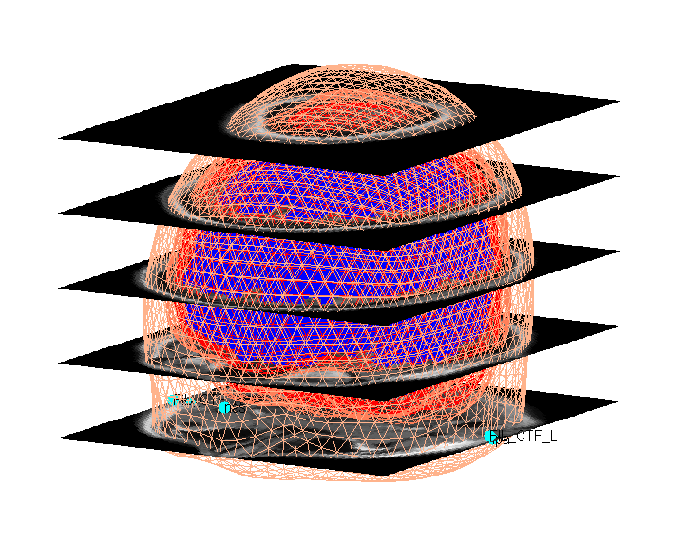

Slide 17
Specify your hypothesis in a generative model
Invert (fit) the model to your data
Make an inference!
Conduct an experiment to collect data that can answer your hypothesis

Slide 18
MODEL A
DATA
MODEL B
Bayesian Model Comparison
MODEL C

