Slide 1


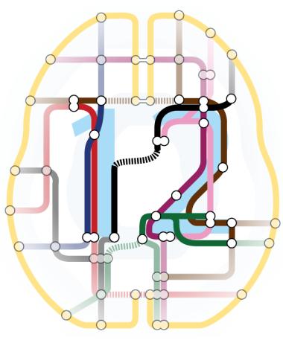

M/EEG pre-processing
Robert Seymour
Wellcome Centre for Human Neuroimaging
SPM Course 2022

Slide 2

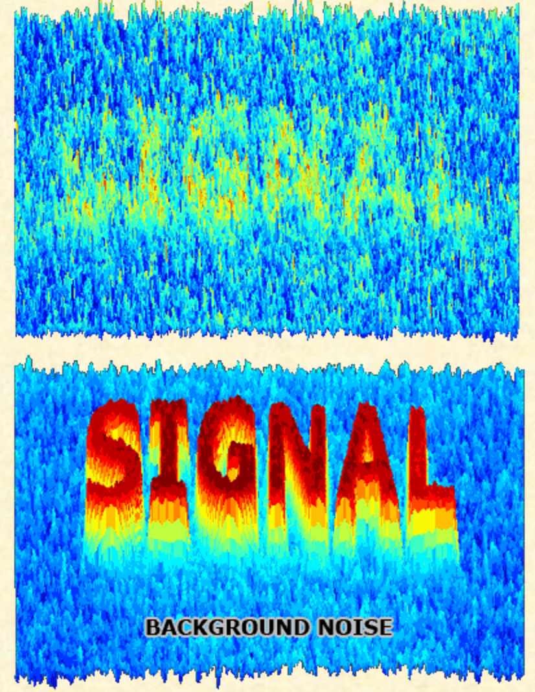
What is pre-processing?
Load raw continuously recorded M/EEG data
Clean the data to remove artefacts
Improve signal to noise ratio
Segment the data into trials
Pre-processing is often boring and time consuming, but absolutely VITAL!

Slide 3
Steps to cover
Conversion
Filtering
Down-sampling
Epoching
Re-referencing for EEG
Artefacts
Averaging
Time-frequency analysis
Co-registration

Slide 4
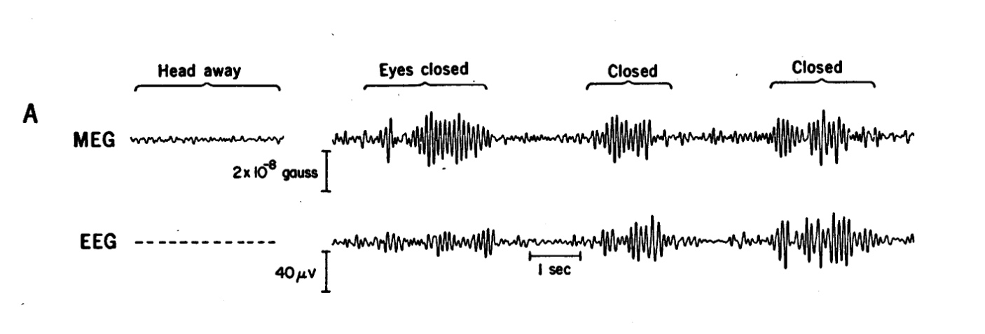
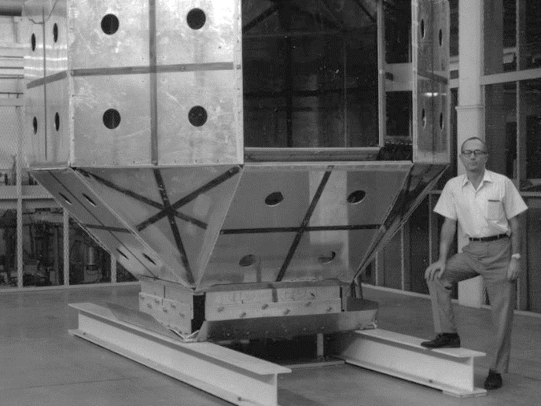
What do we need?
The basics of M/EEG recordings
Empty Room
Experimental Trials
Cohen, 1972
Notes:
Hans Berger (21 May 1873 – 1 June 1941) was a German psychiatrist, best known as the inventor of electroencephalography (EEG) (the recording of "brain waves") in 1924, coining the name,^{[1]} and the discoverer of the alpha wave rhythm known as "Berger's wave".

Slide 5
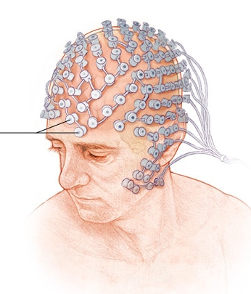
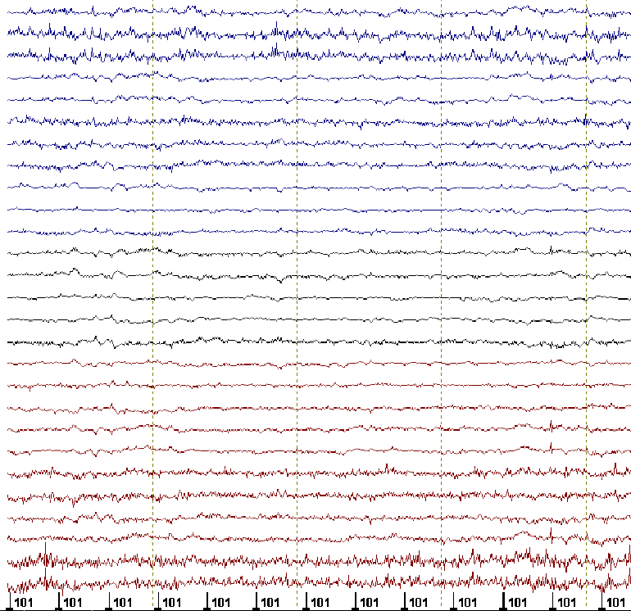
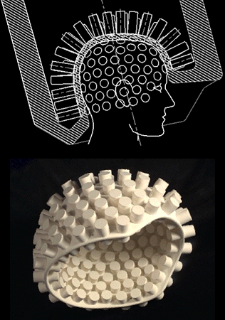
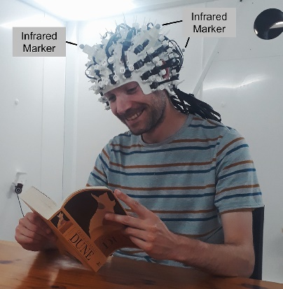
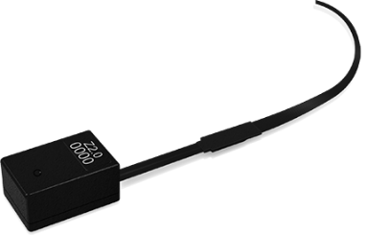
Modern M/EEG recordings
EEG
MEG
<256 sensors
Channel
~300 sensors
Time (s)
Notes:
With no conductive gel, dry systems are subject to several challenges. First, the sensor must be specially designed to directly touch scalp or skin, even through thick hair. Second, the sensor must remain securely in place in order to minimize artifacts and noise. Finally, the electronics must tolerate high contact impedances - 100-200x higher than wet - while rejecting noise and interference. Therefore, a complete dry solution always involves not just the sensors but mechanics and electronics as well.
The MEG (and EEG) signals derive from the net effect of ionic currents flowing in the dendrites of neurons during synaptic transmission. In accordance with Maxwell's equations, any electrical current will produce a magnetic field, and it is this field that is measured. The net currents can be thought of as current dipoles, i.e. currents with a position, orientation, and magnitude, but no spatial extent. According to the right-hand rule, a current dipole gives rise to a magnetic field that points around the axis of its vector component.
To generate a signal that is detectable, approximately 50,000 active neurons are needed.[7] Since current dipoles must have similar orientations to generate magnetic fields that reinforce each other, it is often the layer of pyramidal cells, which are situated perpendicular to the cortical surface, that gives rise to measurable magnetic fields. Bundles of these neurons that are orientated tangentially to the scalp surface project measurable portions of their magnetic fields outside of the head, and these bundles are typically located in the sulci. Researchers are experimenting with various signal processing methods in the search for methods that detect deep brain (i.e., non-cortical) signal, but no clinically useful method is currently available.
It is worth noting that action potentials do not usually produce an observable field, mainly because the currents associated with action potentials flow in opposite directions and the magnetic fields cancel out. However, action fields have been measured from peripheral nerves.

Slide 6
M/EEG Artefacts
Some unexpected or unwanted feature in the data that we acquired with our EEG or MEG system.
Eye movements
Heartbeat
Participant head movement
Muscle Artefact
Poorly attached EEG electrode
SQUID Jump
50/60Hz Line Noise
Physiological
Non-physiological
Notes:
With no conductive gel, dry systems are subject to several challenges. First, the sensor must be specially designed to directly touch scalp or skin, even through thick hair. Second, the sensor must remain securely in place in order to minimize artifacts and noise. Finally, the electronics must tolerate high contact impedances - 100-200x higher than wet - while rejecting noise and interference. Therefore, a complete dry solution always involves not just the sensors but mechanics and electronics as well.
The MEG (and EEG) signals derive from the net effect of ionic currents flowing in the dendrites of neurons during synaptic transmission. In accordance with Maxwell's equations, any electrical current will produce a magnetic field, and it is this field that is measured. The net currents can be thought of as current dipoles, i.e. currents with a position, orientation, and magnitude, but no spatial extent. According to the right-hand rule, a current dipole gives rise to a magnetic field that points around the axis of its vector component.
To generate a signal that is detectable, approximately 50,000 active neurons are needed.[7] Since current dipoles must have similar orientations to generate magnetic fields that reinforce each other, it is often the layer of pyramidal cells, which are situated perpendicular to the cortical surface, that gives rise to measurable magnetic fields. Bundles of these neurons that are orientated tangentially to the scalp surface project measurable portions of their magnetic fields outside of the head, and these bundles are typically located in the sulci. Researchers are experimenting with various signal processing methods in the search for methods that detect deep brain (i.e., non-cortical) signal, but no clinically useful method is currently available.
It is worth noting that action potentials do not usually produce an observable field, mainly because the currents associated with action potentials flow in opposite directions and the magnetic fields cancel out. However, action fields have been measured from peripheral nerves.

Slide 7

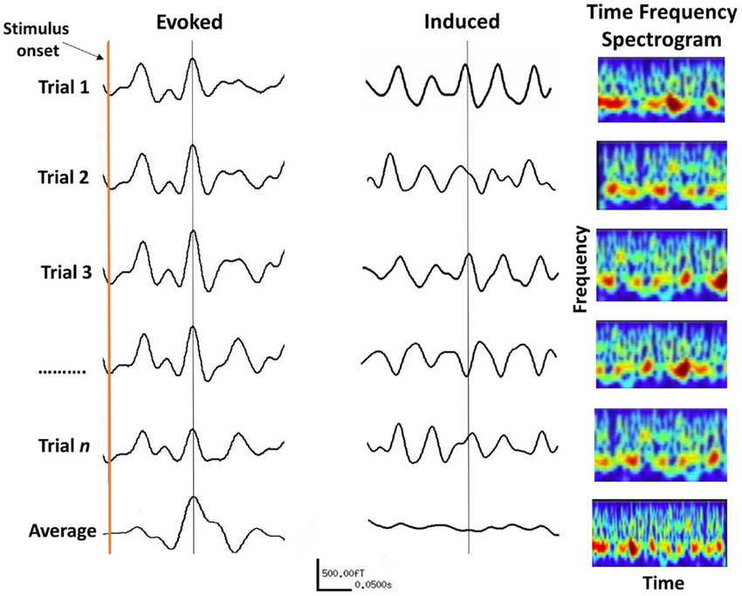
Evoked response vs. spontaneous activity
Evoked response vs. induced response
Notes:
Evoked responses are where measured activity is phase locked over trials – i.e. occurring at exactly the same time.
Induced responses are where measured activity is not phase locked over trials – i.e. response does not occur at exactly the same time (e.g. motor beta)
We can access by performing time-frequency on individual trials → then averaging

Slide 8
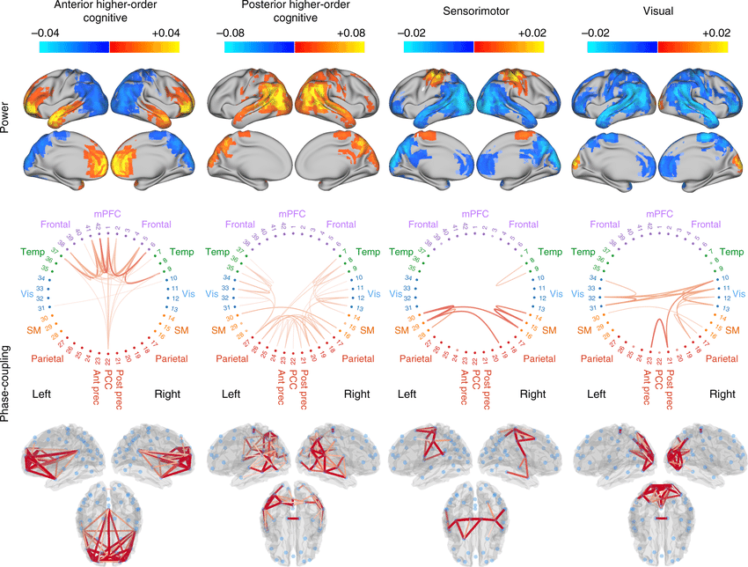
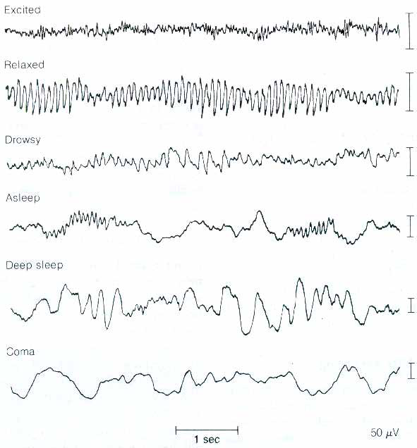
Evoked response vs. spontaneous activity
Spontaneous Activity
active
awake state
resting state
falling asleep
sleep
deep sleep
coma
50 uV
1 sec
Ongoing Rhythms
Vidaurre et al., 2018
Notes:
Increasing interest in spontaneous or continuous activity
Ongoing methods development for characterising transient periods of functional connectivity within continuous data throughout cortical networks of the brain

Slide 9
An Introduction to the SPM Interface

Slide 10
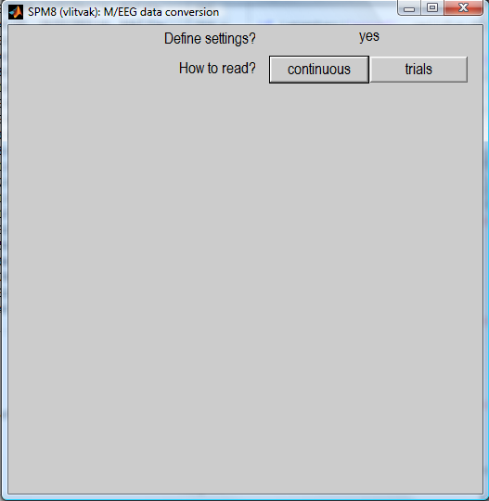
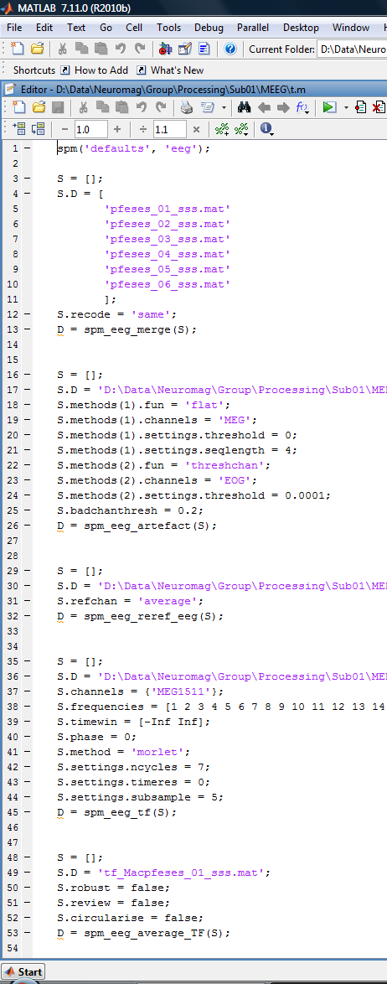
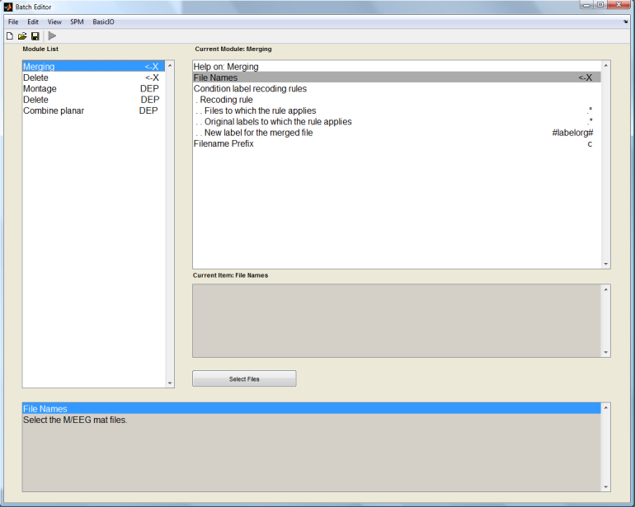
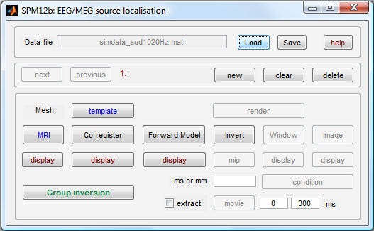
Clarification of terms – SPM speak
Different analysis approaches
GUI
Script
Batch
Accessed via GUI
Can be saved and run within MATLAB script
Using spm_jobman
spm eeg
spm_eeg_ …
Notes:
GUI = Easy to understand for novice
Script = MATLAB interface. Slightly more flexible
MATLAB Batch : Accessed via GUI, Can be saved and run within MATLAB script, Using spm_jobman

Slide 11
Why batch?
SPM Batch
As opposed to GUI
  - it is easy to reproduce analyses, apply them to different datasets and make modifications.
  - removing interactive GUI elements from the code makes it cleaner and easier to maintain.
As opposed to script
  complex pipelines can be built without programming expertise
  saved pipelines can be examined without deciphering other people’s code
  batch provides uniform interface for scripting to different parts of SPM code.
Disadvantages of batch
  there is no step-by-step guiding of the user
  the need to prepare all the inputs in advance makes some of the operations less intuitive and requires getting used to.
Notes:
- SPM Batch can be used to reproduce analyses – often preprocessing is repetitive with same steps applied to every run, participant.
Speeds up analysis and avoids button clicking.
complex pipelines can be built without programming expertise
saved pipelines can be saved in standardised way without deciphering other people’s code
batch provides uniform interface for scripting to different parts of SPM code.

Slide 12
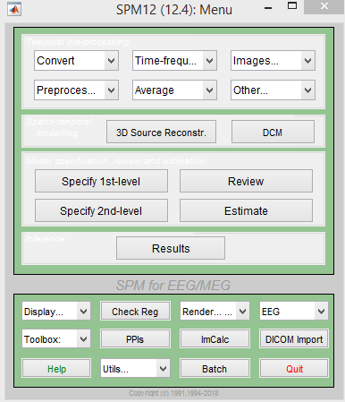
Steps to cover
Conversion
Filtering
Downsampling
Epoching
Re-referencing for EEG
Artefacts
Averaging
Time-frequency analysis
Coregistration
spm_eeg_convert
Notes:
Every time you run a preprocessing step, it will save a new dataset with a specific letter prepending it for example convert adds spmeeg_ to the front of the filename and filtering adds an f so you can track what steps you have done from the letters of the filename and you can also go back to previous steps and rerun things.

Slide 13
Conversion
Conversion
MEG
CTF
Neuromag
BTi-4D
Yokogawa
EEG
EEGLAB
Biosemi
Brainvision
Neuroscan
EGI
ANT
SPM5
…
Biosig
Arbitrary
ASCII
Matlab
Fieldtrip
raw
timelock
freq
GUI
script
Prepare
(Import from workspace)
+
Reviewing tool
Convert button
(fileio)
spm_eeg_convert
spm_eeg_ft2spm
SPM dataset
*.dat – binary data file
*.mat – header file
Notes:
.dat file is a binary datafile which has a matrix of channel x time x trial or channel x time x frequency x trial
.mat file contains all other things associated – time axis, sampling rate, name of channels

Slide 14
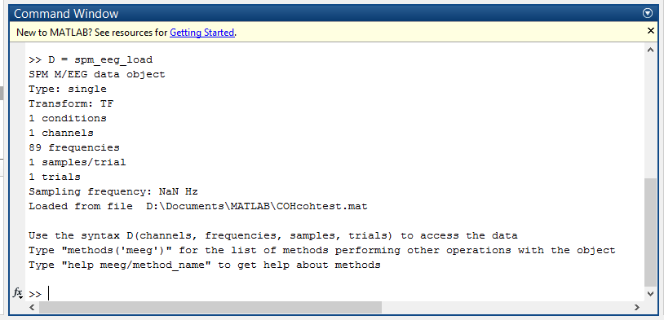
Expert’s corner
Properties of M/EEG dataset
The *.mat file contains a struct, named D, which is converted to an meeg object by spm_eeg_load.
The *.dat file contains the data and is memory-mapped and linked to the object in order to save memory.
Typing ’D’ summarises object
Notes:
- Unlike other languages the data is not held in a MATLAB structure.
- The .mat file can also hold an event structure which allows for various events, that can be coded as numbers (trigger values) or as strings (annotations and trial classifications). Events have a location in the file (sample number) and may have a duration.
- The *.dat file contains the raw data and is memory-mapped and linked to the object in order to save memory.

Slide 15
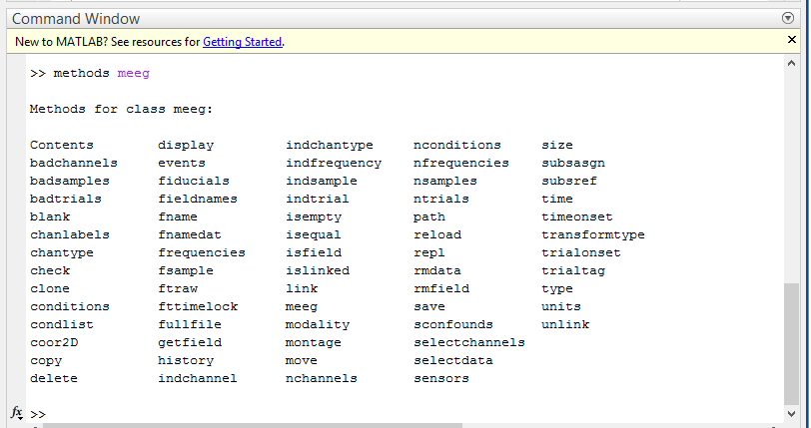
Expert’s corner
Properties of M/EEG dataset
MEG object loaded with D = spm_eeg_load(‘example.mat’)
getdata = D(:,:,:);
setdata, D(1,2,3) = 1;
Special functions, ‘methods’ provide an interface for getting information from the object and updating it
Notes:
getdata = D(:,:,:);
setdata, D(1,2,3) = 1;
The object can only be manipulated using standardized functions (called methods), which makes it very hard to introduce any inconsistency into SPM M/EEG data. Also, using methods simplifies internal book-keeping, which makes it much easier to program functions operating on the M/EEG object.
SPM functions only access the header data via the object interface and we strongly encourage the power users to become faimilar with this interface and also use it in their own code.

Slide 16
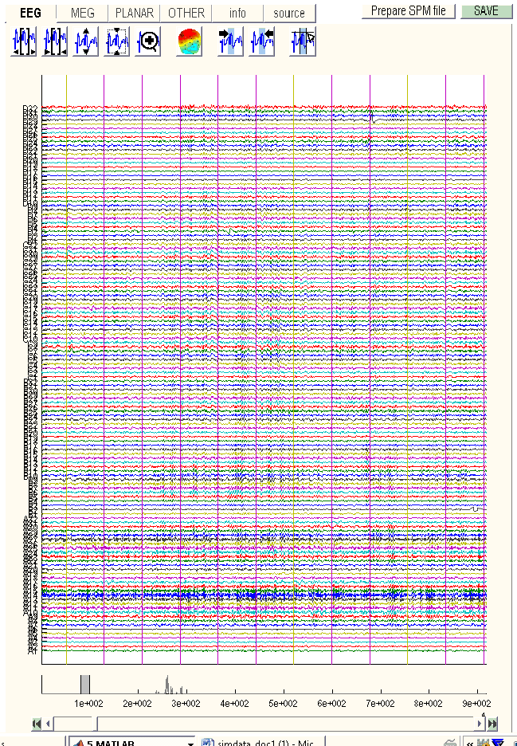
Data visualisation
spm_eeg_review
channels
time

Slide 17
Steps to cover
Conversion
Filtering
Downsampling
Epoching
Re-referencing for EEG
Artefacts
Averaging
Coregistration
Generating scalp x time images
Time-frequency analysis
spm_eeg_filter

Slide 18
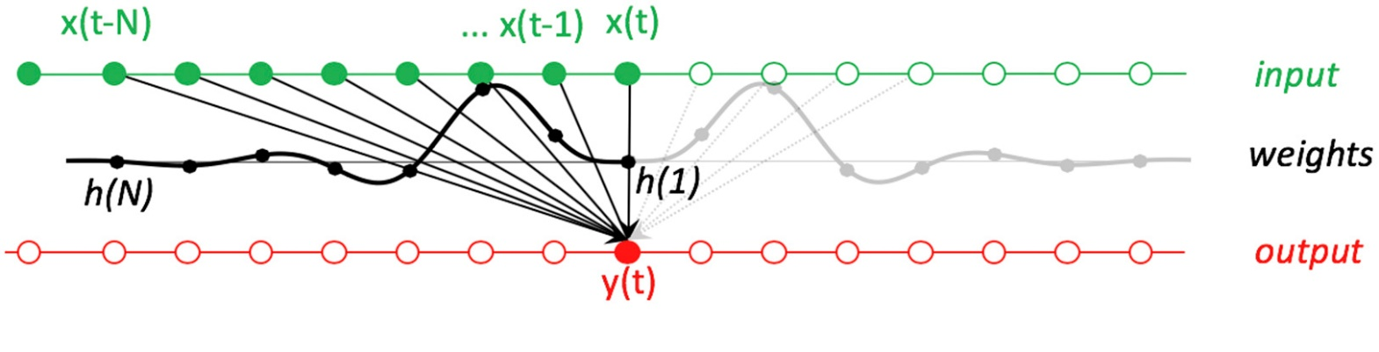
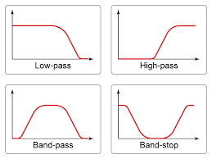
Filtering
Filtering
‘Modifies the spectral content of a signal’
More precisely we can define a filter input-output relationship
Notes:
For many of us, a filter is “a thing that modifies the spectral content of a signal.”. A filter is an operation that produces each sample of the output waveform y as a weighted sum of several samples of the input waveform x. This operation is called convolution. The data can be convolved with various different “response functions” which modify the signal in various ways.

Slide 19
Filtering
Filtering
High-pass – remove the DC offset and slow trends in the data.
Low-pass – remove high-frequency noise. Similar to smoothing.
Notch (band-stop) – remove artefacts limited in frequency, most commonly line noise and its harmonics.
Band-pass – focus on the frequency of interest and remove the rest. More suitable for relatively narrow frequency ranges.
Notes:
Cannot use frequencies above the Nyquist frequency (half the sampling rate)

Slide 20
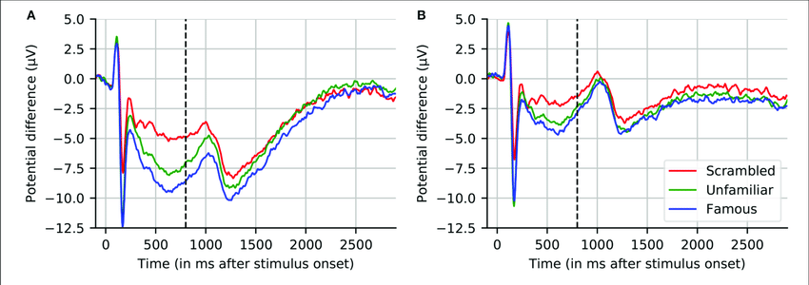
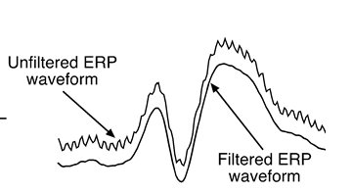
Filtering - examples
Filtering examples
Without hp-filter
With hp-filter
Notes:
Good idea to start with wide frequency band and then perhaps specify smaller frequency band at later stages once you’ve explored your data

Slide 21
Steps to cover
Conversion
Filtering
Downsampling
Epoching
Re-referencing for EEG
Artefacts
Averaging
Coregistration
Generating scalp x time images
Time-frequency analysis
spm_eeg_downsample

Slide 22
Filtering - examples
Downsampling
Sampling rate: speed at which your data is recorded/sampled
PROS to downsampling: Speeds up analysis
CONS:
Aliasing: an effect that causes different signals to become indistinguishable (or aliases of one another) when sampled
Nyquist Frequency: Highest frequency that can be resolved without alisasing = ½ of sampling rate
Notes:
Good idea to start with wide frequency band and then perhaps specify smaller frequency band at later stages once you’ve explored your data

Slide 23
Steps to cover
Conversion
Filtering
Downsampling
Epoching
Re-referencing for EEG
Artefacts
Averaging
Coregistration
Generating scalp x time images
Time-frequency analysis
spm_eeg_epochs

Slide 24
Epoching
Epoching
Definition: Cutting segments around events.
Need to know:
What happens (event type, event value)
When it happens (time of the events)
Need to define:
Pre and post-trigger time intervals (e.g. -0.1 to +0.5s)
Trial type (can be different triggers => single trial type)
Shift of time zero of the trial with respect to the trigger (no shift by default).
Note:
SPM only supports fixed length trials
The epoching function also performs baseline correction (using negative times as the baseline). You can also do this separately.
Notes:
You can have different types of triggers corresponding to a single trial type

Slide 25
Steps to cover
Conversion
Filtering
Downsampling
Epoching
Re-referencing for EEG
Artefacts
Averaging
Coregistration
Generating scalp x time images
Time-frequency analysis
spm_eeg_montage

Slide 26
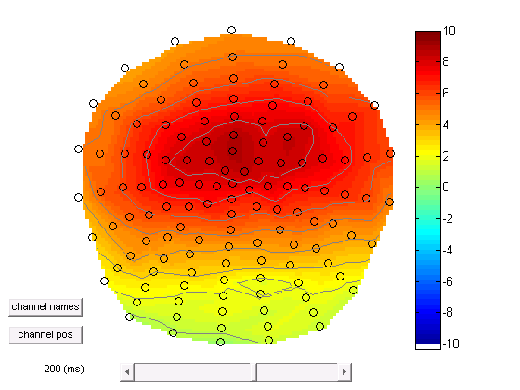
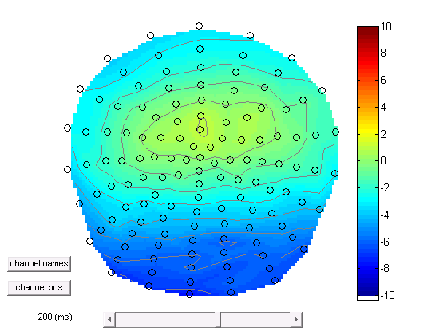
EEG – re-referencing
EEG – Re-referencing
In EEG, voltages recorded at each electrode are relative to voltages recorded at other electrodes.
Best practice to use ONE common electrode for all electrodes
E.g. mastoid or Cz
Can also use average of all channels, but harder to detect subtler voltage changes
Montage function can apply any linear weighting to the channels & has a wider range of applications.
Notes:
Potential difference between 2 points. Can use somewhere on head like nose or mastoid or average across all channels as reference – compromise – bad if few channels might be harder to see subtle changes
Can take most positive channel and make this ref so all else is negative or vice versa – if you then do stats – you can sensitise to particular phenomena.

Slide 27
Steps to cover
Conversion
Filtering
Downsampling
Epoching
Re-referencing for EEG
Artefacts
Averaging
Coregistration
Generating scalp x time images
Time-frequency analysis
spm_eeg_artefact

Slide 28
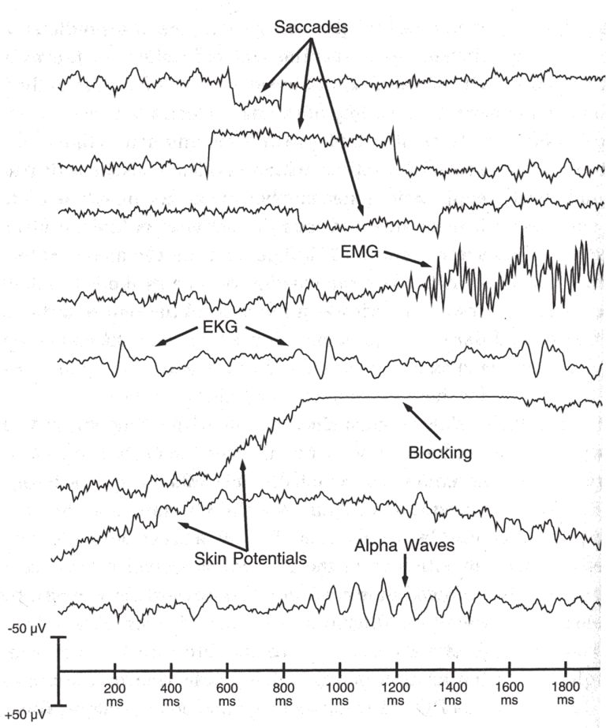
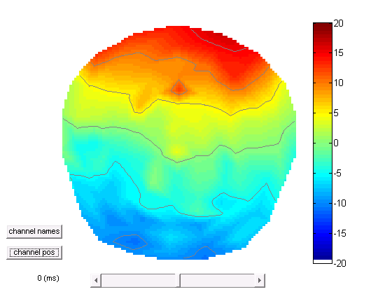
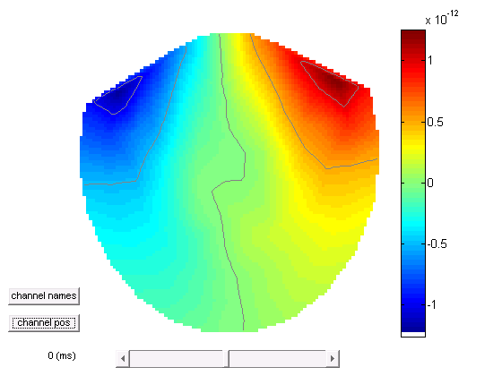
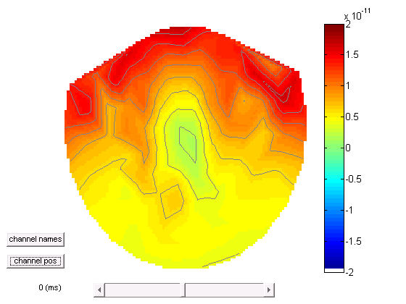
Artefacts
Artefacts
Eye blink
EEG
MEG
Planar
Notes:
Eye movement
Saccades
Muscle artifact (temporal electrodes , muscle artifact )
ECG
Saturated (blocking)
Slow potentials from sweating
Alpha waves
Features in time
Features in sensor space (topography)

Slide 29
Artefacts
Artefacts
SPM has an extendable artefact detection function where plug-ins implementing different detection methods can be applied to subsets of channels.
A variety of methods are implemented including, amplitude thresholding, jump detection, flat segment detection, ECG and eye blink detection.
In addition, topography-based artefact correction method is available. Similar to ICA - more details in the SPM manual
Notes:
Similar to what ica does in eeg lab (topography based artefact correction)

Slide 30
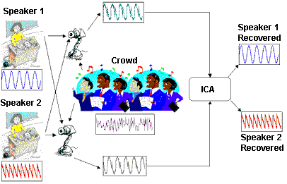
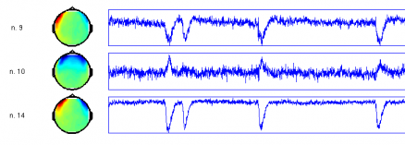
New in SPM12
Independent Components Analysis
Technique for blind source separation
Assumes data are a linear mixture of different neuromagnetic sources that are statistically independent, stationary over time and non-gaussian.

Slide 31
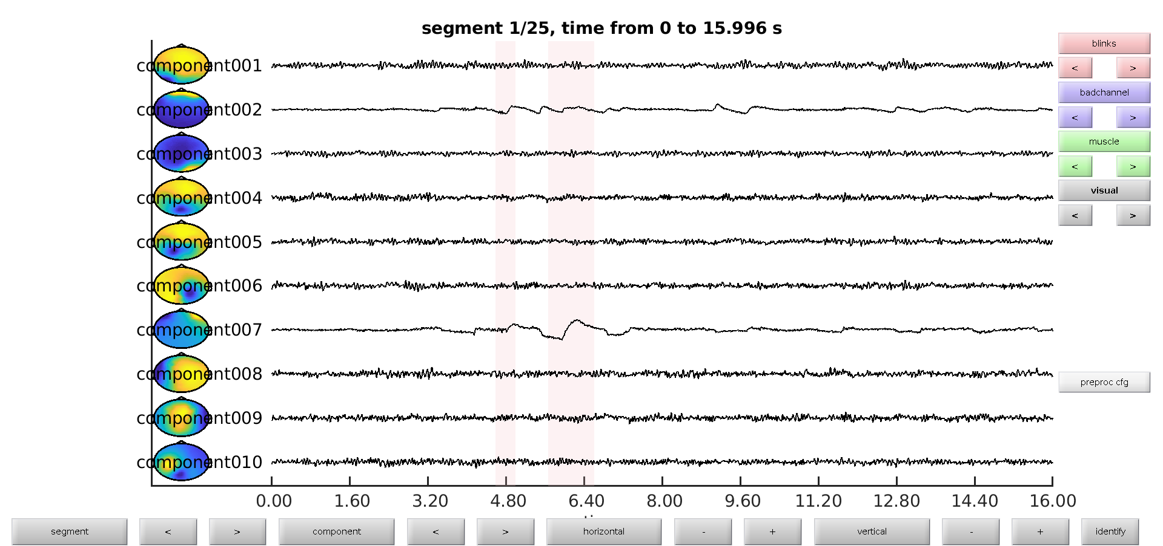
New in SPM12
Independent Components Analysis
Export to Fieldtrip
ft_component_analysis
Export back to SPM: spm_eeg_ft2spm

Slide 32
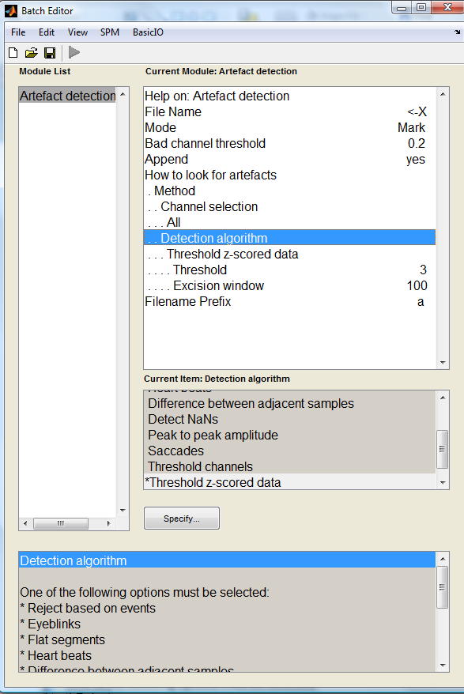
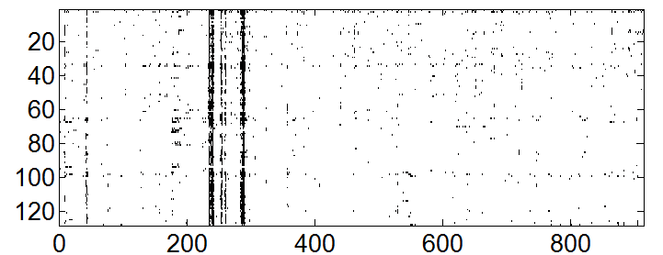
New in SPM12
Artefacts
It is now possible to mark artefacts in continuous data
Marked artefacts are saved as events which are carried over with subsequent processing. So it is possible e.g. to mark artefacts before filtering and keep for later.
Marked artefacts can be used for trial rejection at a later stage (‘Reject based on events’)
>> imagesc(D.badsamples(D.indchantype('EEG'), ':', 1))
Channels
time (s)

Slide 33
A note about order
A note about order
There is no single correct order of steps, but here are some considerations for order choices
  It is better to filter continuous data prior to epoching to avoid filter ringing artefacts in every trial. Alternatively the epochs of interest can be padded with more data and then cropped after filtering.
  It is better to do high-pass filtering or baseline correction before other filtering steps to reduce filter ringing.
  It is convenient to put downsampling early in the pipeline to make the subsequent steps faster.
  SPM only filters channels with physiological data. So the channel types should be set correctly before filtering.
  Some artefacts (e.g. discontinuous jumps, muscle) are more difficult to detect after filtering.

Slide 34
Steps to cover
Conversion
Filtering
Downsampling
Epoching
Re-referencing for EEG
Artefacts
Averaging
Coregistration
Generating scalp x time images
Time-frequency analysis
spm_eeg_average

Slide 35
Evoked response vs. spontaneous activity
Evoked response

Slide 36
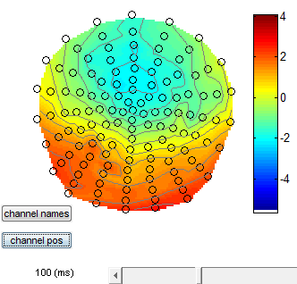
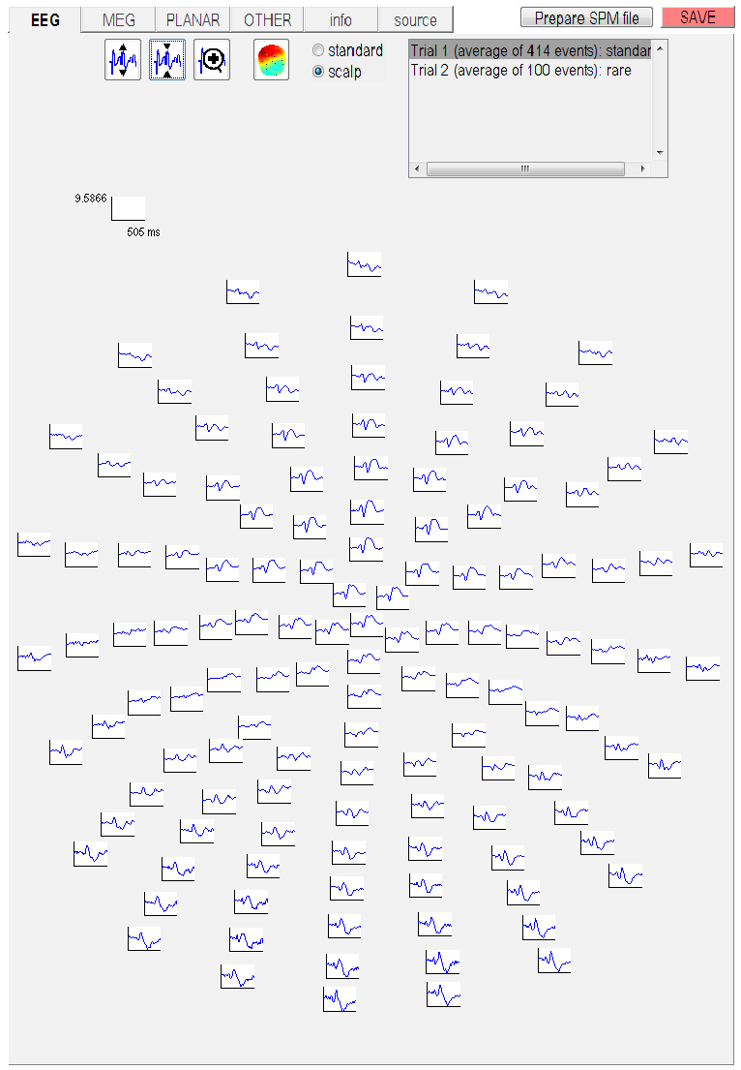
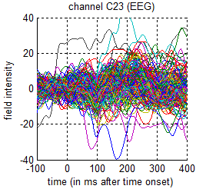
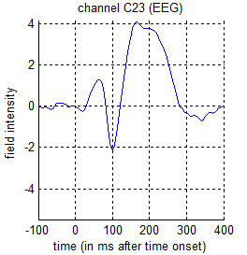
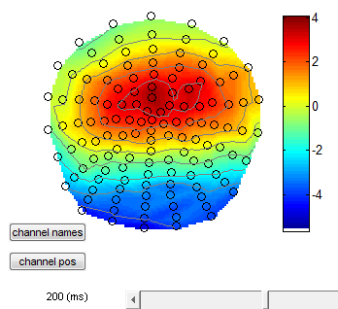
Data visualisation

Slide 37
Averaging across trials

Slide 38
Robust averaging
Robust averaging
Robust averaging is an iterative procedure that computes the mean, down-weights outliers, re-computes the mean etc. until convergence.
It relies on the assumption that for any channel and time point most trials are clean.
The number of trials should be sufficient to get a distribution (at least a few tens).
Robust averaging can be used either in combination with or as an alternative to trial rejection.
Notes:
Robust averaging is good for artefact suppression – uses the distribution of data to find outliers (distance from median) and suppress them (downweight them)
Need a good number of trials – need most to be clean
If artefact at same time each trial then this is not good – could use ICA instead

Slide 39
Steps to cover
Conversion
Filtering
Downsampling
Epoching
Re-referencing for EEG
Artefacts
Averaging
Coregistration
Time-frequency analysis
spm_eeg_tf

Slide 40
Evoked response vs. spontaneous activity
Evoked response vs. induced response
Notes:
Evoked responses
Steady state – sleep , drug induced, pathology such as tremor or Parkinson's disease

Slide 41
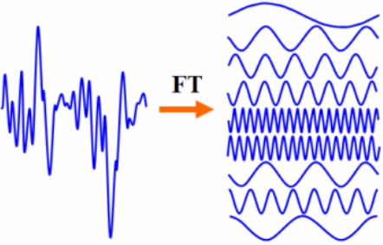
Fourier analysis
Fourier analysis
Joseph Fourier (1768-1830)
Time domain signal → frequency domain
Any complex time series can be broken down into a series of superimposed sinusoids with different frequencies

Slide 42
Fourier analysis
Fourier analysis
Original
Different amplitude
Different phase

Slide 43
Methods of spectral estimation
Methods for spectral estimation
Power
Power
Power
…
Frequency (Hz)
Frequency (Hz)
Frequency (Hz)
BUT spectral smearing due to short time window (aliasing)
Notes:
Wavelet is a sine wave multiplied by a gaussian kernel
Aim of tapers is to reduce spectral leakage
Tapering is pulling the data at the edges towards 0 to diminish edge effects
Trade off between temporal and frequency resolution
Boxcar, Hanning taper, Hillbert transform, multitaper
Gaussian is narrower and more curved compared to hanning
Higher freq is more usually broadband – multitapes useful for this
Low freq usually better estimated by single (Hanning) taper
Multitaper good for gamma

Slide 44
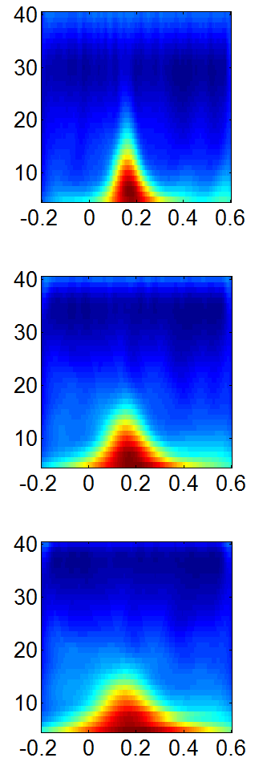
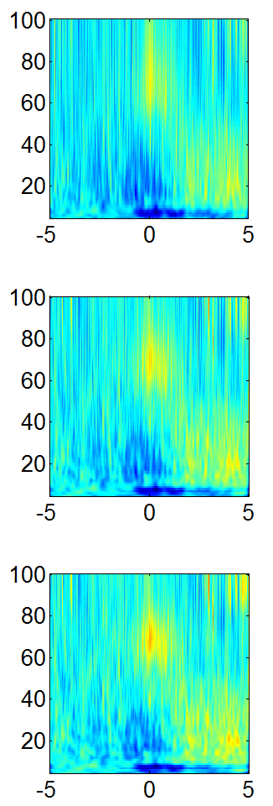
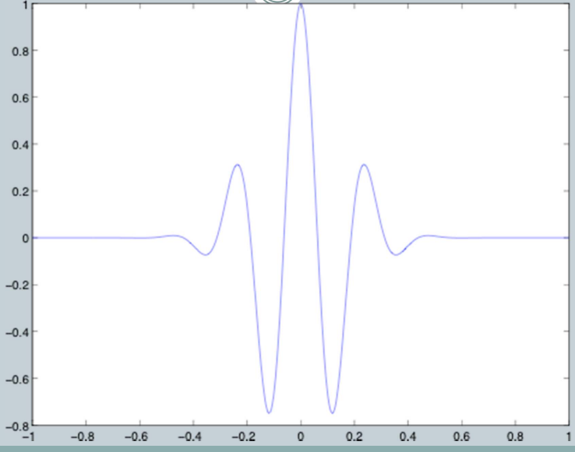
Methods of spectral estimation
Methods for spectral estimation
Wavelet = sin*gaussian
Morlet 3 cycles
Morlet 5 cycles
Amplitude
Morlet 5 cycles
Morlet 7 cycles
Time (s)
More cycles = better frequency resolution
More cycles = worse time resolution
Morlet 7 cycles
Morlet 9 cycles
Notes:
Wavelet is a sine wave multiplied by a gaussian kernel
Aim of tapers is to reduce spectral leakage
Tapering is pulling the data at the edges towards 0 to diminish edge effects
Trade off between temporal and frequency resolution
Boxcar, Hanning taper, Hillbert transform, multitaper
Gaussian is narrower and more curved compared to hanning
Higher freq is more usually broadband – multitapes useful for this
Low freq usually better estimated by single (Hanning) taper
Multitaper good for gamma

Slide 45
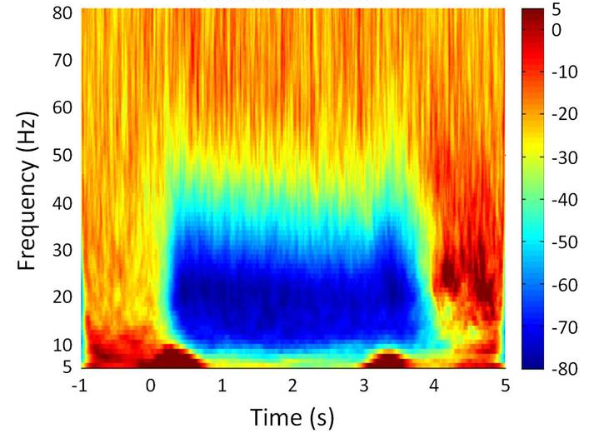
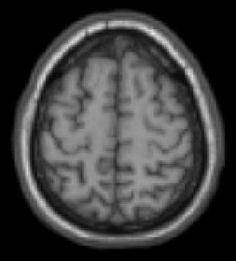
Time-frequency spectrograms

Slide 46
Steps to cover
Conversion
Filtering
Downsampling
Epoching
Re-referencing for EEG
Artefacts
Averaging
Time-frequency analysis
Coregistration

Slide 47
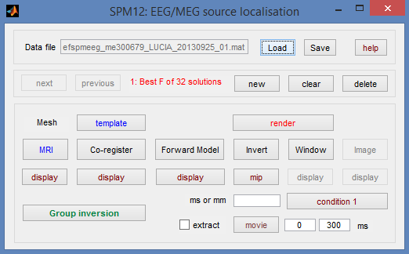
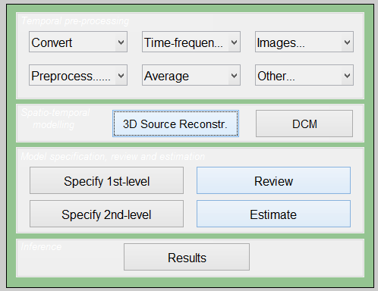
3D Source Reconstruction
Map sensors onto template brain or individual structural MRI
Need template/structural
Need fiducial coordinates if using individual MRI
Need to choose a forward model (e.g. single shell)
Notes:
We now need to obtain a model that explains how neural electric currents (the source space) produce magnetic fields and differences in electrical potentials at external sensors (the sensor space), given the different head tissues (essentially white and grey matter, cerebrospinal fluid (CSF), skull bone and skin).
The process of modeling how data values can be obtained outside of the head with MEG/EEG from electrical current dipoles in the brain is called forward modeling or solving a forward problem.
Available methods for MEG forward modeling
Single sphere: The head geometry is simplified as a single sphere, with homogeneous electromagnetic properties.
Overlapping spheres: Refines the previous model by fitting one local sphere under each sensor.
OpenMEEG BEM: Symmetric Boundary Element Method from the open-source software OpenMEEG. Described in an advanced tutorial: BEM head model.

Slide 48

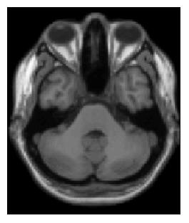
Why do we need fiducials?
Y
Sensory Array
Y
Rigid Body Transform
M
Inverse(M)
X
X
For Forward modelling need to match the co-ordinate system of sensors and anatomy (MRI)
Notes:
We now need to obtain a model that explains how neural electric currents (the source space) produce magnetic fields and differences in electrical potentials at external sensors (the sensor space), given the different head tissues (essentially white and grey matter, cerebrospinal fluid (CSF), skull bone and skin).
The process of modeling how data values can be obtained outside of the head with MEG/EEG from electrical current dipoles in the brain is called forward modeling or solving a forward problem.
Available methods for MEG forward modeling
Single sphere: The head geometry is simplified as a single sphere, with homogeneous electromagnetic properties.
Overlapping spheres: Refines the previous model by fitting one local sphere under each sensor.
OpenMEEG BEM: Symmetric Boundary Element Method from the open-source software OpenMEEG. Described in an advanced tutorial: BEM head model.

Slide 49
Summary
We have covered all these pre-processing steps:
Conversion
Filtering
Down-sampling
Epoching
Re-referencing for EEG
Artefacts
Averaging
Time-frequency analysis
Co-registration
From here you can go on to source analysis and stats…

Slide 50
Thanks to:
Thank you
And to all developers of the SPM M/EEG package
Vladimir Litvak
Stefan Kiebel
Jean Daunizeau
Gareth Barnes
James Kilner
Robert Oostenveld
And others…

