Slide 1
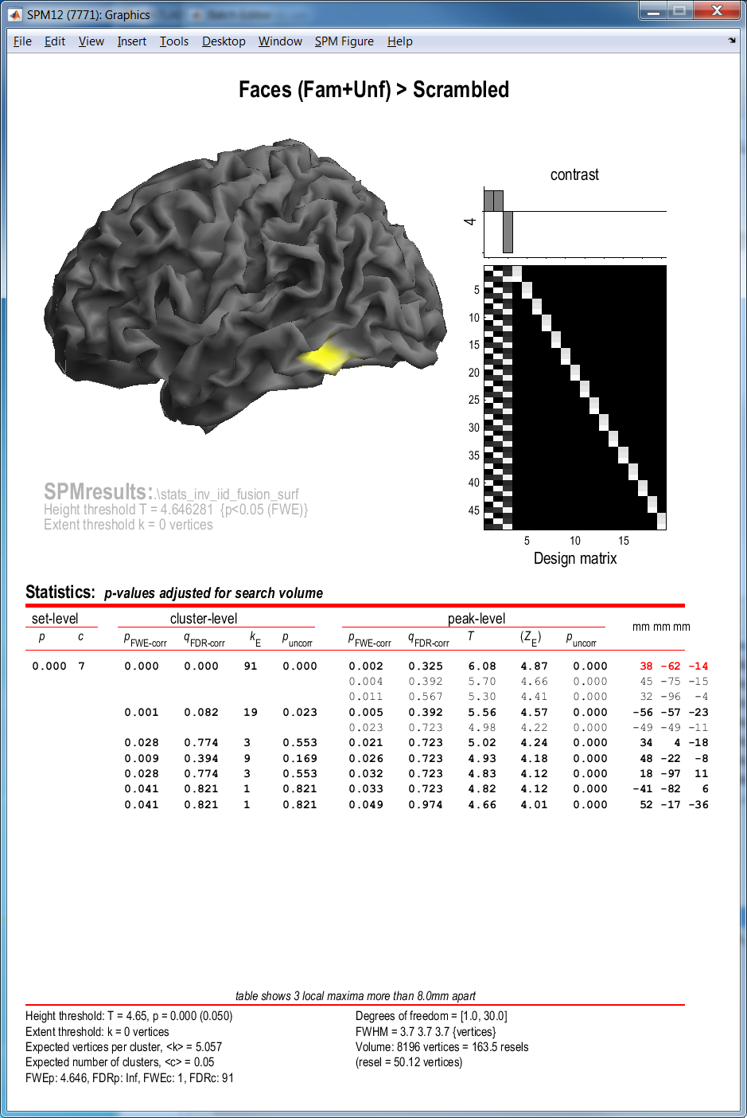
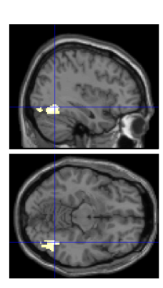
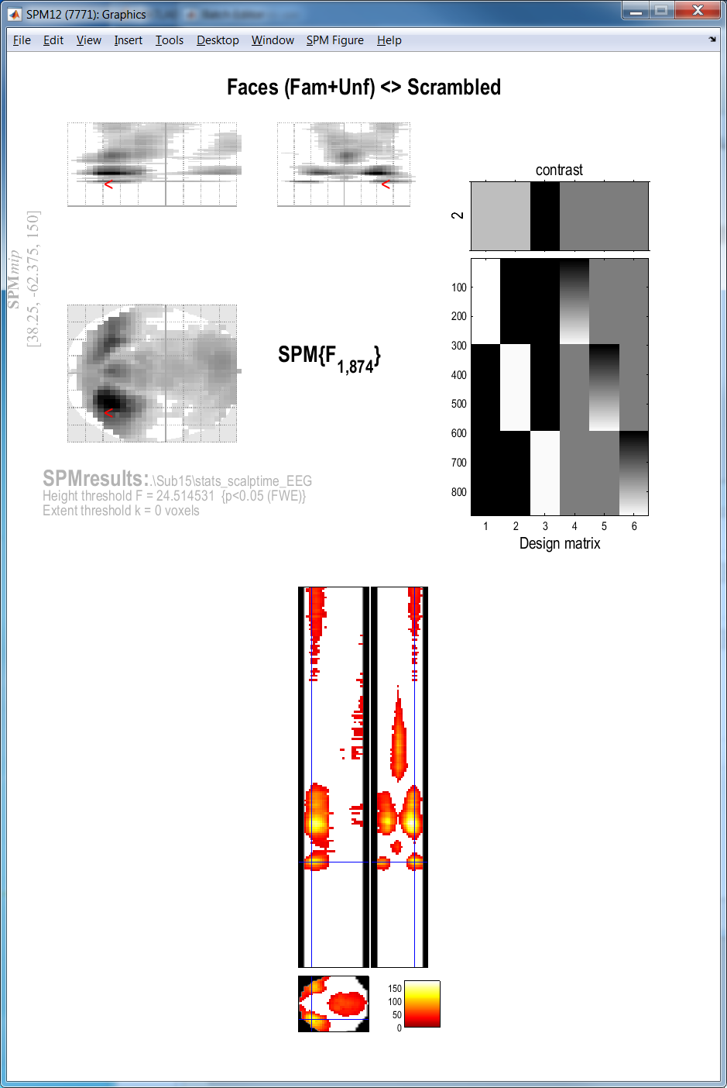
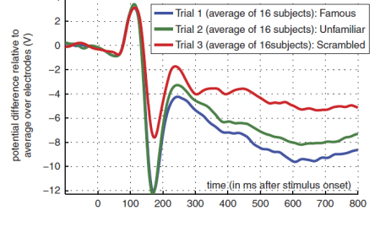
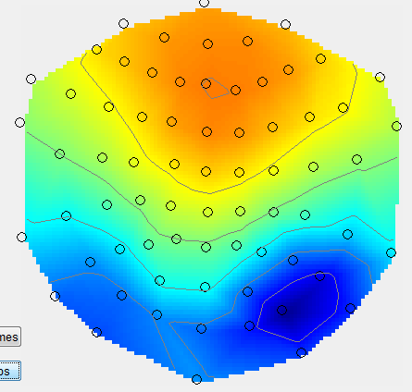
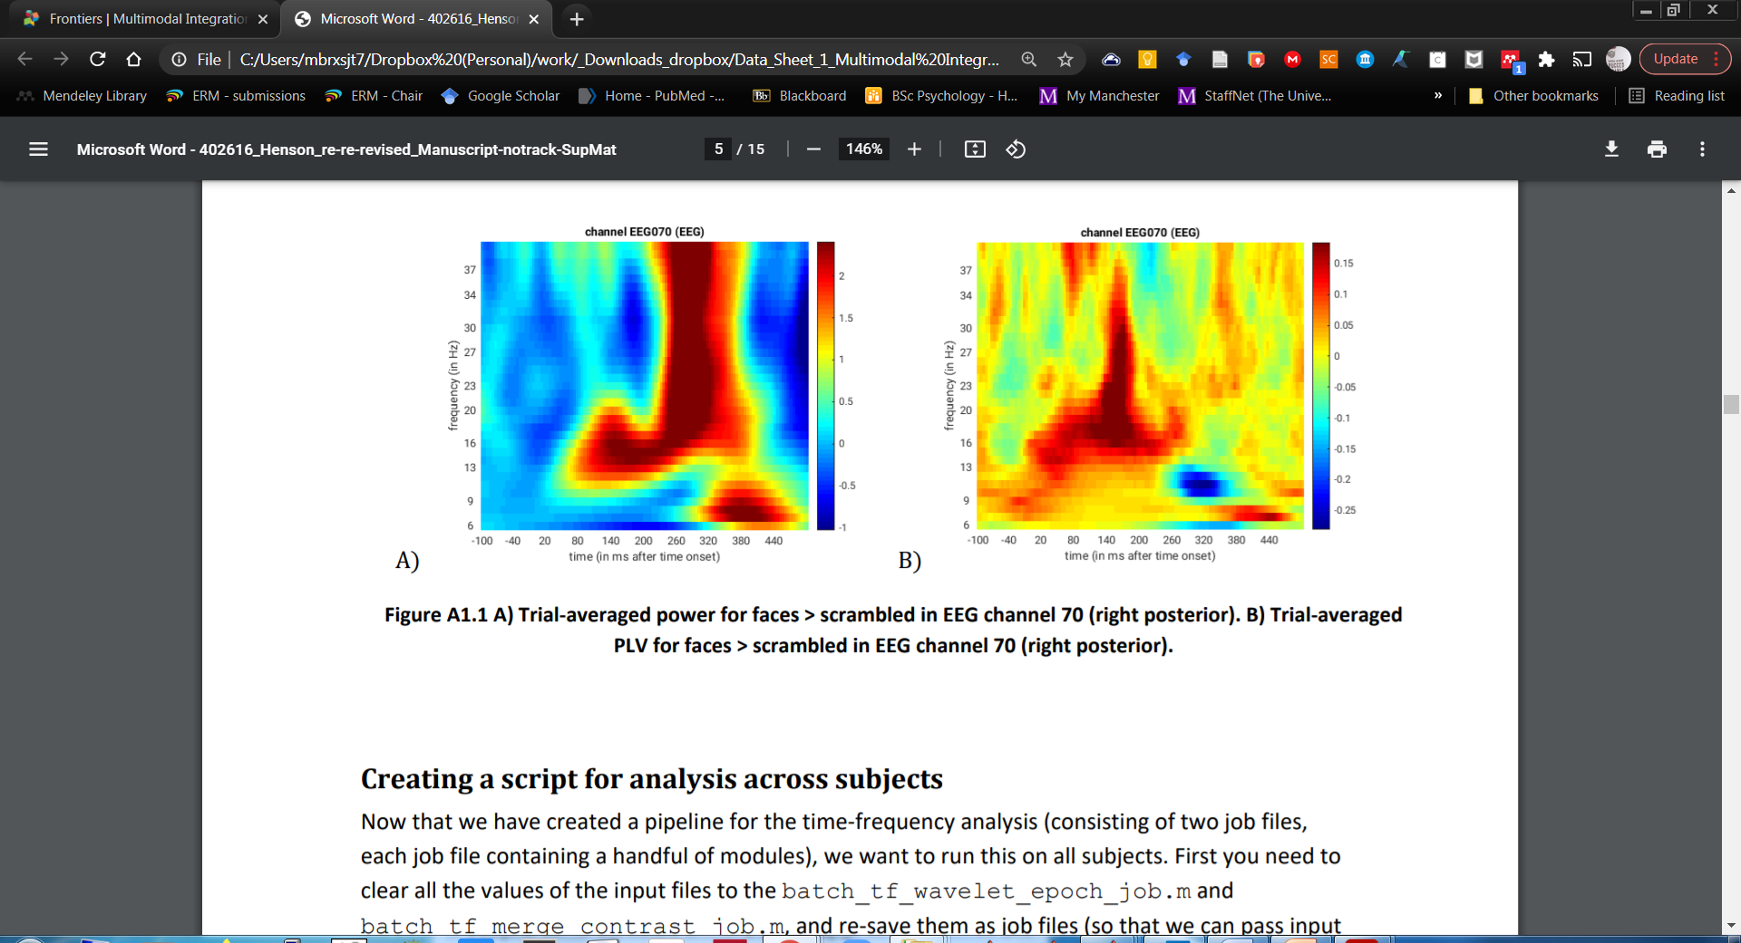
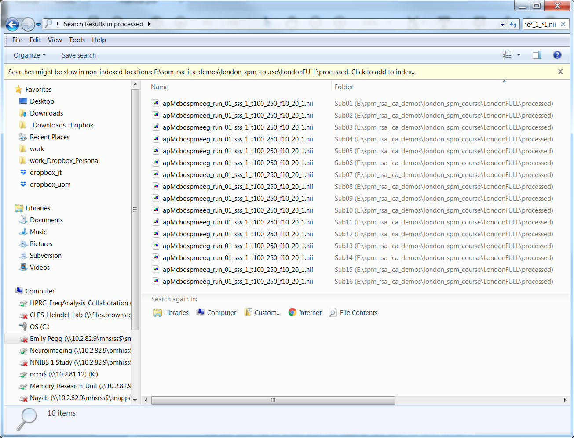
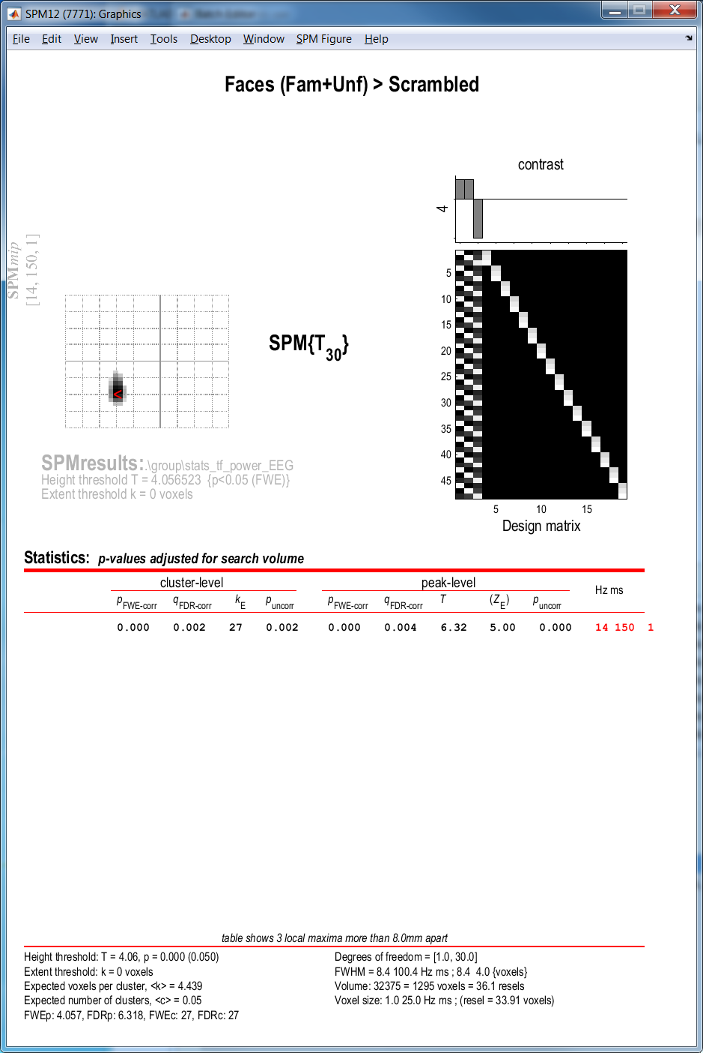
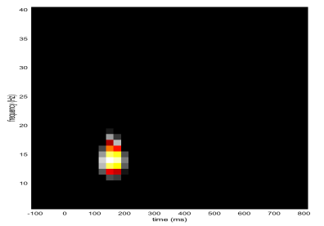
Group M/EEG Analysis Demo
Statistics in sensor and source space
Jason Taylor
University of Manchester
With thanks to Dan Wakeman (data), Rik Henson (code & demo), Martin Dietz (prev demo)

Slide 2
Demo Plan
0. Re-introduce data & preprocessing batch
1. Scalp x time stats (3D)
  Single-subject (over trials), including trial-wise covariate
    You should be able to do this if you have run preprocessing up to writing trial-wise scalp x time images on Sub15 according to Chapter 42 in the SPM12 Manual
2. Time x frequency stats (2D)
  Second-level (over N=16 subjects), collapsed across channels
    For this you will need time x frequency images for all 16 subjects
3. Source stats (3D MNI space)
  Second-level (over N=16 subjects), in time-frequency window
    For this you will need source (MNI) images for all 16 subjects

Slide 3

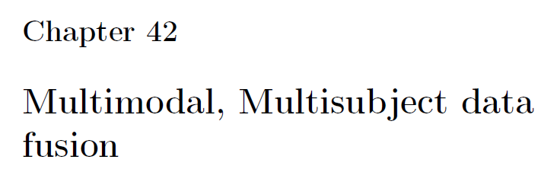
Data
Wakeman & Henson (2015) multimodal (fMRI, M/EEG) face-processing dataset:
Wakeman & Henson (2015), Scientific Data http://www.nature.com/articles/sdata20151
‘Multimodal, multisubject data fusion’ in https://www.fil.ion.ucl.ac.uk/spm/course/material/
We have run the full pre-processing pipeline (to ERP/Fs and scalp x time images) on one subject (subject 15)
We’ll also use images (TF, source) derived from all N=16 participants for group-level stats
ANALYSIS PIPELINE
We follow chapter 42 of the SPM12 manual
see also: Henson et al. (2019), Front Neurosci, BIDS format https://doi.org/10.3389/fnins.2019.00300

Slide 4
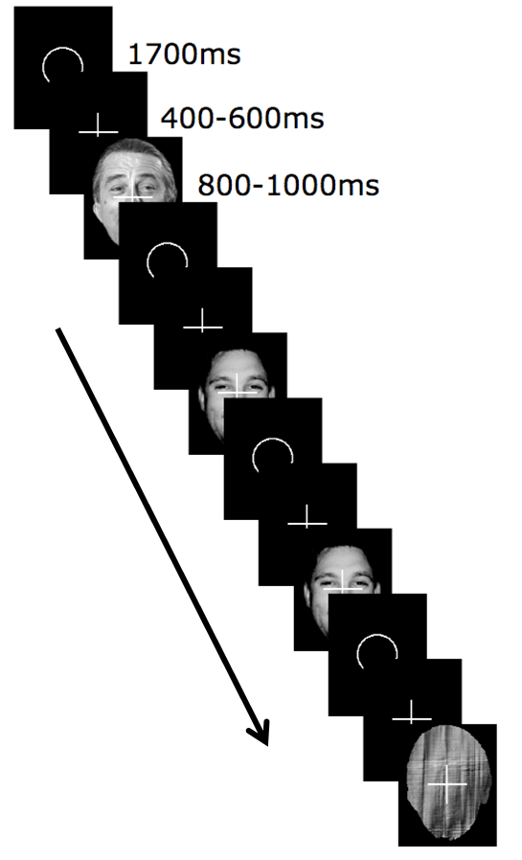

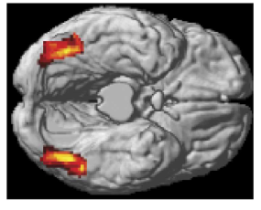
1700 ms
N=16 Subjects
EEG = 70 channels, nose-reference (concurrent with MEG)
MEG = 102 magnetometers + 204 planar gradiometers
fMRI = BOLD EPI 3x3x3mm (3T Siemens Trio)
MRI = T1 MPRAGE 1x1x1mm
Stimuli: 3 types of greyscale face images:
300 x Famous
300 x Unfamiliar (previously unseen)
300 x Phase-scrambled versions of above
Task: Judge left-right symmetry
400-600 ms
800-1000 ms
TIME
Time
x Freq
ERP/Fs
Scalp
x Time
Source

Slide 5
Screenshots

Slide 6
0. Review of preprocessing

Slide 7
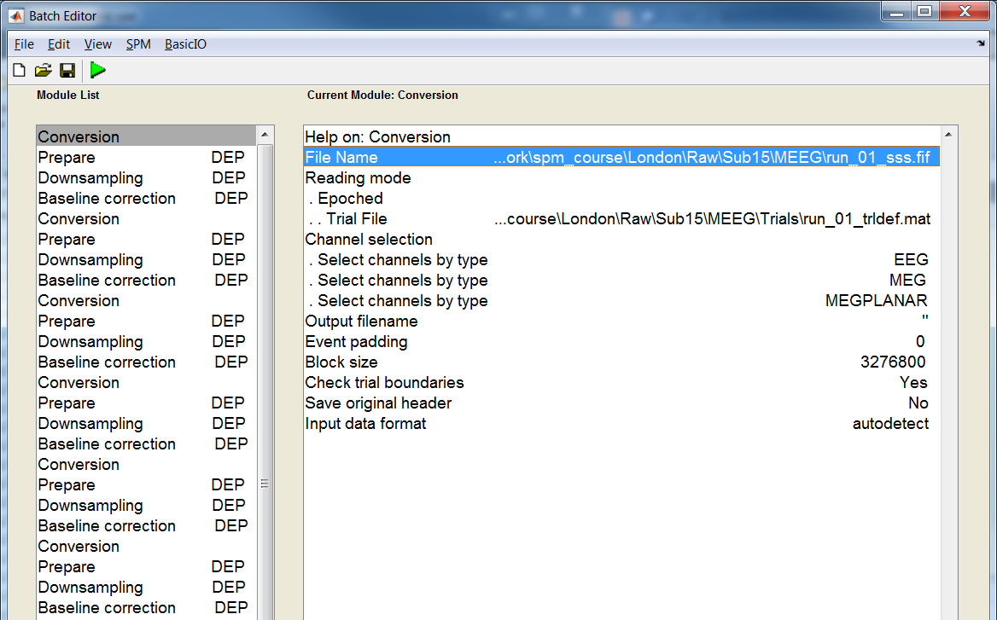
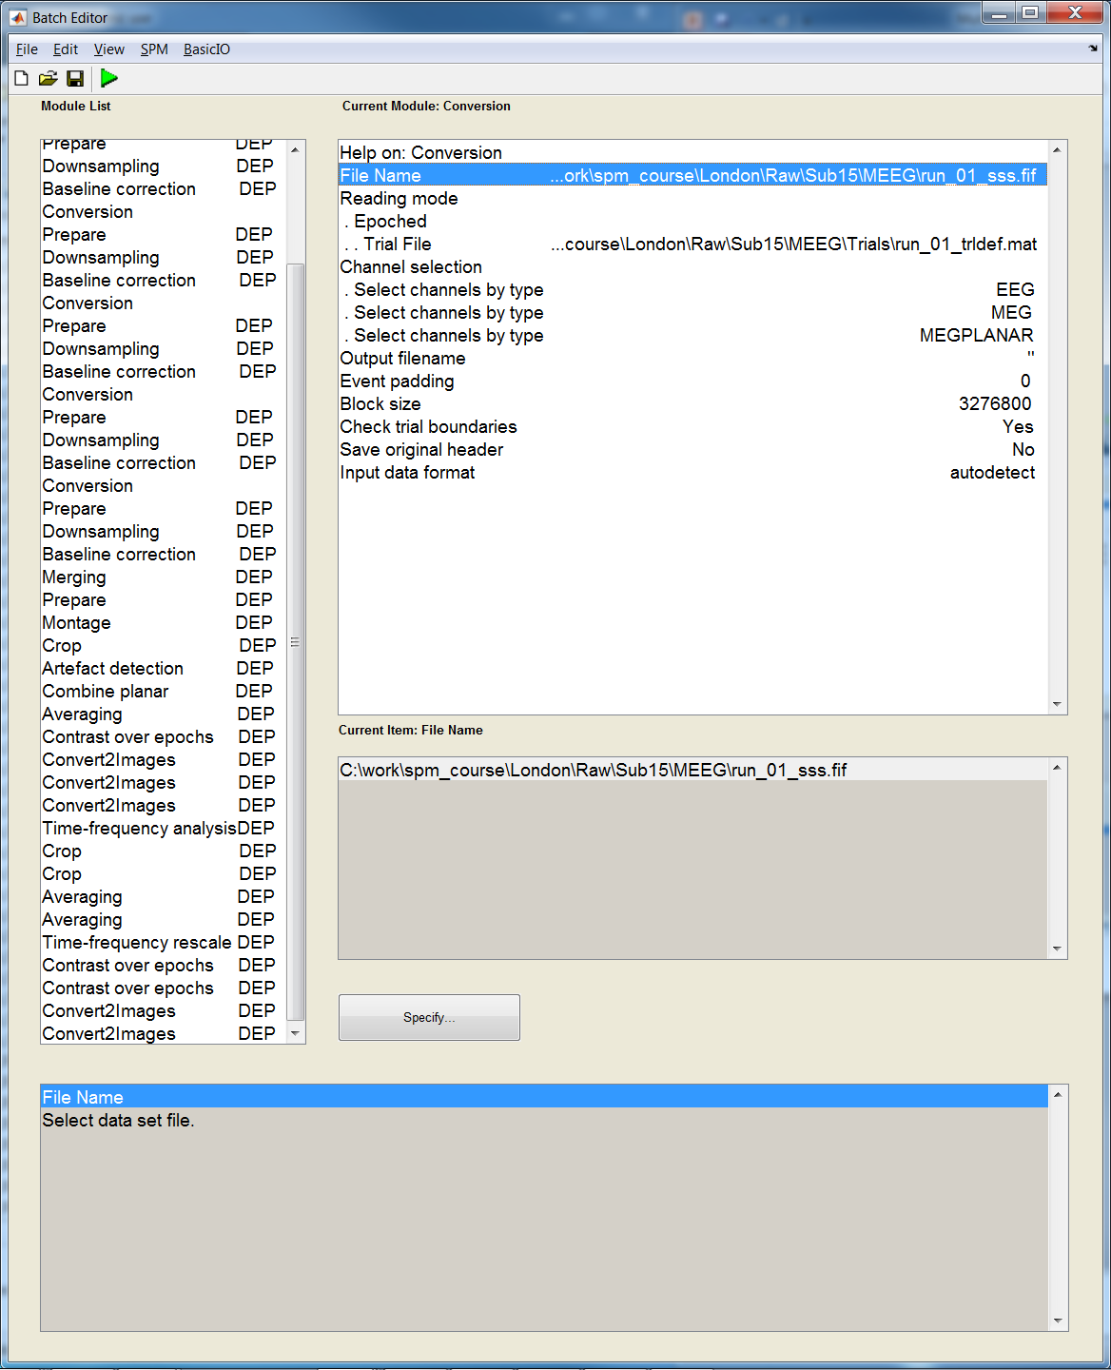
Preprocessing
Pipeline
6 runs
Artefact-rejected (a*.mat)
Source estimation &
Source (Brain) Images
Combine Planar (P*.mat)
Scalp x Time Images
Time-Freq Rescale (r*.mat)
Time x Freq Power Images

Slide 8
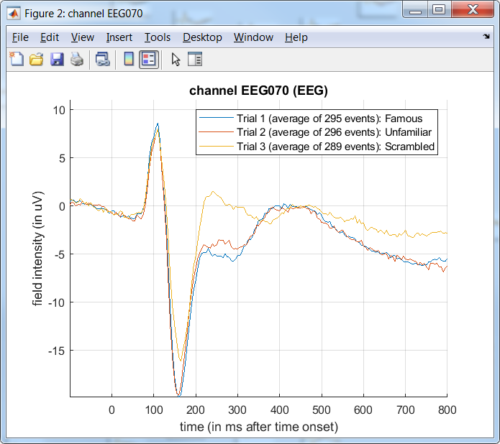
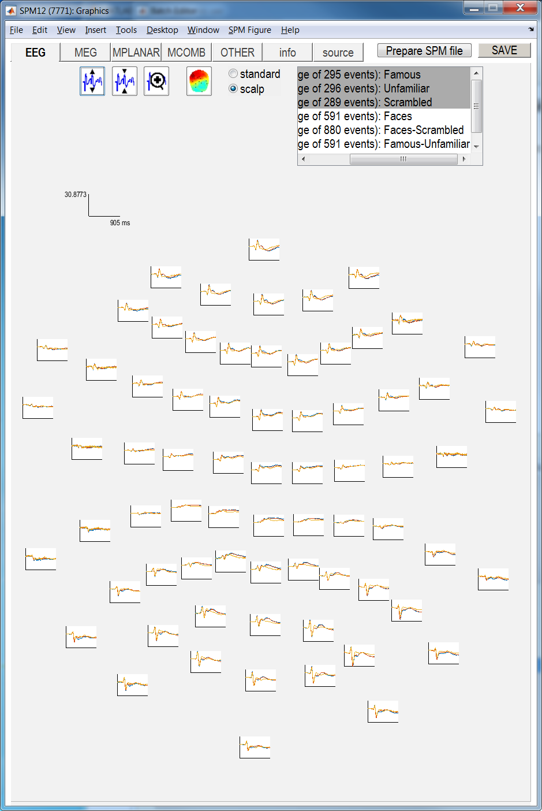
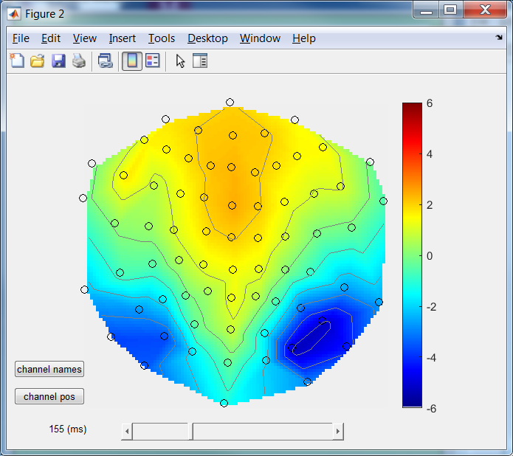
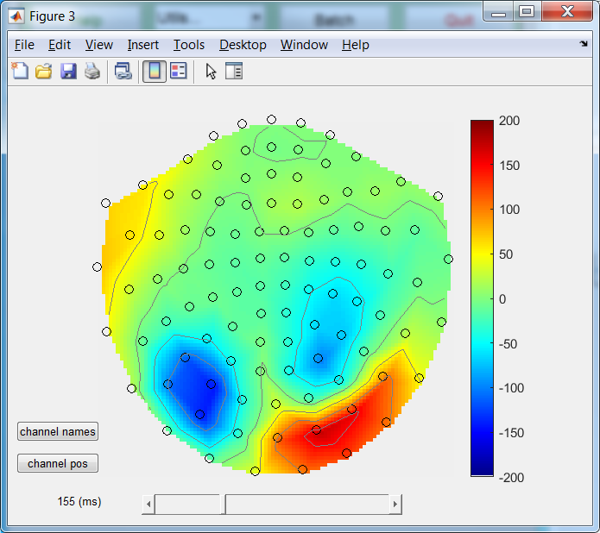
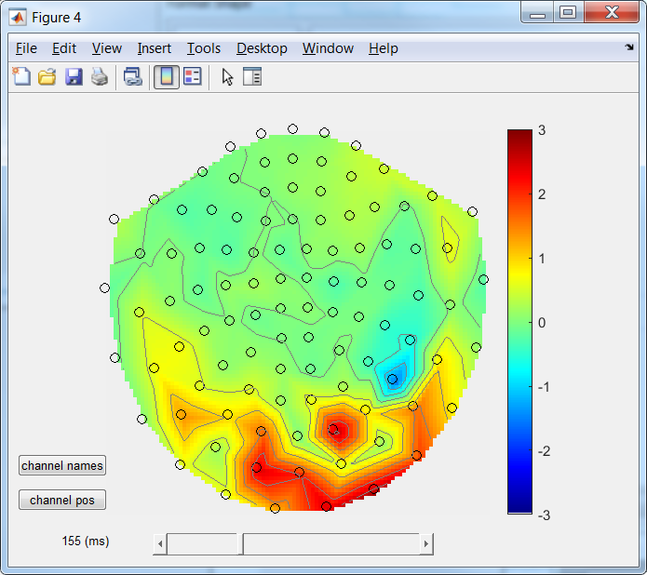
Display -> M/EEG (file: wm*.mat)
Faces – Scrambled difference topographies
EEG
MEG
magnetometers
MEG
planar
gradiometers
(RMS)

Slide 9
1. Scalp x Time Stats in Sub15

Slide 10
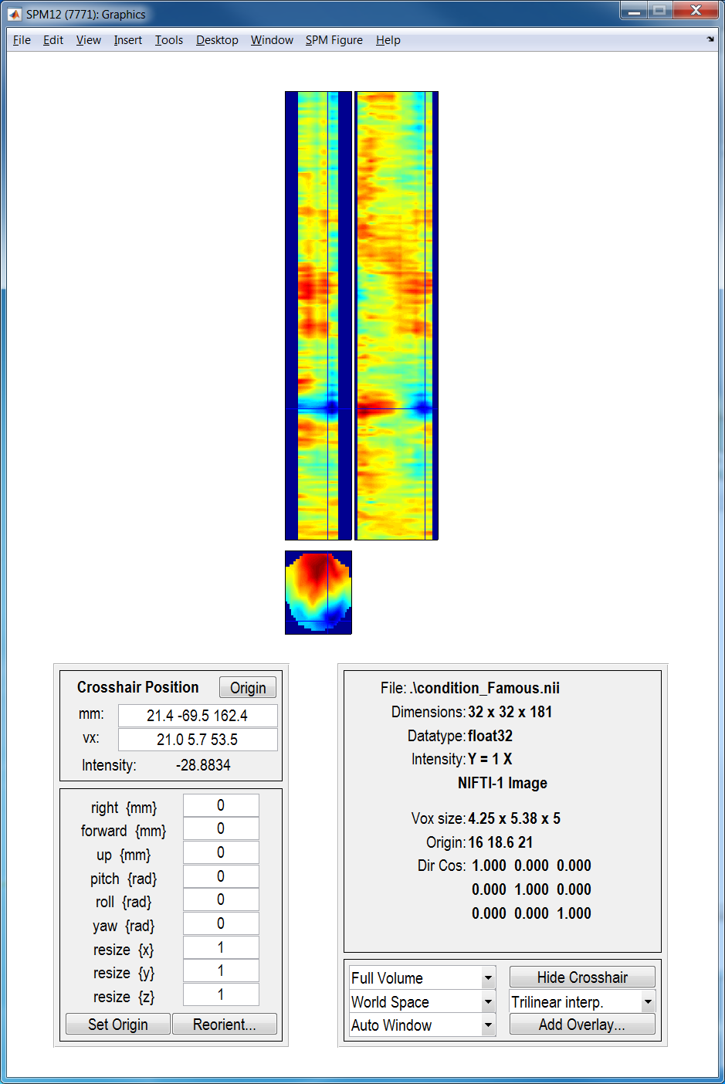
Display -> Image (scalp x time: condition_Famous.nii)

Slide 11
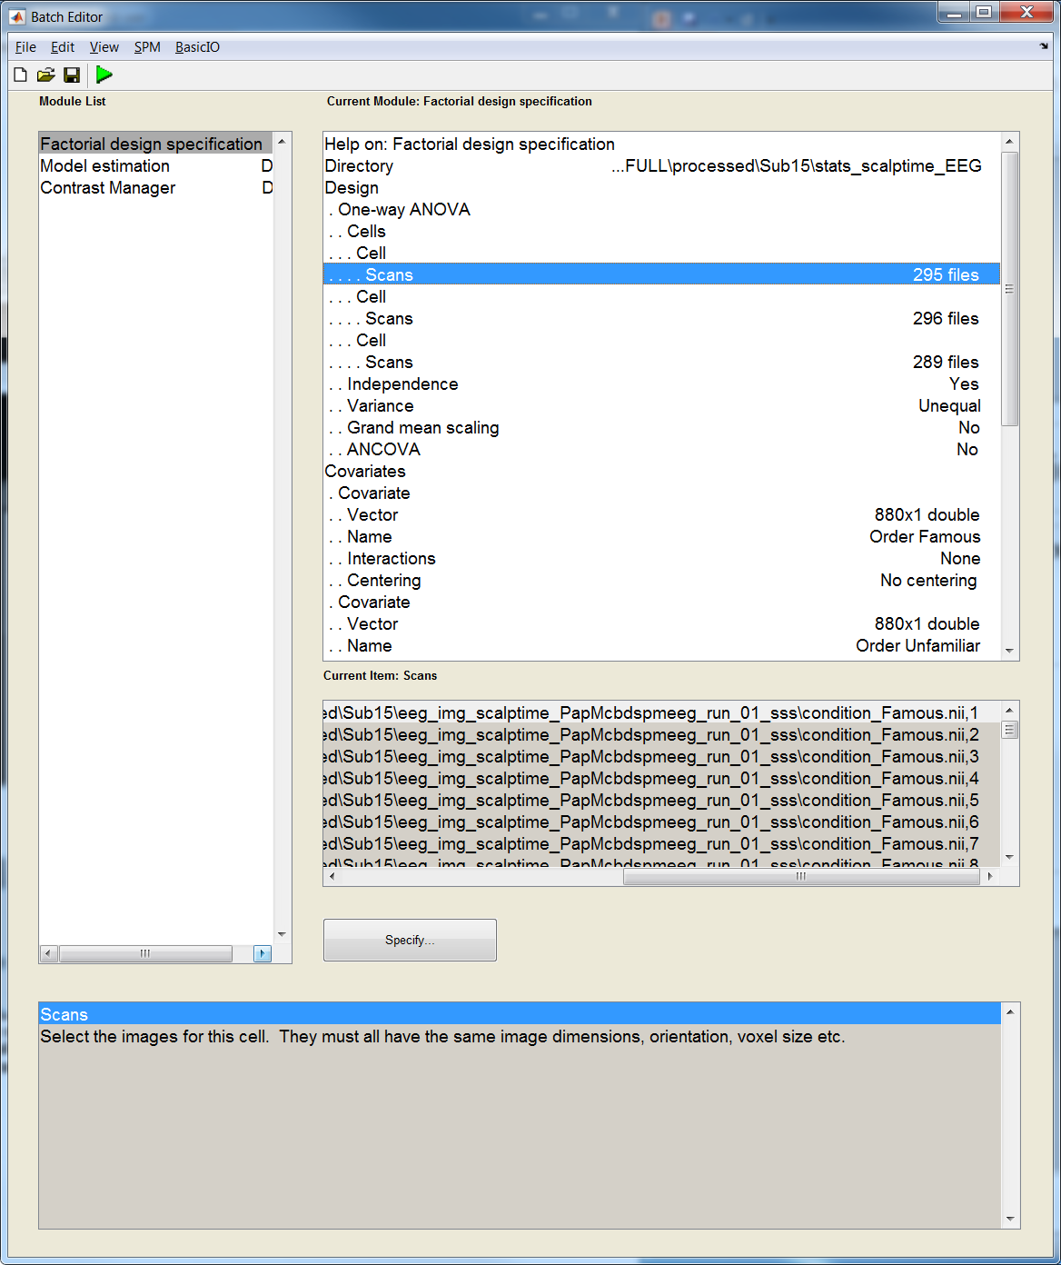
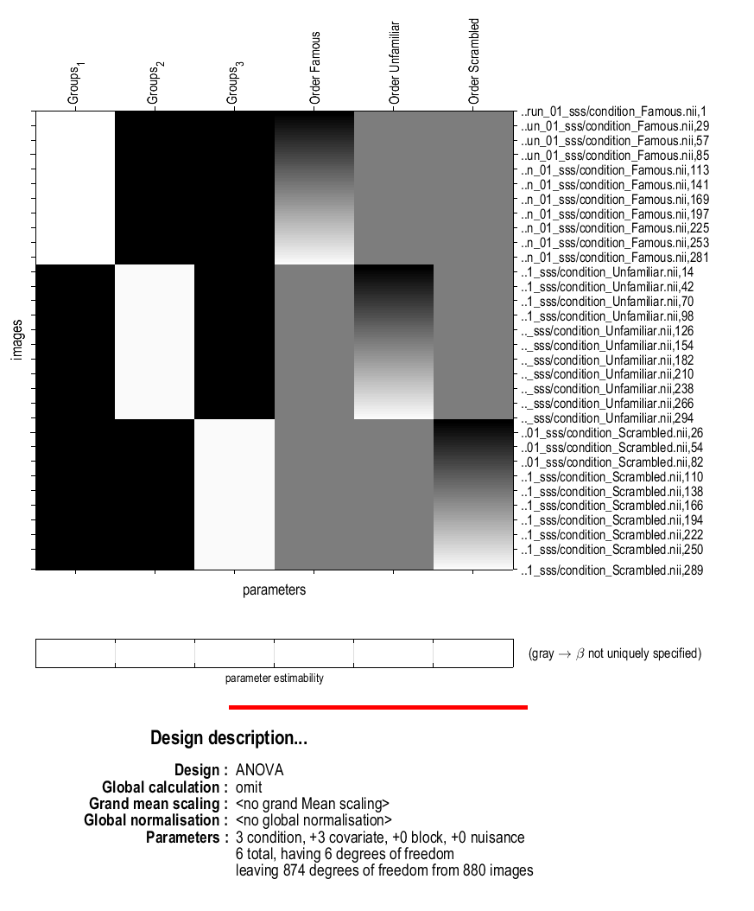
Scalp x Time Stats batch & model (One-way ANOVA)
Famous
Unfamiliar
Scrambled
Order Famous
Order Unfamiliar
Order Scrambled
Famous
Unfamiliar
Famous trial 1
Famous trial 2
…
Unfamiliar trial 1
Unfamiliar trial 2
…
Scrambled trial 1
Scrambled trial 2
…
Scrambled trial N
Scrambled
Famous.*nii
(1:Ntrials)
in this cell
order_famous = [detrend([1:295],0) zeros(1,296+289)];
order_unfamiliar = [zeros(1,295) detrend([1:296],0) zeros(1,289)];
order_scrambled = [zeros(1,295+296) detrend([1:289],0)];

Slide 12
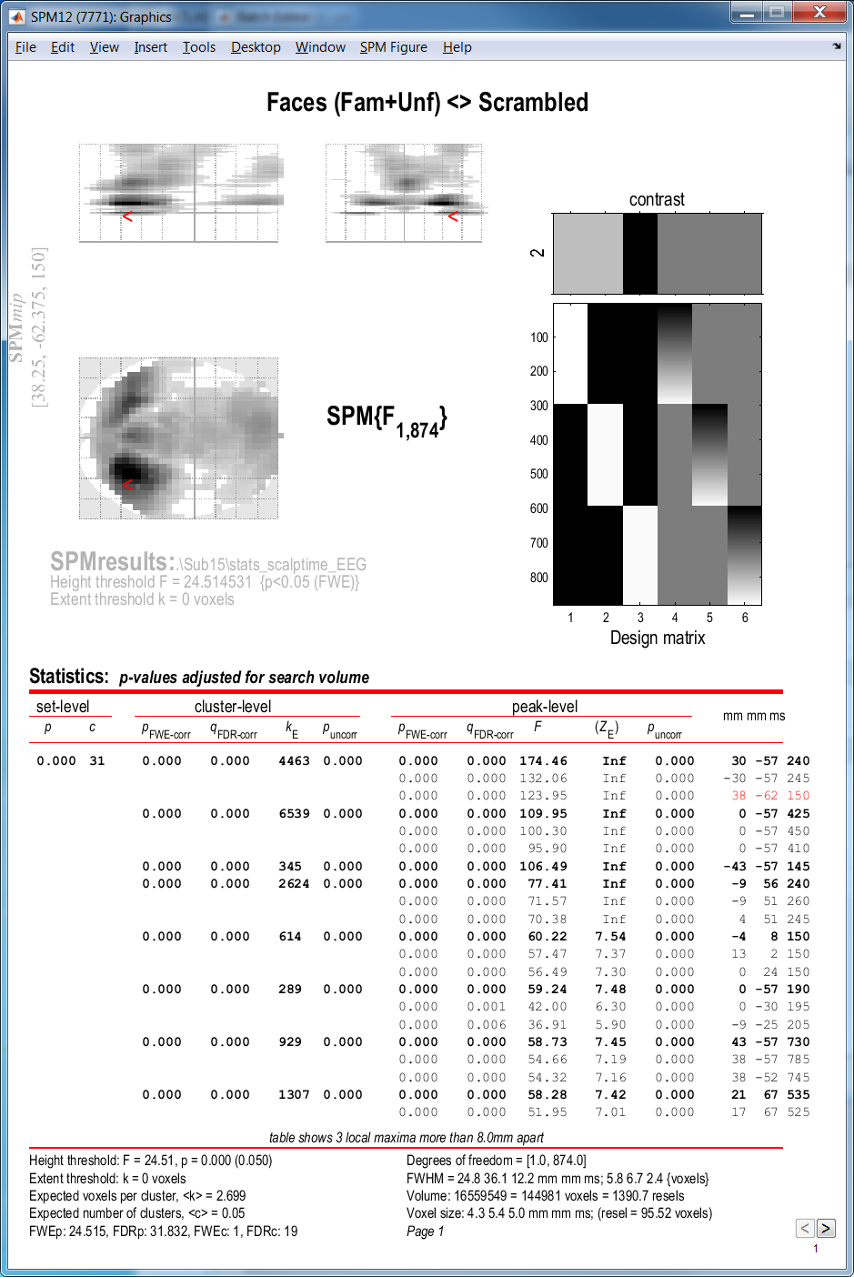
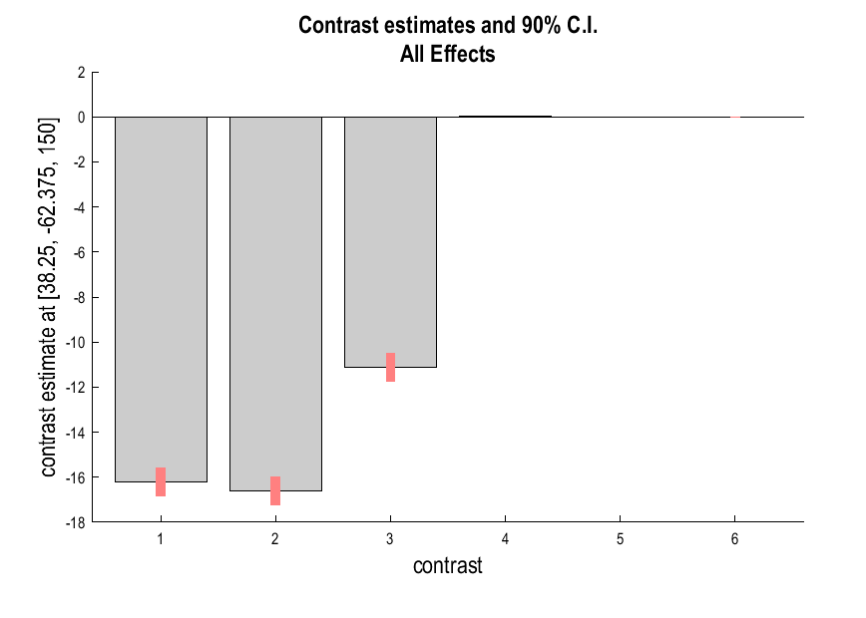
Scalp x Time Stats results
Overlays -> sections: mask.nii (implicit mask)
Plot contrast estimates (Effects of Interest)
EOI contrast: [eye(6)]

Slide 13
2. Time x Frequency Stats in N=16

Slide 14
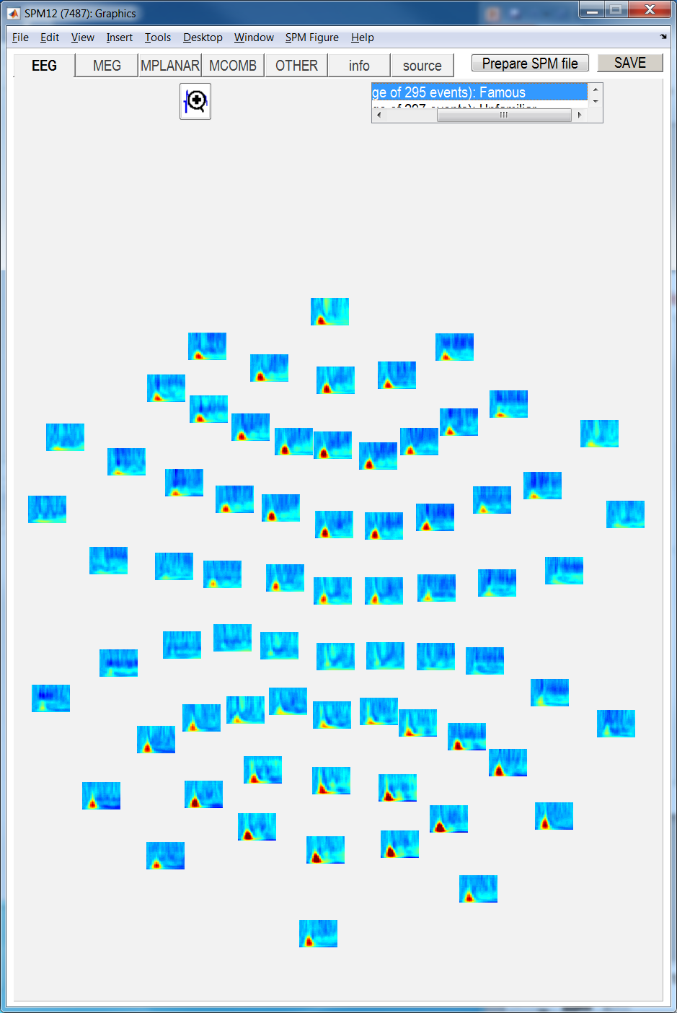
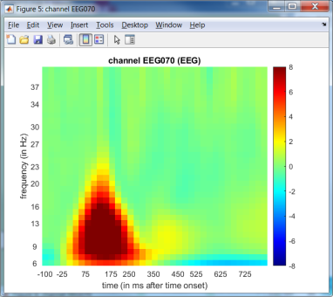
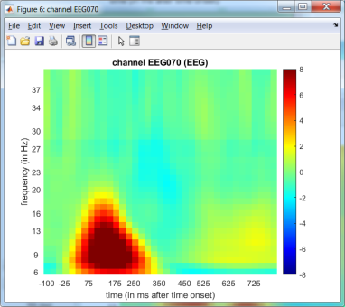
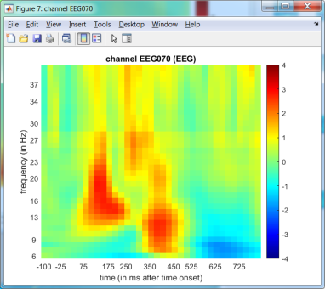
Display -> M/EEG (file: wrmptf*.mat)
EEG070
Faces
Scrambled
Faces
-
Scrambled
Contrast: [.5 .5 -1]

Slide 15
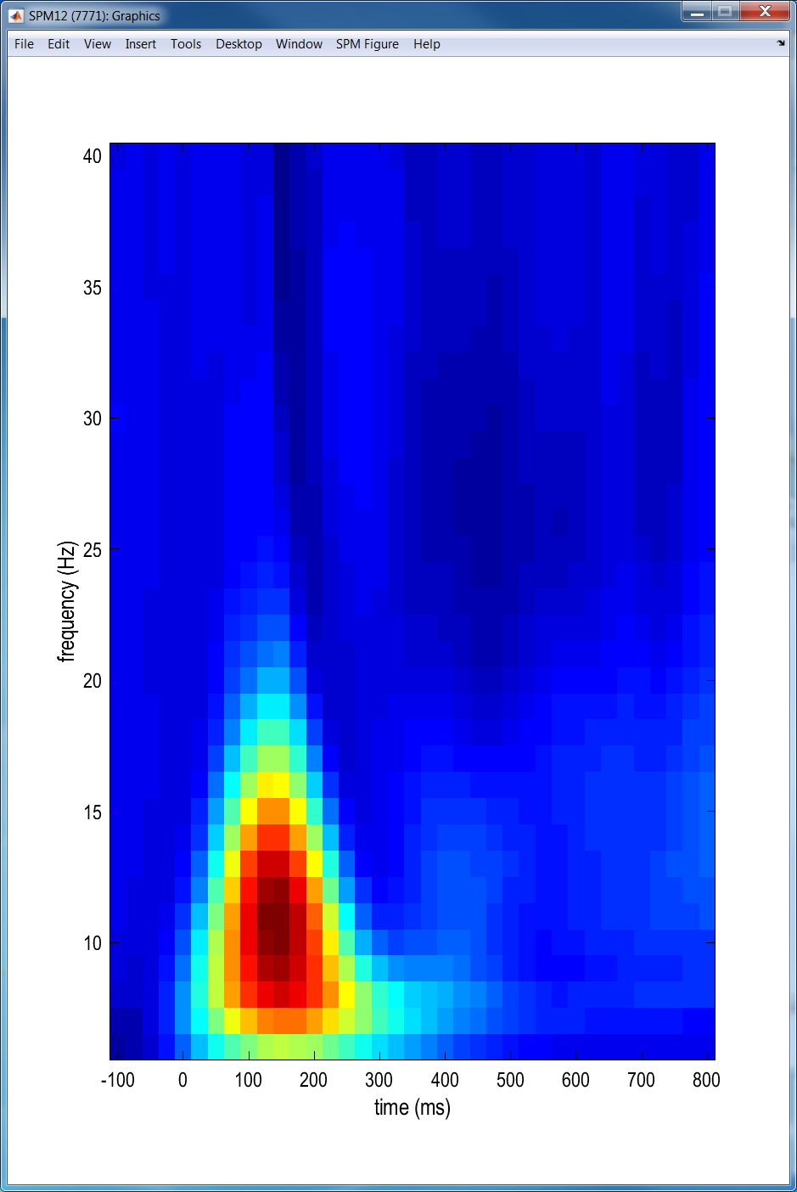
Display -> TF Images (time x frequency: condition_Famous.nii)

Slide 16
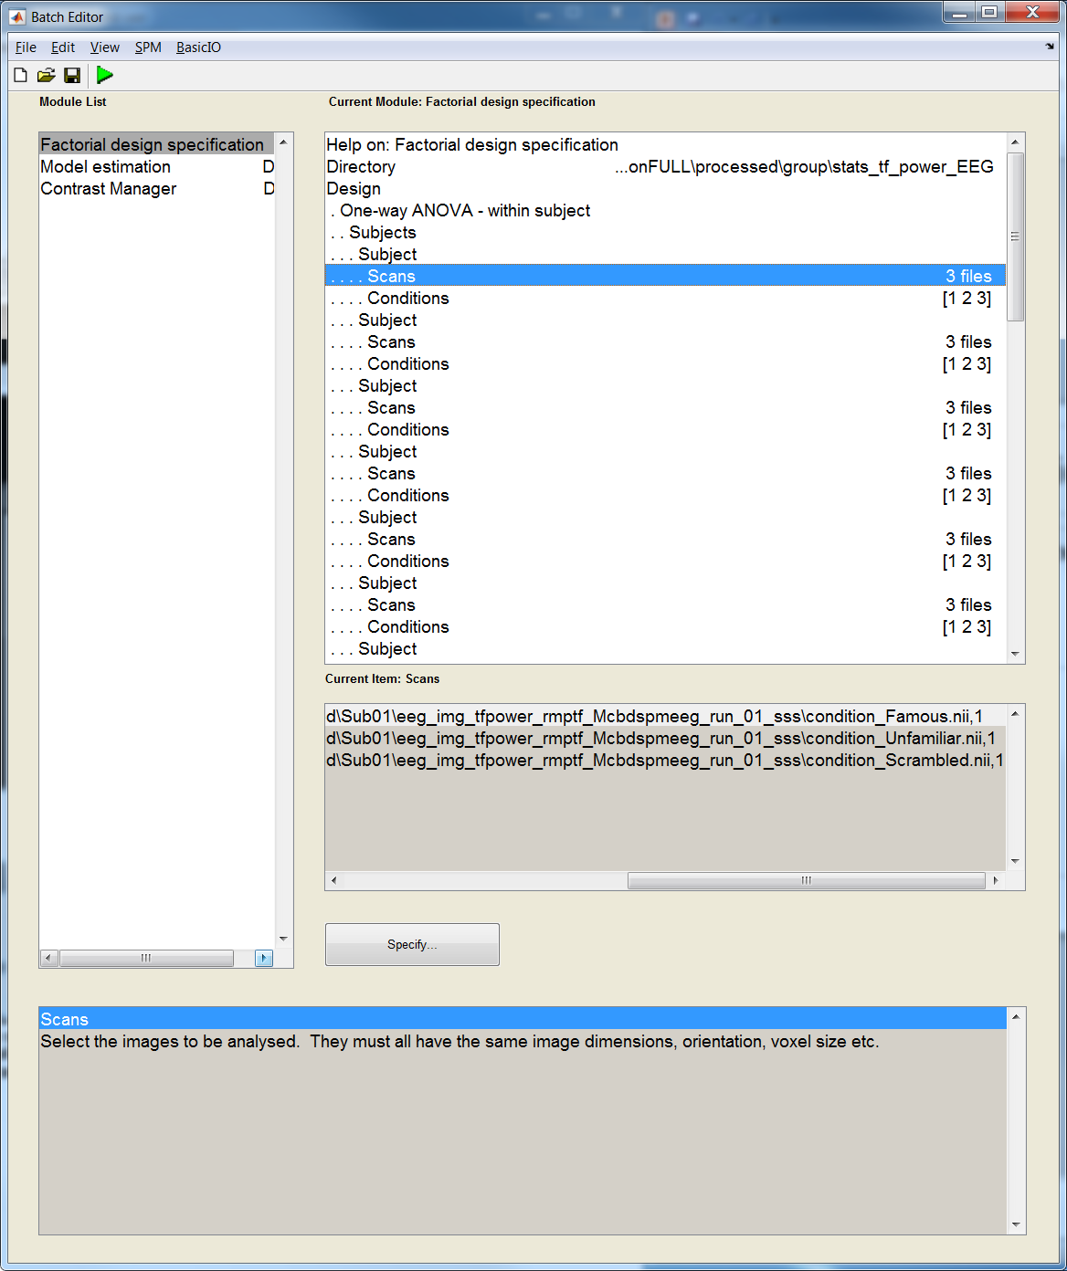
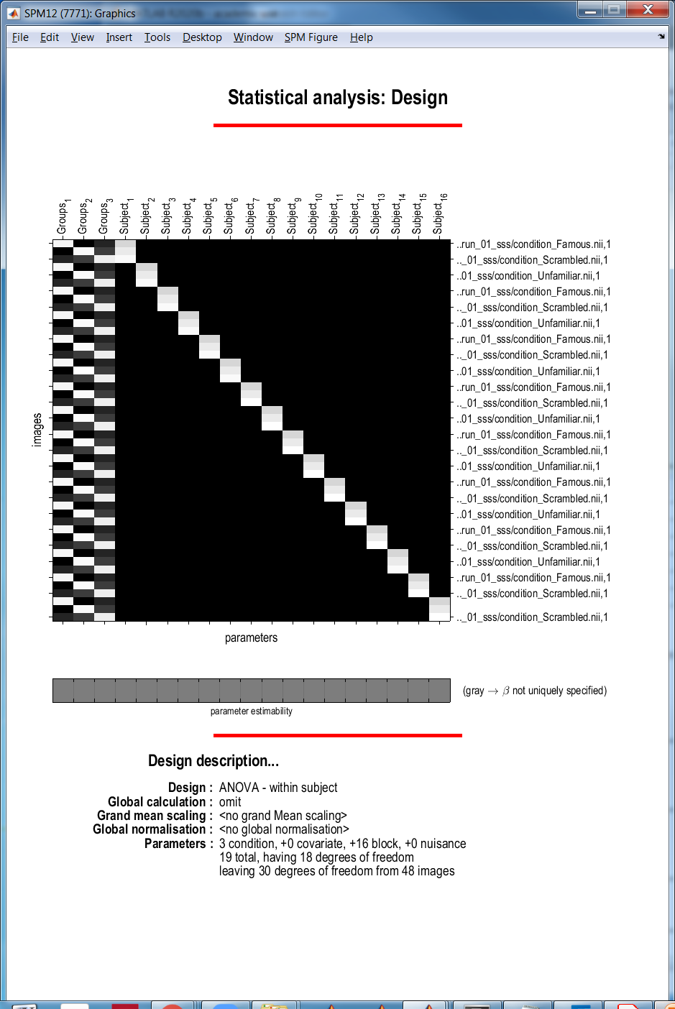
Time x Frequency Stats batch & model (One-way repeated measures ANOVA)
Famous
Unfamiliar
Scrambled
Subjects
Sub01
Sub02
Sub01 Famous
Sub01 Unfamiliar
Sub01 Scrambled
Sub03
Sub02 Famous
Sub02 Unfamiliar
…
Sub02 Scrambled
…
Famous
Unfamiliar
Scrambled

Slide 17

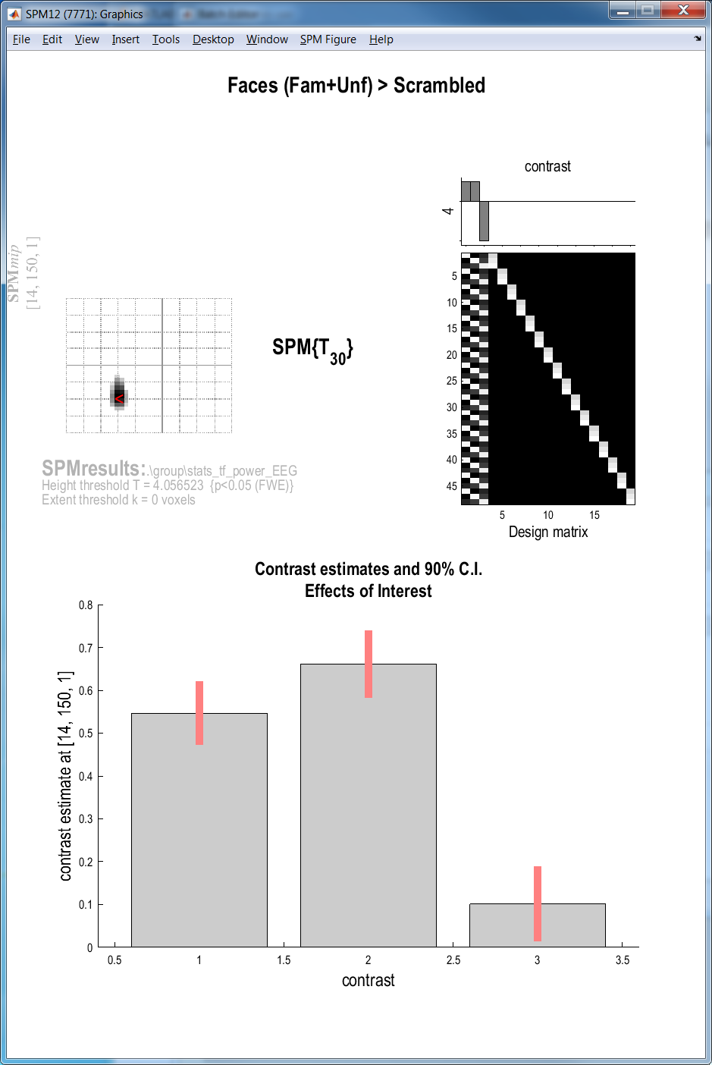
Time x Frequency results
Save -> thresholded image
then Display -> TF images
Plot contrast estimates (Effects of Interest)
EOI contrast: [[eye(3) ones(3,16)/16]]

Slide 18
3. Source Stats in N=16

Slide 19
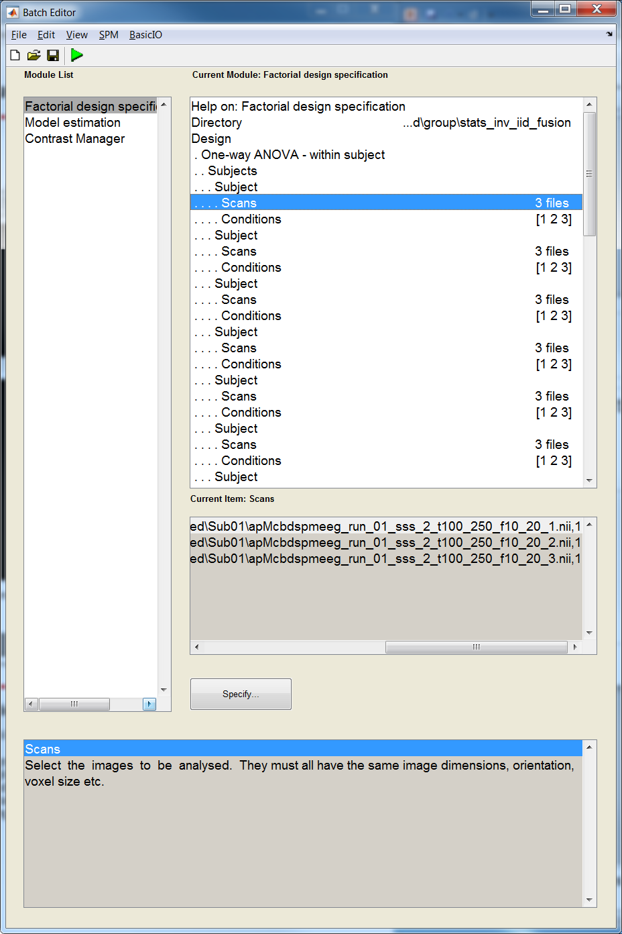

Source Stats batch & model (One-way repeated measures ANOVA)
Inverse index
2=IID
i.e., Min. Norm
in my analysis
Time-win
100-250ms
Freq-win
10-20Hz
Condition
1=Famous / 2=Unfamiliar / 3=Scrambled
According to condition order in the file

Slide 20
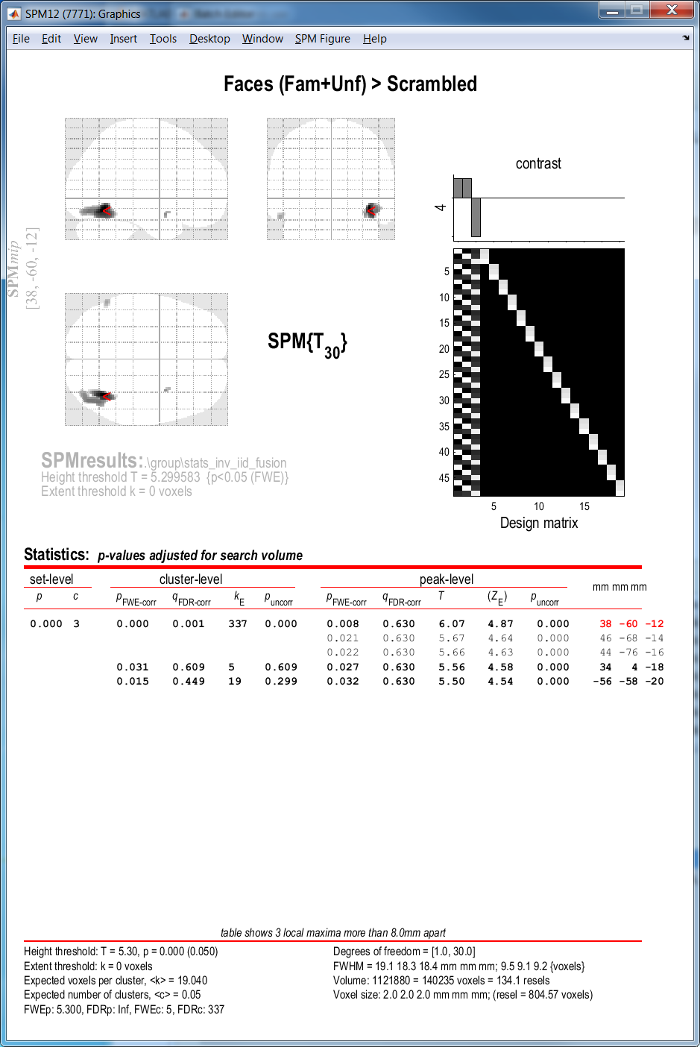

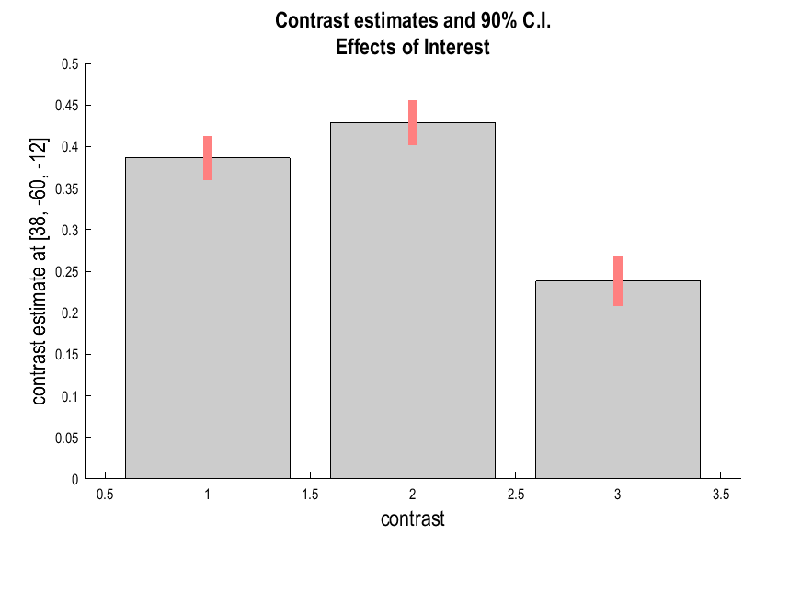
Source results (images *.nii)
Overlay -> sections -> individual T1
Plot contrast estimates (Effects of Interest)
EOI contrast: [[eye(3) ones(3,16)/16]]

Slide 21
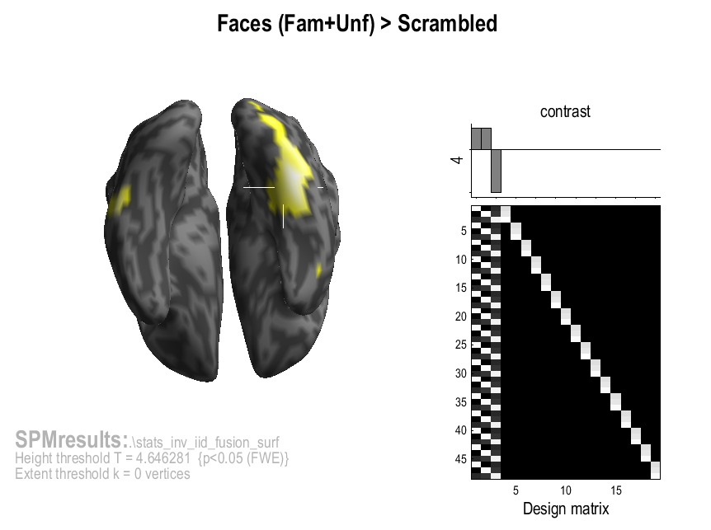
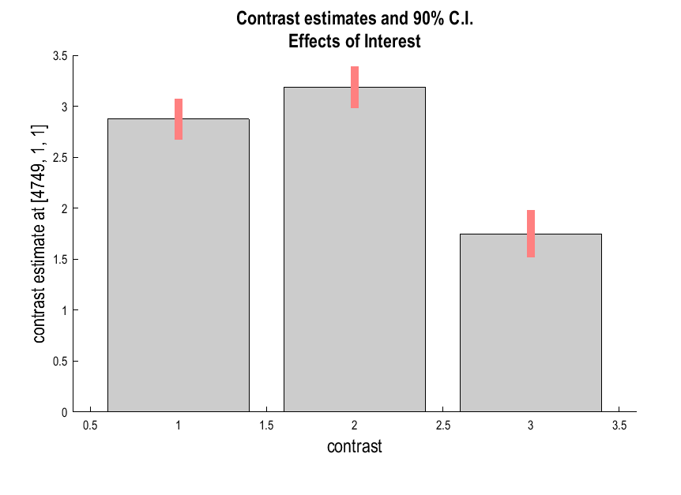
Source results (surfaces *.gii)
Rotated & inflated
Plot contrast estimates (Effects of Interest)
EOI contrast: [[eye(6) ones(6,16)/16]]

