Slide 1
DCM for EEG-CSD
demo
Frederik Van de Steen
Vrije universiteit Brussel

Slide 2
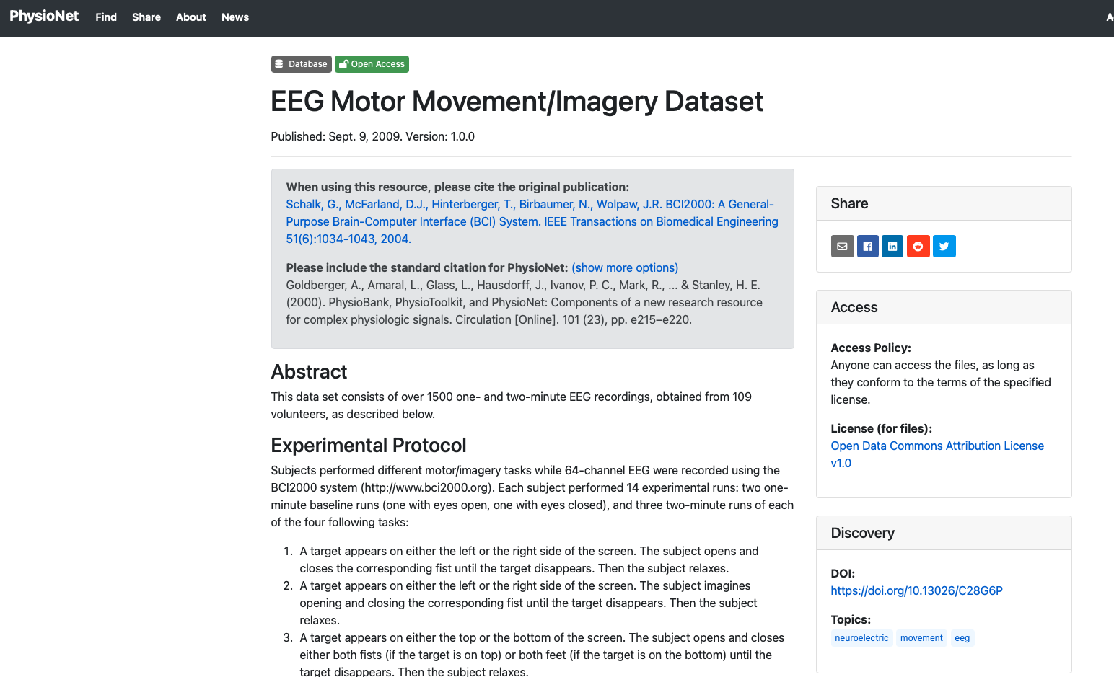
DCM for EEG-CSD: Demo
DCM for CSD: Modelling steady/resting state EEG
Raw data:
  64 channel EEG data
  1 Minute resting state
  109 subjects

Slide 3
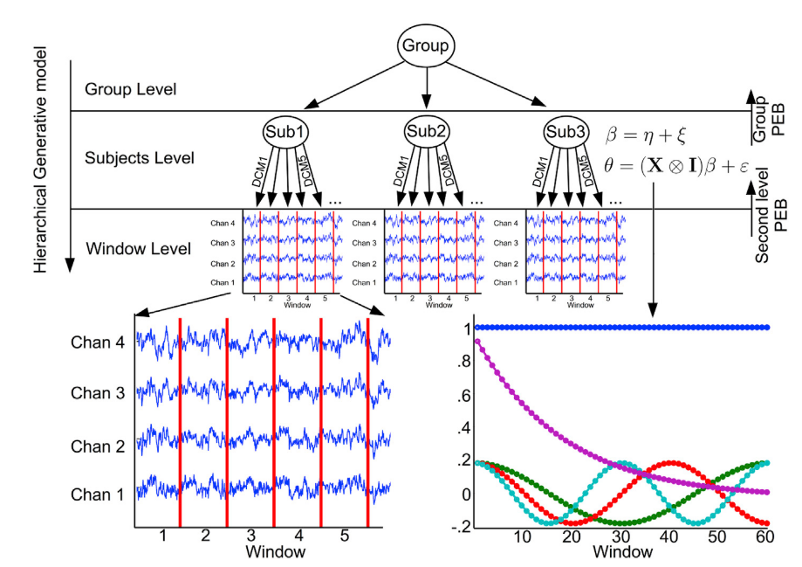
DCM for EEG-CSD: Demo
Analysis:
Github link
Raw EEG
Pre-processing
(tv-)DCM for CSD
Van de Steen et al (2019)

Slide 4
DCM for EEG-CSD: Demo
DCM analysis: Connectivity modulation first 10sec. Vs. Last 10 second of EEG
mPFC
Forward
Backward
Prec
lLP
rLP
Van de Steen et al (2019)

Slide 5
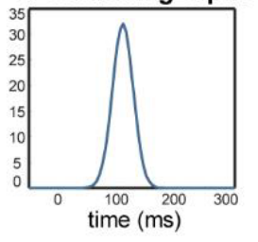
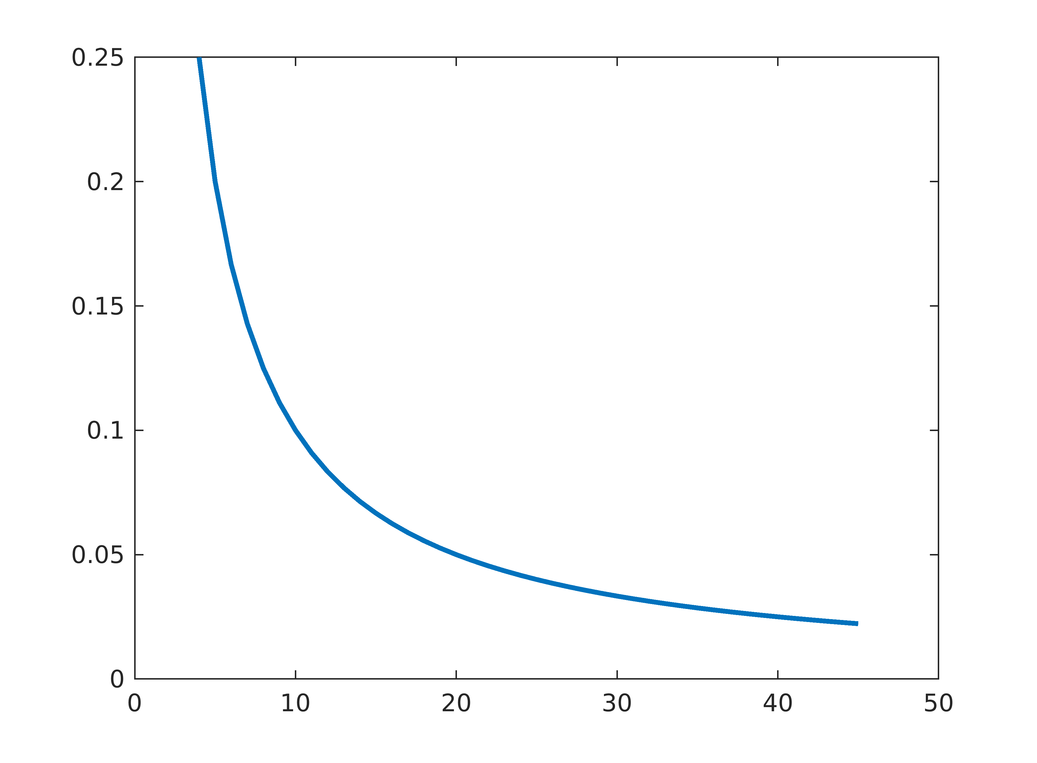
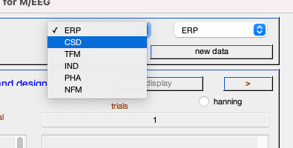
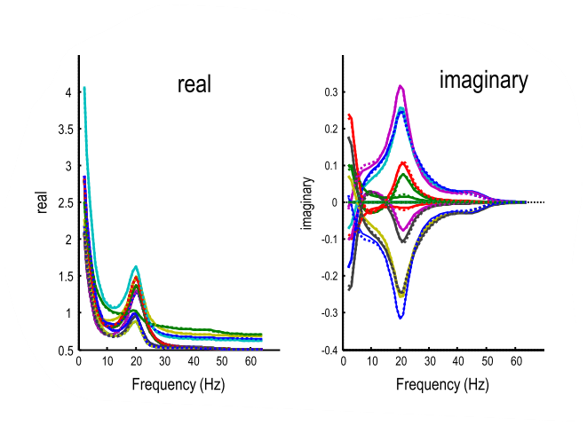
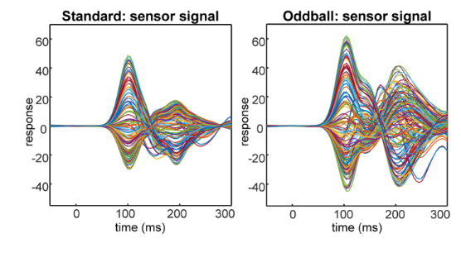




DCM for EEG-CSD: Demo
ERP
CSD
Step 1: Analysis type
Input: Stimulus onset
Input: ‘neural innovations’
:
U(t)$={Ce}^{−\frac{1}{width}{( t−delay)}^{2}}$
U(f)$=α f^{−β}$
y(t)$=g(x(t),\text{θ})$
G(f)$=S·U(f)·S′$

Slide 6
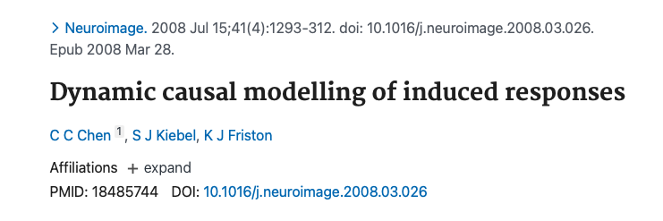
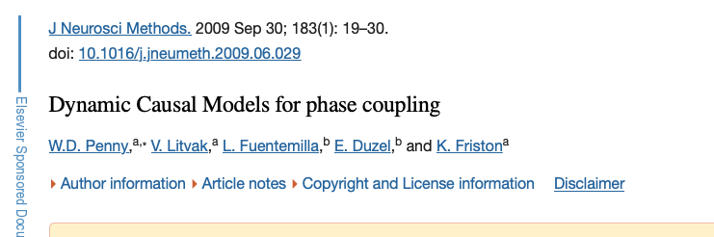
DCM for EEG-CSD: Demo
Step 1: Analysis type
  Phenomenological DCMs
    IND
    PHA

Slide 7
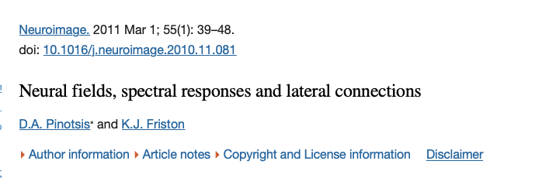
DCM for EEG-CSD: Demo
Step 1: Analysis type
  NFM: Neural field model; DCM for CSD with spatial domain
  TFM: DCM for time-frequency data
(with neural model)

Slide 8
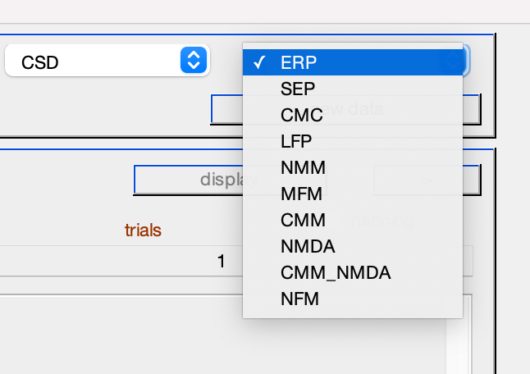
DCM for EEG-CSD: Demo
Step 2: Neural model

Slide 9
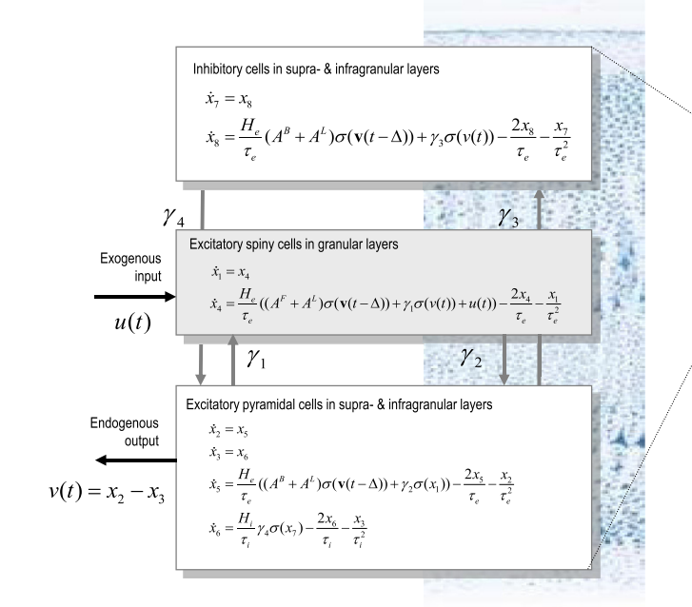
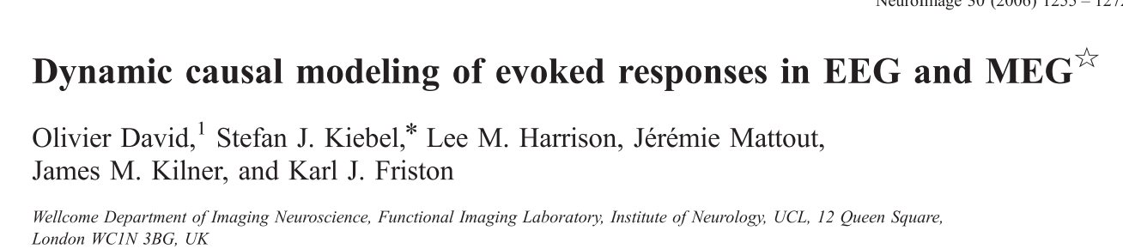
DCM for EEG-CSD: Demo
Step 2: Neural model
  ‘ERP’ model

Slide 10
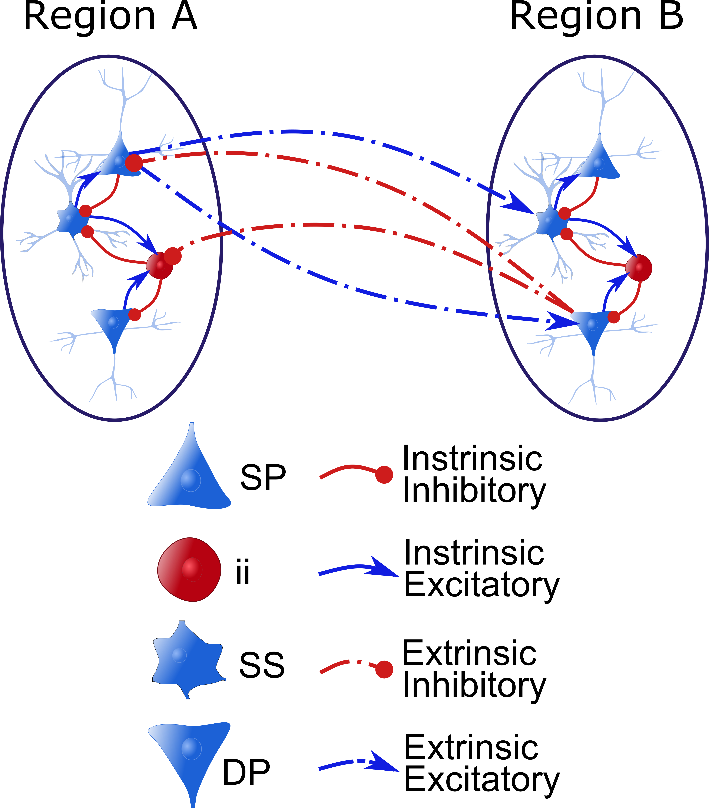
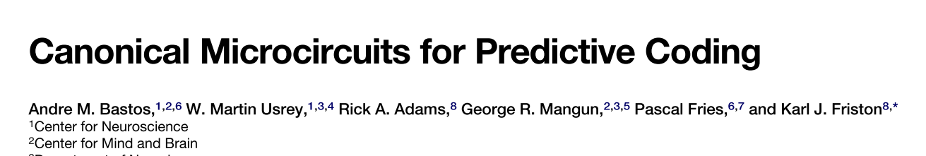
DCM for EEG-CSD: Demo
Step 2: Neural model
  ‘CMC’ model

Slide 11
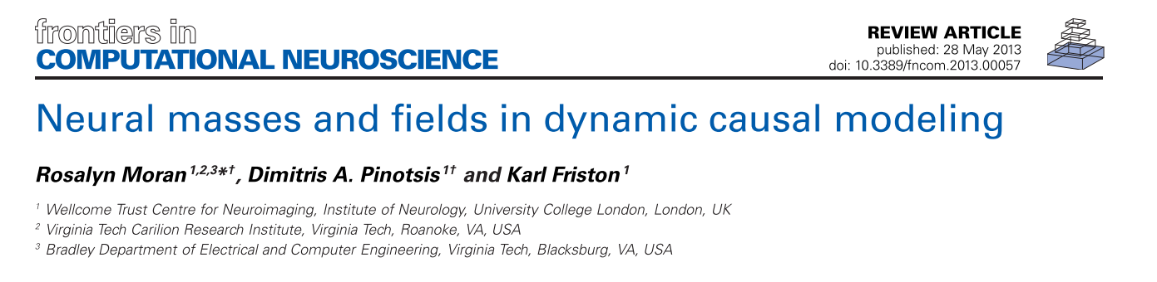
DCM for EEG-CSD: Demo
Step 2: Neural model
  Other models:

Slide 12
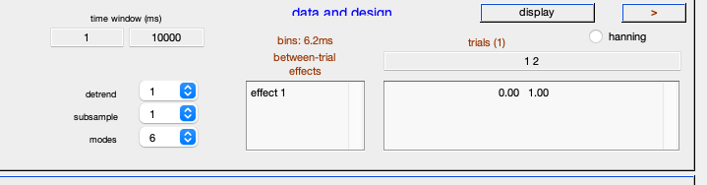
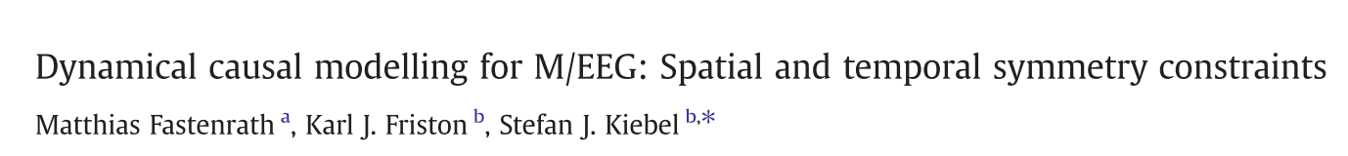
DCM for EEG-CSD: Demo
Step 2: Data & design
Number of DCT components that are ‘regressed out’
Downsampling
Data dimensionality reduction

Slide 13
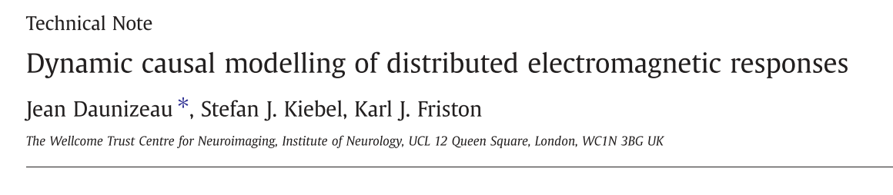
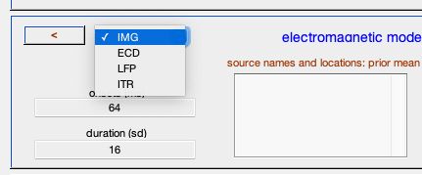
DCM for EEG-CSD: Demo
Step 3: Electromagnetic model
Patch on cortical surface
Equivalent current dipole
Local Field potentials (EcoG)
Intra-laminar recordings

Slide 14
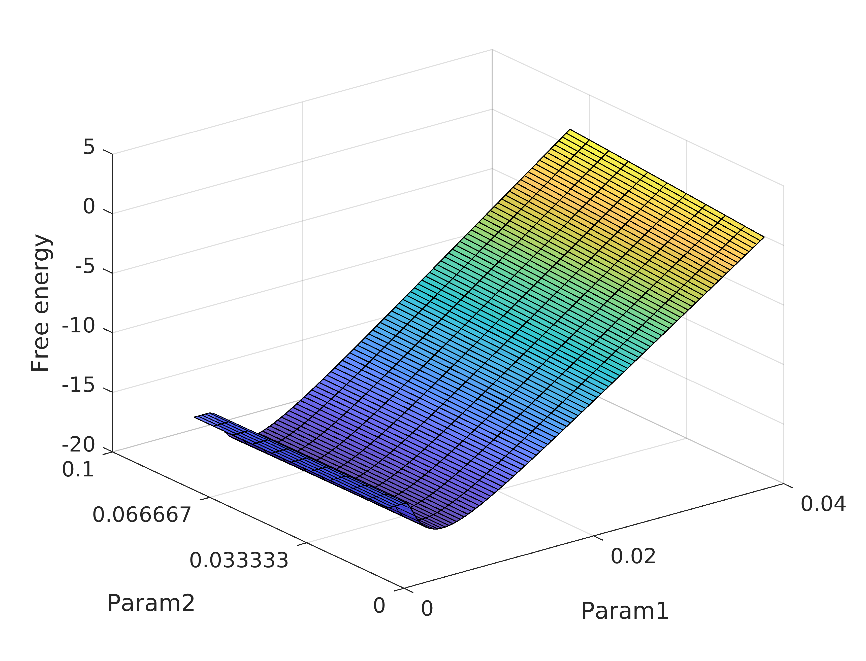
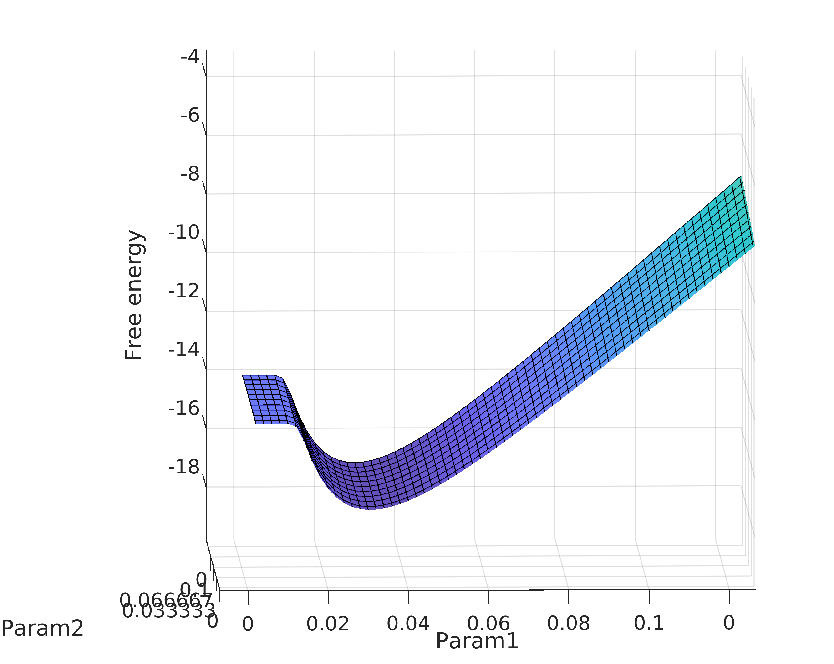
DCM for EEG-CSD: Demo
Watch out for local minima
Initial conditional mean

Slide 15
DCM for EEG-CSD: Demo
Thank you!
Contact: Frederik.van.de.steen@vub.be

