Slide 1
Experimental design
Carolin Moessnang
Central Institute of Mental Health, Mannheim, Germany
With thanks to:
Elisa van der Plas
Mona Garvert
Sara Tomiello
Sara Bengtsson
Christian Ruff
Rik Henson
Notes:
Give overview of different experimental designs that you may want to use for your fmri experiment
not: how to optimize your design in terms of timing parameters (will be dealt with in next talk)
Instead: structural overview of different types of experimental designs in order to guide you select the right one for your research question
Before starting: it’s really important that you select the right design;

Slide 2
The most important slide of this talk
It all starts with a good design!
How do I need to design my experiment in order to measure that process?
What process do I want to measure?
Research question
Experimental design

Slide 3
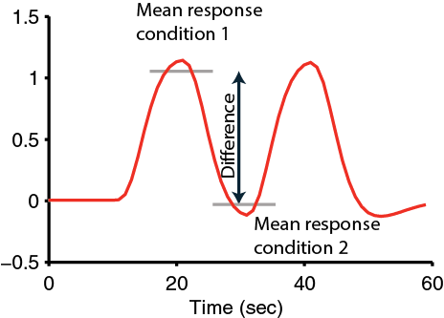
Why is that?
The BOLD signal does NOT provide you with an absolute measure of neural activity
Therefore, you need to compare activity across conditions
The sensitivity of your design depends on maximizing the relative change between conditions
Notes:
BOLD signal in itself is not an absolute measure of neural activity
E.g. a bold signal of 130 does not really tell you anything
In order for it to become informative, you need to compare between experimental conditions
And so the sensitivity of your design depends on maximizing the relative BOLD activity difference between conditions
And so your design questions are going to lead directly to the number of questions and the types of questions that you are able to answer

Slide 4



SPM processing hierarchy
At the very top…
Statistical parametric map (SPM)
Image time-series
Kernel
Design matrix
Realignment
Smoothing
General linear model
Statistical
inference
Gaussian
field theory
Normalisation
Template
p <0.05
Parameter estimates
Notes:
Processing hierarchy figure shows: design comes on very top
Your design will determine what design matrix you’ll be able to look at, which parameters you will be able to estimate, what contrasts you will be able to compute, and eventually also what questions you will be able to answer
And when we talk about a good design, we usually mean that it’s a design from which your results will be straightforward to interpret based on the conditions you have used in your experiment

Slide 5
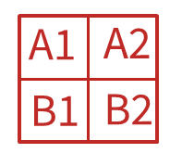
Overview
Categorical designs
  Subtraction Pure insertion, evoked / differential responses
  Conjunction Testing multiple hypotheses
Parametric designs
  Linear Adaptation, cognitive dimensions
  Nonlinear Polynomial expansions, neurometric functions
  Model-based regressors
Factorial designs
  Categorical Interactions and pure insertion
  Parametric Linear and nonlinear interactions
    Psychophysiological Interactions (PPI)
A vs B
AAAAAA
A1
A2
B1
B2
Notes:
Categorical designs: difference between two tasks can be formulated as a separate cognitive process or sensory motor process. One is looking for brain activation that corresponds to this difference
In parametric designs, one is looking for brain activation that varies systematically with the amount of cognitive or sensory motor load
And finally, factorial designs are very useful because they allow one to look at both main effects and interaction effects
The most elementary form of an experimental design is cognitive subtraction.

Slide 6
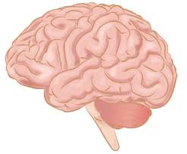
Cognitive subtraction
Aim
  Neuronal structures underlying a single process P
Procedure
  Contrast: [Task with P] – [matched task without P ] → P
A good control task is critical!
P
P
_
=
However…
Notes:
The basic idea behind cognitive subtraction is that in order to find neuronal structures underlying a single process P, you would have participants performing a task where they have to engage in process P.
Then in a separate condition, you would have to perform a control task which is matched to all aspects, except for the fact that your participants are not engaging in process P.
When you then subtract BOLD signal of the control task minus the BOLD signal from your experimental task with P, you are left with the activation related to your process of interest P.
Very intuitive approach, very common: when reading papers or when designing own experiment that involves the idea of neuronal subtraction, you will have to think very carefully about two separate things.
First: you have to be very careful in designing your control task and we will get back to this in detail
Second: you also have to be very careful with this critical assumption of pure insertion, which means that it is possible to add or take away a single process in the brain without influencing other processes that are going on.
And this assumption is not always met
And it’s very important that if this may be the case, you will have to design your task differently to account for it
Let’s first talk about control task

Slide 7


The critical assumption of pure insertion
Pure insertion assumption: Assumption that adding components does not affect other processes
Pretty close to pure insertion…
…this one not…
… the assumption of pure insertion is not realistic for brain processes.

Slide 8
The critical assumption of pure insertion
P
P
_
=
“Adding” or “removing” a process might change other processes
→ non-linearity, i.e. interactions

Slide 9
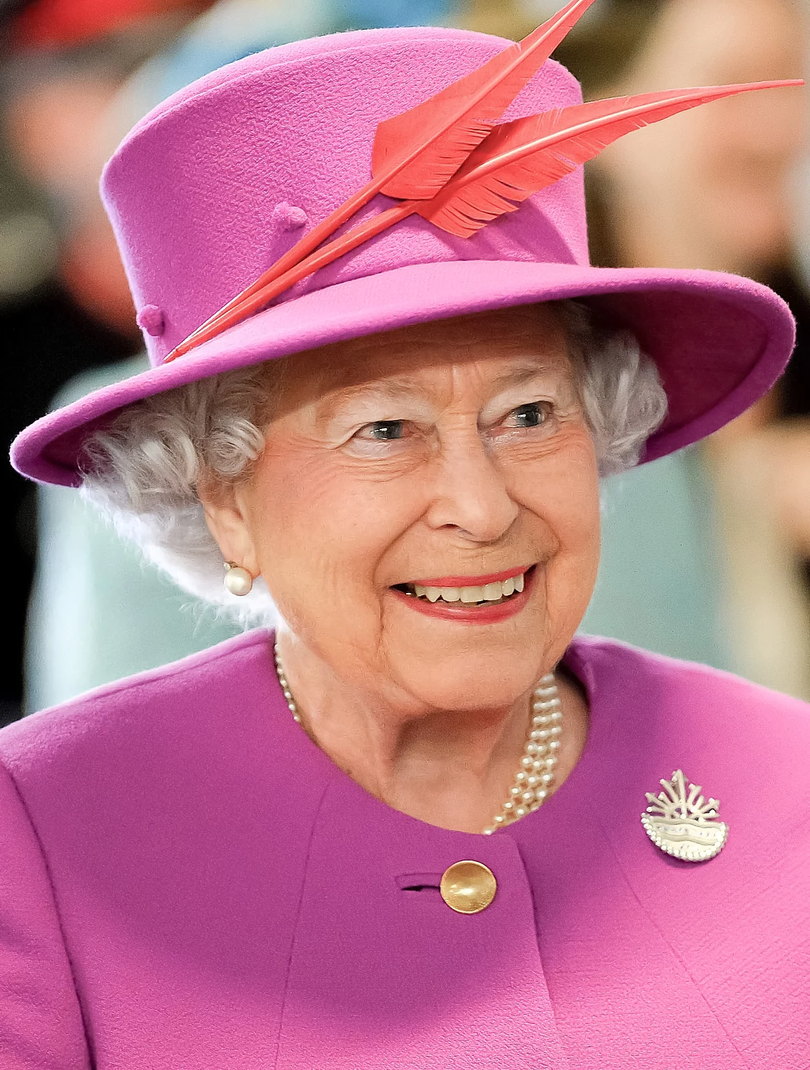
Simple subtraction
Question: Which neural structures support face recognition?
What is a good control task?
  Aim: Isolation of a cognitive process
  Method: Compare the neural signal for a task that activates the cognitive process of interest (P) and a second task that controls for all but the process of interest (P)
Notes:
Say you’re interested in which neural structures support face recognition
You can think of an experiment where you show participants lots of faces, and you will want to know what control conditions you would have to use in addition to this experimental condition – what would be a good control task?
Actually: you can ask many questions, depending on the control task!

Slide 10

Choosing your baseline
Problem: Difficulty of finding baseline tasks that activate all but the process of interest
Different stimuli and task
Different stimulus, same task
+
vs.
‘Ah, that’s the Queen’
‘I am so hungry…’
Name: ‘The Queen”
Name: ‘A burger’
Several components differ (visual-perceptual, cognitive, …) → not good control tasks
Notes:
What we can think is, for example, showing participants faces in the experimental condition and showing them a fixation cross in the control condition
This would indeed give you brain activation related to face processing, but would also give you ill defined activations in the brain because these two stimuli differ in many aspects, such as colour or frequency.
Rest may not be truly rest
• Will give wide-spread activation. Hard to draw conclusions about specific cognitive Processes

Slide 11

Choosing your baseline
Problem: Difficulty of finding baseline tasks that activate all but the process of interest
Related stimuli, same task
Same stimulus, different tasks
vs.
vs.
Famous? - yes
Famous? – hm, wait, maybe… somewhat familiar…
Name the person! Name the gender!
Process P implicit in control task?
Difficulty matched?
Process P cancelled out (highly specific naming-related activity)?
Interaction of task and stimuli?
Notes:
What would be a better way, for example, is to give participants a very similar stimulus also in the control condition
For example, you could use both faces in the control condition, or use for example famous faces in the experimental and non famous faces in the control condition
These two conditions are indeed matched in visual perception.
But you need to be careful that the participants do not spend more time dwelling and processing the control condition than the experimental condition
A useful rule of thumb is that you want to make sure that the experimental task is more demanding than the control task and not vice versa
So right here, it might be very easy to spot the famous person, but people may have associations with the control task on what this face looks like, and that may be a confound.
A very elegant way to go about this is to present the exact same stimulus in both conditions. But you could, for example, ask participants to answer a different question in both of these cases
So, for example, in the experimental condition, they may have to name the person, whereas in the control condition, they have to name the gender.
What is to note is that in this situation, you would get activity for a very particular process, namely that of naming faces, whereas more implicit processes involved in face recognition might go lost in the contrast.
Also, it is important to note that there may be an interaction of seeing the same stimulus twice. We’ll get back to that later.

Slide 12
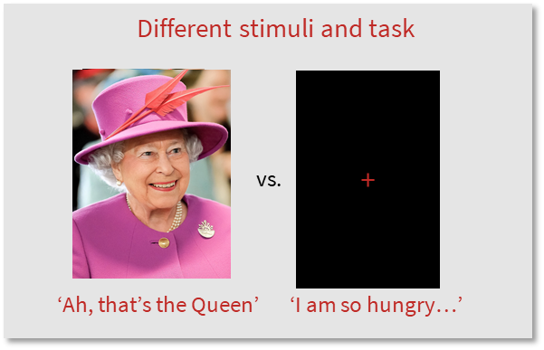
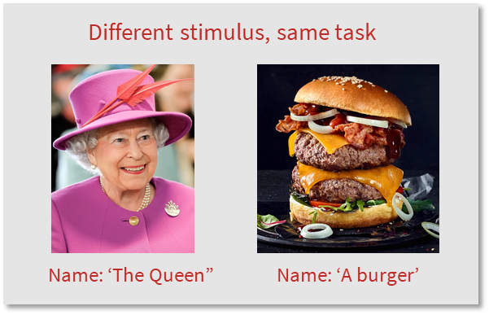
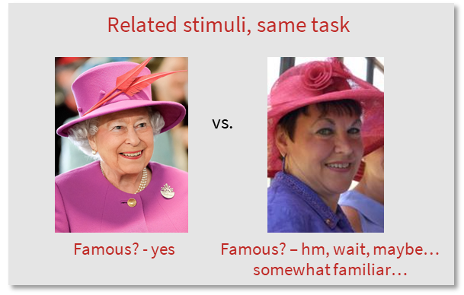
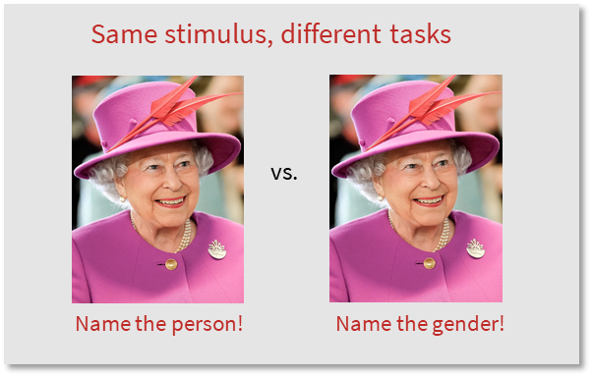
Choosing your baseline
Depending on your choice of the control condition, you will answer very different questions!

Slide 13
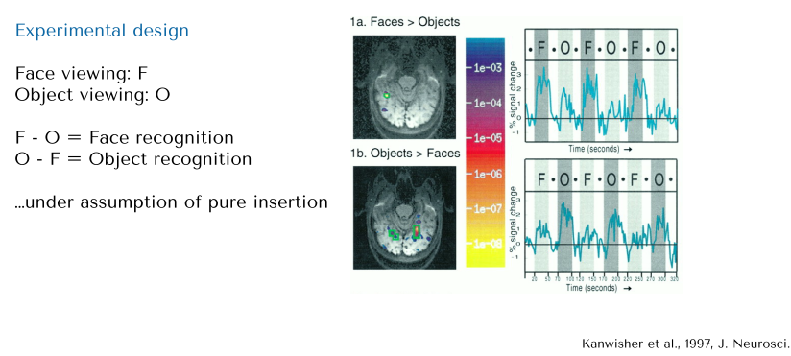
An example of cognitive subtraction

Slide 14
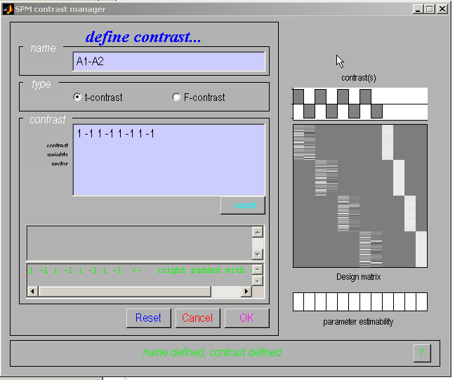
Categorical responses
SPM interface
Task 1
Task 2
Session
Notes:
The way you enter a categorical response in the spm interface is very easy.
You put a 1 for an experimental condition and a -1 for the control condition
Say you have four different sessions in this experiment, you would have to repeat a 1 and a -1 up to four times

Slide 15
The problem of cognitive subtraction
Problems:
Difficulty of finding baseline tasks that activate all but the process of interest (the “baseline problem”)
Subtraction depends on the assumption of “pure insertion” (an extra cognitive component can be inserted without affecting the pre-existing components)
B
B
B
B
A
A
A
A
A
B
A+B
AxB
AxB
Friston et al., (1996)
Notes:
Now let‘s discuss the problem of cognitive subtraction
This is also sometimes called the baseline problem
Say a cognitive process B is added to an initial cognitive process A
So A is the same, and B is just added
However, it is not always true that A and B are completely independent.
It could be that if they are presented together, they interact with one another, and this will either give more activity that is unexplained or even subtract from activity
It is sometimes important to keep this in mind, given that the brain may have specific interactions that are not necessarily obvious from behavior only.
So we need to know that the brain is nonlinear and one needs to keep that in mind when designing an experiment

Slide 16
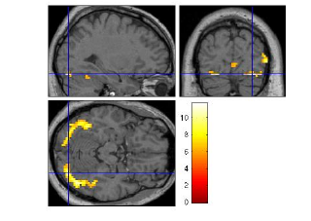
fMRI adaptation as an example of neural interaction
Famous faces: 1st time vs 2nd time
Peri-stimulus time (sec)

Slide 17
Overview
Categorical designs
  Subtraction Pure insertion, evoked / differential responses
  Conjunction Testing multiple hypotheses
Parametric designs
  Linear Adaptation, cognitive dimensions
  Nonlinear Polynomial expansions, neurometric functions
  Model-based regressors
Factorial designs
  Categorical Interactions and pure insertion
  Parametric Linear and nonlinear interactions
    Psychophysiological Interactions (PPI)
A vs B
AAAAAA
Notes:
Now let’s talk about conjunctions, which is one of the ways to account for this

Slide 18
Tackling the baseline problem
Contrast 1: condition A – condition B
P
P
_
=
_
P
=
Contrast 2: condition C – condition D
P
P
_
=

Slide 19
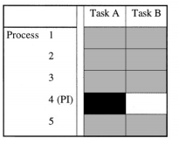
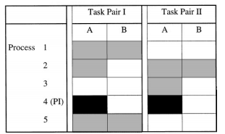
Conjunction
Minimization of “the baseline problem” by isolating the same cognitive process by two or more separate contrasts
Conjunctions can be conducted across different contexts: tasks, stimuli, senses (vision, audition), …
Note: The contrasts entering a conjunction have to be independent (i.e. they must be orthogonal, which is ensure automatically by SPM)
Subtraction
Conjunction analysis
Only the process of interest (here: P4) is common to all task pairs.
Notes:
Conjunctions minimize the baseline problem or control task problem by isolating the same cognitive process by two or more separate contrasts and inspect the resulting simple effects for commonalities
They’re quite flexible
So to say, you look at common activations between different tasks or stimuli to see, for example, which areas are commonly activated across those different tasks
So for example, if people do two different tasks that both involve the process P, you would assume that they are commonly activating the same areas that are involved in process P.
What you need to keep in mind is that the contrast you’re entering in your analysis should be independent, so they should not share data or scans for the reasons that were explained before

Slide 20
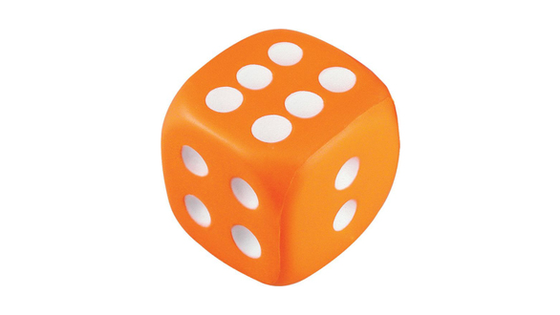
An example…
Question: Which neural structures support phonological retrieval, independent of item?
Visual analysis
Object recognition
Phonological retrieval
Verbal output
Notes:
So here‘s an example, the experimenter was interested in which neural structures support phonological retrieval, independent of item.

Slide 21
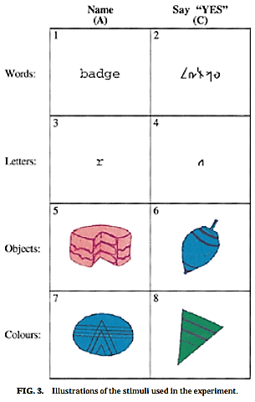
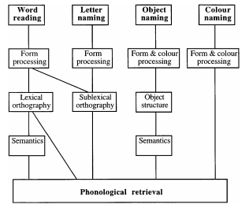
Conjunction analysis
Question: Which neural structures support phonological retrieval, independent of item?
Control task
Control task
Control task
Control task
Phonological retrieval is the only cognitive component common to all task pair differences.
Price & Friston (1996)
Notes:
What they did is they designed four conditions with each a different task
In one condition, participants had to read a word
In another condition, participants had to name a letter
In a third condition, they have to name an object
In the fourth condition, they have to name a colour
And importantly, each of these four conditions also had their control condition.
So for example in the word naming task, participants either had to read the word or say Yes to this non-word.
In the letter task, they either had to name this letter or say Yes and so forth
The question is: what is the common activation across all these four items, which all involve phonological retrieval?

Slide 22
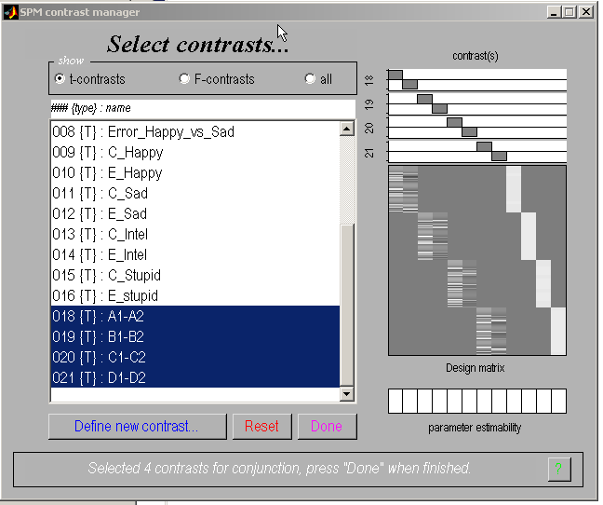
Conjunction analysis
SPM
1 task/session
Notes:
Practically to go about this in the SPM interface, if you hold down your control key and select the contrasts that you want to enter in your conjunction analysis

Slide 23
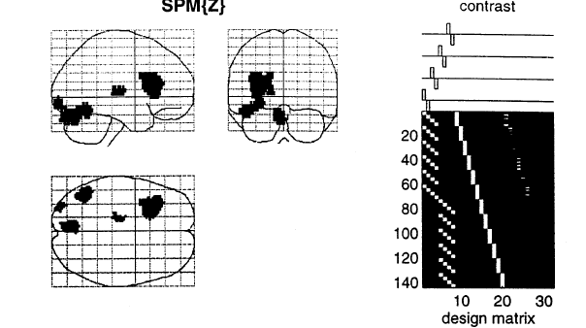
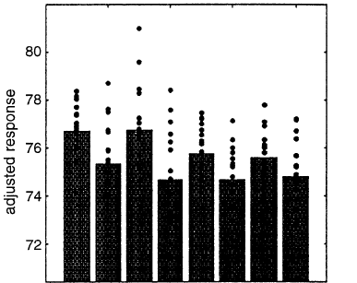
Conjunction analysis
Isolates the process of Phonological retrieval, no interaction with visual processing etc
Overlap of 4 subtractions
Areas are identified in which task-pair effects are jointly significant (conjunction)
→ Associated with process of interest (phonological retrieval)
Price & Friston (1996)
Notes:
This is the result of the study I just gave an example of.
If we plot the activation in the inferior temporal cortex, you can see that for each item, there’s more activation in the experimental task compared to the control task
And when taken together, these task-pair effects are jointly significant.

Slide 24
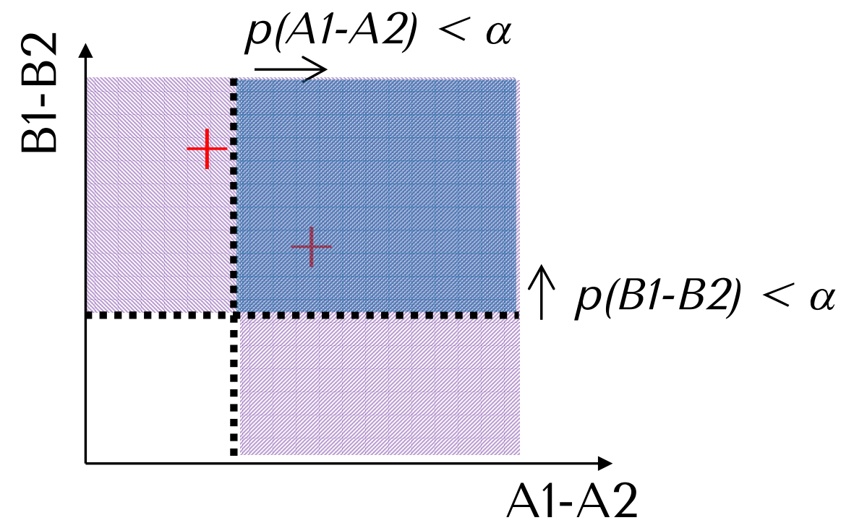
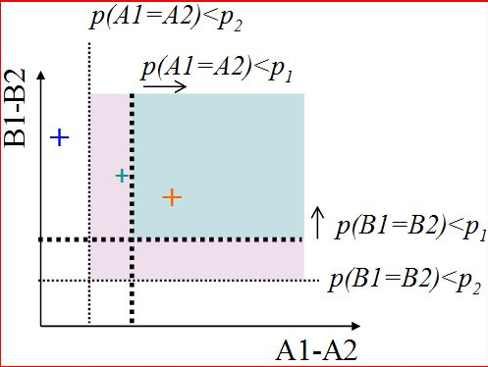
Conjunction: two ways of testing for significance
SPM offers two general ways to test
the significance of conjunctions:
  Test of global null hypothesis:
  Significant set of consistent effects
  “which voxels show effects of similar direction (but not necessarily individual significance) across contrasts?”
  Test of conjunction null hypothesis:
  Set of consistently significant effects
  “which voxels show, for each specified contrast,
  effects > threshold p?”
Friston et al., (2005). Neuroimage, 25:661-7.
Nichols et al., (2005). Neuroimage, 25:653-60.
Notes:
Spm offers two general ways to test the significance of conjunctions.
One way of testing the conjunction is called the global null hypothesis, and here you’re testing for a significant set
In other words, you’re looking at which voxels show effects of similar direction, but not necessarily individual significance
Another way is called the conjunction null hypothesis
Here you’re testing a set of consistently significant effects
You ask the question: which voxels show, for each specified contrast, effects above the significance threshold
The difference between these two can be illustrated with this figure
Here we have a conjunction with only two contrasts,
We have contrast A and contrast B which significant thresholds are represented with the dotted lines
If you test for the conjunction null hypothesis, then you would need to end up in this blue square, whereas when you’re looking at the global null hypothesis, you could also end up in this pink area
So the conjunction is a bit more sensitive

Slide 25
Overview
Categorical designs
  Subtraction Pure insertion, evoked / differential responses
  Conjunction Testing multiple hypotheses
Parametric designs
  Linear Adaptation, cognitive dimensions
  Nonlinear Polynomial expansions, neurometric functions
  Model-based regressors
Factorial designs
  Categorical Interactions and pure insertion
  Parametric Linear and nonlinear interactions
    Psychophysiological Interactions (PPI)
A vs B
AAAAAA
Notes:
Move on to parametric designs

Slide 26
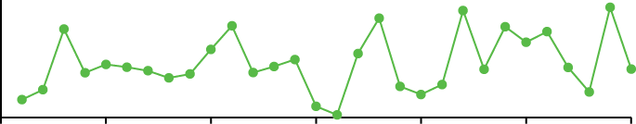
Parametric designs
Does activity vary systematically with a continuously varying parameter?
Varying the stimulus-parameter of interest on a continuum, in multiple (n>2) steps and relating BOLD to this parameter
  Possible tests for such relations :
        Linear
        Nonlinear: Quadratic/cubic/etc.
        „Data-driven“ (e.g., neurometric functions, computational modelling)
Avoids pure insertion but does assume no qualitative change in processing.
AAAAAA
AAAAAA
Notes:
In a parametric design, you are varying your stimulus parameter of interest in a continuum so that’s more than two steps
And then relate BOLD activation to this parametric regressor
These tests are flexible because you can look at nonlinear effects, and you could even use data driven analysis, such as with computational models
And the idea behind this is that you retain a parametric regressor from, for example, behavioral data which you can correlate with neural data

Slide 27
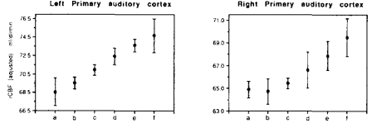
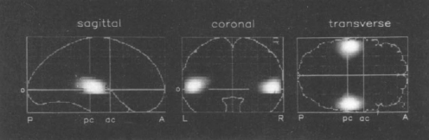
Parametric designs
PET
Auditory words presented at different rates (rest, 5 rates between 10wpm and 90 wpm)
Activity in primary auditory cortex is linearly related to word frequency
Price et al. 1992

Slide 28
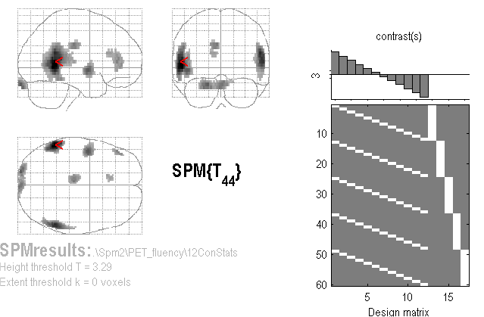
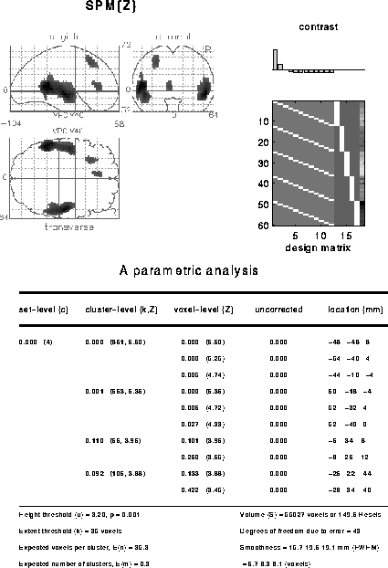
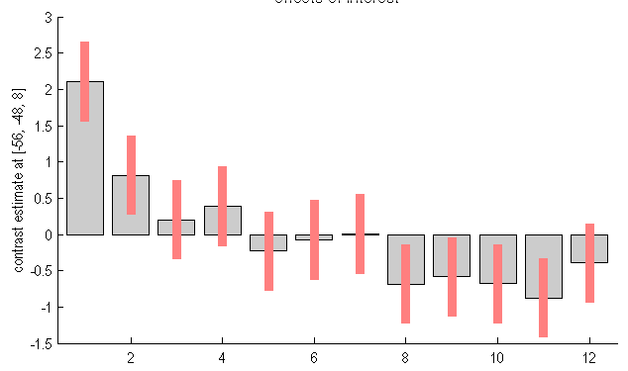
A linear parametric contrast
Is there an adaptation effect if people listen to words multiple times?
Linear effect of time
Non-linear effect of time
Notes:
So here’s an example of linear parametric contrast
The experimenter wanted to know whether there was an adaptation over time as a function of how often a word was listened to
This is a fixed design with five participants
As you can see here, if you would introduce this contrast into an spm, you would have to standardise the effect
So instead of going from 1 to 12, you would have to rescale it from -6 to +6
And then they ask the question: which areas show this linear decrease over time?
If you plot parameter estimates in the posterior temporal lobe, you can see that this activation pattern actually does not follow a linear pattern here, looks a bit nonlinear, and we can actually use spm to also test this effect of nonlinar effects, similarly in the contrast window

Slide 29
Overview
Categorical designs
  Subtraction Pure insertion, evoked / differential responses
  Conjunction Testing multiple hypotheses
Parametric designs
  Linear Adaptation, cognitive dimensions
  Nonlinear Polynomial expansions, neurometric functions
  Model-based regressors
Factorial designs
  Categorical Interactions and pure insertion
  Parametric Linear and nonlinear interactions
    Psychophysiological Interactions (PPI)
A vs B
AAAAAA
Notes:
And this brings us so the next section

Slide 30
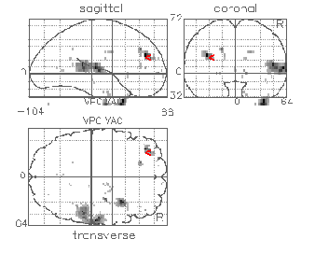
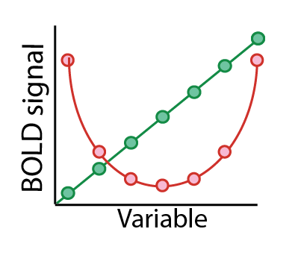
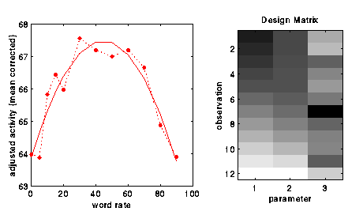
A non-linear parametric design matrix
F-contrast [1 0] on linear param
F-contrast [0 1] on quadratic param
Polynomial expansion:
f(x) = b₁ x + b₂ x² +
...up to (N-1)^{th} order for N levels
SPM offers polynomial
expansion as option during creation
of parametric modulation regressors.
SPM{F}
Büchel et al., (1996)
Notes:
So the nice thing about spm is that it will help you compute nonlinear parametric regressors with polynomial expansion.
The principle behind this case is that any function of the regression can be approximated by the sum of their weighted linear component, quadratic, cubic component up until the eleventh order
So here’s an example of a study that declares brain activation of increasing word rates and scan participants who had a stroke or participants that had not had a stroke
There was a linear effect of word rate in the auditory cortex,
but interestingly, there was a quadratic u-shaped effect in a left prefrontal cortex for people with a stroke, but not for those who had not had a stroke
This is showing how spm can help you find interesting features of your data by using both linear and nonlinear effects simultaneously

Slide 31
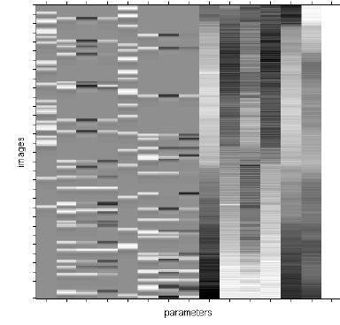
Parametric modulation
Quadratic param regress
Linear param regress
Delta function
seconds
Delta
Stick function
Parametric
regressor

Slide 32
Overview
Categorical designs
  Subtraction Pure insertion, evoked / differential responses
  Conjunction Testing multiple hypotheses
Parametric designs
  Linear Adaptation, cognitive dimensions
  Nonlinear Polynomial expansions, neurometric functions
  Model-based regressors
Factorial designs
  Categorical Interactions and pure insertion
  Parametric Linear and nonlinear interactions
    Psychophysiological Interactions (PPI)
A vs B
AAAAAA
Notes:
Another approach is model-based regressors

Slide 33
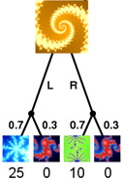

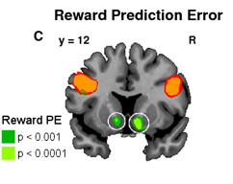
Parametric design: Model-based regressors
Signals derived from a computational model are correlated against BOLD, to determine brain regions showing a response profile consistent with the model, e.g. Rescorla-Wagner prediction error
Time-series of a model-derived reward prediction error
Reward
Prediction
error
Trial number
Gläscher & O’Doherty (2010)
Notes:
So here‘s an example of a study that uses model-based regressors to look at how signal derived from behavior-based computational models correlated with BOLD
So in this specific case, participants had to make decisions between different stimuli, which, over the course of the experiment, were associated with probabilistic outcomes which could be learned over the course of the experiment
Based on the response in every trial, the researchers could compute a trial by trial prediction error, so the difference between the actual and expected outcomes
So if you would expect something to redeem reward, you do not get that, then you would have a higher prediction error in that particular trial
And the fluctuation in the prediction error derived from the model can be modelled at the time of the outcome presentation on each trial and converted into a time series
This yields a regressor of a design matrix which can then be correlated against BOLD to get like a neural representation of the reward prediction error.

Slide 34
Overview
Categorical designs
  Subtraction Pure insertion, evoked / differential responses
  Conjunction Testing multiple hypotheses
Parametric designs
  Linear Adaptation, cognitive dimensions
  Nonlinear Polynomial expansions, neurometric functions
  Model-based regressors
Factorial designs
  Categorical Interactions and pure insertion
  Parametric Linear and nonlinear interactions
    Psychophysiological Interactions (PPI)
A vs B
AAAAAA
Notes:
Next I’m going to talk about factorial designs
Factorial designs are very useful and very efficient

Slide 35
Factorial design
Factor A
A
a
Highly efficient: Factorial designs allow for testing main effects and interactions!
B
A B
a B
Factor B
We can address the “pure insertion” problem!
b
A b
a b
Notes:
You can see this is a 2x2 factorial design with two factors that each vary in two levels,
This 2x2 factorial design consists of four conditions represented with four cells in the figure
So if you have the same amount of scans in each of those four conditions, if is said a factorial design is the most efficient way of testing your research questions in terms of the least scans for the most possible findings.
If you’re interested in the main effect of A, you would, for example, subtract xxx
Or you could also look at the main effect of B
And on top of that, you can also look at interaction effects, which is how these to interact with one another

Slide 36
Factorial design
Question: Is the inferiotemporal cortex sensitive to both object recognition and phonological retrieval of object names?
Visual analysis
Object recognition
Phonological retrieval
Verbal output
Notes:
As an example for a factorial design, there‘s this study which asks whether the inferior temporal cortex is sensitive to both object recogntion and phonological retrieval of object names.

Slide 37
Factorial design
Question: Is the inferiotemporal cortex sensitive to both object recognition and phonological retrieval of object names?
A
Say ‘yes’ when you see an abstract image
Say ‘yes’ when you see an object
Name the object
Visual analysis
Verbal output
B
Visual analysis
Object recognition
Verbal output
C
Visual analysis
Object recognition
Phonological retrieval
Verbal output
Notes:
Importantly, they first started off with three conditions, so it was not full factorial at first.
These researchers had a condition which as a non object, in which participants were shown a non-object and had to say yes.
A second condition in which participant were shown an object and had ot say yes
As you can see, this condition involves not only visual analysis, but also object recognition.
And then there was this third condition in which participants were shown an object and also name the object
S in this case, there’s also an aspect of phonological retrieval.

Slide 38
Factorial design
Question: Is the inferiotemporal cortex sensitive to both object recognition and phonological retrieval of object names?
A
Say ‘yes’ when you see an abstract image
Say ‘yes’ when you see an object
Name the object
Friston et al., (1997)
Results in inferotemporal cortex:
B
A
B
C
B
A
>
Object recognition
C
B
C
=
IT not involved in phonological retrieval?!
Notes:
If you plot the BOLD activation in the inferior temporal cortex,
This is what it would look like
You can see that there is a difference in BOLD activity between condition A and B, and also between A and C, meaning that this area here is sensitive to object recognition, which is the main difference between A and B, and A and C.
But there does not seem to be any difference between B and C, suggesting that the IFC is not sensitive to phonological retrieval, which is the main difference between these two conditions
This is curious in terms of previous research
Problem: we assumed that IT response to object recognition is context independent

Slide 39
Addressing interactions in factorial designs
Is the task the sum of its component processes, or does A modulate B?
B
B
B
B
Object recognition
Phonological retrieval
A
A
A
A
Let’s test the interaction explicitly!
How?
→ Vary A and B independently!
Notes:
and it could be that, maybe, that the process A modulates process B so that there is an interaction between those conditions.
And in order to actually find that out, they had to set up a proper 2 by 2 design, and that’s what they did.

Slide 40
Factorial designs: Main effects and interaction
Question: Is the inferiotemporal cortex sensitive to both object recognition and phonological retrieval of object names?
say ‘yes’
Non-object
a.
b.
c.
Visual
analysis
Speech
say ‘yes’
Object
Visual
analysis
Object
recognition
Speech
a
b
c
name
Object
Visual
analysis
Object
recognition
Phonological
retrieval
Speech
Friston et al., (1997)

Slide 41
Factorial designs: Main effects and interaction
name say ‘yes’
Main effect of task (naming): (ONAME + NNAME) – (OYES + NYES)
Main effect of stimuli (object): (OYES + ONAME) – (NYES + NNAME)
Interaction of task & stimuli: (ONAME + NYES) – (OYES + NNAME)
Objects
Non-objects
Can show a failure of pure insertion
interaction effect
(Stimuli x Task)
‘Say yes’ (Object vs Non-objects)
Phonological retrieval (Object vs Non-objects)
Inferotemporal (IT) responses do discriminate between situations where phonological retrieval
is present or not. In the absence of object recognition, there is a deactivation in IT cortex, in the
presence of phonological retrieval.
Friston et al., (1997)
Notes:
They added one condition to it, in particular this one, where they had to name non object.
So participants were presented a non object and they have name xxx
This is a then a full factorial design with naming or saying yes.
If we compare objects, we see a difference suggesting that this area is sensitive to object recognition.
However, when we compare the difference between naming an object versus naming an non-object, there is even larger difference, suggesting that this area is sensitive to phonological retrieval in the absence of phonological recognition.
For example,when they were naming a non-object, there’s a deactivation in this area, which explains why this effect was not seen before, that’s a failure of pure insertion.

Slide 42
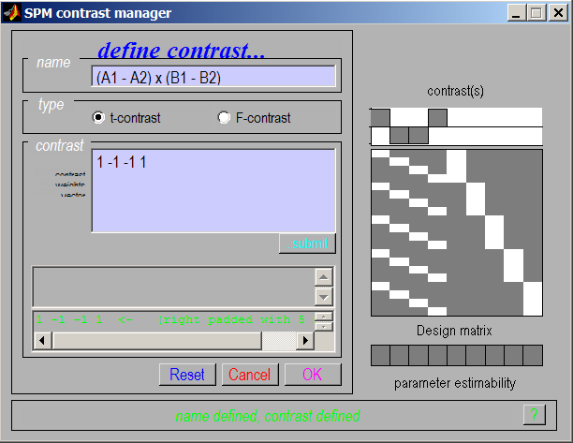
Interaction in SPM
Interactions:
cross-over
and
simple
We can selectively inspect our data for one or the other by masking during inference
Notes:
To enter this in your contrast manager, you have to use 1 or -1 in contrast for your category.
And we can selectively inspect our data for one o the other by masking during inference.

Slide 43
Overview
Categorical designs
  Subtraction Pure insertion, evoked / differential responses
  Conjunction Testing multiple hypotheses
Parametric designs
  Linear Adaptation, cognitive dimensions
  Nonlinear Polynomial expansions, neurometric functions
  Model-based regressors
Factorial designs
  Categorical Interactions and pure insertion
  Parametric Linear and nonlinear interactions
    Psychophysiological Interactions (PPI)
A vs B
AAAAAA
Notes:
Now something similar can be done with parametric interactions.

Slide 44
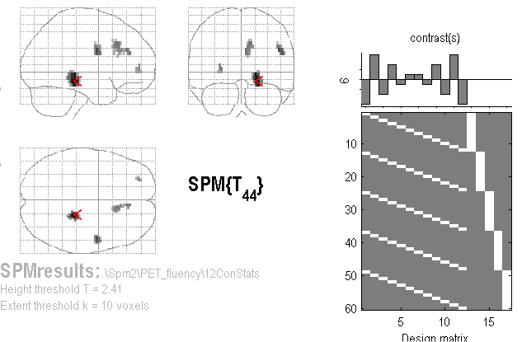
Linear Parametric Interaction
Question: Are there different kinds of adaptation for word generation and word repetition as a function of time?
A (Linear)
Time-by-Condition
Interaction
(“Generation strategy”?)
Contrast:
[5 3 1 -1 -3 -5](time) ⊗ [-1 1] (categorical)
= [-5 5 -3 3 -1 1 1 -1 3 -3 5 -5]
Notes:
One of the questions you could ask is: are there different kinds of adaptations for word generation and word repetition as a function of time?
And the nice thing is that here, you can see that you would have to compare linear and nonlinear effects.

Slide 45

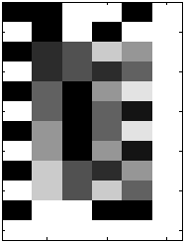
Non-Linear Parametric Interaction
F-contrast tests for
Generation-by-Time interaction
(including both linear and
Quadratic components)
Factorial Design with 2 factors:
Gen/Rep (Categorical, 2 levels)
Time (Parametric, 6 levels)
Time effects modelled with both linear and quadratic components…
G-R
Time
Lin
Time
Quad
G x T
Lin
G x T
Quad
Notes:
So you can both look ant categorical with two levels as well as a parametric level with the parametric factor with six levels for the time as well as quadratic and linear effects, allowing you to explore various interesting aspects of your xxx

Slide 46
Overview
Categorical designs
  Subtraction Pure insertion, evoked / differential responses
  Conjunction Testing multiple hypotheses
Parametric designs
  Linear Adaptation, cognitive dimensions
  Nonlinear Polynomial expansions, neurometric functions
  Model-based regressors
Factorial designs
  Categorical Interactions and pure insertion
  Parametric Linear and nonlinear interactions
    Psychophysiological Interactions (PPI)
A vs B
AAAAAA
Notes:
The very last thing I would like to talk about is psychophysiological interactions, where you predict brain activation in one area on the basis of the activation in another area as a function of whether a contextual factor was present or not.

Slide 47
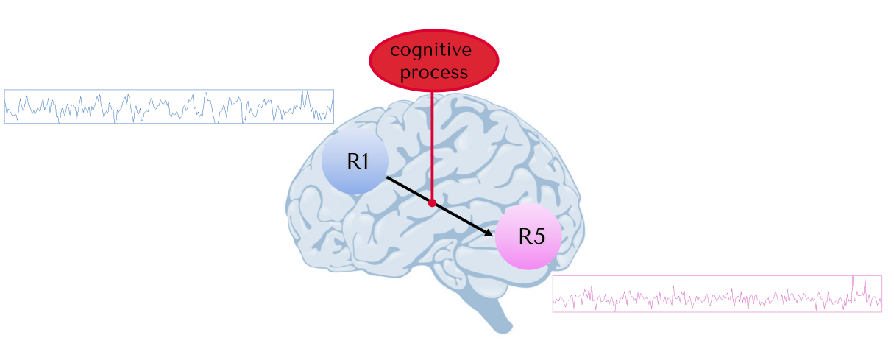
Psycho-physiological Interaction (PPI)
Question:
Does the activation in one area of the brain predict the activation in another area, depending on whether a contextual factor was present or not.

Slide 48
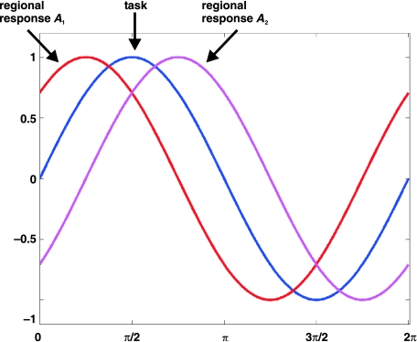
Psycho-physiological Interaction (PPI)
Functional connectivity measure
Can activity in one part of the brain be predicted by an interaction between task and activity in another part of the brain?
If two areas interact, they will display synchronous activity
Stephan, 2004
Notes:
With PPI, we predict a physiological response in one part of the brain in terms of an interaction between a task and activity in another part of the brain, we do a GLM analysis
You get a number of statistically significant areas.
This does not mean that they’re interaction if two areas
Xxx
Like for example, if you have this task vector in blue, you could say that since this task vector does indeed correlate with the activity in area A1 and also with the activity in area A2.
But the blue and the pink vectors do not necessarily correlate together. So in order to really understand how these two areas are functionally connected to one another, PPI can be insightful,.

Slide 49
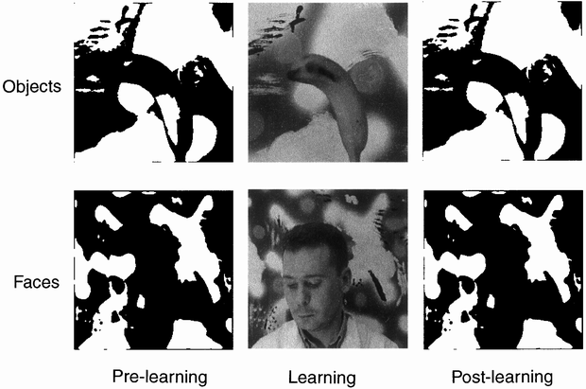
Psycho-physiological Interaction (PPI)
Factorial design
Learning
Objects before (Ob) | Objects after (Oa)
Faces before (Fb) | Faces after (Fa)
Stimuli
Dolan et al., 1997
Notes:
A factorial design or an example of a PPI analysis is the study where participants were presented with blurred images of either objects, and faces while they were being scanned and after they were scanned, they learned what these blurred objects actually meant by showing them the actual pictures.
And then, after this learning phase, they were scanned again, and were shown blurred images again.
Well, as you can see, you can both look at the stimuli, the effect of either faces or objects, but you can also look at the learning effect, pre or post scanning.

Slide 50
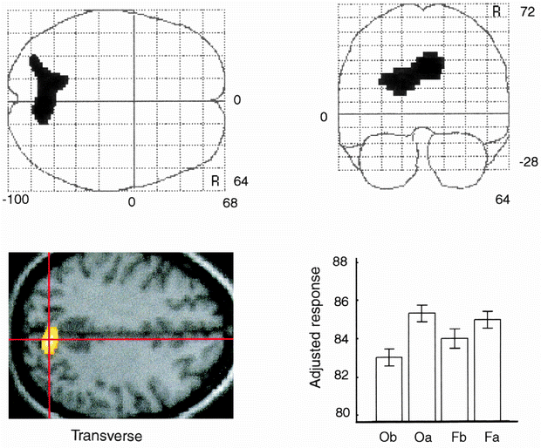
Psycho-physiological Interaction (PPI)
Main effect of learning
Learning
Objects before (Ob) | Objects after (Oa)
Faces before (Fb) | Faces after (Fa)
Stimuli
Dolan et al., 1997
Notes:
And you can look at both these main effects, and when they look at the learning effect, they see increased activation in the parietal cortex, the main effect of learning.
Now their question was: does learning involve for functional connectivity between parietal cortex and stimuli specific areas?

Slide 51
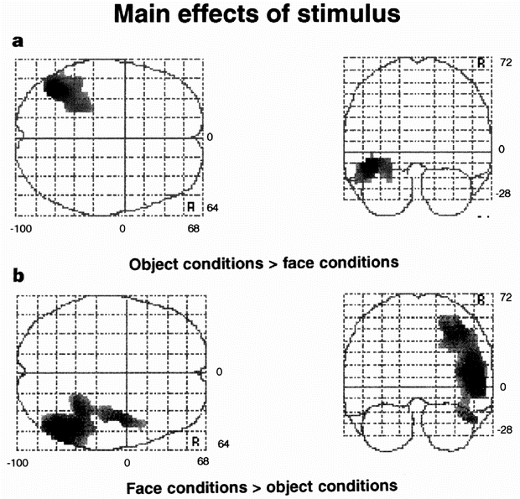
Psycho-physiological Interaction (PPI)
Main effect of stimulus
Learning
Objects before (Ob) | Objects after (Oa)
Faces before (Fb) | Faces after (Fa)
Stimuli
Does learning involve functional connectivity between parietal cortex and stimuli specific areas?
Dolan et al., 1997

Slide 52
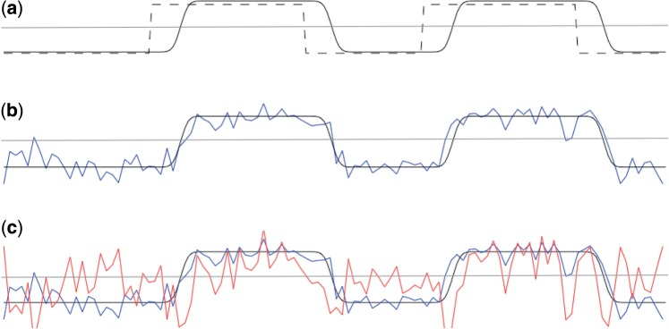
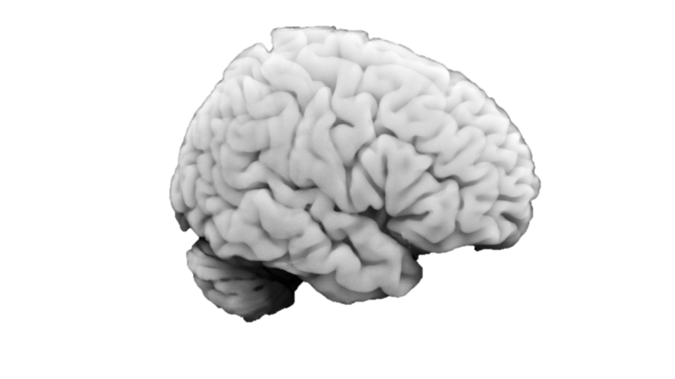
Psycho-physiological Interaction (PPI)
Does learning involve functional connectivity between parietal cortex and stimuli specific areas?
Main effect of task (Faces - objects)
Activity in parietal cortex (main effect learning)
Seed region
PPI regressor = HRF convolved task x seed ROI regressors
Whole brain
correlated for faces
Anti-correlated for objects
O’Reilly (2012)
Notes:
In order to do this, they started with a regressor representing the main effect of task
So in this case, a block design of either faces or objects
And they convolve it with the HRF to get an HRF convolved task regressor. You get the black line here.
Then I also had a time course extraction that was active of the task, of the activity in the parietal cortex, the main effect of learning.
And when you take the product of both these, you get the PPI regressor, which is the one that you’re interested in to correlate with BOLD activity.
And so the result of this PPI regressor is that it’s correlated with the seed region time course during task blocks, but anticorrelated with it during rest blocks.
And that’s when you correlate this with BOLD activation,

Slide 53
Psycho-physiological Interaction (PPI)
Does learning involve functional connectivity between parietal cortex and stimuli specific areas?
1 0 0
Main effect of task (Faces - Objects)
Activity in parietal cortex (main effect of learning)
PPI regressor = HRF convolved task x seed ROI regressors
PPI activity task
The interaction term should account for variance over and above what is accounted for by the main effect of task and physiological correlation
correlated for faces
Anti-correlated for objects
O’Reilly (2012)

Slide 54
Psycho-physiological Interaction (PPI)
Learning
Objects before (Ob) | Objects after (Oa)
Faces before (Fb) | Faces after (Fa)
Stimuli
Orthogonal contrasts reduce correlation between PPI vector and the regressors of no interest
Dolan et al., 1997

Slide 55
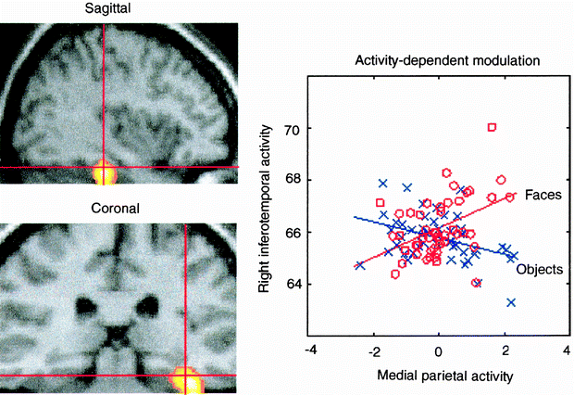
Psycho-physiological Interaction (PPI)
Coupling between ITC and parietal cortex depends on the stimulus
Coupling between the temporal face area and the medial parietal cortex when, and only when, faces were perceived
Suggests: ITC can differentiate between faces and objects only if parietal activity is high
Dolan et al., 1997
Notes:
you got in the specific area that is coupling between the temporal face area and the medial parietal cortex when and only when face were perceived.

Slide 56
Psycho-physiological interactions (PPI)
A standard PPI analysis does not make inferences about the direction of information flow (causality)
Stimuli:
Faces or objects
Stimuli:
Faces or objects
Modulation of
stimulus-specific
responses
Context-sensitive
connectivity
PPC
PPC
IT
IT
Notes:
One caveat to keep in mind when conducting PPI analysis is that it does not make the inference about the direction of information flow or causality.
So you cannot say exactly how, they are different
And if you want to have more directional information, you should go on an do DCM analysis, which will be discussed in a different lecture

Slide 57
Overview
Categorical designs
  Subtraction Pure insertion, evoked / differential responses
  Conjunction Testing multiple hypotheses
Parametric designs
  Linear Adaptation, cognitive dimensions
  Nonlinear Polynomial expansions, neurometric functions
  Model-based regressors
Factorial designs
  Categorical Interactions and pure insertion
  Parametric Linear and nonlinear interactions
    Psychophysiological Interactions (PPI)
A vs B
AAAAAA

Slide 58
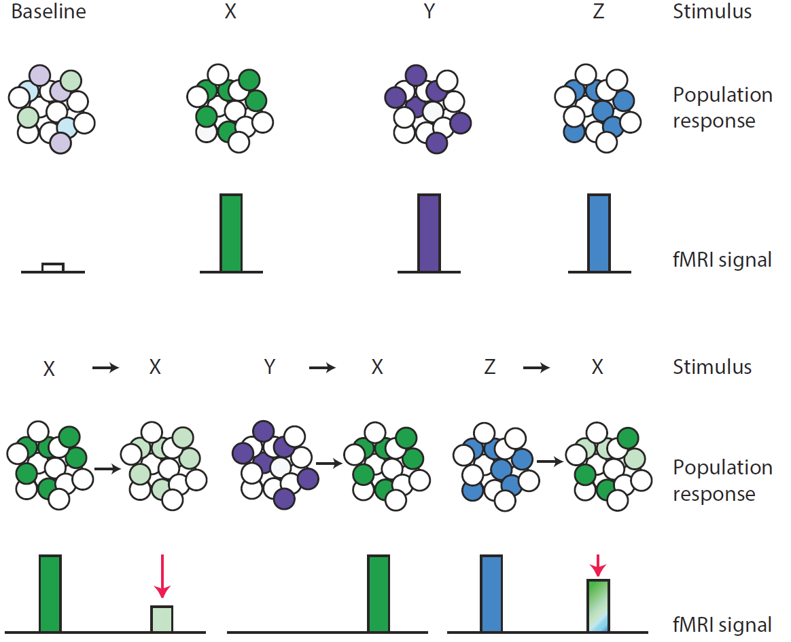
Representational neuroimaging
Approaches described so far investigate the involvement of regions in a specific mental activity rather than the representational content of regions or voxels
Barron, Garvert, Behrens 2016

Slide 59
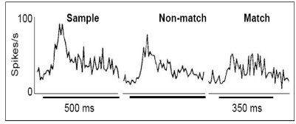
Repetition suppression
Neurons in inferotemporal cortex display a diminished response if a stimulus is repeated
Li et al. (1993),
Grill-Spector (2006)

Slide 60
Conventional fMRI vs fMRI adaptation
Repetition suppression as an index of representational similarity
Barron, Garvert, Behrens 2016

Slide 61
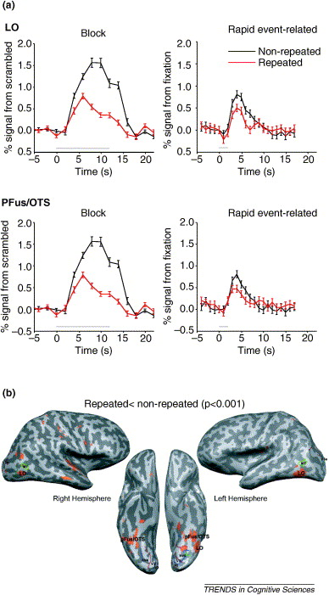
fMRI adaptation
Object-repetition effects measured with fMRI
Grill-Spector et al. (2006)

Slide 62
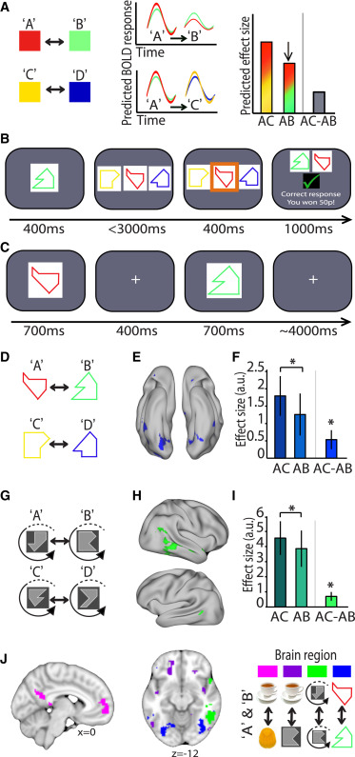
Indexing cortical associations in the human brain using cross-stimulus adaptation
Barron et al. 2016

Slide 63
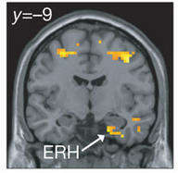
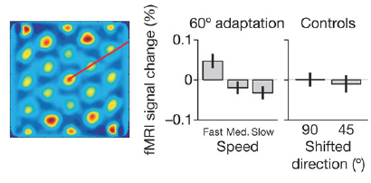
fMRI adaptation as a tool for measuring complex computations in the human brain
Doeller et al. (2010)

Slide 64

Multivariate vs. univariate methods
Multivariate methods investigate the representational content of regions
Information is represented in a distributed fashion
fine-grained spatial structure across voxels

Slide 65


Multi-variate pattern analysis
Norman et al. 2006

Slide 66



Representational similarity analysis
Comparing representations across experimental conditions
Kriegeskorte et al. (2008)

Slide 67

Connecting research branches
Kriegeskorte et al. (2008)

Slide 68

Matching object representations in inferior temporal cortex of man and monkey
Kriegeskorte et al. (2008)

Slide 69
Questions?

